Slide 1
Experimental Philosophy

Slide 2
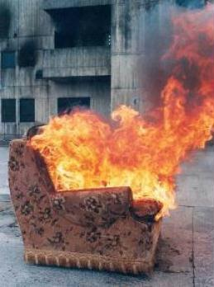
Is…
The use of psychological experimental methods to engage in philosophical investigation

Slide 3
Why
Most importantly to find out what “people” actually think
To explain differences in what people actually think
To give appeals to intuition some force
To find out to what extent our reasoning is effected by other (i.e. not strictly rational) considerations

Slide 4
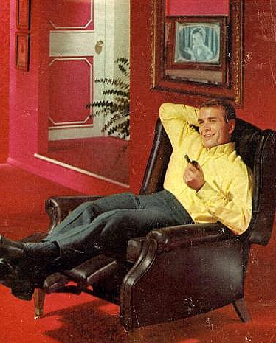
How to use it
Everyone will agree that X
Most people think that X
Normal people think that X
The way we perceive things is X
When people do X they feel Y
When people feel Y they do X

Slide 5
Empirical basis for empirical claims
“I am sometimes asked … why, if conceptual analysis is concerned to elucidate what governs our classificatory practice, don’t I advocate doing serious opinion polls on people’ responses to various cases? My answer is that I do- when it is necessary…often we know that our case is typical and so can generalize from it to others”. (Jackson,1998,37)

Slide 6
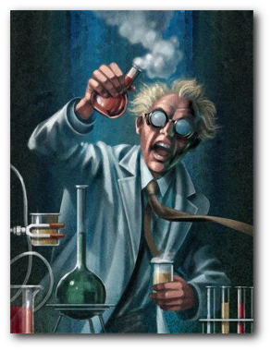
When is our case typical?
Empirical question, needs an empirical answer.

Slide 7
Can X-phi be avoided
Yes but any way of avoiding x phi involves unwanted consequences.

Slide 8
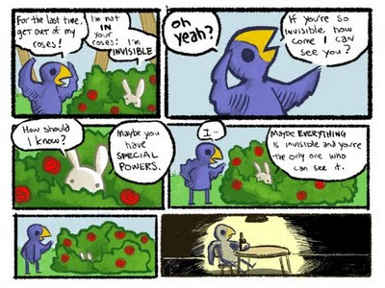
No more appeals to common intuitions
You cannot say that something is ridiculous because other people would agree.

Slide 9
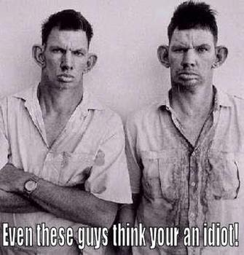
Claim Other People are Wrong
This involves the claim that certain people simply have inferior intuitions.

Slide 10
Is it philosophy really?
Not as such. Since the mere collection of the philosophical dispositions of all the people in the world does not amount to philosophizing.
But it is necessary in order to make many of the philosophical claims we would like to make.

Slide 11
The Knobe effect
Moral judgments effect whether the product of an action was intentionally produced.
Intention is therefore not something that is divorced from other world view considerations.

Slide 12
Harm and Help
Most subjects think that in the Harm condition the harm to the environment was intentional
Most subjects think that in Help condition, the help to the environment was not intentional
Knobe thinks that intention is something that actually applies differently in the different scenarios. Nobody seems to like this.

Slide 13
Psychological Bias Account
Our concepts of blame for the executive drive us to apply intention fallaciously to the two outcomes.
We do not want him to be innocent so we say he intended the harm
We do not want him to be rewarded so we say he did not intend the help.

Slide 14
However..
In the variation with the Nazi law, people were told that the CEO knowingly violated an immoral law for more profits. In this case although the outcome was good, people say (81%) that it was intentional. So the fact that we do not want to give credit for a good outcome cannot be the explanatory factor here.

Slide 15
Gricean account
Conversational implicature is were the use of language is modified by the intent of its effect.
Knowingly VS Intentionally

Slide 16
However
Although some differentiated knowingly from intentionally, the majority responded that the CEO harmed the environment knowingly and intentionally

Slide 17
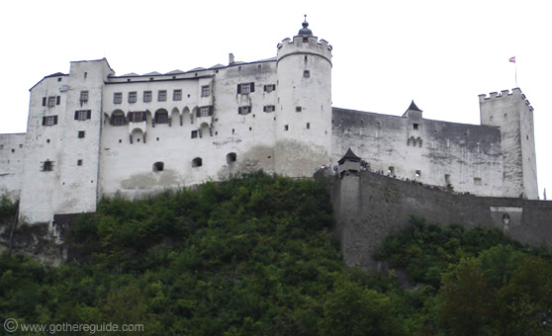
Knobe says..
Both cases are using the concept of intention correctly
Such that in the harm case the CEO intended the harm, and in the help case he did not intend it

Slide 18
The Minority
How can we explain the significant and recurring minority?
Test for order effects
No order effects but similar responses between questions.
Such that both intentional, both unintentional, asymmetric oneway

Slide 19
Interpretive diversity
Nichols and Ulatowski conclude that people have different but consistent interpretations (definitions?) of intention
CEO knew…
CEO had a motive
Two different intentions, not one intention with to uses a la knobe

Slide 20
Flexibility
The asymmetric group seems to have a flexible use of the definitions
In this case their may be some Gricean/Knobean stuff going on
Unfair?

Slide 21
SO
Grice or Knobe or Nichols?
Forget Grice
Two definitions VS a single word which works in more than one way depending on the moral context.
Is Knobes view radical?

Slide 22
Culture and Cognition

Slide 23
Holistic Vs Analytic
Nisbett and friends illustrate a cognitive dived between east and west
The philosophical background seems to play a key role
Does philosophy effect cognition?

Slide 24
Social Organization

Slide 25
East
Eastern Societies, (including the middle east India, parts of Russia and Eastern Europe) typically refer to southeast asia (most studies having been done there).
In these collective societies social organization defines identity more so than in western cultures I.E. Identity does not exist in a vaccum

Slide 26
For instance
For the following scenarios, please indicate your response as follows:
1. <There is no significant change, I remain the same person.
2. <The change is minor, I do not change much.
3. <there is some change.
4. <the change is, large I change a lot.
5. <The change is extreme, I am hardly the same person.
6. <The change is complete I am no longer the same person.

Slide 27
…
A) You get into an accident; most of your body is replaced with electronic parts.
1 2 3 4 5 6
No change Minor change some change large change Extreme change Complete change
B) Your brain is removed from your body and placed in your friend’s body.
1 2 3 4 5 6
No change Minor change some change large change Extreme change Complete change
C) You receive super powers and are now able to fly.
1 2 3 4 5 6
No change Minor change some change large change Extreme change Complete change
D) You are completely paralyzed for life.
1 2 3 4 5 6
No change Minor change some change large change Extreme change Complete change
E) You are shrunk to one tenth your natural size, all else remains the same.
1 2 3 4 5 6
No change Minor change some change large change Extreme change Complete change

Slide 28
…
F) You lose your memory and do not remember anyone you have ever met.
1 2 3 4 5 6
No change Minor change some change large change Extreme change Complete change
H) There is a natural disaster. All your friends and family disappear.
1 2 3 4 5 6
No change Minor change some change large change Extreme change Complete change
I) Your mind is suddenly swapped with a plantation workers mind in Brazil. You now live his life.
1 2 3 4 5 6
No change Minor change some change large change Extreme change Complete change
J) You get a new job that requires you to move away from your friends and loved ones.
1 2 3 4 5 6
No change Minor change some change large change Extreme change Complete change
K) You move to a different country. You close contact with all your friends and make all new ones.
1 2 3 4 5 6
No change Minor change some change large change Extreme change Complete change
L) You are chosen for a space mission. You will spend the rest of your life alone.
1 2 3 4 5 6
No change Minor change some change large change Extreme change Complete change

Slide 29
...
M) You change all your goals in life and start to do something completely different from what you are currently doing.
1 2 3 4 5 6
No change Minor change some change large change Extreme change Complete change
N) You become very religious
1 2 3 4 5 6
No change Minor change some change large change Extreme change Complete change
P) You lose your ability to speak coherently.
1 2 3 4 5 6
No change Minor change some change large change Extreme change Complete change
Q) You fall in love with you future spouse.
1 2 3 4 5 6
No change Minor change some change large change Extreme change Complete change

Slide 30
…
R) You are convicted of a crime you did not commit; you are now forced to live the rest of your life in prison with people you hate.
1 2 3 4 5 6
No change Minor change some change large change Extreme change Complete change
S) Due to a neurological condition you become extremely depressed.
1 2 3 4 5 6
No change Minor change some change large change Extreme change Complete change
T) You are given a drug that makes you become extremely happy.
1 2 3 4 5 6
No change Minor change some change large change Extreme change Complete change
U) You do something that makes you permanently ashamed.
1 2 3 4 5 6
No change Minor change some change large change Extreme change Complete change
V) You watch a movie that makes you cry
1 2 3 4 5 6
No change Minor change some change large change Extreme change Complete change
W) A perfect clone is made of you (thinks what you think, wants the things you want etc.) The original you is destroyed.
1 2 3 4 5 6
No change Minor change some change large change Extreme change Complete change

Slide 31
Attention
More complex social environments cause easterners to be more attentive to a wider range of stimuli in a given environment. Westerners attend to central focal “parts” of an environment.

Slide 32
Attention study results
Westerners make more comments about central elements, I.E there was a brown fish
Easterners make more holistic observations I.E there was a pond
Eyetracker studies compound results

Slide 33
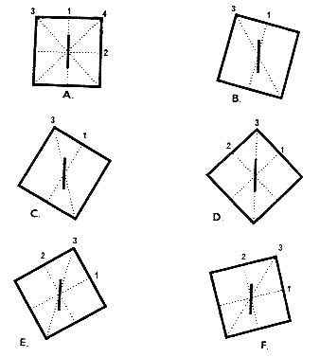
Field dependence
Moving rod

Slide 34
Fundamental Attribution error

Slide 35
Cultural variation
Since western cultures put identity and behavior onus on the individual acts of individuals are more likely to be construed as personal traits I.E. lazy, productive, clever etc
Eastern cultures tend to speculate on the social situation of individuals in making judgments. I.E. he is in a hurry, it is hot etc
Cuba writing assignment

Slide 36
Hindsight Bias
Good samaritan
Did not help in condition C, westerners maintain surprise, easterners say they saw it coming. (80% vs 50%)
Also little surprise at outcomes regardless of theoretical predictability

Slide 37
Relationships Vs. Categories
Easterners tend to use relational and functional similarities in categorizing , induction, learning, and resemblence judgements.
Westerners use categorical ones.

Slide 38
Logic stuff
Syllogism with more exemplary individuals (penguin/eagle)
Is either more reasonable?
Law of identity, non contradiction, excluded middle
Easterners seem more comfortable with conflict
What to make of this?

Slide 39
Strong VS. Weak arguments
The dialectic method of easterners takes into account strengths of all arguments (cultural historic song and dance, debates in Athens etc)
Western conviction strengthened by strong arguments, eastern conviction weakened.

Slide 40
Consumer choice
Conciliatory behavior
Easterners take the middle way.

Slide 41
And much much more
Holistic vs. analytic practices
Argument, debate and rhetoric
Law and contracts
Religion
Language and writing

Slide 42
Weinberg, Nichols, and Stich
Undermining epistemic projects
Normative
Descriptive
Evaluative project

Slide 43
Epistemic Romanticism
We have the truth within ourselves we just need to let it shine.
Reflective equilibrium type methods

Slide 44
Variety of ways to show that..
There is no universal “our” intuitions
What does this mean?

Slide 45
Is it philosophy
Just because we have to let go of “our” intuitions does this mean we have to rethink intuition.
In a sense experimental philosophy points out what is not philosophy.

Slide 46
So
Regardless of how central X phi is to the pursuit of philosophy the way use appeal to intuitions in current discourse necessitates experimental philosophical methods

