Slide 1
Stocking Your Collaborative Practice Tool Kit
Be clear, quick, and effective.
Advocate with clarity.
Move toward consensus.

Slide 2
Project collaborators

Slide 3
Overview
Part 1: Why collaborative practice tools?
Part 2: Overview and practice with the tools
Be clear, quick, and effective (3 tools)
Advocate with clarity (3 tools)
Move toward consensus (2 tools)
Part 3: Reflect on practice

Slide 4
Learner outcomes
Recognize utility of collaborative practice skills.
Learn collaborative practice skills, including when and how to use them in the context of the care process.
Reflect on practice.

Slide 5
Part 1
Why collaborative practice tools?

Slide 6
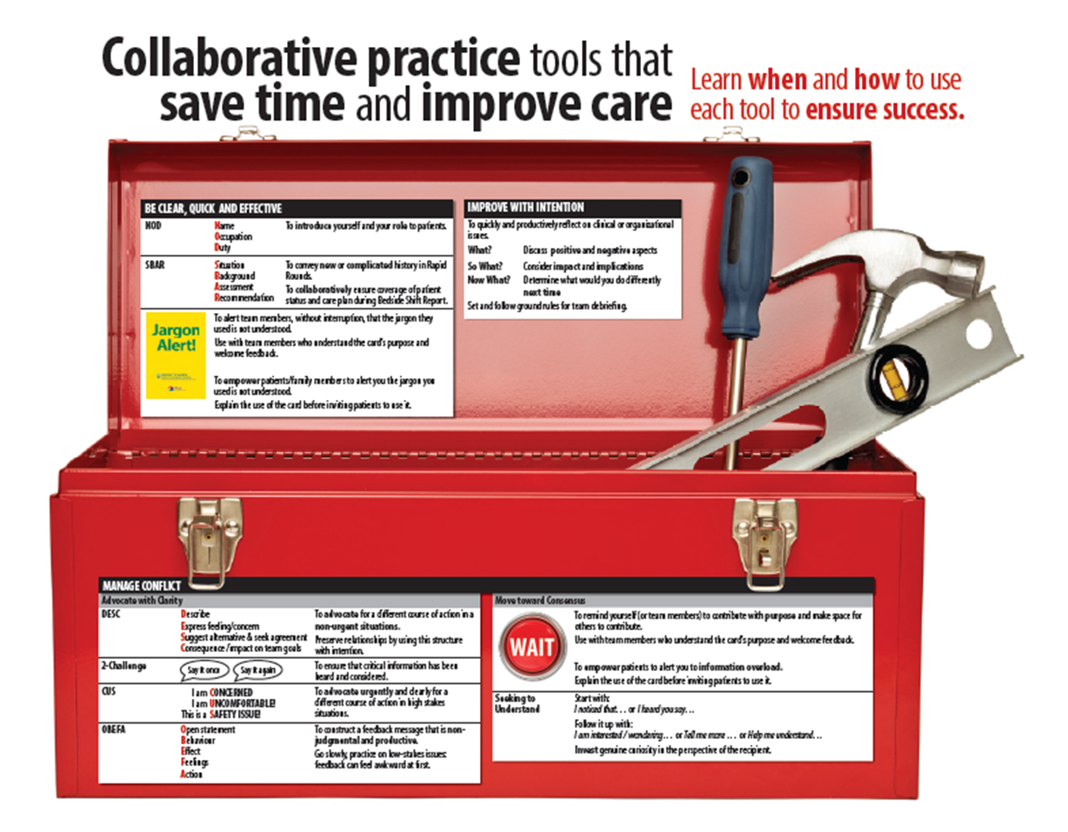
http://www.hserc.ualberta.ca/TeachingandLearning/VIPER/IPCareProcesses.aspx

Slide 7
What doesn’t work: Hinting & hoping

Slide 8
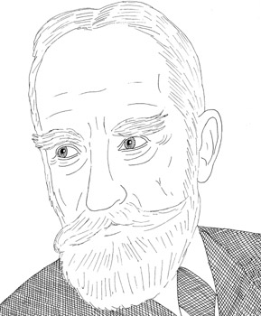
The single biggest problem with communication is the illusion that it has taken place.
- George Bernard Shaw
http://www.doonething.org/heroes/shaw.htm

Slide 9
Part 2
Overview of the tools.
Practice using the tools.

Slide 10
Be clear, quick, and effective
3 communication tools to help you…
SBAR
I Pass the Baton
I-SHAPED
Situation
Background
Assessment
Recommendation
Introduction
Patient
Assessment
Situation
Safety
Background
Actions
Timing
Ownership
Next
Introduce
Story
History
Assessment
Plan
Error
Prevention
Dialogue
ahrq.gov/professionals/education/curriculum-tools/teamstepps/instructor/essentials/pocketguide.html

Slide 11
SBAR example in Rapid Rounds
Situation | OT and I re-assessed Mr. Xu yesterday,
Background | as his family noted concern about use of stairs at home on discharge. The pneumonia had reduced his strength and steadiness.
Assessment | We found he has improved and no longer requires 1-person standby to walk.
Recommendation | He should be strong enough to return home once IV antibiotics finish on Friday.

Slide 12
Rounds practice
Think of a patient you saw last week. Use SBAR to either:
Introduce the patient as a new admission in rounds, or
Deliver a complicated update of their status in rounds.
Partner and practice SBAR. (2 min)
Share as a group. (3 min)
How did it go?
When would you use it?
Cautions?

Slide 13
What SBAR looks like at the bedside
S
Situation
Outgoing Provider
Complete the shift: “I’m leaving now and Jane will be taking care of you next shift. Jane has ... so I’m leaving you in good hands.”
Incoming Provider
Introduce self using NOD (name, occupation, and duty).
Update whiteboard, if available.
Ask the patient to state their name and date of birth, while checking the patient’s ID tag.
B
Background
A
Assessment
R
Recommendation
Baker, S., & McGowan, N. (Section Ed.). (2010). Bedside shift report improves patient safety and nurse accountability. Journal of Emergency Nursing, 36(4), 355-358.
Griffin, T. (2010). Bringing change-of-shift report to the bedside: A patient- and family-centered approach. Journal of Perinatal and Neonatal Nursing, 24(4), 348-353.

Slide 14
What SBAR looks like at the bedside
S
Situation
Outgoing Provider
Include the patient: “It’s time for me to give my report to Jane and we would like to do this at your bedside so that you can be included. This will give you a chance to ask questions and to add information, which will help Jane to take the best possible care of you. Because we need to do this for all of our patients, it is a quick report — it will only take two to three minutes. If you need more time, Jane will come back later.”
Incoming Provider
“Do we have your permission?”
B
Background
A
Assessment
R
Recommendation
Baker, S., & McGowan, N. (Section Ed.). (2010). Bedside shift report improves patient safety and nurse accountability. Journal of Emergency Nursing, 36(4), 355-358.
Griffin, T. (2010). Bringing change-of-shift report to the bedside: A patient- and family-centered approach. Journal of Perinatal and Neonatal Nursing, 24(4), 348-353.

Slide 15
What SBAR looks like at the bedside
S
Situation
Outgoing Provider
Provide information.
Provide a brief status update including the patient’s primary complaint and what treatment and medications have occurred to date with a focus on the last shift and any follow-up that needs to occur.
Incoming Provider
Review the chart and check any documentation.
Conduct a quick physical exam (if necessary) and check all IV sites/pumps for accuracy.
Assess the patient’s pain using a pain scale.
B
Background
A
Assessment
R
Recommendation
Baker, S., & McGowan, N. (Section Ed.). (2010). Bedside shift report improves patient safety and nurse accountability. Journal of Emergency Nursing, 36(4), 355-358.
Griffin, T. (2010). Bringing change-of-shift report to the bedside: A patient- and family-centered approach. Journal of Perinatal and Neonatal Nursing, 24(4), 348-353.

Slide 16
What SBAR looks like at the bedside
S
Situation
Outgoing Provider
Review all orders and the plan of care with incoming provider (tests, treatments, medication therapy, IV sites/meds).
Include medications that have been ordered and any ancillary or support services (e.g., physio, radiology).
Ask the patient, “Do you have any questions? Is there anything else Jane needs to know at this time?”
Incoming Provider
Validate the treatment orders and plan of care. Ask the outgoing provider and patient/family if they have any additional comments or questions.
Thank the patient. Check to ensure the patient understands the plan of care and is comfortable.
B
Background
A
Assessment
R
Recommendation
Baker, S., & McGowan, N. (Section Ed.). (2010). Bedside shift report improves patient safety and nurse accountability. Journal of Emergency Nursing, 36(4), 355-358.
Griffin, T. (2010). Bringing change-of-shift report to the bedside: A patient- and family-centered approach. Journal of Perinatal and Neonatal Nursing, 24(4), 348-353.

Slide 17
I PASS the BATON
Introduction | Outgoing nurse introduces incoming nurse to patient using NOD.
Patient | Confirm patient’s identity and permission to proceed.
Assessment | Review relevant diagnosis & complaints, vital signs & symptoms.
Situation | Review ADLs, intake, elimination, behavior, cognition, code status, recent changes, & response to treatment.
Safety | Complete safety check. Identify critical lab values/reports, allergies, alerts, falls, isolation.
Background | Review comorbidities, previous episodes, current medication.
Actions | Outline actions taken or required. Provide brief rationale.
Timing | Identify level of urgency, explicit timing, prioritization of actions.
Ownership | Clarify who is responsible, including patient/family responsibilities.
Next | Clarify what will happen next. Identify contingency plans.
Adapted from TeamSTEPPS/AHRQ for AHS Bedside Shift Report Cornerstones

Slide 18
I-SHAPED
Introduce | Outgoing nurse introduces incoming nurse to patient using NOD.
Story | Review diagnosis and/or reason for admission.
History | Review medical history details relevant to hospitalization.
Assessment | Review status, including system review appropriate for clinical status.
Plan | Review plan of care, including daily goals and discharge plan.
Error Prevention | Review potential safety issue(s) and complete Safety Check. Communicate high risk including any precautions.
Dialogue | Patient involved throughout, encouraged to ask questions and provide feedback. Thanked for their participation.
Adapted from Friesen et al 2013 for AHS Bedside Shift Report Cornerstones

Slide 19
Bedside practice
Think of a patient you shared last week.
Partner and Practice using structured handoff tool. (2 min)
Share as a group. (3 min)
How did it go?
When would you use it?
Cautions?

Slide 20
Jargon Alert!
Use Jargon Alert cards to alert team members, without interruption, that the jargon they used is not understood.
Use with team members who understand the card’s purpose and welcome feedback.
Use Jargon Alert cards to empower patients/family members to alert you the jargon you used is not understood.
Explain the use of the card before inviting patients to use it.

Slide 21
Advocate with clarity
3 communication tools to help you…
CUS
I am ONCERNED!
I am NCOMFORTABLE!
This is a AFETY ISSUE!
“Stop the Line”
DESC
Describe
Express feelings/concerns
Suggest alternatives & seek agreement
Consequences stated in terms of impact on established team goals
C
U
S
2 Challenge Rule
ahrq.gov/professionals/education/curriculum-tools/teamstepps/instructor/essentials/pocketguide.html

Slide 22
What advocating might look like
2 Challenge
CUS
DESC
Say it once
Say it again
Video demonstrating CUS (10 sec):
http://www.ahrq.gov/professionals/education/curriculum-tools/teamstepps/instructor/videos/ts_CUS_LandD/CUS_LandD.html
Video demonstrating DESC (6 min):
http://www.youtube.com/watch?v=BHk_S54ZAH8

Slide 23
Move toward consensus
2 communication tools to help you…
WAIT
Seek to Understand

Slide 24
WAIT: Why Am I Talking?
The flip side of advocating is listening.

Slide 25
Move toward consensus
Use WAIT to remind yourself (or team members) to contribute with purpose and make space for others to contribute.
Use WAIT to empower patients to alert you to information overload.

Slide 26
Assumptions activity
“Always” means ____% of the time.
“Sometimes” means ____% of the time.
“Occasionally” means ____% of the time.
“Rarely” means ____% of the time.
“Never” means ____% of the time.
On a slip of paper, fill in the blanks for the statements above. There are no right or wrong answers. (2 mins)

Slide 27
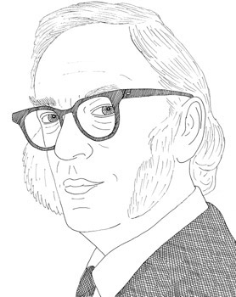
Your assumptions are your windows on the world.
Scrub them off every once in a while, or the light won't come in.
- Isaac Asimov
http://www.doonething.org/heroes/asimov.htm

Slide 28
Seek to understand
Start with a statement about what you saw or heard.
Follow it up with an invitation for the person to tell you their perspective.
I noticed that…
I heard you say…

Slide 29
Practice
Think of a missed opportunity to advocate for a different course of action or move toward consensus.
Try the tool you think would be best suited to respond in that case.
Partner and practice. (2 min)
Share as a group. (5 min)

Slide 30
Rapid Rounds troubleshooting
When this happens… | Try this…
Flow is interrupted by rambling contributions or sidebars | Start with reference to cornerstones Use SBAR, WAIT Provide feedback
Takes too long | Use SBAR for new or complicated cases, only Use WAIT to contribute purposely Assign a timekeeper Separate roles of facilitator and recorder
Unclear plan or follow up is not assigned | Use the “what gets covered” checklist to guide each Rapid Round Start each case with update on previously assigned tasks
I did not get a response to my concern | Use 2-challenge
(What else might happen?) | (How might you address it?)

Slide 31
Bedside shift report troubleshooting
When this happens… | Try this…
Colleague is reluctant to conduct report at the bedside | Refer to the cornerstones which emphasize safety checks and patient engagement
Patient has needs or concerns unrelated to report | Complete comfort rounds ½ hour prior to shift change Start report with NOD to highlight your role and purpose of report
Takes too long | Use SBAR, WAIT Complete comfort rounds ½ hour prior to shift change
Concern for patient confidentiality, loss of dignity | Explain the process to the patient, ask permission to conduct report at the bedside Think critically about what information must be shared outside the room
(What else might happen?) | (How might you address it?)

Slide 32
Part 3
Reflect on practice.

Slide 33
Reflect on practice
Where and when can I use 2-challenge? CUS? DESC? SBAR? Jargon Alert? WAIT? Seek to understand?
What others skills/ competencies do I already have that enable me to be successful?
What might I need to unlearn or relearn?
What others skills and competencies do I need?
Am I ready to apply these skills in practice?
What might I need to implement them?

Slide 34
References
CUS, 2 Challenge, & DESC
Agency for Healthcare Research and Quality (AHRQ): TEAMSTEPPS project.
http://teamstepps.ahrq.gov/about-2cl_3.htm
Jargon Alert
University of Alberta: Health Sciences Council: Interprofessional Clinical Learning Unit project. http://www.hserc.ualberta.ca/TeachingandLearning/ VIPER/EducatorResources/JargonAlertCard.aspx
SBAR
Originated by US Navy, adapted for health care by M. Leonard from Kaiser Permanente.
WAIT
Source unknown.

Slide 35
Acknowledgements
These materials were produced for Better Teams, Better Care: Enhancing Interprofessional Care Processes through Experiential Learning (Interprofessional Care Processes Project). This project is a joint initiative of Alberta Health Services and the University of Alberta, in partnership with Covenant Health, and funded by Alberta Health.
Thank you to all the people and organizations who supported and encouraged this project in countless ways.
For further information about this initiative, please contact the project co-leads: Dr. Sharla King (780-492-2333; Sharla.King@ualberta.ca) and Dr. Esther Suter (403-943-0183; Esther.Suter@albertahealthservices.ca).
These materials were published on July 1, 2015.
© 2015 Alberta Health Services and University of Alberta
Image Credits
George Bernard Shaw. The People for Peace Project, via DoOneThing.org (http://www.doonething.org/heroes/shaw.htm). Used with permission.
Hinting and hoping. Health Sciences Education and Research Commons, University of Alberta.
Isaac Asimov. The People for Peace Project, via DoOneThing.org (http://www.doonething.org/heroes/asimov.htm). Used with permission.

