Slide 1
Refining Your Collaborative Practice Skills
The what, why, and how of debriefing.
Practice giving feedback and debriefing.
Set ground rules.

Slide 2
Project collaborators

Slide 3
Overview
Part 1: The what and why of debriefing
Part 2: Practice giving feedback and debriefing
Practice the skills
Set ground rules for debriefing
Role play
Part 3: Reflect on team debriefing

Slide 4
Learner outcomes
Recognize utility of team debriefing.
Learn feedback and debriefing skills, including when and how to use them.
Reflect on practice.

Slide 5
Part 1
The what and why of debriefing.

Slide 6
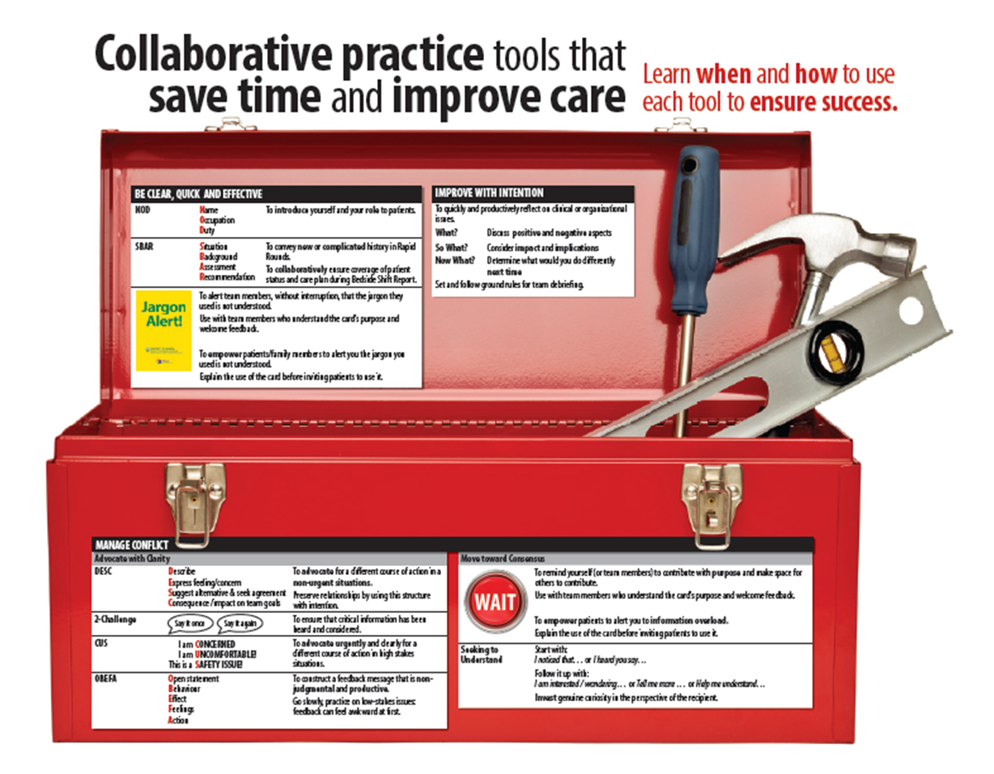
http://www.hserc.ualberta.ca/TeachingandLearning/VIPER/IPCareProcesses.aspx

Slide 7
What debriefing is (and isn’t)
Debriefing
Venting/Gossip
structured
focused
intentional
analysis for improvement
contributes to a safe work environment
unstructured
unfocused
lacks clear purpose
divisive
unsafe

Slide 8
Why debrief?
Debriefing is a method for discovery to identify opportunities for professional development, team and organizational improvement, and innovation.

Slide 9
Part 2
Practice giving feedback and debriefing.

Slide 10
What do we debrief?
Clinical
Relational
Logistical

Slide 11
How do we debrief?
Build a culture where everyone commits to accountability by:
Protecting time to debrief.
Seeking, accepting, and giving feedback.
Communicate with the intent to improve.
Focus on the what, not the who.
Use tools to build constructive feedback.
Use structured approach to ensure safety needed to sustain relationships.

Slide 12
Cornerstones of good feedback: CORBS model
Clear | Be clear that you are about to provide feedback. Being vague and faltering will increase anxiety in the receiver and will confuse your message.
Owned | Use “I” statements to own the feedback. Feedback is your own perception and not an “ultimate truth.” It says as much about you as it does about the receiver.
Regular | Give feedback as soon after the event as possible. Feedback given regularly is more likely to be useful than grievances that are saved up and delivered as one large package.
Balanced | Balance negative and positive feedback over time.
Specific | Generalized feedback is not productive. Focus feedback on particular interactions or behaviours that you have witnessed.

Slide 13
Construct feedback
A feedback tool to help you…
OBEFA
Open statement | I have a concern.
Behaviour | When you do X …
Effect | … this happens …
Feelings | … and I feel …
Action | I would like us to resolve this together.
Whetten, D.A. & Cameron, K.S. (2011). Developing management skills (8th ed.), Boston, MA, U.S.A.: Prentice Hall.

Slide 14
What feedback might look like
OBEFA
Open statement | I have a concern.
Behaviour | When you tell me you are walking home alone, then don’t show up or call …
Effect | … I don’t know where you are …
Feelings | … and I worry about your safety.
Action | I would like us to work this out.

Slide 15
Feedback practice 1
Think about a situation where you wanted to give feedback
E.g. Someone took your parking space or cut in line, or something your kids, mother-in-law, or partner did
Partner and practice OBEFA (2 min)
Share as a group (3 min)
How did it go?
When would you use it?
Cautions?

Slide 16
Feedback practice 2
Watch the video segment How not to do Bedside Shift Report [YouTube link; watch 1:15 - 2:23]
Use the Bedside Shift Report checklist to analyze the interaction [VIPER website link].
Partner and take turns constructing and then providing feedback using OBEFA (3 min)
Share as a group (3 min)
How did it feel to provide negative feedback using OBEFA?
How did it feel to receive this feedback?
When would you use it?
Cautions?

Slide 17
Timely and effective team debriefing
A team process tool for…
What? | Describe/review event success & challenge.
So what? | What was the impact/implications?
Now what? | What would you do differently moving forward, what needs to happen next?
Based on work of Schön: The Reflective Practitioner: How professionals think in action. London: Temple Smith, 1983.

Slide 18
What team debriefing might look like
T: So Kathy, how did you think that went?
K: I thought the team responded really well, and the work that went up on the chart paper really helped us to move on to the next step.
T: I agree. I was surprised when other team members spoke to Bedside Shift Report which at first glance seems mostly to be a nursing process. That really underscored the need to involve everyone in the sessions. One challenge with all the great discussions, we kept getting behind on time.
K: You’re right, it did cause some pressure.
T: Yes, and when I am watching the time I get distracted and worry I am not being clear, or worse, will miss something. Given that we can’t likely extend the sessions, let’s plan to do less in the time allotted.
K: That’s great. Everything’s a learning experience, right!
What?
So what?
Now what?

Slide 19
What team debriefing might look like
T: So Kathy, how did you think that went?
K: I thought the team responded really well, and the work that went up on the chart paper really helped us to move on to the next step.
T: I agree. I was surprised when other team members spoke to Bedside Shift Report which at first glance seems mostly to be a nursing process. That really underscored the need to involve everyone in the sessions. One challenge with all the great discussions, we kept getting behind on time.
K: You’re right, it did cause some pressure.
T: Yes, and when I am watching the time I get distracted and worry I am not being clear, or worse, will miss something. Given that we can’t likely extend the sessions, let’s plan to do less in the time allotted.
K: That’s great. Everything’s a learning experience, right!
What?
So what?
Now what?

Slide 20
What team debriefing might look like
T: So Kathy, how did you think that went?
K: I thought the team responded really well, and the work that went up on the chart paper really helped us to move on to the next step.
T: I agree. I was surprised when other team members spoke to Bedside Shift Report which at first glance seems mostly to be a nursing process. That really underscored the need to involve everyone in the sessions. One challenge with all the great discussions, we kept getting behind on time.
K: You’re right, it did cause some pressure.
T: Yes, and when I am watching the time I get distracted and worry I am not being clear, or worse, will miss something. Given that we can’t likely extend the sessions, let’s plan to do less in the time allotted.
K: That’s great. Everything’s a learning experience, right!
What?
So what?
Now what?

Slide 21
Planning for group debriefing
As you move forward, your team will identify expectations for debriefing, which can include:
Where | Location
When | Frequency of formal & informal discussion
How | Ground rules, format

Slide 22
Practice
Review ground rules
Role Play
Decompress
Debrief using
What?
So What?
Now What?

Slide 23
Rapid Rounds troubleshooting
When this happens… | Try this…
Flow is interrupted by rambling contributions or sidebars | Start with reference to cornerstones Use SBAR, WAIT Provide feedback
Takes too long | Use SBAR for new or complicated cases, only Use WAIT to contribute purposely Assign a timekeeper Separate roles of facilitator and recorder
Unclear plan or follow up is not assigned | Use the “what gets covered” checklist to guide each Rapid Round Start each case with update on previously assigned tasks
I did not get a response to my concern | Use 2-challenge
(What else might happen?) | (How might you address it?)

Slide 24
Bedside Shift Report troubleshooting
When this happens… | Try this…
Colleague is reluctant to conduct report at the bedside | Refer to the cornerstones which emphasize safety checks and patient engagement
Patient has needs or concerns unrelated to report | Complete comfort rounds ½ hour prior to shift change Start report with NOD to highlight your role and purpose of report
Takes too long | Use SBAR, WAIT Complete comfort rounds ½ hour prior to shift change
Concern for patient confidentiality, loss of dignity | Explain the process to the patient, ask permission to conduct report at the bedside Think critically about what information must be shared outside the room
(What else might happen?) | (How might you address it?)

Slide 25
Part 3
Reflect on team debriefing.

Slide 26
Reflect on team debriefing
What might we need to do differently to align our practice with the goals of this new process? To improve our practice?
What new information have we learned about or from each other? What questions do we still have?
How might this new process change our relationships with each other and our patients?
What other benefits might result as we strengthen our collaborative practice?

Slide 27
References
Urbach, D. R., Govindarajan, A., Saskin, R., Wilton, A. S., & Baxter, N. N. (2014). Introduction of surgical safety checklists in Ontario, Canada. New England Journal of Medicine, 370, 1029-1038. doi: 10.1056/NEJMsa1308261
Salas, E., DiazGranados, D., Weaver, S. J., King, H. (2008). Does team training work? Principles for health care. Academic Emergency Medicine 15(11), 1002-1009.
Salisbury, M. (March 2014). The practical side of debrief: Using event debriefs and formative feedback on the frontline. [Webinar]. In TeamSTEPPS Webinar Series. Retrieved from TeamSTEPPS website: http://www.teamsteppsportal.org/webinars/past-teamstepps-webinars

Slide 28
Acknowledgements
These materials were produced for Better Teams, Better Care: Enhancing Interprofessional Care Processes through Experiential Learning (Interprofessional Care Processes Project). This project is a joint initiative of Alberta Health Services and the University of Alberta, in partnership with Covenant Health, and funded by Alberta Health.
Thank you to all the people and organizations who supported and encouraged this project in countless ways.
For further information about this initiative, please contact the project co-leads: Dr. Sharla King (780-492-2333; Sharla.King@ualberta.ca) and Dr. Esther Suter (403-943-0183; Esther.Suter@albertahealthservices.ca).
These materials were published on July 1, 2015.
© 2015 Alberta Health Services and University of Alberta

