Slide 1
Shared subcases, constitutive classification, and the blending configuration
David Tuggy SIL Mexico

Slide 2
Salient Categorization
Many concepts come into our minds “pre-categorized” (to some extent). It is hard if not impossible to think HALIBUT without activating the category FISH, or APPLE without thinking FRUIT, or STARE without thinking LOOK.
* A hammer is a _____. (An anvil?)
* A piano is a ______ ________.
But we know they can fit in other categories, which may also be relevant at times:
Notes:
Not long ago, at an American university, a friend of mine was making the final presentation of the project for her doctoral thesis.
She had grown up in Mexico, trilingual in English, Popoluca (Mixe-Zoquean) and Spanish, and as an adult has worked with two variants of Tepehua (Totonacan languages).
She wanted to give her committee a bit of a taste for what life is like for members of the Mexican indigenous cultures, and had brought some household items along with her to use in her presentation. She brought out a rebozo, for instance, a typical item of women’s dress, and showed her professors how it could be used to carry groceries or a baby, for warmth, to cover ones head in church, and so forth. She brought out a machete, which men typically carry everywhere, and began showing them the ways it is used for everything from chopping down trees to peeling fruit.

Slide 3
Alternative Categorization
Here’s one that interests me. (IMs in story):
Please say that a cartoonish anvil is going to fall on Mrs. Foster. Wouldn't mind Mr. Foster taking a grand piano either.
(Reply to above):
And do imagine giant pianos and anvils falling on mrs and mr foster
Notes:
Not long ago, at an American university, a friend of mine was making the final presentation of the project for her doctoral thesis.
She had grown up in Mexico, trilingual in English, Popoluca (Mixe-Zoquean) and Spanish, and as an adult has worked with two variants of Tepehua (Totonacan languages).
She wanted to give her committee a bit of a taste for what life is like for members of the Mexican indigenous cultures, and had brought some household items along with her to use in her presentation. She brought out a rebozo, for instance, a typical item of women’s dress, and showed her professors how it could be used to carry groceries or a baby, for warmth, to cover ones head in church, and so forth. She brought out a machete, which men typically carry everywhere, and began showing them the ways it is used for everything from chopping down trees to peeling fruit.

Slide 4
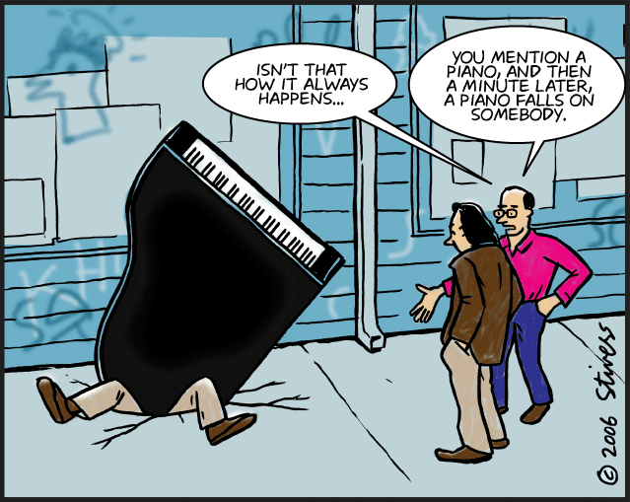
Alternative Categorization
It’s an established categorization in (parts of) our culture.
A piano is a large heavy object that is (improbably) liable to fall on you (especially in cartoons).
Notes:
Not long ago, at an American university, a friend of mine was making the final presentation of the project for her doctoral thesis.
She had grown up in Mexico, trilingual in English, Popoluca (Mixe-Zoquean) and Spanish, and as an adult has worked with two variants of Tepehua (Totonacan languages).
She wanted to give her committee a bit of a taste for what life is like for members of the Mexican indigenous cultures, and had brought some household items along with her to use in her presentation. She brought out a rebozo, for instance, a typical item of women’s dress, and showed her professors how it could be used to carry groceries or a baby, for warmth, to cover ones head in church, and so forth. She brought out a machete, which men typically carry everywhere, and began showing them the ways it is used for everything from chopping down trees to peeling fruit.

Slide 5
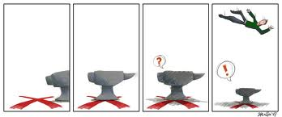
Alternative Categorization
(So is an anvil… even when that expectation is contravened.)
Notes:
Not long ago, at an American university, a friend of mine was making the final presentation of the project for her doctoral thesis.
She had grown up in Mexico, trilingual in English, Popoluca (Mixe-Zoquean) and Spanish, and as an adult has worked with two variants of Tepehua (Totonacan languages).
She wanted to give her committee a bit of a taste for what life is like for members of the Mexican indigenous cultures, and had brought some household items along with her to use in her presentation. She brought out a rebozo, for instance, a typical item of women’s dress, and showed her professors how it could be used to carry groceries or a baby, for warmth, to cover ones head in church, and so forth. She brought out a machete, which men typically carry everywhere, and began showing them the ways it is used for everything from chopping down trees to peeling fruit.

Slide 6
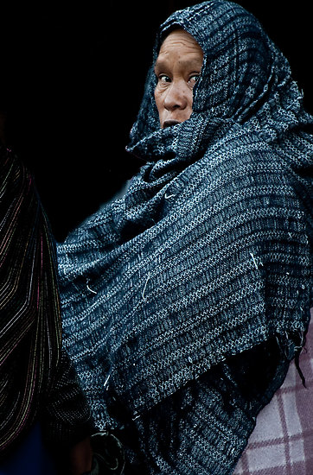
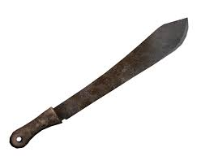
Anecdote
Friend at an American university, qualifying for dissertation.
Grown up in rural/ indigenous Mexican cultures
Showing multipurpose items typical of the cultures
Rebozo (women)
Machete (men)
Notes:
Not long ago, at an American university, a friend of mine was making the final presentation of the project for her doctoral thesis.
She had grown up in Mexico, trilingual in English, Popoluca (Mixe-Zoquean) and Spanish, and as an adult has worked with two variants of Tepehua (Totonacan languages).
She wanted to give her committee a bit of a taste for what life is like for members of the Mexican indigenous cultures, and had brought some household items along with her to use in her presentation. She brought out a rebozo, for instance, a typical item of women’s dress, and showed her professors how it could be used to carry groceries or a baby, for warmth, to cover ones head in church, and so forth. She brought out a machete, which men typically carry everywhere, and began showing them the ways it is used for everything from chopping down trees to peeling fruit.

Slide 7
Anecdote
Strong reaction from committee members to the latter.
Notes:
Not long ago, at an American university, a friend of mine was making the final presentation of the project for her doctoral thesis.
She had grown up in Mexico, trilingual in English, Popoluca (Mixe-Zoquean) and Spanish, and as an adult has worked with two variants of Tepehua (Totonacan languages).
She wanted to give her committee a bit of a taste for what life is like for members of the Mexican indigenous cultures, and had brought some household items along with her to use in her presentation. She brought out a rebozo, for instance, a typical item of women’s dress, and showed her professors how it could be used to carry groceries or a baby, for warmth, to cover ones head in church, and so forth. She brought out a machete, which men typically carry everywhere, and began showing them the ways it is used for everything from chopping down trees to peeling fruit.

Slide 8
Much has been written about cases where a schema (pattern) has multiple subcases (instantiations).

Slide 9
Sometimes the pattern is fully schematic for the subcases: each subcase *is* (a kind of) the schema.
E.g. a dog or a cat *is* an/a kind of animal.

Slide 10
Sometimes the pattern is only partially schematic for the subcase: the subcase *is like* the schema.
E.g. a pet cat or project is/is like (can be seen “ás”) a person’s baby.

Slide 11
The differences between the two cases (full and partial schematicity = “being” and “being like” a pattern) are matters of degree, not absolute differences in kind.

Slide 12
In both cases a kind of classification (of the instantiation/similar concept as an example of the pattern) is effected.

Slide 13
In the second case it is clear that the classification affects the conceptualization of the subcase.
Calling a project or a pet your “baby” makes (or at least encourages) you to think of it differently.
We have here, in fact, two cases of “constitutive metaphor”.

Slide 14
In Langacker’s terms, the conceptualizer is thinking of the pet or project “ás” a baby.

Slide 15
Less attention has perhaps been lavished on cases of overlap between schemas, where a single concept instantiates more than one pattern.
For instance, a dog “is” at the same time a carnivore and a domesticable animal.

Slide 16
❖ The main thing I want to say this afternoon is that here also the instantiation is seen “ás” the pattern.
❖ Seeing a dog “ás” a carnivore is not the same as seeing it “ás” a domesticable animal. (Though of course it “is” both.)

Slide 17
❖ Where the putative “subcase” is related to the “schemas“ by partial rather than full schematicity, you have a blending configuration.

Slide 18
❖ Blends, we have been taught to expect, typically exhibit a four-box (four-“space”) pattern.

Slide 19
❖ Besides “input spaces” for the two concepts which get blended, and the blended space, we expect a “schematic space” consisting of semantic specifications common to the blended concepts.

Slide 20
❖ Similarly for the case of overlapping schemas, there is typically a higher schema subsuming them.

Slide 21
❖ As many have pointed out, using these “network” structures to map or represent meanings can easily give rise to false ideas about how separate, discrete, and countable they are.

Slide 22
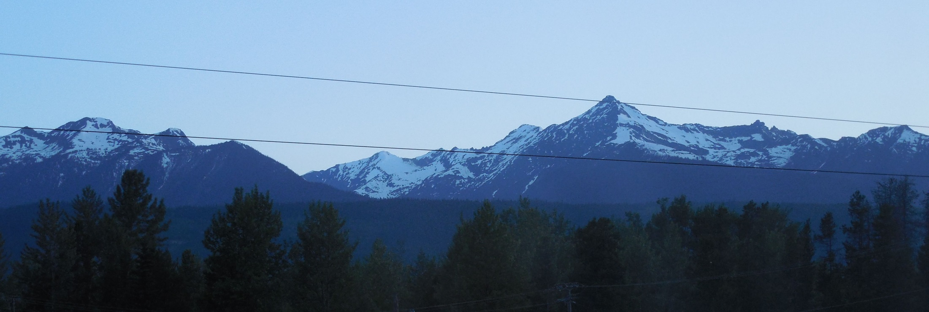
Langacker suggests supplementing the network model with a “mountain range” model.
How many peaks are there in a mountain range?
How discrete are they?

Slide 23
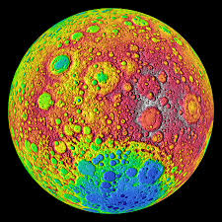
There are a number of other models, including the “moon craters” model Joan Bybee suggested,
or the “moon as Swiss cheese / sponge” model somebody else suggested.

Slide 24
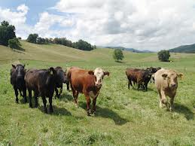
Ask me about E.B. White’s “Cow Pasture” model: it’s another good one.

Slide 25
A favorite of mine is a cloud model.
Like the mountain range model, it makes for multiple, not-easily countable peaks, but but they can develop in all directions,
and they don’t lead you to think they are permanent and unchangeable.

Slide 26
They may have sparse and thick parts, and so forth.
But the rela- tionships of schematicity (full or partial) exist in the cloud and help structure it.

Slide 27
So we can think of this “blending configuration” as a complex cloud within which the relations specified in the network hold.

Slide 28
Let’s model what happened when my friend brandished her machete in her thesis proposal defense.
Pretty clearly we have a case of competing schemas, with different constitutive effects.

Slide 29
Oversimplifying, my friend saw her machete ás an AGRICULTURAL IMPLEMENT.
Her committee saw it ás a WEAPON.

Slide 30
And they forced her to construe it ás a WEAPON as well.

Slide 31
Note that both categories are subcases of the category TOOL ( / IMPLEMENT.)
Thus we fill out the four- cell structure.

Slide 32
As suggested before, this might be better represented as a complex cloudlike structure.
Let’s examine some of the details that constitute the cloud a little more carefully.

Slide 33
In my friend’s mind the machete was categorized along with hoes, rakes, and such things.
Entrenched in her mind, and enhanced by the classification were specifications of how the machete is to be used for such purposes, esp. for cutting plants.

Slide 34
Her committee’s reaction coerced her into categorizing a machete with guns, bombs, etc., whose function is to hurt or kill people.

Slide 35
This naturally (filling out the cloud) prompted her to conceive of a machete in a new way: as an instrument of killing or wounding.

Slide 36
These two machete concepts are so similar one can hardly avoid schematizing over them.

Slide 37
On the other hand you can hardly help combining (blending?) them into a richer concept as well.

Slide 38
We now have four MACHETE-concepts:
MACHETE-ás-agricultural-implement
MACHETE-ás-weapon (=MACHETE’)
MACHETE-ás-neither (=MACHETE’’) (Schema [Dict?])
MACHETE-ás-both (=MACHETE’’’) (Blended subcase [Ency?])

Slide 39
That whole four-celled structure constitutes (part of) the meaning (semantic pole) of machete.

Slide 40
Of course it lies within the four-celled cloud we saw before.

Slide 41
It happens at lower levels too, I’m would argue (though time constraints forbid.)

Slide 42
In this way, and in its ubiquity, the configuration is fractal-like.

Slide 43
I said we were oversimplifying.
One way we did so is that my friend (of course) already knew that machetes *could* be used to hurt or kill people.
What happened was not that she learned a brand-new sense, but that the sense “MACHETE-ás-weapon” suddenly was made more salient in her mind.

Slide 44
That salience was (naturally) tied in various ways to the context in which the interaction took place. She learned (or at least guessed and thus started to conclude) that in American, and particularly American academic culture, when speaking English the prominence of use as a weapon for machetes is much higher than in her Mexican cultures & languages.
Which categorizations are how prominent is very much a cultural (and / or personal and / or occasional) matter.

Slide 45
This sort of thing happens all the time, though its effects are not always so traumatic and obvious.
It is the way new specifications get worked into encyclopedic meanings (among other things.)
Another way to say it is that it is natural, as part of the way the cloud surrounding meanings grows, to expand both up and down as far as is reasonable along the dimension of schematicity. The four-cell box results from this tendency.

Slide 46
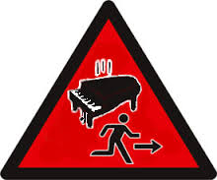
(And that’s about all I have to say.)

