Slide 1
Frame Semantics and Presidential Debates
Natalia Knoblock
Saginaw Valley State University

Slide 2
“Politics is discourse and discourse is politics” (O. Feldman)
“rhetoric equals action” (A. Kiewe)
“a structured background of experience, beliefs, or practices” (Fillmore and Atkins, 1992)

Slide 3
https://framenet2.icsi.berkeley.edu/fnReports/data/frameIndex.xml?frame=Hostile_encounter

Slide 4
https://framenet.icsi.berkeley.edu/fndrupal/FrameGrapher

Slide 5
I will fight tooth and nail for minimum wage
I believe I'm going to win.
Just want to make sure they're safe. When a drug comes in from Canada, I want to make sure it cures you and doesn't kill you
9/11
AK-47, assault weapons
nuclear fuel

Slide 6
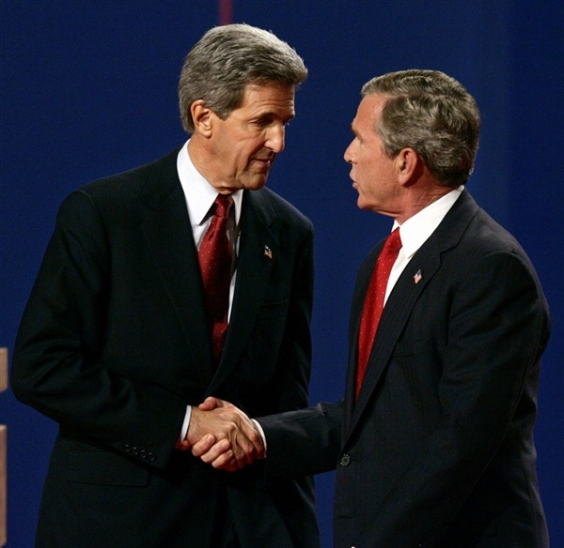
2004

Slide 7
war (43/4)
reason (14/3)
threat (47/6)
enemy's(4/2)
democracy (59/7)
safety (64/7)
peace (9/3)
result
victory(36/6)
loss (5/5)
ΑΩ
beginning6/4
end (4/3)
ours
sides
we (35/10)
allies (79/31)
enemy(211/34
military ranks (27/6)
veterans(8/2)
agencies(16/7
beneficiaries(53/18)
strategy(26/5)
actions
instrument
weapons(40/10)
intelligence24/4
diplomacy71/15
cost (26/17)
time (9/3)
duration (2/2)
location 56/9
depictive
goal (1/1)
agents
situation73/21
we (45/23)
enemy(7/5)
means(1/1)
9/11 (12/1)
ours (116/54)
enemy(15/10)
potential allies(26/9)
equipment(16/5)
casualties 4/4
weak points18/3

Slide 8
war (68/3)
reason (3/1)
threat (29/3)
safety (38/4)
peace (15/2)
victory(27/4)
ΑΩ
beginning(11/3)
end (1/1)
sides
we (29/7)
allies (52/7)
enemy(39/5)
military ranks (59/8)
veterans4/2
agencies(3/2)
beneficiaries (47/12)
strategy(32/2)
actions
instrument
weapons(41/10)
intelligence(24/4)
diplomacy(71/15)
cost (36/13)
time (11/3)
location (72/12)
depictive
goal (1/1)
agents
situation(46/18)
we (39/16)
means(1/1)
president's decision (21/4)
combat (37/4)
equipment(12/5)
casualties(12/6)
weak points(25/6)
WMD(6/1)
Hussein/ bin Laden (21/2)
military units(65/11)
result
organizational support(11/6)
invasion (8/2)
siege (2/2)
sally (1/1)
attack(7/2)
defence (21/3)

Slide 9
National Guard, Reserves, Active Duty, Special Forces, Air Force, division, and referring to military leaders: Joint Chiefs of Staff, General , Admiral, General Tony McPeak, General Wes Clark, General Bacca
call-ups, deployments, rotation, returnees, stop-loss policies
troops, military, and manpower
have been brought to justice / to use troops / to use force /to commit troops

Slide 10
weapons of mass destruction, nuclear weapons, bunker-busting nuclear weapons, chemical weapons, bombs, guns, assault weapons, AK-47, ammo, body armor, Humvees
yellowcake, enriched uranium, nuclear fuel, fuel rods
the Armistice of 1952 DMZ issues, the treaties, Nuclear Test Ban Treaty, anti-proliferation initiatives
bridges and tunnels, chemical plants, nuclear plants, hospitals
weapons of mass destruction / weapons
diplomacy, inspections, resolutions

Slide 11
Saddam Hussein / Saddam Hussein / Saddam Hussein / Saddam Hussein / Saddam Hussein / Saddam Hussein / Saddam Hussein / Saddam Hussein / Saddam Hussein / Saddam Hussein / Saddam Hussein / Saddam Hussein / Saddam Hussein / Saddam Hussein / Saddam Hussein / Saddam Hussein / Saddam Hussein / Saddam Hussein / Saddam Hussein / Saddam Hussein / Saddam Hussein / Saddam Hussein / Saddam Hussein / Saddam Hussein / Saddam Hussein / Saddam Hussein / Saddam Hussein / Saddam / he (Saddam Hussein) / he (Saddam Hussein) / he (Saddam Hussein) / he (Saddam Hussein) / he (Saddam Hussein) / him (Saddam Hussein) / him (Saddam Hussein) / he (Saddam Hussein) / he (Saddam Hussein) / He (Saddam Hussein) / He (Saddam Hussein) / He (Saddam Hussein) / Him (Saddam Hussein) / He (Saddam Hussein) / He (Saddam Hussein / He (Saddam Hussein) / He (Saddam Hussein) / He (Saddam Hussein) / / We knew he (Saddam Hussein) hated us / We knew he'd (Saddam Hussein) been -- invaded other countries / We knew he (Saddam Hussein) tortured his own people Saddam loyalists / Saddam loyalists / them (Saddam loyalists) / them (Saddam loyalists) / they (Saddam loyalists) / they (Saddam loyalists)

Slide 12
Osama bin Laden, Khalid Sheikh Mohammed, Zarqawi, A.Q. Khan, al Qaeda, Lackawanna cell, The A.Q. Khan network, Taliban, Ba'athists, Saddam loyalists

Slide 13
When the president had an opportunity to capture or kill Osama bin Laden, he took his focus off of him, outsourced the job to Afghan warlords, and Osama bin Laden escaped.
… spoils of the war…, to save for Halliburton the spoils of the war…, I didn't want to give a slush fund to Halliburton.

Slide 14
And I saw a unique threat in Saddam Hussein, as did my opponent, because we thought he had weapons of mass destruction. And the unique threat was that he could give weapons of mass destruction to an organization like al Qaeda, and the harm they inflicted on us with airplanes would be multiplied greatly by weapons of mass destruction. And that was the serious, serious threat.
…the president invaded it…

Slide 15
Yes, we can be safe and secure if we stay on the offense against the terrorists and if we spread freedom and liberty around the world.

Slide 16
In Iraq, no doubt about it, it's tough. It's hard work. It's incredibly hard. … There's a lot of good people working hard. ……Director Mueller of the FBI. He comes into my office when I'm in Washington every morning, talking about how to protect us. There's a lot of really good people working hard to do so. It's hard work. …Of course we're doing everything we can to protect America. I wake up every day thinking about how best to protect America. That's my job.

Slide 17
wrong war – right war, pitiful, embarrassing, dangerous – vital mission, difficult missions – a smarter, more effective war, the real war, the true war, pitiful, embarrassing, dangerous, rush….

Slide 18
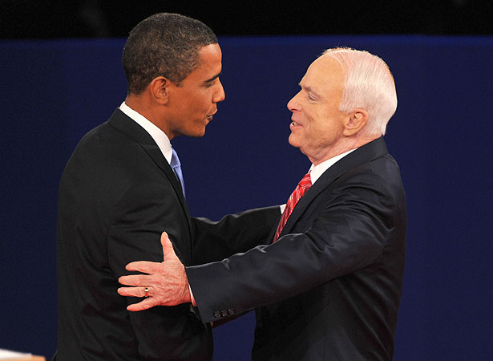
2008

Slide 19
war 27/12
threat(30/11
democracy (3/2)
safety23/10
peace(9/3)
result
victory(33/5)
loss(26/7)
ΑΩ
beginning13/4
end (15/5)
sides
we(34/9)
allies(27/5)
enemy113/14
military ranks (43/6)
veterans33/6
agencies(2/2
beneficiaries15/6
means
strategy 39/7
actions
instrument
weapons (12/4)
intelligence (4/2)
cost(14/7)
time(11/6)
depictive
goal
agents(9/9)
situation (11/8)
issue(5/3)
military families(2/2)
military units (6/1)
half-ally(16/1
casualties (10/6)
location (56/14)
surge11/1
ours(38/15)
weak points
targets (1/1)
energy16/2
POWs(6/5)
reason
enemy of enemy (33/8)
enemy's
(14/6)
diplomacy (38/15)
equipment (5/3)

Slide 20
war 24/12
threat(17/3)
safety(18/3)
result
victory(1/1)
loss(2/2)
ΑΩ
beginning (14/11)
end (13/7)
sides
we(38/8)
allies(28/16)
enemy(130/17)
military ranks(50/9)
veterans(3/2)
agencies(1/1)
beneficiaries
(26/12)
means
strategy (13/7)
actions
instrument
weapons (29/14)
intelligence (1/1)
cost (28/12)
time(12/9)
depictive
goal
agents(29/13)
situation30/22
issue(2/2)
military families(6/2)
casualties(6/6)
location(58/14)
surge(2/2)
ours(34/18)
weak points
targets(6/6)
energy(7/2)
reason
enemy's(7/4)
diplomacy (74/ 28)
moral duty (10/7)
half-ally(16/4)
duration (16/8
focus (16/8)
battle (1/1)
attack(6/4)
defense(2/2)
retreat(1/1)

Slide 21
We had to take Saddam Hussein out of Kuwait or it would've threatened the Middle Eastern world supply .

Slide 22
If we could have intervened effectively in the Holocaust, who among us would say that we had a moral obligation not to go in? If we could've stopped Rwanda, surely, if we had the ability, that would be something that we would have to strongly consider and act. So when genocide is happening, when ethnic cleansing is happening somewhere around the world and we stand idly by, that diminishes us. And so I do believe that we have to consider it as part of our interests, our national interests, in intervening where possible.

Slide 23
…to stay and fight for Iraqi freedom and American freedom…

Slide 24
We have seen Afghanistan worsen, deteriorate. We need more troops there. We need more resources there. Senator McCain, in the rush to go into Iraq, said, you know what? “We've been successful in Afghanistan. There is nobody who can pose a threat to us there.” This is a time when bin Laden was still out, and now they've reconstituted themselves.
nobody is talking about defeat…, nobody is talking about losing this war…

Slide 25
And we are winning in Iraq, and we will come home. And we will come home as we have when we have won other wars and not in defeat. … But if we snatch defeat from the jaws of victory and adopt Senator Obama's plan…
And I can tell you right now that Senator Obama would have brought our troops home in defeat. I'll bring them home with victory and with honor ...
… They said, let us win. They said, let us win.

Slide 26
bringing that war to a close
it’s important for us to end the war in Iraq
… if we adopted Senator Obama's set date for withdrawal, then that will have a calamitous effect in Afghanistan and American national security interests in the region…
… we don't leave and make the situation worse…

Slide 27
General Petraeus
Troops
Veterans
Military families
Pakistan
Russia / Russians – 36; Putin – 7; KGB – 4; Soviet Union – 1; Osama bin Laden – 5, Taliban – 6; AlQaeda – 7; Saddam Hussein – 1; Iran / Iranians – 20; Ahmadinejad – 7; North Korea – 5; Kim Long Il - 1

Slide 28
…we took our eye off Afghanistan…
…the central front on terror…
…we've been focused on Iraq…

Slide 29
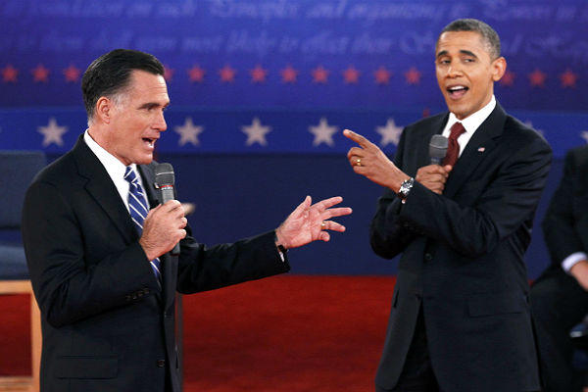
2012

Slide 30
war (4/2)
reason
threat (21/6)
safety(9/4)
peace(10/4)
result
victory(2/1)
ΑΩ
end (6/5)
sides
we(23/6)
allies(49/11)
enemy(80/15)
potential allies (13/2)
military ranks (32/5)
military units (6/2)
beneficiaries (27/12)
means(1/1)
strategy(11/2
actions
instrument
weapons(32/11)
intelligence2/1
diplomacy (36/13)
cost (16/7)
time (1/1)
location (54/11)
depictive
goal
agents (35/17)
situation26/14)
issue (2/2)
half-ally(21/2)
ours(20/12)
enemy's(9/4
equipment (11/5)
loss (0)
casualties/ victims (9/5)

Slide 31
war (9/6)
reason
threat(10/3)
safety(24/4)
result
victory (0)
loss (0)
ΑΩ
end(28/9)
sides
we(34/6)
allies(38/6)
enemy(72/17)
military ranks (29/6)
veterans(18/5)
beneficiaries (39/15)
means
strategy(9/5)
actions
instrument
weapons(21/8)
intelligence(4/2
diplomacy
(54/23)
cost (24/9)
duration (7/3)
location(55/14)
depictive
goal
agents(21/10)
situation(7/7)
issue(3/2)
half-ally(11/3)
military units (4/2)
military cooperation(6/4)
ours (30/13)
enemy's(15/9)
equipment(8/6)
continuation (6/3)
casualties/terror victims (5/5)
time (0)

Slide 32
I said that I'd end the war in Iraq, and I did. I said we'd refocus attention on those who actually attacked us on 9/11, and we have gone after Al Qaeda's leadership like never before and Osama bin Laden is dead.
I said I'd end the war in Libya -- in -- in Iraq, and I did.
I said that we'd go after al-Qaeda and bin Laden, we have. I said we'd transition out of Afghanistan, and start making sure that Afghans are responsible for their own security, that's what I'm doing.

Slide 33
But just a few weeks ago, you said you think we should have more troops in Iraq right now. … You said we should have gone into Iraq, despite that fact that there were no weapons of mass destruction.
You said that we should still have troops in Iraq to this day.

Slide 34
You mentioned the Navy, for example, and that we have fewer ships than we did in 1916. Well, Governor, we also have fewer horses and bayonets, because the nature of our military's changed. We have these things called aircraft carriers, where planes land on them. We have these ships that go underwater, nuclear submarines.

Slide 35
Let's talk about China. China has an interest that's very much like ours in one respect, and that is they want a stable world. They don't want war.… We don't have to be an adversary in any way, shape or form. We can work with them, we can collaborate with them, if they're willing to be responsible.

Slide 36
Conclusion
frequency
filled / empty FEs
elaboration / keeping it general
The role of personality in shaping the discourse.
Manipulation
Future research

Slide 37
References:
Biocca, F. (1991). Viewers’ mental models of political messages: Toward a theory of the semantic processing of television. Television and political advertising, 1, 27-89.
Bybee, J. (2010). Language, usage and cognition. Cambridge: Cambridge University Press.
The Commission on Presidential Debates. (2012). Debate History. Retrieved from: http://www.debates.org/index.php?page=debate-history
Van Dijk, T. A. (2006). Ideology and discourse analysis. Journal of Political Ideologies, 11(2), 115-140.
Fairclough, N., Mulderrig, J., & Wodak, R. (2011). Critical discourse analysis. Discourse Studies: a multidisciplinary introduction.
Fauconnier, G. (1994). Mental Spaces: Aspects of Meaning Construction in Natural Language. Cambridge: Cambridge University Press.
Feldman, O. (1998). Politically speaking: A worldwide examination of language used in the public sphere. Praeger Publishers.
Fillmore, C. J., & Atkins, B. T. (1992). Toward a frame-based lexicon: The semantics of RISK and its neighbors. Frames, fields, and contrasts, 102.
International Computer Science Institute in Berkeley, California. (2013). Hostile_encounter. Retrieved from: https://framenet2.icsi.berkeley.edu/fnReports/data/ frameIndex.xml?frame=Hostile_encounter
Lakoff, G. (2002). Moral politics: How liberals and conservatives think. University of Chicago Press.
Langacker, R. W. (1987). Foundations of cognitive grammar: Theoretical prerequisites (Vol. 1). Stanford university press.
Kiewe, A. (1998). The crisis tool in American political discourse. Politically speaking: a worldwide examination of language used in the public sphere, 79-90.
Tannen, D. (1993). Framing in discourse. Oxford University Press on Demand.

Slide 38
Thank you!

