Slide 1
How to interpret the LIGO signal
on the back of an envelope
Alexander Penin
University of Alberta & TTP Karlsruhe
NYU, New York
October 6th, 2016

Slide 2
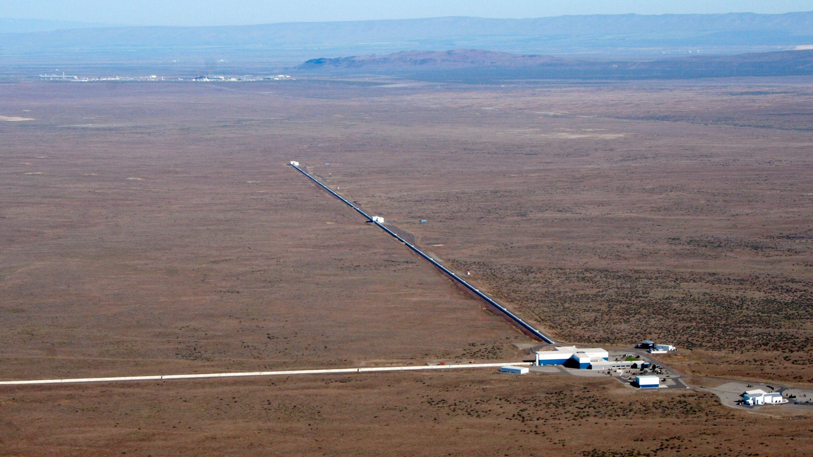
LIGO experiment

Slide 3
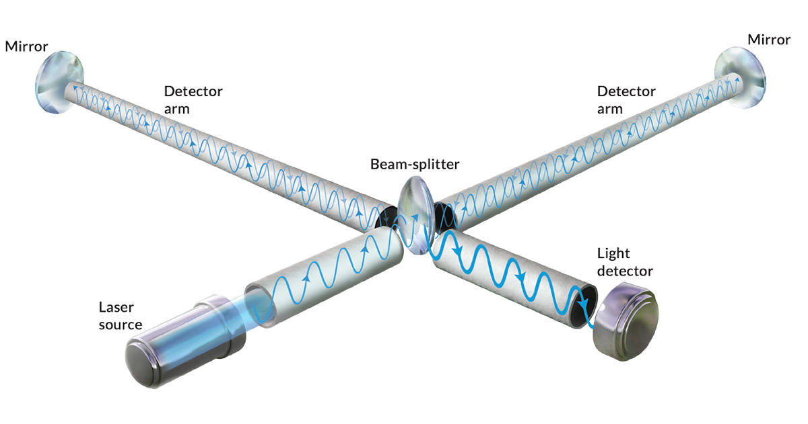
LIGO experiment

Slide 4
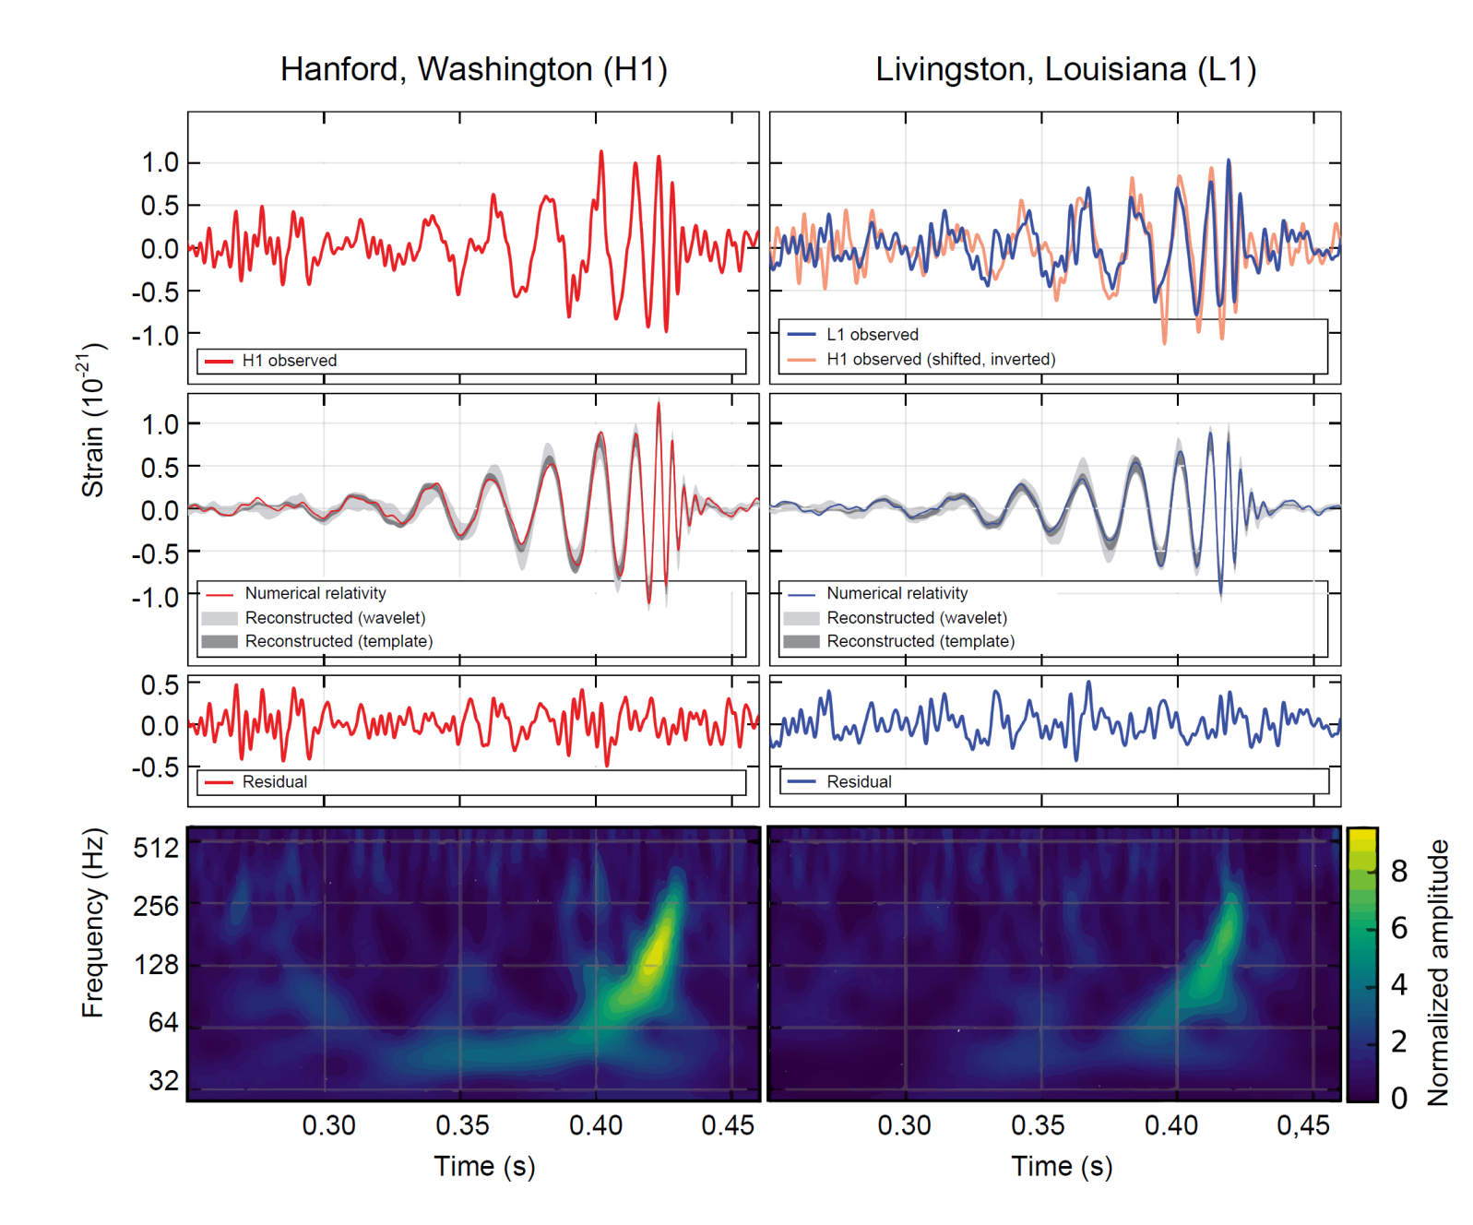
LIGO data

Slide 5
Can we hear the shape of a drum?

Slide 6
Can we hear the shape of a drum?
Yes!
for convex planar drums with analytic boundary
Steve Zelditch (2000)

Slide 7
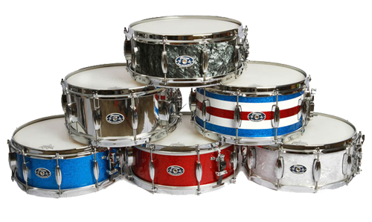
Can we hear the shape of a drum?
Yes!
for convex planar drums with analytic boundary
Steve Zelditch (2000)
LIGO event reconstruction:
fitting with templates based on numerical gravity

Slide 8
Is it possible to identify the astrophysical origin of the LIGO event by hand rather than by a supercomputer?

Slide 9
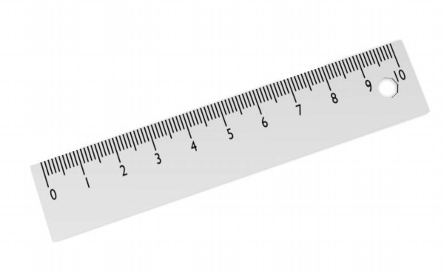
Tools

Slide 10
Plan
Gravitational waves in a nutshell
polarization
radiation
energy flow
detection
Data analysis
Initial phase: linear regime, determination of the mass
Final phase: nonlinear regime, determination of the distance

Slide 11
Gravitational waves

Slide 12
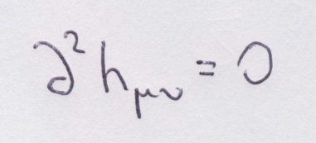
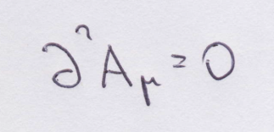
General properties
Linearized/weak field approximation
Gravity
Electrodynamics
Coordinate transformation
Gauge transformation
Einstein equations
Maxwell equations

Slide 13
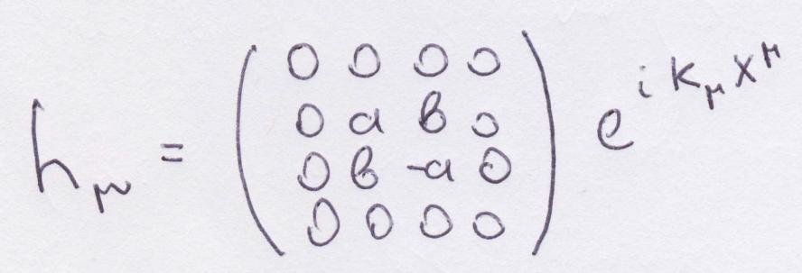
Polarization
Gravity
Electrodynamics

Slide 14
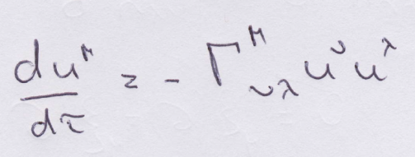
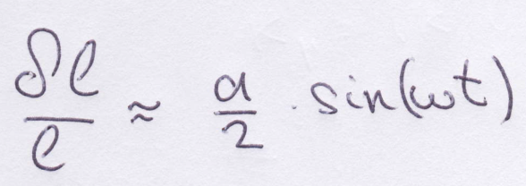
Detection
Geodesic equation:
no acceleration!
Length variation:

Slide 15
Energy flow
Electrodynamics
Gravity

Slide 16
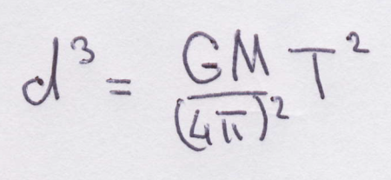
Radiation
Gravity quadrupole
Electric dipole
Newtonian binary system:
(Hulse/Taylor NP 92)

Slide 17
Innermost stable orbit
Effective potential
Innermost stable orbit
Energy release

Slide 18
Data analysis

Slide 19
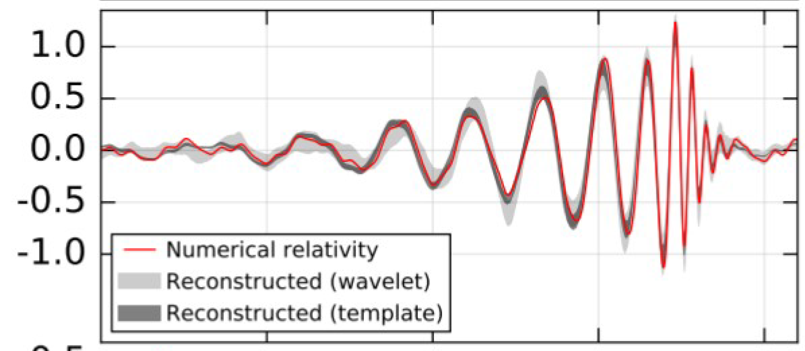
Two regions

Slide 20
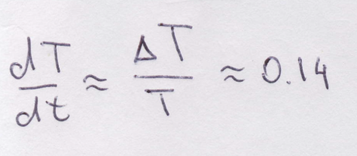
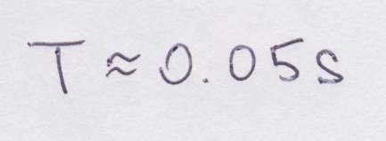
Linear region
Weak time dependence of period/amplitude

Slide 21
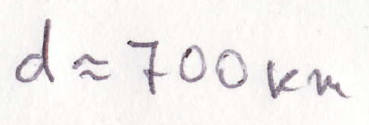
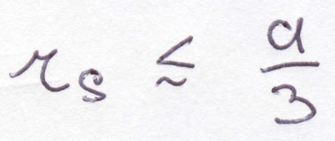
Determination of the mass
Theory:
Data:
Results (equal masses, e=0):
Stable orbit condition:
e 0
Mass upper bound:

Slide 22
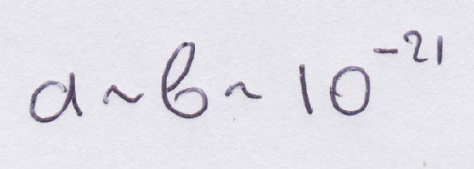
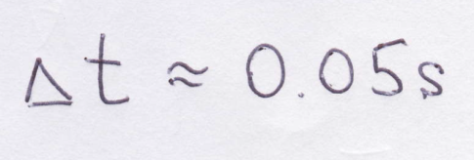
Non-Linear region
strong time dependence of the period and the amplitude

Slide 23
Determination of the distance
Theory:
Data:
Result:

Slide 24
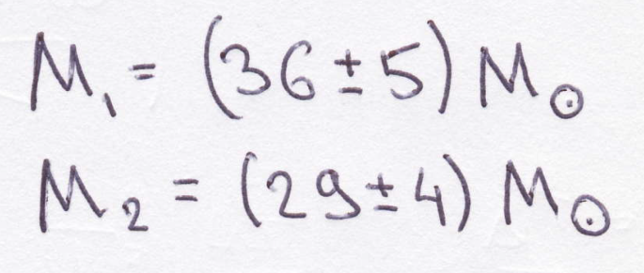
Comparison to numerical gravity

Slide 25
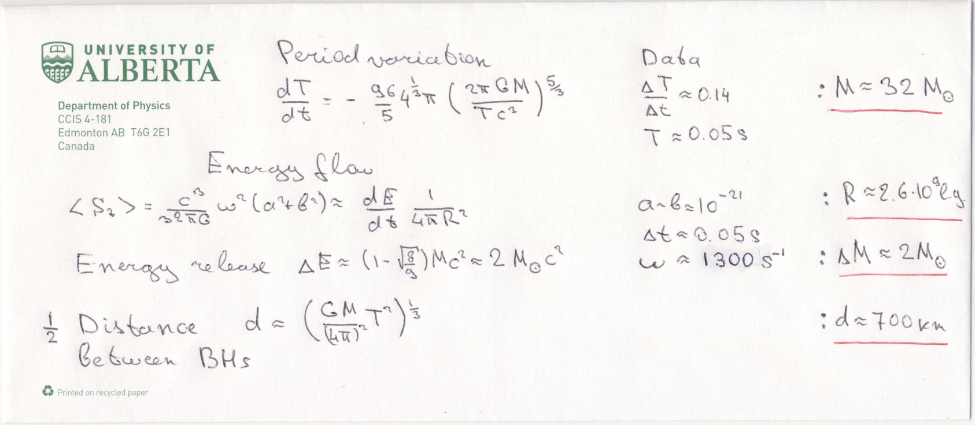
Summary

