Slide 1
Business Research@ualberta.ca Alberta School of Business PhD Orientation 2019
Janet Williamson
Winspear Business Library
University of Alberta Library

Slide 2
Space | Resources | Services
Space:
Actual & Electronic
Resources:
Get information
Services:
Get help

Slide 3
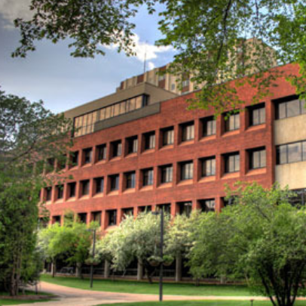
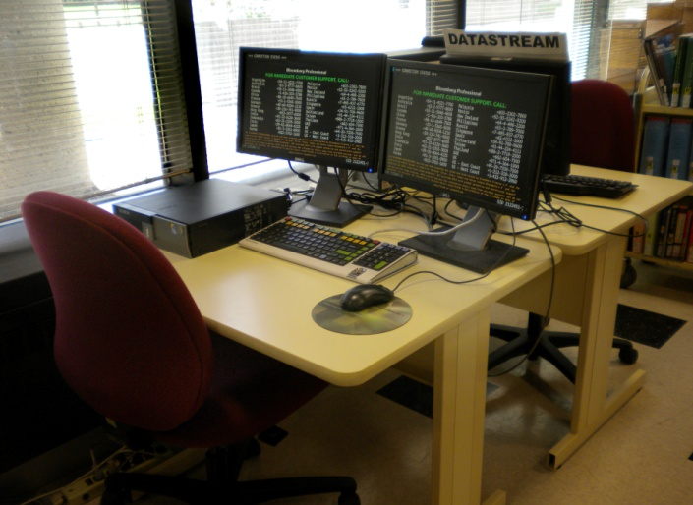
Space | Resources | Services
research help
business reserve
Bloomberg & Datastream
pick up holds

Slide 4
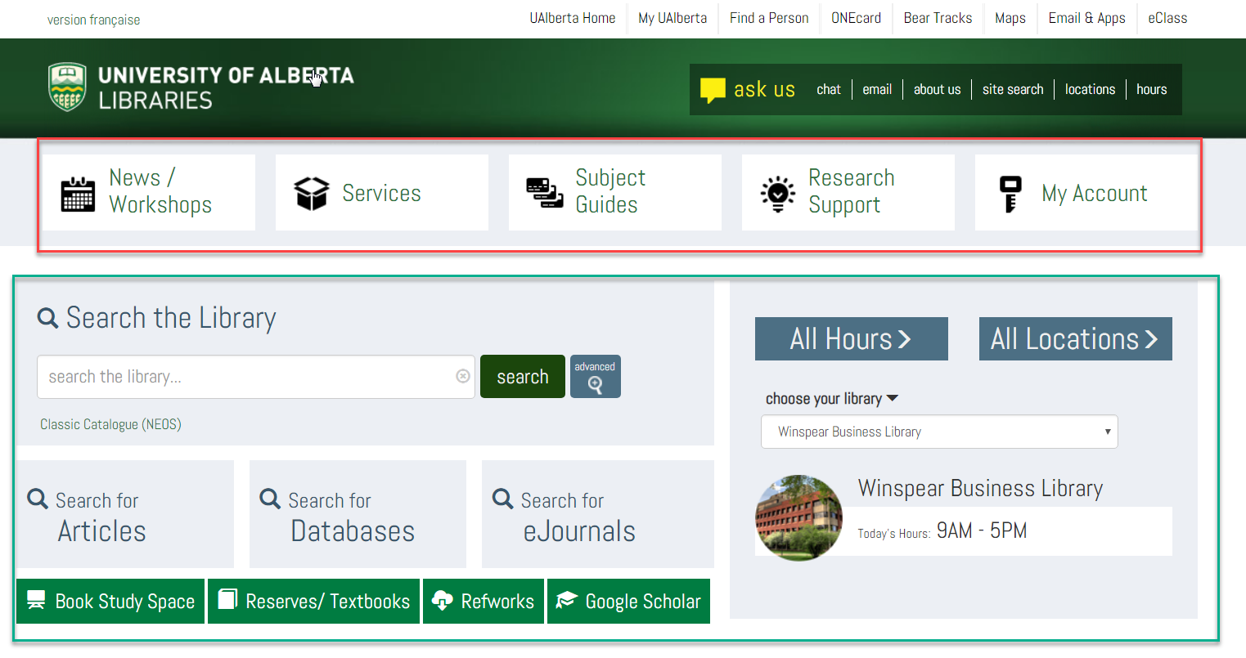
Space | Resources | Services

Slide 5
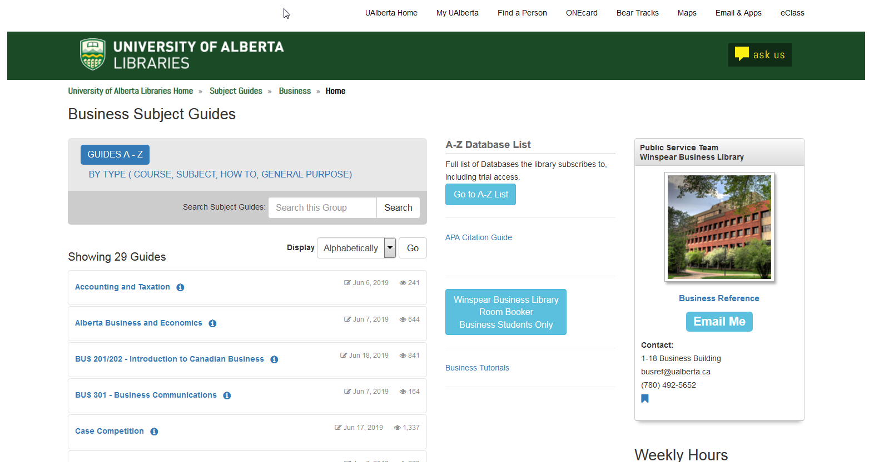

Slide 6
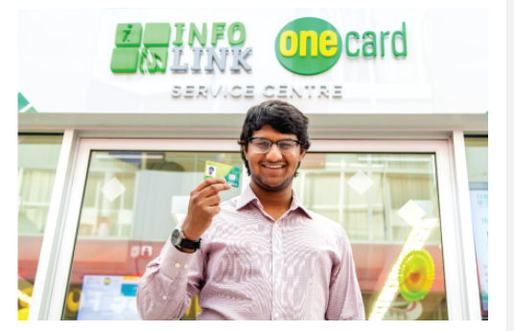
Space | Resources | Services
Campus Computing ID (CCID)
off campus access to library resources
One Card

Slide 7
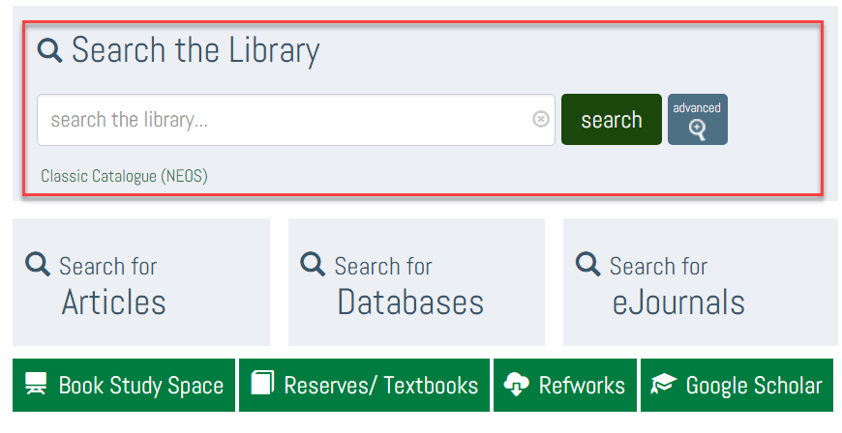
Space | Resources | Services

Slide 8
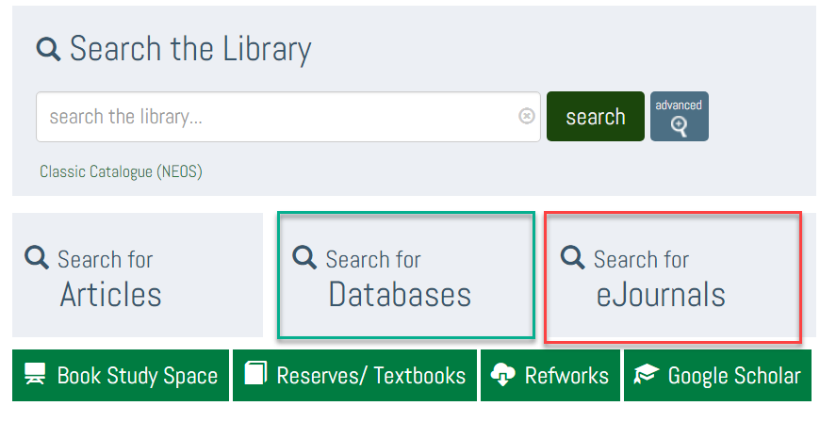
Space | Resources | Services

Slide 9
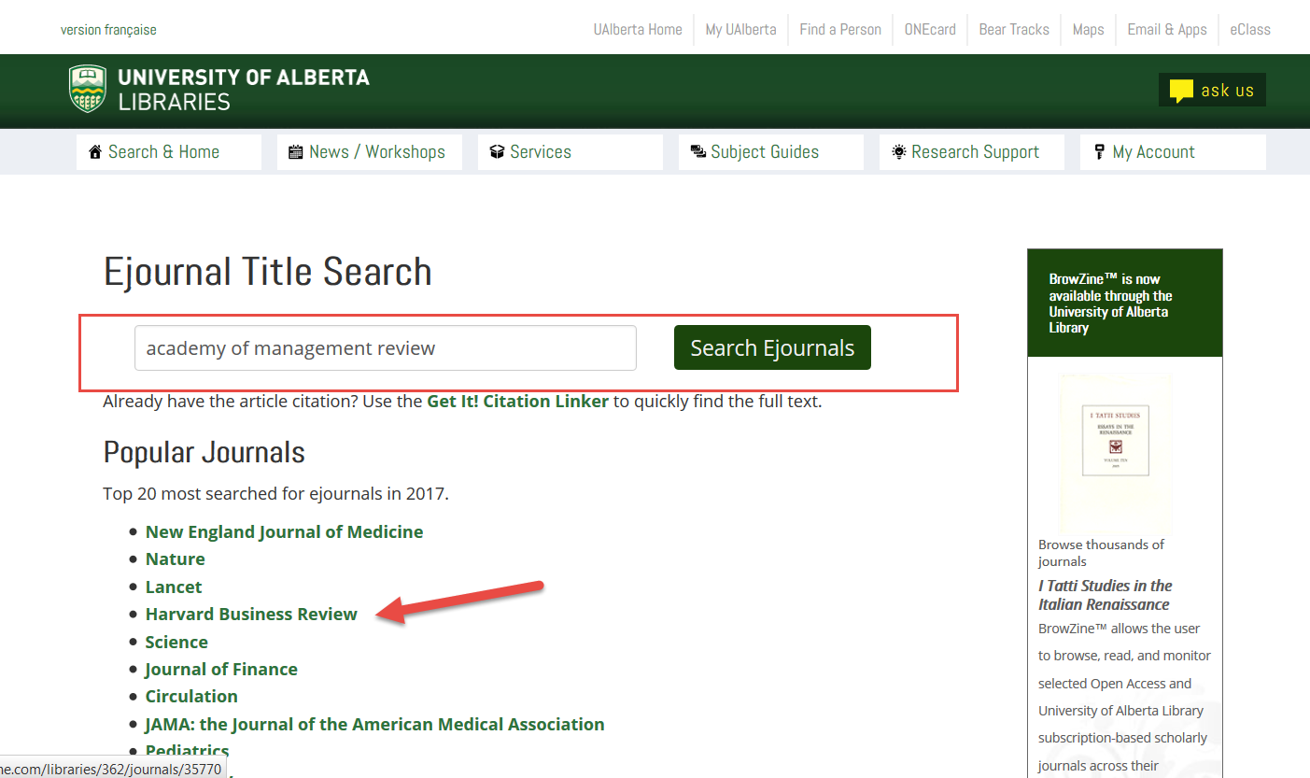
Space | Resources | Services

Slide 10
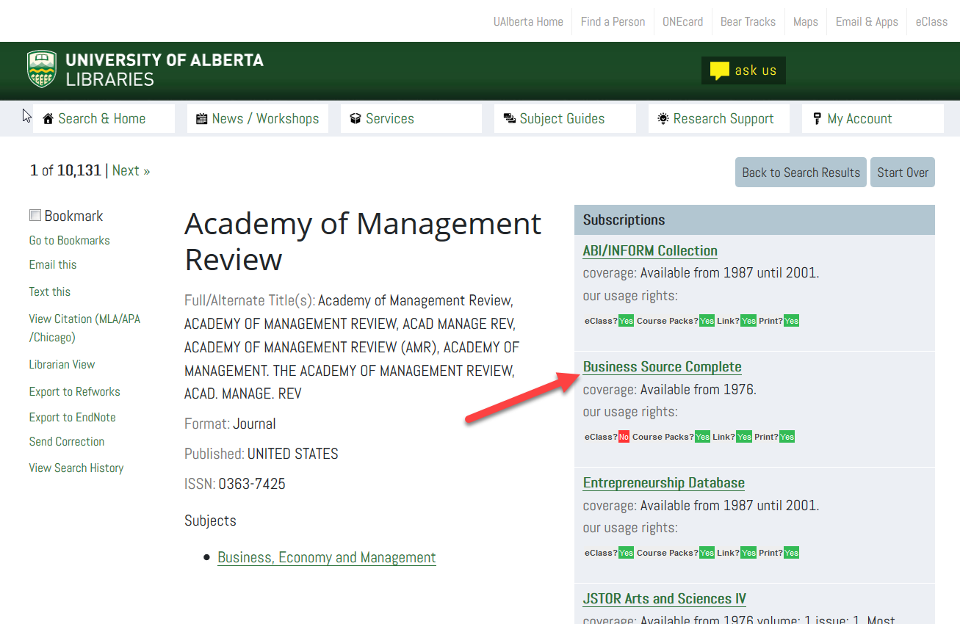

Slide 11
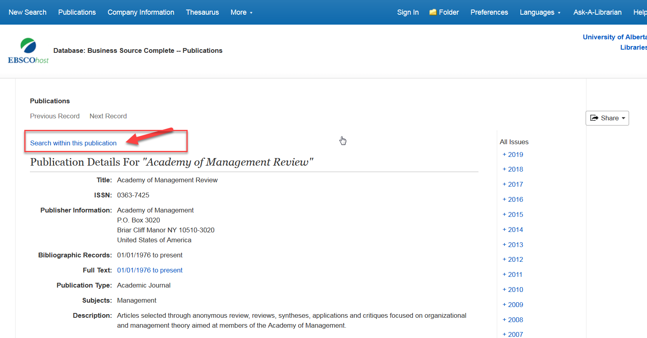

Slide 12
Space | Resources | Services

Slide 13
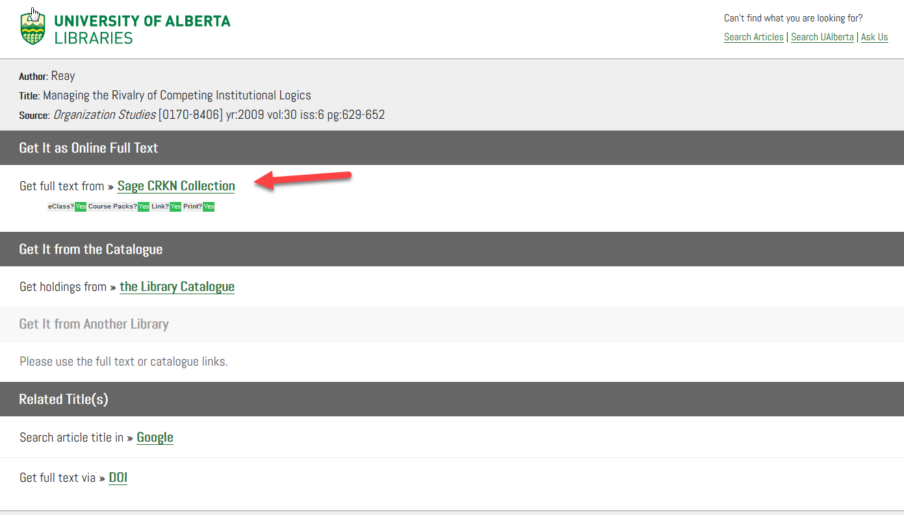
Space | Resources | Services

Slide 14
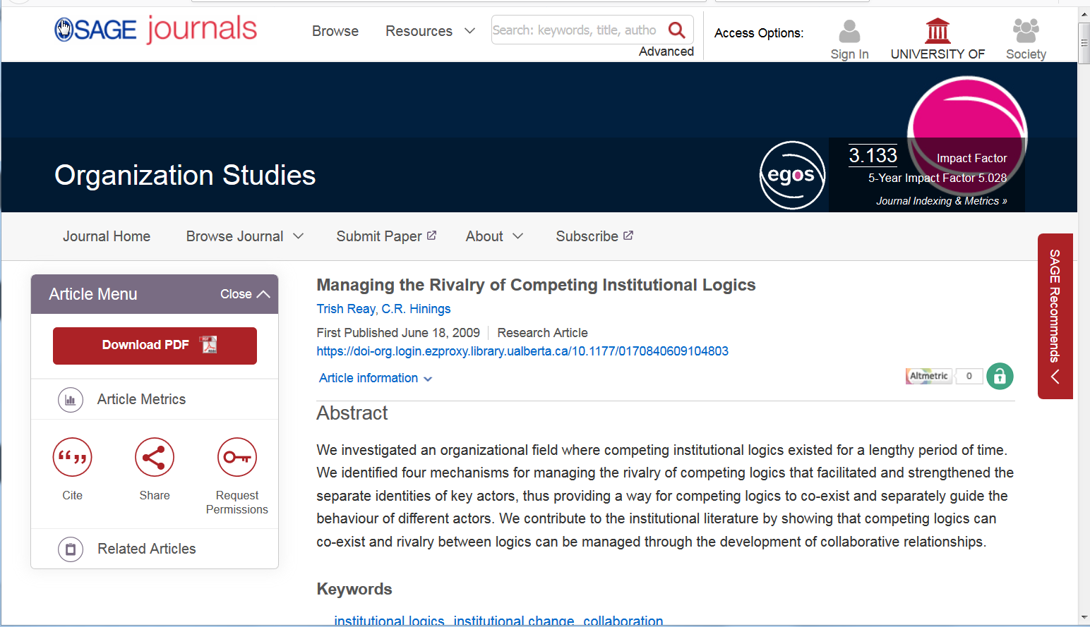

Slide 15
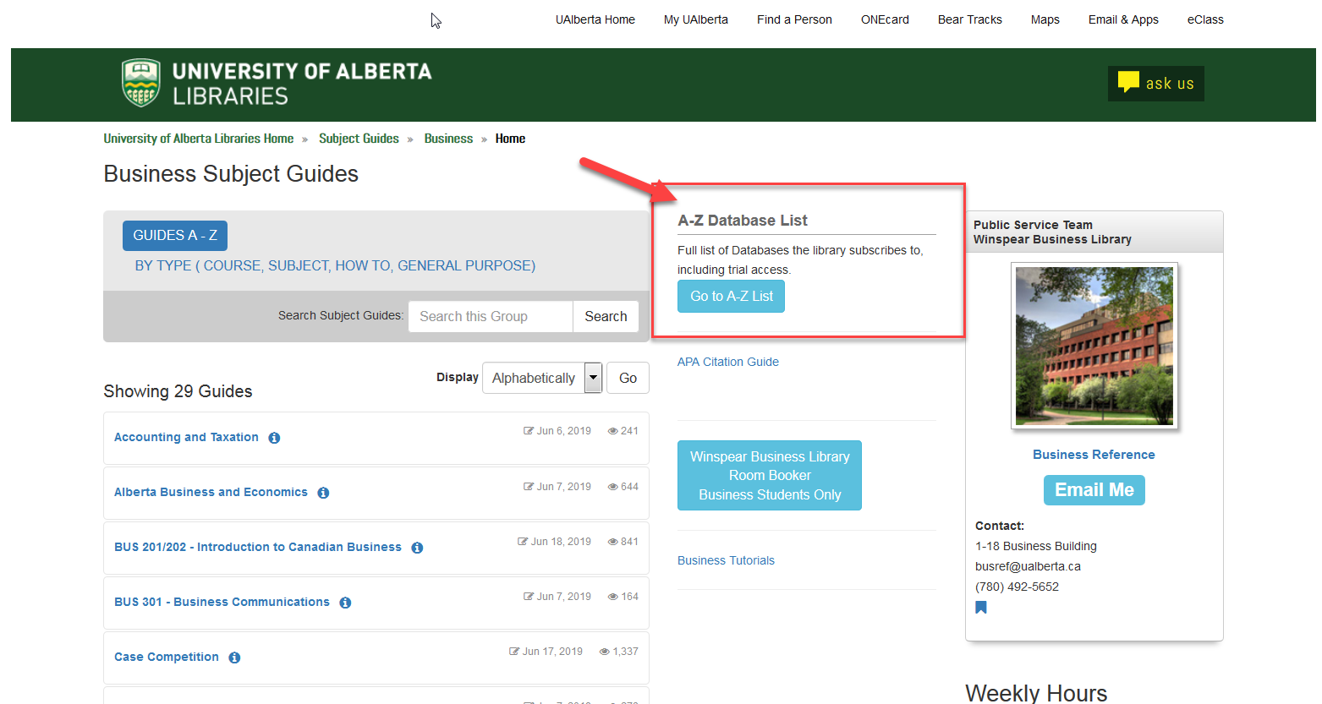
Space | Resources | Services

Slide 16
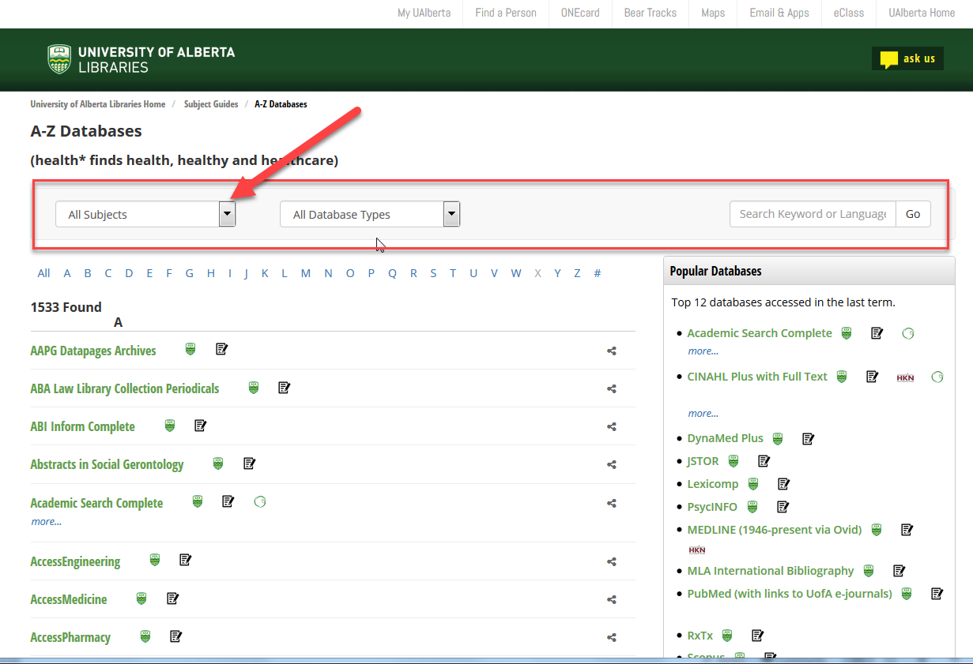

Slide 17
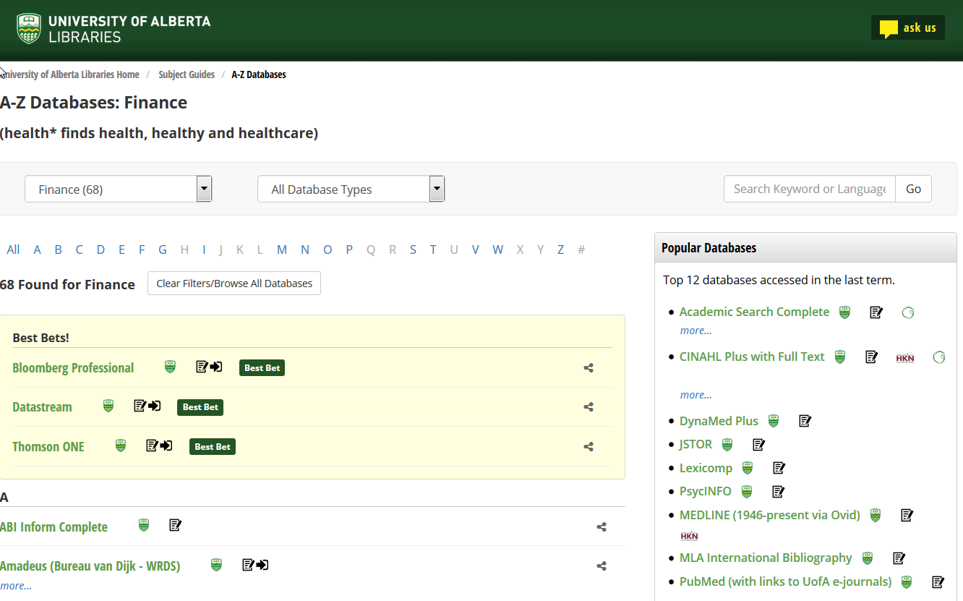
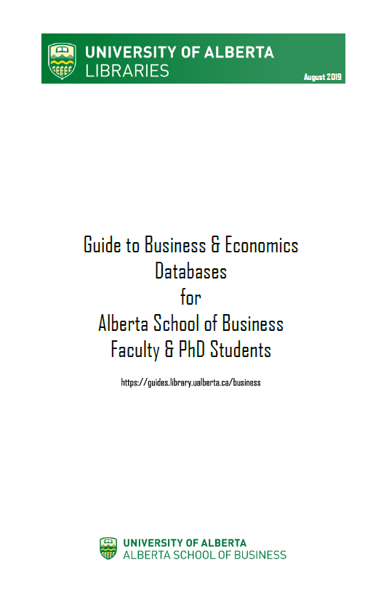

Slide 18
Space | Resources | Services
Selected Databases for PhD students:
Discipline literature: ABI Inform, Business Source Complete, Econlit, Science Direct
Citation databases: Web of Science, Scopus
Preprints/working papers: SSRN, NBER Working Papers
Research Methodology: Sage Research Methods, CARMA (Center for the Advancement of Research Methods & Analysis)

Slide 19
Space | Resources | Services
Financial: WRDS - Capital IQ, Compustat, CRSP, FDIC, I/B/E/S, Isis, KLD, Osiris
Marketing: Passport, Mintel, Marketline, Marketresearch.comAcademic
ESG: GMI Ratings, Compustat Exec Comp, Boardex
Industry: Frost & Sullivan, BMI, Trucost, BCC Research

Slide 20
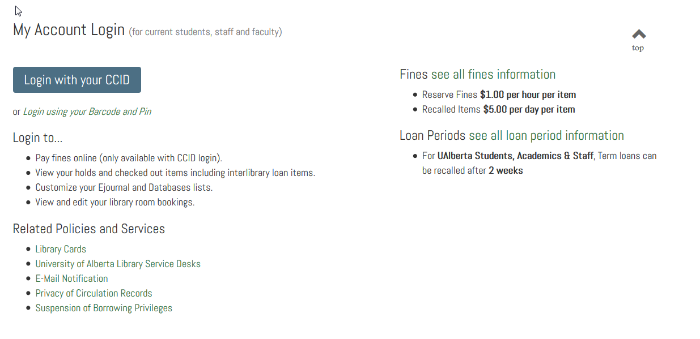
Space | Resources | Services

Slide 21
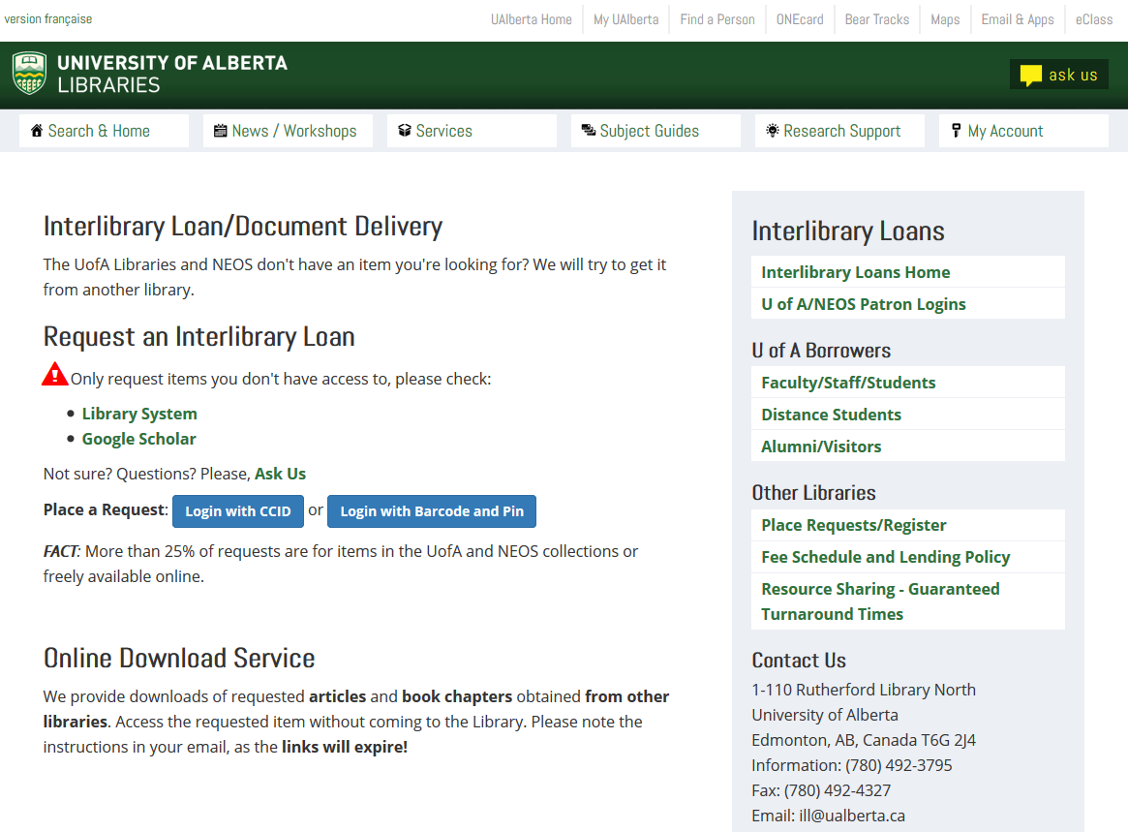
Space | Resources | Services

Slide 22
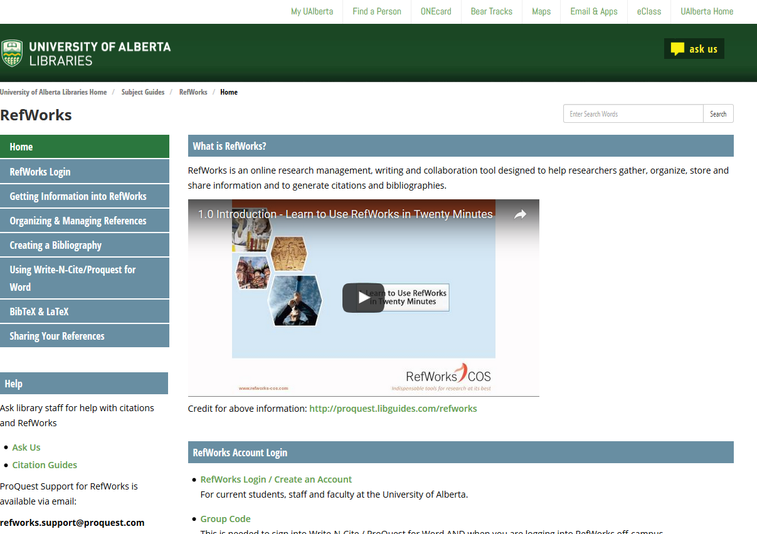
Space | Resources | Services

Slide 23
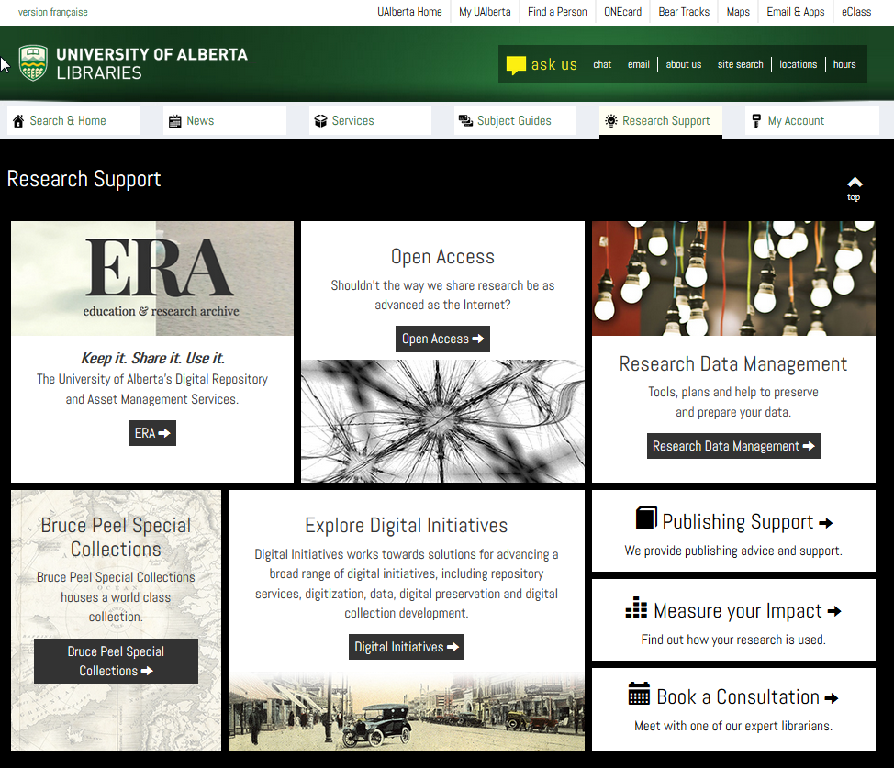
Space | Resources | Services

Slide 24
Space | Resources | Services
Winspear Business Library
busref@ualberta.ca
Business Librarians
Patti Sherbaniuk psherban@ualberta.ca
Janet Williamson janet.williamson@ualberta.ca

