Slide 1
Bigger is Better! Encouraging Active Learning in Large Classes
Connie Varnhagen
In this session, participants experienced three active learning strategies as students while learning about the evidence-based goals for using them in a large class to support student learning

Slide 2
Engaging students in learning
This “class” is the second class in a “course” on the psychology of teaching and learning. We started the class by reviewing the last class – review of the previous lecture helps students prepare for the new learning
Student Experience
Course
Experience
Course goals
Assessment
Course activities
PSYCO 529 Psychology of teaching and learning

Slide 3
Why do we care about active learning?
To increase retention of information
To encourage deeper learning
To improve critical thinking and problem solving
To foster transfer and generalization of knowledge and skills
All of the above
The use of clicker questions was discussed later in the session as one of the active learning strategies – this is an example of a fact-based assessment question to help gauge understanding and help students review previous material

Slide 4
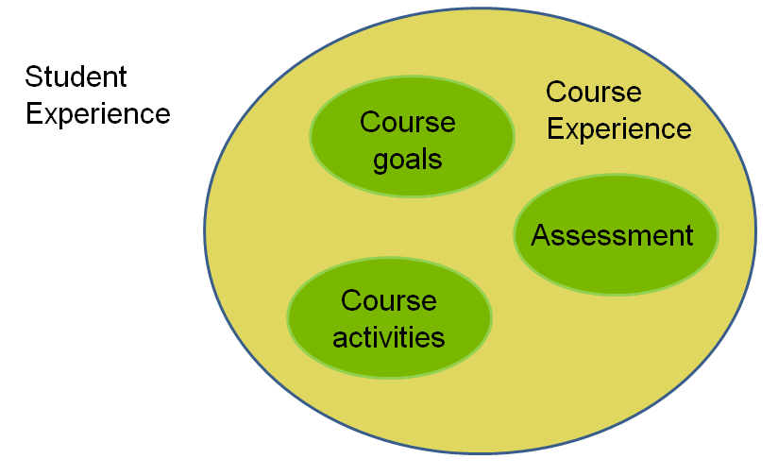
Course Activities: Strategies for Active Learning
Relevant examples
Modeling
Demonstrations, simulations
Discussions
Personal Response Systems
Thought questions, reflection papers
Service learning, experiential learning
Research project, independent study
writing for learning
close slides
Today
Notes:
Start this then go to next slide...

Slide 5
Do we really need to employ these active learning strategies for effective teaching and learning?
Yes
No
It depends
Not sure
This clicker question prompted discussion. From the larger class discussion, I selected 2 participants to take part in an ideomotor demonstration to show that what one says may not exactly be what one believes
Notes:
Take some who said no or not sure and perform ideomotor demonstration
Using active learning, I bet I can demonstrate that you really do believe in active learning.

Slide 6
Demonstrations, simulations
Provide a live example
Encourage participation
Allow prediction, application, analysis
Direct attention
Considerations for success
Recognize background understanding
Develop wrap-around
Prepare for failure
Evidence-based goals and tips for using demonstrations are outlined here.

Slide 7
Benefits of demonstrations/simulations
Think about a time you participated in a particularly effective demonstration or simulation.
What characteristic made it particularly effective?
Reflect alone for 1 minute
Discuss with your neighbor for 2 minutes
Be prepared to summarize your neighbor’s reflection.
This was used as an example of a think-pair-share discussion strategy

Slide 8
Discussions
Stimulate interaction
Allow time for reflection
Encourage deeper learning
Lead to better retention
Considerations for success
Identify an achievable goal for the discussion
Provide explicit instructions for the discussion
Evidence-based goals and tips for incorporating discussion in large classes are outlined here.

Slide 9
This was a clicker question example for collecting data in class. This can be used for discussion, to survey the class on sensitive issues, etc..
What is your perception of this session?
I am motivated to integrate one of these strategies in my large class
Active learning is an interesting concept and I will think about the strategies when I design my lectures
The session is entertaining but the strategies don’t work for me
I haven’t learned anything that will affect how I teach
I have too much content to get across in the lecture to attempt many active learning strategies

Slide 10
Personal Response Systems
Gauge learning, understanding
Promote discussion
Encourage application
Experimentation
Considerations for success
Match question to goal for asking question
Be creative
Consider only low stakes assessment
Evidence-based goals and tips for using clickers in large classes are outlined here. There is a large literature on using clickers – some can be found at http://ctl.ualberta.ca/technology-services/iclicker/teaching-tips

Slide 11
Activating active learning
Align activity with learning goals
Develop wrap-around
Practice
Prepare to lose control
Anticipate failure
Develop a sense of humor
CTL has a lot of resources and scheduled workshops at their website: http://ctl.ualberta.ca/
Feel free to contact the “instructor” as well at varn@ualberta.ca

