Slide 1
Transforming Teaching & Learning:
The EDEL 325 Story
Amanda P. Montgomery
Department of Elementary Education
Notes:
Title Slide

Slide 2
Course Type:
One of 7 Curriculum & Pedagogy courses in BEd. Elementary
Content:
Theory and research surrounding children’s musical development and learning
Concrete application of pedagogy
Structure:
Inquiry & constructivist based
----------------------------------------------------------------------------------
Current Format:
F2F sections of 35-40 students each - taught in variable time formats (3/4/8 weeks compressed and regular 13 weeks)

Slide 3
Challenges:
My experience: blended and online graduate teaching
No current undergraduate models
EDEL 325 needs lots of hands-on application time – how to keep constructivist/inquiry based model

Slide 4
I read the literature on blended learning…
Definitions:
“the thoughtful integration of classroom, face-to-face learning experiences with online learning experiences”(Garrison & Kanuka, 2004, p.96)
can be any % mixture of F2F and online learning depending on context (Halverson et al., 2012)
is not simply taking F2F material and moving it online but rather involves a complete rethinking and redesign of instruction (Vaughn, 2007)

Slide 5
Early goals highlighted blended learning’s potential to transform higher education towards:
More constructivist and inquiry based learning
More interactive and collaborative learning with less big hall lecture
Building communities of inquiry

Slide 6
More recently as the flipped classroom has gained conversation time, goals have expanded to include:
The opportunity for students to take more ownership and responsibility for their learning (i.e., online work first – application in F2F second)
The opportunity for individual pacing and greater access for review of course content (e.g., screencasts, podcasts, etc.)

Slide 7
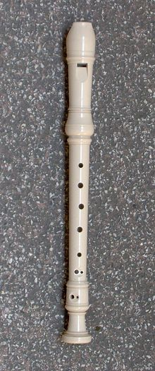
So as a result, I decided to be innovative and create a ‘flipped’ music classroom within a blended format
Developed a theoretical learning model for this flipped-blended classroom
EARS’s of Learning:
Explore-Apply-Reinforce

Slide 8
EAR’s of Learning
1. Explore: Individual online exploration of course material through multiple modalities (e.g., screencasts, podcasts, videos, readings, group discussions, etc.) in conjunction with practice quizzes and/or assignments – Moodle eClass
2. Apply: Collaborative, synchronous application of this course material during the F2F class – on campus
3. Reinforce: Individual review of course material online as needed plus assignments – Moodle eClass

Slide 9
EDEL 325 Blended Learning
E: Flexlab
10 Units
20 Modules
A: Interactive
Class LIVE!
R: Assignment

Slide 10
EDEL 325 Online Learning (ATEP)
E: Flexlab
10 Units
20 Modules
A: LIVE! Online Class
via Adobe Connect
R: Flexlab Revisited

Slide 11
Notes:
Title Slide

Slide 12
Things to think about…
Read a bit of the literature
Look at other instructor’s courses (amanda.montgomery@ualberta.ca)
Tap into the campus support
Start small - a couple of modules
Be creative with learning objectives – no one size fits all
Notes:
Title Slide

