Slide 1
Recruit for Success Series

Slide 2
Gearing Up for Fall: Campus Recruitment at U of A

Slide 3
Land Acknowledgement
The University of Alberta respectfully acknowledges that we are located on Treaty 6 territory, a traditional gathering place for diverse Indigenous peoples including the Cree, Blackfoot, Métis, Nakota Sioux, Iroquois, Dene, Ojibway/ Saulteaux/Anishinaabe, Inuit, and many others whose histories, languages, and cultures continue to influence our vibrant community."
Notes:
The University of Alberta respectfully acknowledges that we are located on Treaty 6 territory, a traditional gathering place for diverse Indigenous peoples including the Cree, Blackfoot, Métis, Nakota Sioux, Iroquois, Dene, Ojibway/ Saulteaux/Anishinaabe, Inuit, and many others whose histories, languages, and cultures continue to influence our vibrant community."

Slide 4
Topics
Career Centre Career Fairs
Employer Information Sessions
Custom Events
Workplace Visits
Recruitment Events Promotion Package
Campus Interview
Faculty Specific WIL and EL Opportunities
Other Opportunities and Resources
Round Table Discussions

Slide 5
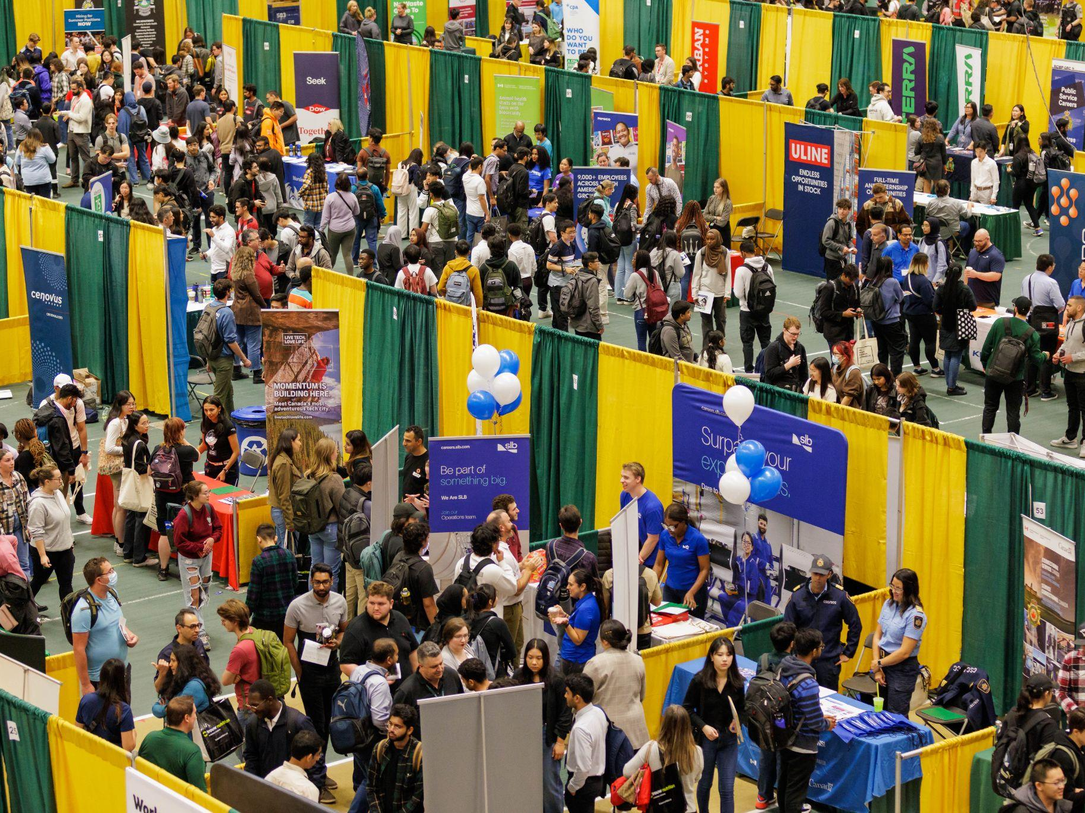
Career Centre Career Fairs
Careers Day / Foire d’emploi bilingue September 25, 2024, 12 - 4:30 p.m.
Healthcare Industry Career Fair
October 29, 2024, 11 a.m. - 3 p.m.
Education Career Fair / Foire d’emploi en éducation
January 22, 2025, 11 a.m. - 3 p.m.
Spring Hiring Fair / Foire d'emploi du printemps
February 4, 2025, 12 - 4:30 p.m.

Slide 6
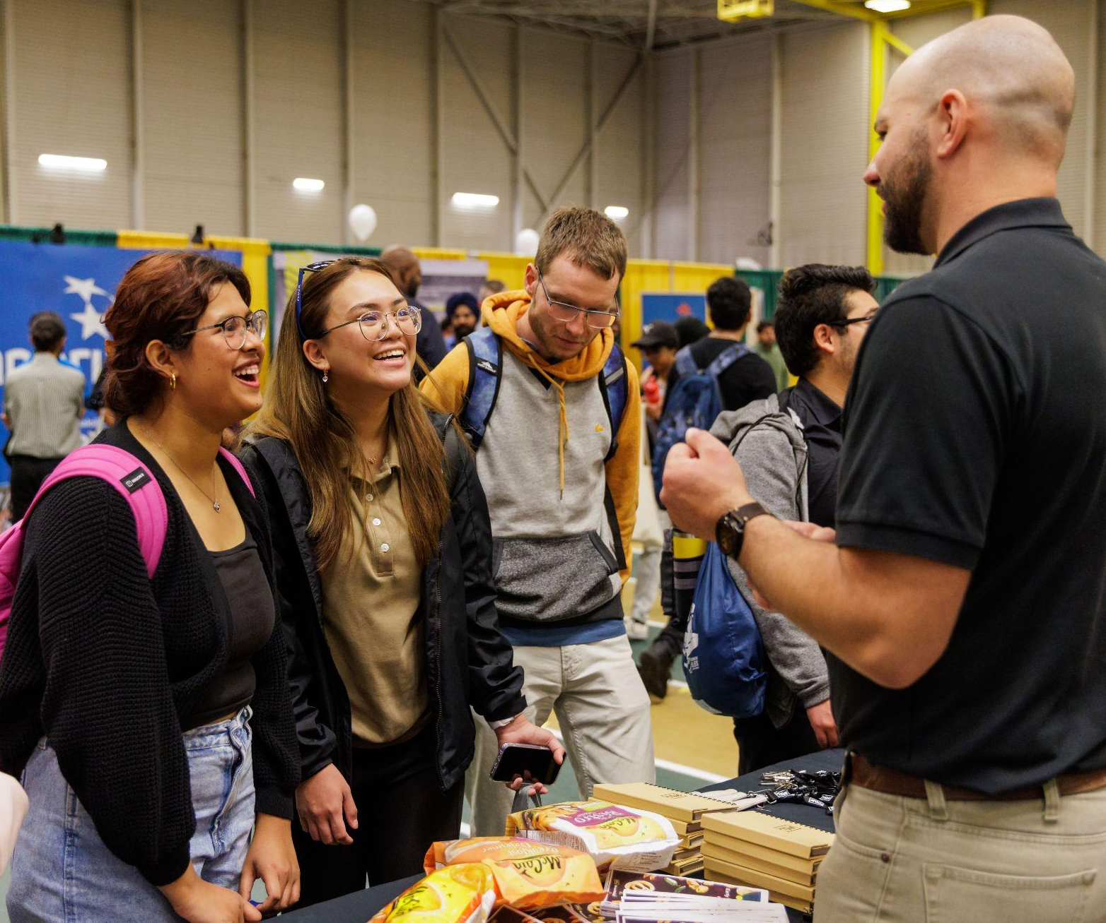
Career Centre Career Fairs
Register on campusBRIDGE
Find more details on the Career Centre’s website
Sponsorship opportunities available
Contact:
Metta Pusa
Recruitment Coordinator
hiretalent@ualberta.ca
780-492-4248

Slide 7
Employer Information Sessions_In-Person
Book 4 weeks in advance
Requests can be submitted starting July 2 for Fall and starting November 15 for Winter
90 minutes in length
Hosted in a classroom on campus
If requested, order pizza for catering
Staff support during the event
Booking Price: $350 (+GST)
More details will be provided after the request has been received.

Slide 8
Employer Information Sessions_Virtual
Book 4 weeks in advance
Requests can be submitted starting July 2 for Fall and starting November 15 for Winter
90 minutes in length
Hosted through the Career Centre’s Zoom platform
Staff support during the event
Booking Price: $300 (+GST)
More details will be provided after the request has been received.

Slide 9
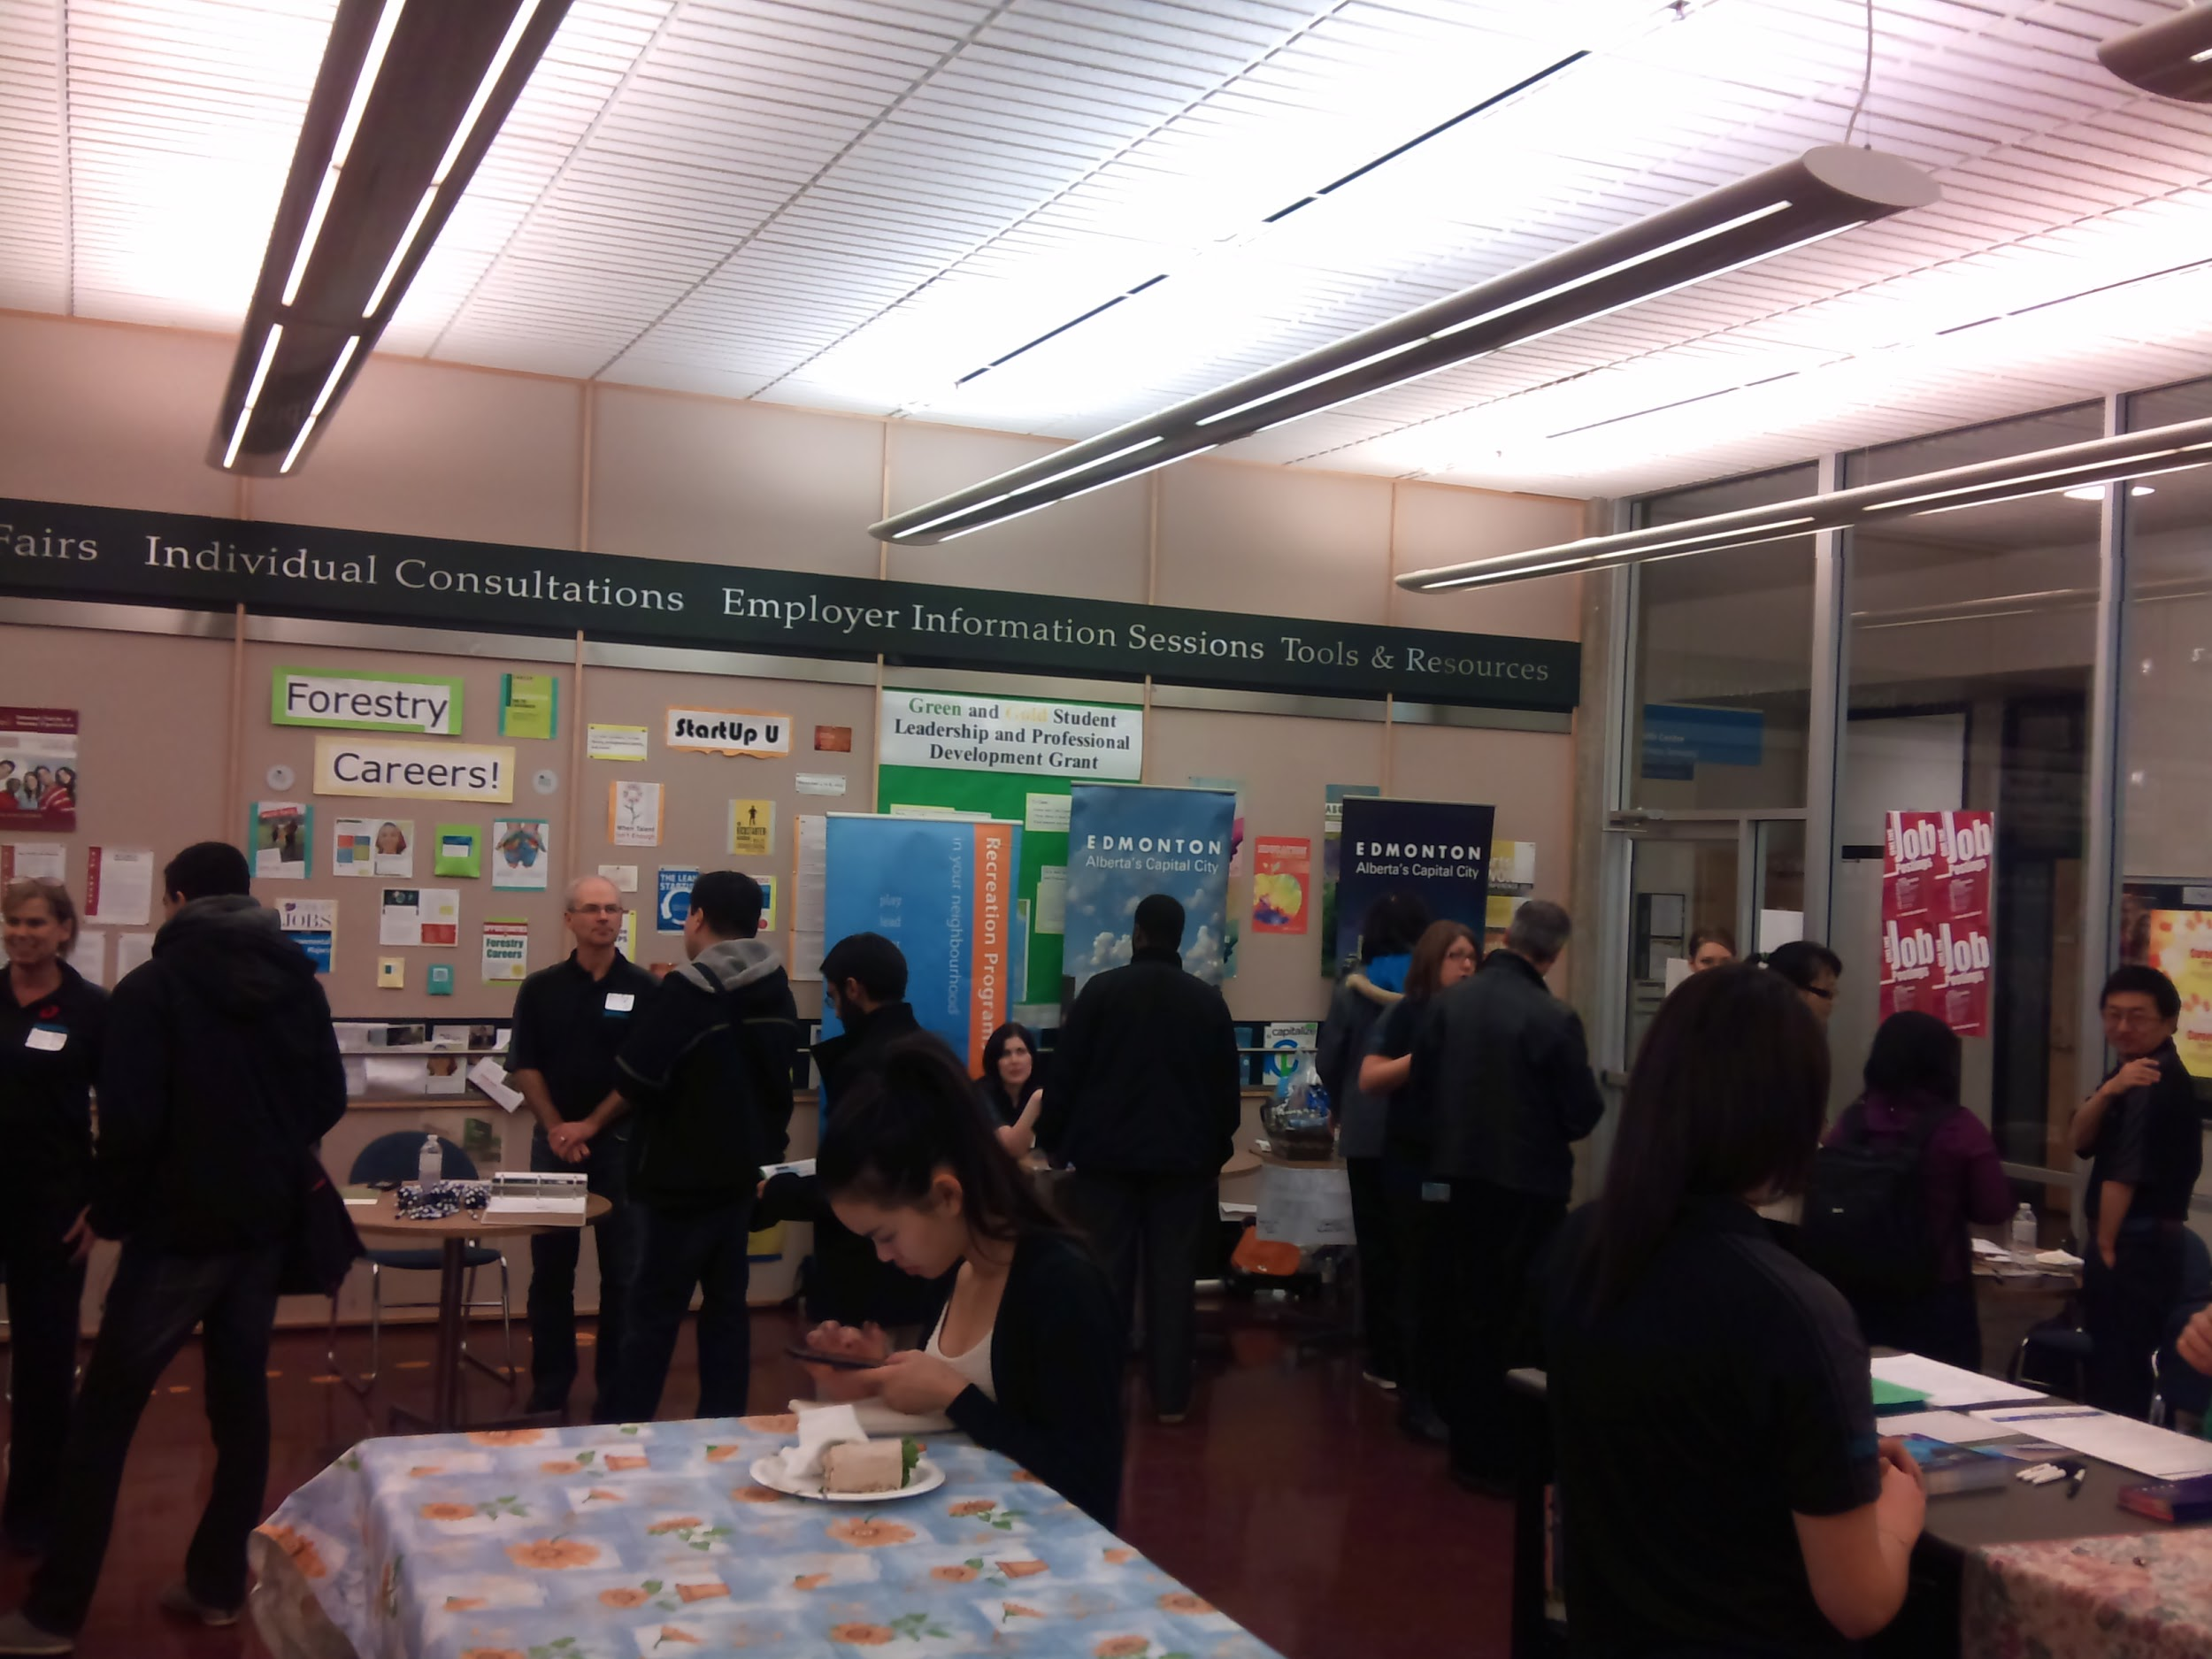
Custom Events (in-person or hybrid)
Book 6 weeks in advance
Customize venue, catering, event length and schedule, etc.
Requests can be submitted starting July 2 for Fall and starting November 15 for Winter
Same blackout periods apply
Same requirements on COI
Booking Price: starting at $500 (+GST)
More details will be provided after the request has been received.

Slide 10
Workplace Visits
Book 8 weeks in advance
Hosted at your workplace location either in Edmonton or Camrose.
Requests can be submitted starting July 2 for Fall and starting November 15 for Winter
Promotion to your target audiences at the U of A
Support on the coordination of logistics
Same blackout periods apply
Booking Price: $750 (+GST)
More details will be provided after the request has been received. Only limited spots are offered each term.

Slide 11
Blackout Periods
The Career Centre will not host in-person recruitment events during December 2024 and April 2025 due to conflicts with other priorities in students’ schedules, which will likely result in poor attendance.
However, if these are the ideal months for your organization to run campus recruitment events, please contact us about hosting a virtual information session, or our Event Promotion Package for promoting external recruitment events.

Slide 12
Recruitment Event Promotion Package
We can promote your event to a target group of students through the campusBRIDGE event calendar, our website, the Career Centre LinkedIn account, as well as relevant campus partners and department contacts.
Three weeks lead time is required.
This package does not include event coordination or organization — if you require this, please refer to other employer event options.
Booking Price: $150 (+GST) Please note, the booking cost for this package is non-refundable.

Slide 13
Campus Interview Room Booking
5 business days lead time is required.
Availability limited, book as early as possible.
September-April, Monday to Friday from 8:30 a.m. to 4:30 p.m.
May-August, Monday to Friday from 8 a.m. to 4 p.m.
Same requirements on COI
Booking Price: $100 (+GST) / per room, per day
Please note, the booking cost for the interview rooms is non-refundable.

Slide 14
How to request?
Register on campusBRIDGE, using Employer Event Requests.
Find more details online
Contact:
Tisha Raj
Recruitment Coordinator
hiretalent@ualberta.ca
780-492-7584

Slide 15
Faculty Specific Work Integrated Learning (WIL) and
Experiential Learning (EL) Programs
Notes:
We define Experiential Learning as learning-by-doing, where students are involved, active and engaged in the learning process.
Experiential Learning can involve many different modes of learning, on and off campus, inside and outside of the classroom.
Work-Integrated Learning or WIL is considered one type of Experiential Learning which combines academic learning with practical work experience.
WIL can be paid or unpaid, and can be a requirement of an academic program, or optional.
Examples of WIL are internships, coop education programs, clinical placements, field and practicum placements, and community service learning.

Slide 16
Arts
Arts Work Experience (AWE)
Allows students to complete 4, 8, 12 or 16 months of full-time, paid, career related work experience
Co-operative and Work-Integrated Learning (CEWIL) Canada accredited co-operative education program
Hire talent from Social Sciences, Humanities and Fine Arts degree programs
campusBRIDGE (recruitment portal) - Post and manage your job opportunities for Arts Work Experience
Questions? Contact us at: artsworkexperience@ualberta.ca

Slide 17
Business
Business Student Co-op/Internship Recruitment:
Business Co-op Program:
Undergrad Business Students available for 4/8 month work terms (paid/full time)
Recruitment for Winter 2025 positions begins September 1
MBA Capstone Projects or Summer Internships
Post on Career Connect job board or contact hirebusiness@ualberta.ca
Business Student Recruitment and Engagement Opportunities in Fall 2024:
Career Cafes, Industry Insights, Mentorship Programs
Contact hirebusiness@ualberta.ca for more information

Slide 18
Engineering
Engineering Co-op Program
Undergraduate students available for 4, 8, or 12 month employment depending on their specific program sequence (paid/full-time)
Recruitment for Winter 2025 positions begins September 3
Post jobs and manage your co-op recruitment process with the Engineering Co-op Program module on campusBRIDGE
Contact your Employer Relationship Manager or HireEngineering@ualberta.ca for questions about recruitment and support for events exclusive to Engineering Co-op students
ESS Engineering Career Fair January 7, 8 and 9, 2025
Contact director.careerfair@ess.ualberta.ca for more details
Promote Your Event | Faculty of Engineering
For virtual or off-campus events hosted by employers targeting Engineering students and alumni
Submit your form to Engineering Career Connections. Questions? Contact enggcc@ualberta.ca

Slide 19
Science
Science Internship Program (SIP)
Allows students to complete 4, 8, 12 or 16 months of full-time, paid, career-related work experience
Hire 3rd and 4th year students from the Faculties of Science, ALES, Campus St. Jean and Augustana (departments of Biological Sciences, Computing Science, Earth and Atmospheric Sciences, Math, Physics, Psychology, Human Ecology, Nutrition and Food Sciences, Renewable Resources and others)
campusBRIDGE - Job portal to post and manage your job opportunities for Science students
Questions? Contact us at: science.internship@ualberta.ca

Slide 20
Graduate Studies
Graduate Student Internship Program (GSIP)
Supports flexible, paid, professional work experience opportunities for
U of A Masters and PhD students and Postdoctoral Fellows
Employers can post opportunities for grad students directly onto the
GSIP job board on campusBRIDGE
Positions can target any graduate degree program specifically, or they may be multidisciplinary
Contact us to learn more about the graduate programs with an internship component and ask about possible wage-subsidies: gsip@ualberta.ca
Notes:
The Graduate Student Internship Program is a bit different from the Undergraduate WIL programs you just heard about.
The GSIP is not an official coop program, so we are able to be a bit more flexible.
The positions are employer-driven so they can start and end any time, they can be part time or full time and any duration, keeping in mind that the students are current students so part time is usually a better fit and most are a year or less.
GSIP internships are posted on Campus Bridge, so employers who have positions suitable for Masters and PhD level students can go in and post any positions on the GSIP job board.
Employers can reach out to us and we can help decide what is a suitable opportunity, which academic programs are the best good fit, and the various other ways we can support you.
GSIP can connect employers with other funding sources.

Slide 21
Other Opportunities and Resources
Connect with student groups
Engage with students through other experiential learning programs
Sponsorship opportunities
Enrollment data
Funding opportunities and wage subsidies
Program search tool
Undergraduate programs
Graduate programs
Anthony Pangilinan
Outreach Coordinator
anthony.pangilinan@ualberta.ca
Notes:
we have a student groups panel coming up on Wednesday, October 16th

Slide 22
Get involved with the Career Centre!
Job Shadow Program
Host one or multiple students or alums at your workplace for one or multiple days from November 12-15
Register as a host by September 16, 2024 at uab.ca/jsp
Career Mentoring Program
Over a 4 month period, students are matched with a professional based on the student’s career goals and interests
Sign up to a prospective Career Mentor at uab.ca/cmp
Notes:
AUGUST 8
Job Shadow Program
Showcase your job and organization to curious students and alums - join our Job Shadow Program as a Job Shadow Host!
Volunteering to be a Job Shadow Host can secure the future of your talent pipeline and industry growth by providing participants with an immersive experience that highlights the day to day realities of a career, enables participants to gain valuable advice, and helps participants explore career options.
The Fall 2024 program takes place from November 12-15, can occur for one or multiple days, and is open to hosts in Edmonton, Camrose, and their surrounding areas. Register on the Job Shadow Program website (uab.ca/jsp) by September 16, 2024.
Career Mentoring Program
We offer a Career Mentoring Program where students are matched with a professional based on the student’s career goals and interests. Career mentors are trusted guides that act as an informal coach, role model, and connector, offering encouragement and advice to mentees. Through this program, you can practice leadership and interpersonal skills, help a new professional leverage unplanned events in their career, and contribute to the future of your talent pipeline and industry group. We offer this program twice in the year, in fall and winter. Unlike other mentorship programs, we do not have a set pool of mentors to match with mentees. Mentors are decided based on the criteria of the students. If you are interested in being a mentor, please sign up to be a prospective mentor at uab.ca/cmp and we will contact you if a student is looking for a mentor with your expertise.

Slide 23
Gearing Up for Fall Recruitment at U of A
Round Table

Slide 24
Thank you!
Next Recruit for Success Series (RSS) session:
Considering EDI in Recruitment and Selection
Blessie Mathew
Director of the University of Alberta Career Centre and Experiential Learning
Thursday, September 12, 2024
11:30 a.m. to 1:30 p.m.
Contact us at hiretalent@ualberta.ca

