Slide 1
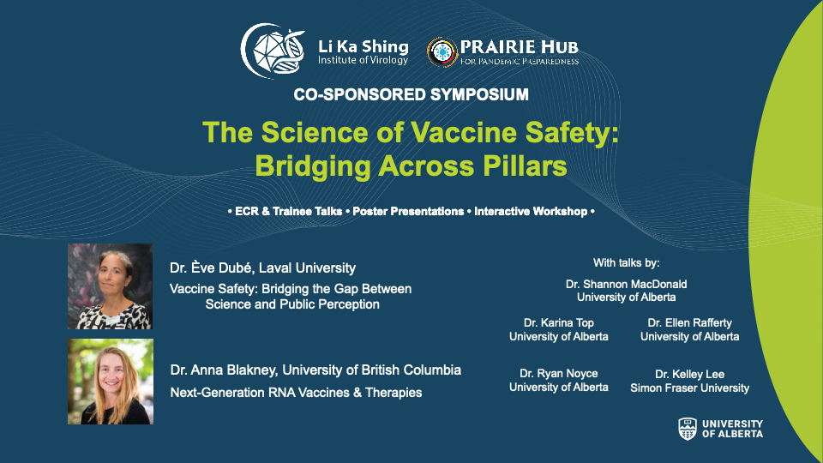


Slide 2
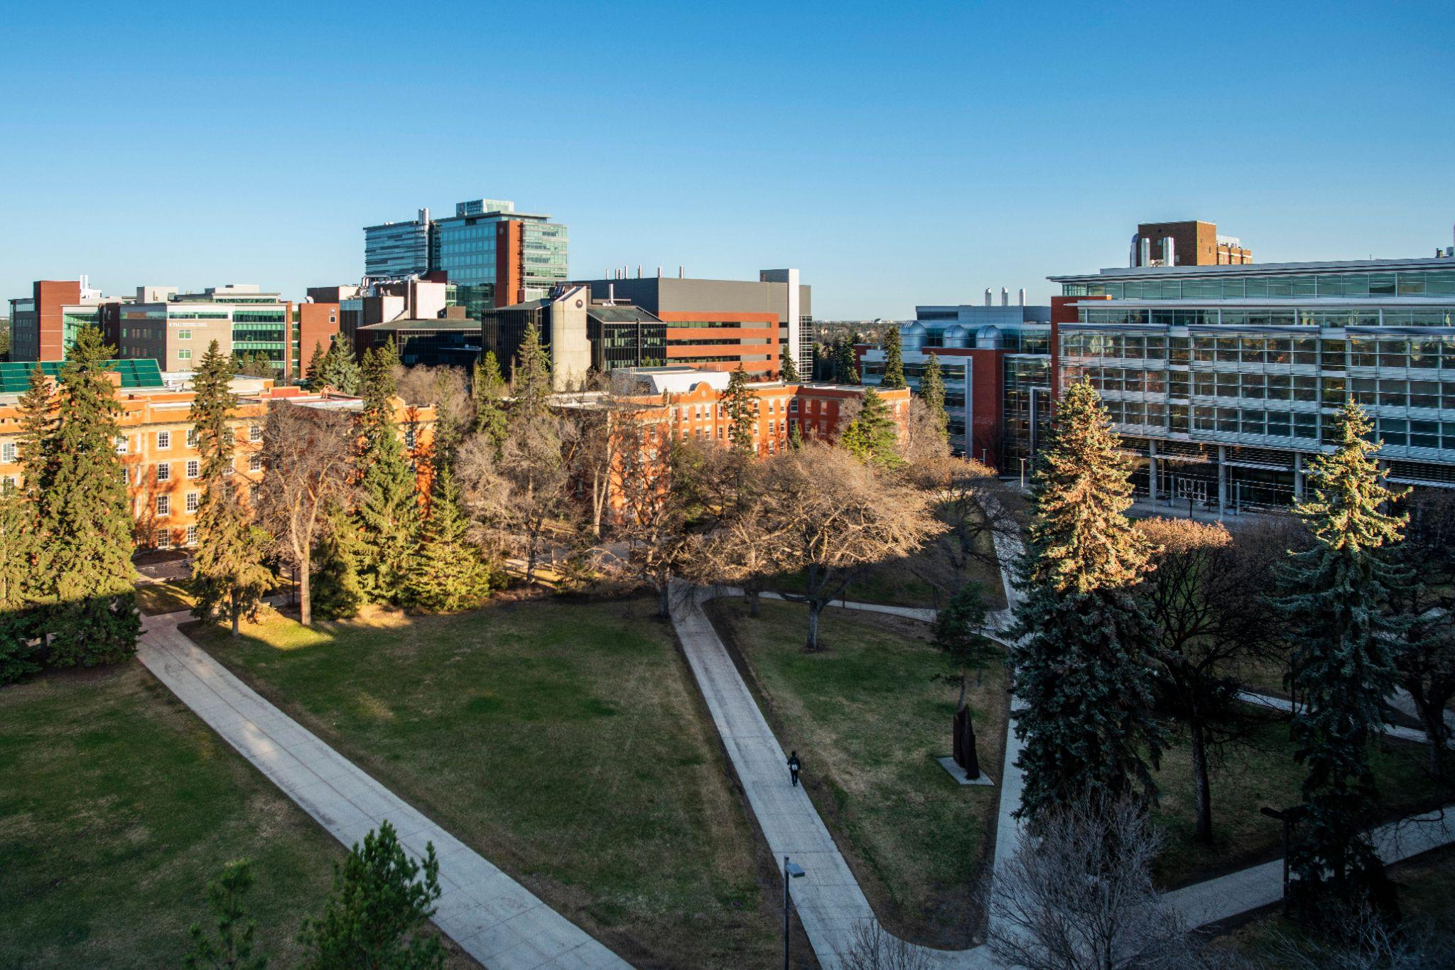


Impact of the Li Ka Shing Institute of Virology
The University of Alberta, its buildings, labs and research stations are primarily located on the territory of the Néhiyaw (Cree), Niitsitapi (Blackfoot), Métis, Nakoda (Stoney), Dene, Haudenosaunee (Iroquois) and Anishinaabe (Ojibway/Saulteaux), lands that are now known as part of Treaties 6, 7 and 8 and homeland of the Métis. The University of Alberta respects the sovereignty, lands, histories, languages, knowledge systems and cultures of all First Nations, Métis and Inuit nations.

Slide 3



Symposium Organizing Committee
D. Lorne Tyrrell (Chair)
Shannon MacDonald (Co-Chair) Maya Shmulevitz
Tim Caulfield Brian Taylor
Brittany Hope Karina Top
Wendy Magee Sue Tsai
Ernest Oludada Stephanie Yanow
Umar Yunusa

Slide 4

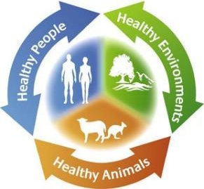
The PRAIRIE Hub for Pandemic Preparedness
One of 5 federally-funded Hubs in Canada – supporting 4 multidisplinary pandemic preparedness teams in the PRAIRIE Hub region - $110 M in funding
Vision
A resilient Canadian health-sciences and biomanufacturing ecosystem.
Mission
To connect researchers, industry, non-profits, government, and communities in preparation for the next Disease X.
One Health Approach
An interdisciplinary model recognizing interconnections between humans, animals and ecosystem health.
Notes:
T

Slide 5

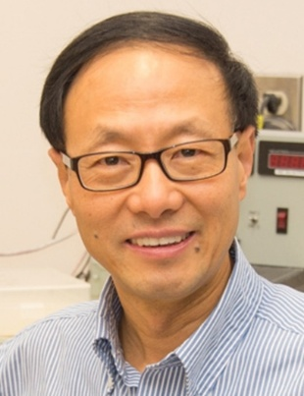
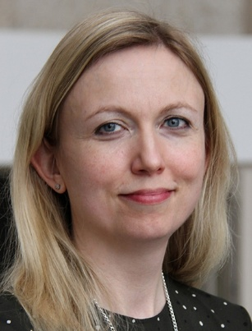
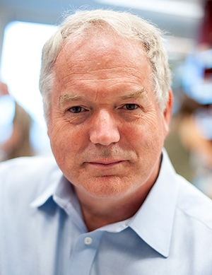
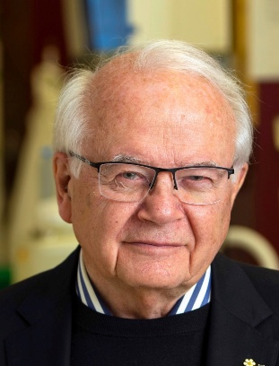
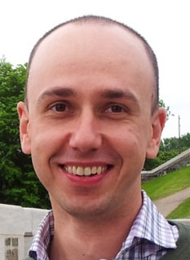
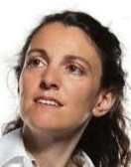
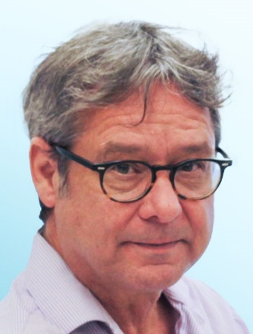

Canadian Biomedical Research Fund (CBRF)
Biosciences Research Infrastructure Fund (BRIF) Teams
PRAIRIE Hub
CBRF - Research
BRIF - Infrastructure
1
Diagnostic Point-of-Care Technologies
2
Vaccines
Biomanufacturing
3
Vaccines
Biomanufacturing
4
Fill / Finish
Biomanufacturing
Innovative techniques and diagnostic tests for pandemic preparedness and health equity
Developing self-amplifying (sa) RNA vaccines against pandemic virus threats
Viral vector vaccine platforms for rapid response to future pandemics
Filling Vials for Pandemic Preparedness
Alberta Cell Therapy Manufacturing (ACTM)
Chris Le UAlberta
Camille Hamula USaskatchewan
Michael Houghton UAlberta
Lorne Tyrrell UAlberta
Peter Pelka UManitoba
Maya Shmulevitz UAlberta
Greg Korbutt UAlberta
Gayle Piat UAlberta
5

Slide 6
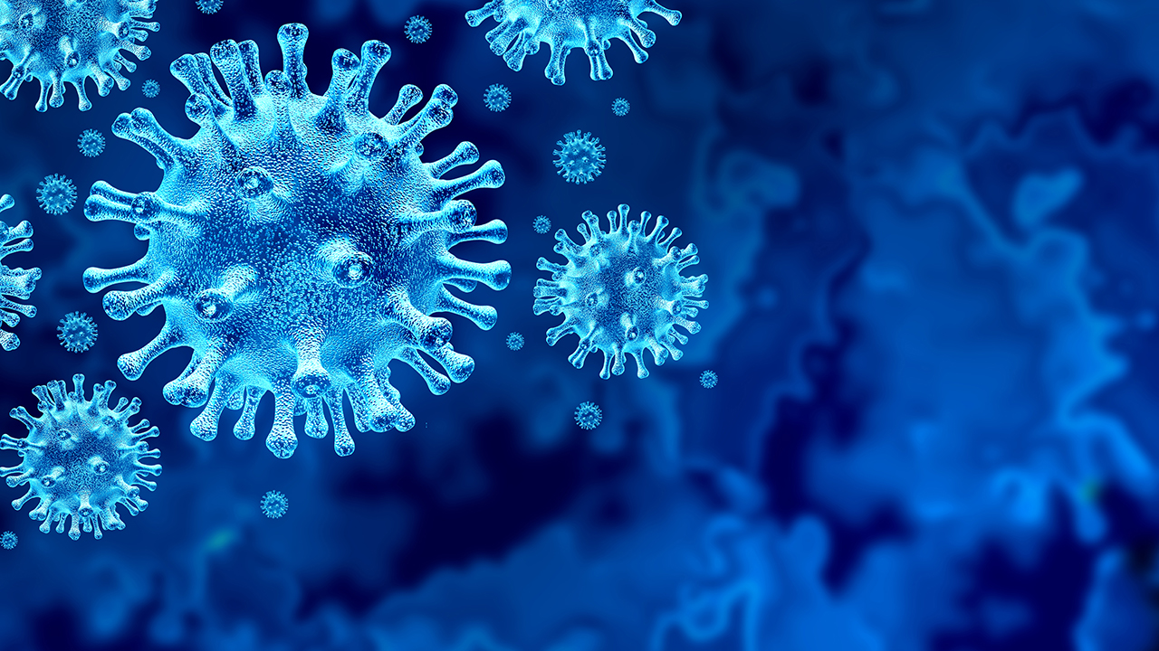


Li Ka Shing Institute of Virology
Established April 23, 2010

Slide 7


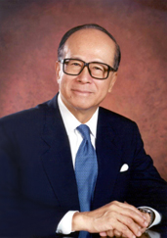
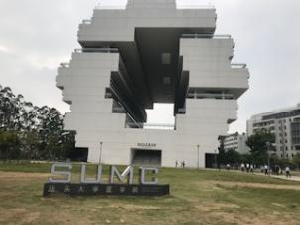


Li Ka Shing Foundation
Mr. Li - philanthropist
Network of 15 Institutes, including:
  Stanford, Berkley, University of Alberta, University of Toronto, Oxford, Cambridge, Harvard, UCSF, Hong Kong University, Chinese University of Hong Kong
Shantou University Medical College
Mr. Li Image: https://www.ckh.com.hk/en/about/senior_advisor.php

Slide 8
Institute’s Vision
Leading the world in virology discoveries and cures.
Institute’s Mission
Through leadership in scientific excellence and international collaboration,
the Li Ka Shing Institute of Virology will invest in virology & immunology research to discover new methods to prevent, treat, and cure virus-related diseases
to reduce the burden of viral disease around the world.

Slide 9
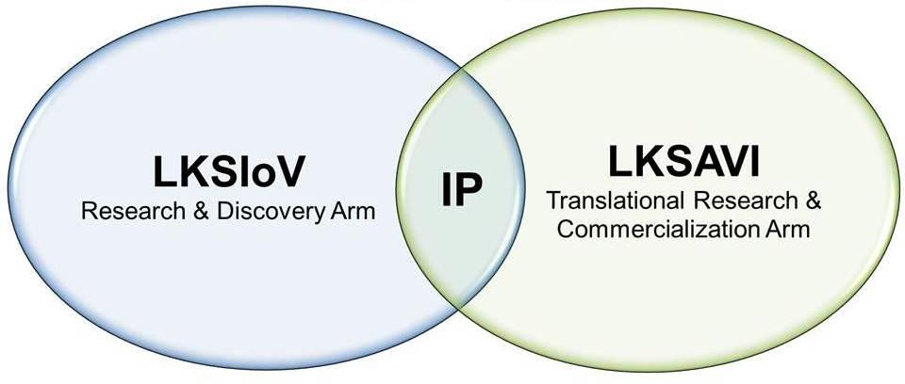
Institute of Virology → Applied Virology Institute

Slide 10
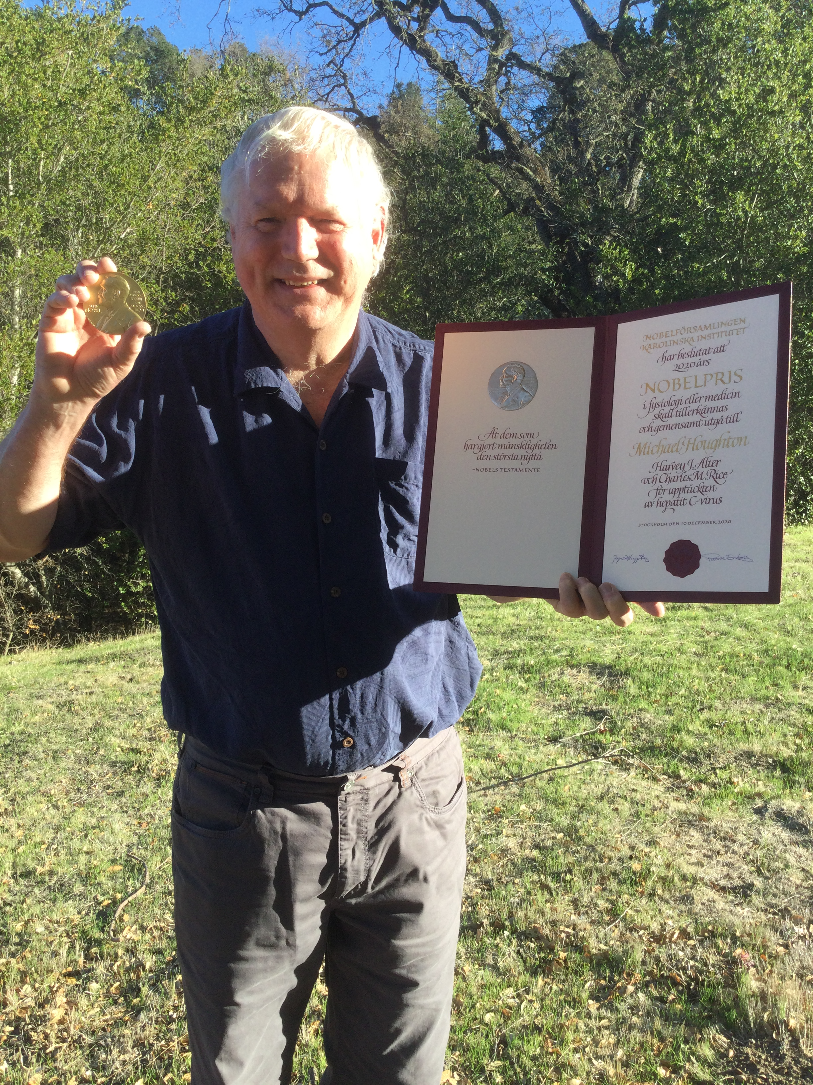

2020 Nobel Laureate Dr. Michael Houghton

Slide 11
Canadian Critical Drug Initiative
2023
A. MacIssac
$80.5 million – Government of Canada
Prairies Economic Development Canada
$35 million – Industry Partners
Applied Virology Institute
2013
M. Houghton
$50 million – Government of Alberta and Alberta Innovates
$3 million – Western Economic Diversification
Li Ka Shing Institute of Virology
2010
PRAIRIE Hub For Pandemic Preparedness
2023-24
J. Lemieux
$112 million – Government of Canada
Canada Biomedical Research Fund
and Biosciences Research Infrastructure Fund
Striving for Pandemic
Preparedness – The Alberta
Research Consortium
2022
M. Götte
$55.1 million – Government of Alberta
($30 million for infrastructure
and $25 million for vaccines and therapeutics)
Canada Excellence Research
Chair in Antiviral Drug Design
2023
Dr. Kalyan Das
$8 million – Government of Canada

Slide 12
Vaccine Safety
Disease Outcome
Vaccine Risks
There are risks with vaccines, but minimal in comparison to risk of diseases
Vaccines have saved more lives than all public health measures except clean water
Vaccines now for 32 different diseases
Estimated 10 to 20 million lives saved per year
Young lives – many life years ahead

Slide 13
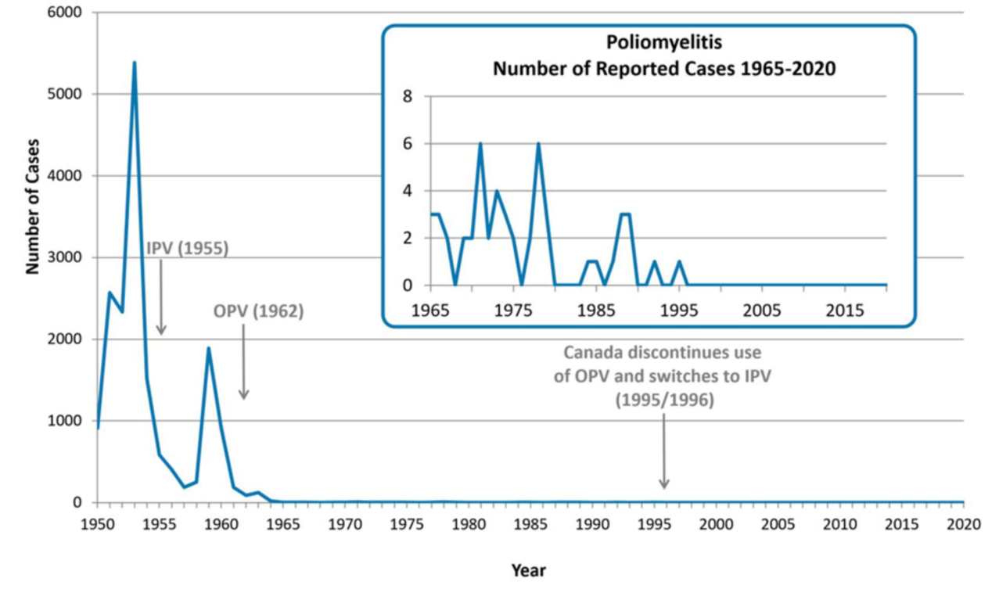
Impact of Vaccination on Polio
https://www.canada.ca/en/public-health/services/diseases/poliomyelitis-polio/health-professionals.html

Slide 14
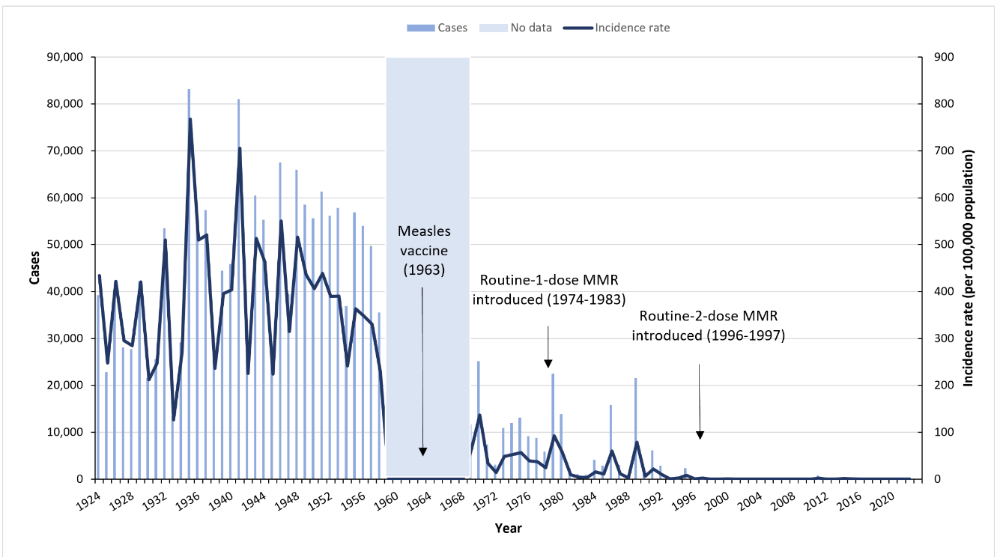
Impact of Vaccination on Measles
https://www.canada.ca/en/public-health/services/diseases/measles/health-professionals-measles.html

Slide 15
Vaccine Safety
Vaccination rates have fallen:
Complacency
Religious reasons
Government policies
Antivaxxers - misinformation
COVID-19 pandemic

Slide 16
Vaccine Safety
There has been a loss of confidence in science – much associated with COVID-19 pandemic and antivaxxers.
Confidence in science (PEW Research Centre):
2019 – 86%
2023 – 69%

Slide 17
Research is Powerful and the Only Path to Solutions
Examples:
HIV-AIDS – 1983 – 100% death in 2-3 years
  Today – single pill – life expectancy near normal
Peptic ulcer – discovery of bacterial cause – H. pylori – 1% of surgery
Hepatitis C virus discovered in 1989 – tainted blood
  Now therapy (2014) cures virtually 100%
Monoclonal antibody therapies – treatment for Crohns, rheumatoid arthritis – changed lives – much improved
Many other examples
Now is not the time to lose confidence in science!

Slide 18
Housekeeping Items
Washrooms are located out the door and to the right
Visitors to the University of Alberta without a CCID can use our Guest@UofA free wireless connection
In the event of an evacuation, the muster point is the northwest corner of the Jubilee Auditorium parking lot

