Slide 1
Setting the Stage:
Vaccine Safety in the Landscape of Vaccine Science
Symposium on the Science of Vaccine Safety: Bridging Across Pillars
October 28, 2025
Shannon MacDonald PhD, RN
Professor, Faculty of Nursing, University of Alberta
Canada Research Chair (Tier II) in Applied Pediatric Immunization
Adjunct Professor, School of Public Health, University of Alberta
Adjunct Professor, Department of Pediatrics, University of Calgary

Slide 2

Land Acknowledgement
The University of Alberta is located on Treaty 6 territory, home to diverse First Nations, as well as the Métis North Saskatchewan River Territory.

Slide 3
Declarations of interest
I have received research grant funds from national and provincial funding bodies.
I am a pediatric nurse, who has seen the adverse outcomes that can occur when children contract infectious disease.
I am also the parent of two teenage children, which also drives my passion for supporting child & youth health.

Slide 4
Outline
The breadth of vaccine science
Why focus on vaccine safety?
The Canadian vaccine safety research landscape

Slide 5
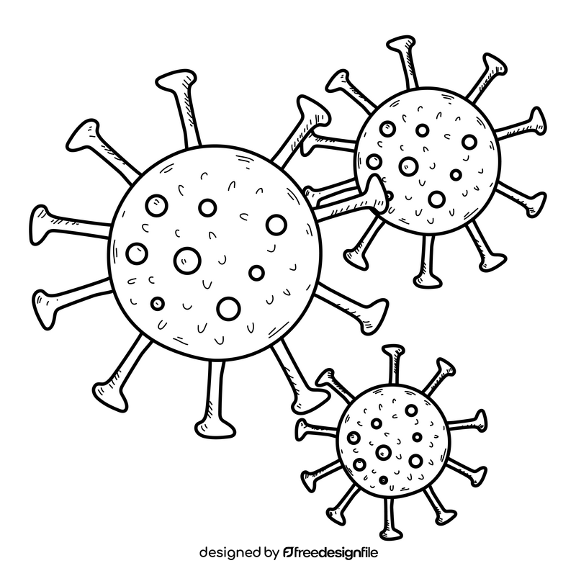
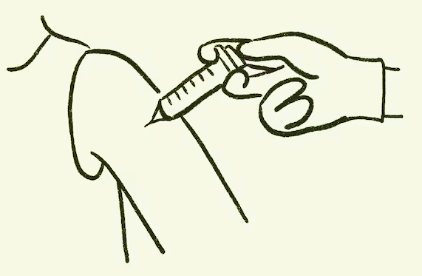
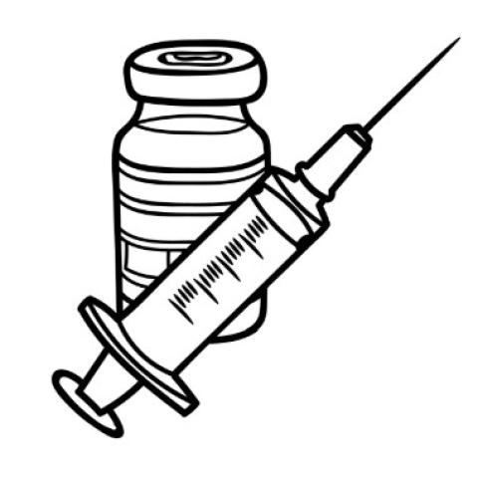
Vaccine science
Pharmacovigilance
Disease surveillance
Vaccine-preventable disease surveillance
Pathogen analysis
Modeling & economics
Pre-clinical laboratory research
Implementation science
Clinical studies & trials
Population & public health
Behavioural science

Slide 6

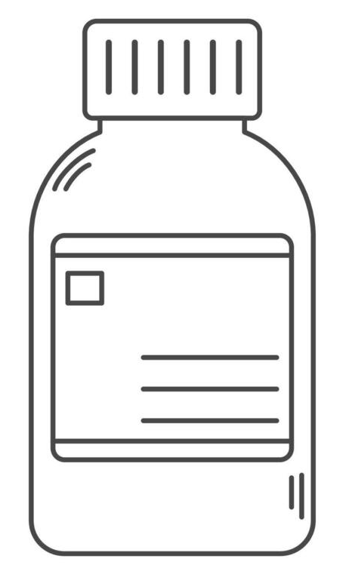
Why Vaccine Safety?
VACCINE SAFETY

Slide 7
Safety across the vaccine lifecycle
Development
Basic Research
Discovery
Pre-clinical Studies
Phase 1 Safety
Phase 2 Immunogenicity & Safety
Phase 3 Safety & Efficacy
Clinical Trials
New Drug Submission to HC
HC: Health Canada
BRDD: Biologic and Radiopharmaceutical Drugs Directorate
NACI: National Advisory Committee on Immunization
Clinical Trial Application
Adapted from: CDC. The Vaccine Life Cycle. Aug 10, 2024; Health Canada. Regulating vaccines for human use in Canada. June 11, 2025

Slide 8
Safety across the vaccine lifecycle
Development
Approval
Basic Research
Discovery
Pre-clinical Studies
Phase 1 Safety
Phase 2 Immunogenicity & Safety
Phase 3 Safety & Efficacy
Health Canada (BRDD) Review
NACI Review
Clinical Trials
New Drug Submission to HC
NACI Recommendation
HC: Health Canada
BRDD: Biologic and Radiopharmaceutical Drugs Directorate
NACI: National Advisory Committee on Immunization
Clinical Trial Application
HC Authorization
Adapted from: CDC. The Vaccine Life Cycle. Aug 10, 2024; Health Canada. Regulating vaccines for human use in Canada. June 11, 2025

Slide 9
Safety across the vaccine lifecycle
Development
Approval
Distribution
Basic Research
Discovery
Pre-clinical Studies
Phase 1 Safety
Phase 2 Immunogenicity & Safety
Phase 3 Safety & Efficacy
Health Canada Review
NACI Review
Manufacturing, transport & storage
Clinical Trials
New Drug Submission to HC
NACI Recommendation
HC: Health Canada
BRDD: Biologic and Radiopharmaceutical Drugs Directorate
NACI: National Advisory Committee on Immunization
Clinical Trial Application
HC Authorization
Adapted from: CDC. The Vaccine Life Cycle. Aug 10, 2024; Health Canada. Regulating vaccines for human use in Canada. June 11, 2025

Slide 10
Safety across the vaccine lifecycle
Development
Approval
Distribution
Vaccination & Monitoring
Basic Research
Discovery
Pre-clinical Studies
Phase 1 Safety
Phase 2 Immunogenicity & Safety
Phase 3 Safety & Efficacy
Health Canada Review
NACI Review
Manufacturing, transport & storage
Phase 4 Safety & Effectiveness
Pharmacovigilance
Program evaluation, including public acceptability
Clinical Trials
New Drug Submission to HC
NACI Recommendation
HC: Health Canada
BRDD: Biologic and Radiopharmaceutical Drugs Directorate
NACI: National Advisory Committee on Immunization
Clinical Trial Application
HC Authorization
Program Implementation
Adapted from: CDC. The Vaccine Life Cycle. Aug 10, 2024; Health Canada. Regulating vaccines for human use in Canada. June 11, 2025

Slide 11
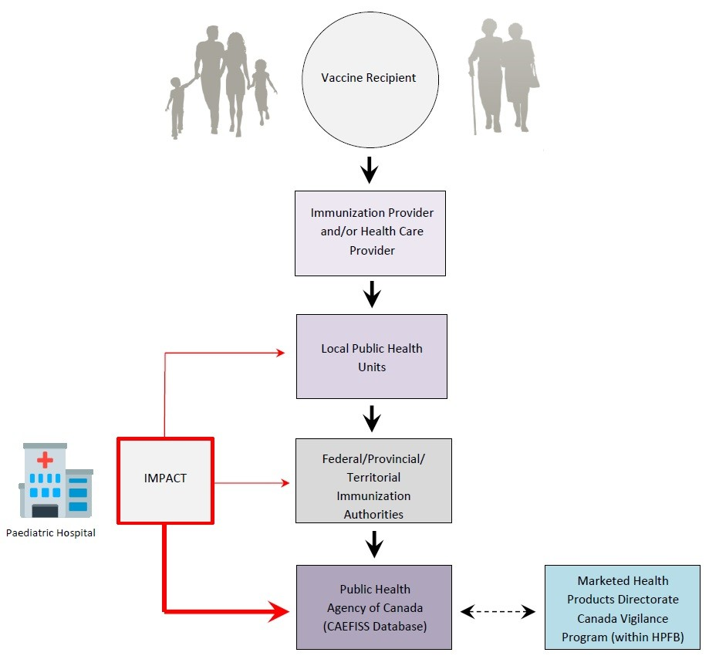
Canadian Adverse Event Following Immunization Surveillance System
Passive vaccine safety surveillance
Canadian Adverse Event Following Immunization Surveillance System (CAEFISS)
Adapted from: https://www.canada.ca/en/public-health/services/immunization/canadian-adverse-events-following-immunization-surveillance-system-caefiss.html

Slide 12




Active vaccine safety surveillance
Canadian National Vaccine Safety Network (CANVAS)
  Enroll vaccine recipients at time of vaccination
  Enroll non-vaccinated controls
Participants provide:
  Vaccination date, vaccine received, first name, email address, telephone #
Survey sent on Day 8 after immunization
Bettinger et al, Eurosurveillance, 2020; canvas-covid.ca

Slide 13
Vaccine safety perceptions: Natural history of an immunization program
Pre-vaccine
Increasing
coverage
Confidence:
Eradication
(vaccination stops?)
Loss Return
Disease
Incidence
Vaccine
Coverage
Outbreak
Adverse Events
(real/perceived)
Eradication ?
From Chen et al., Vaccine 1994
Maturity of immunization programme

Slide 14

Vaccine safety controversies
New vaccines and complex schedules
Lower tolerance for immunization risks
Divergent risk-benefit
Time lag between hypothesis and evidence
Evolving parenting
Limited clinical trial sample size
Chen RT, Shimabukuro TT, Martin DB, Zuber PL, Weibel DM, Sturkenboom M. Enhancing vaccine safety capacity globally: A lifecycle perspective. Vaccine. 2015 Nov 27;33 Suppl 4(0 4):D46-54.

Slide 15

The Canadian vaccine safety research landscape

Slide 16
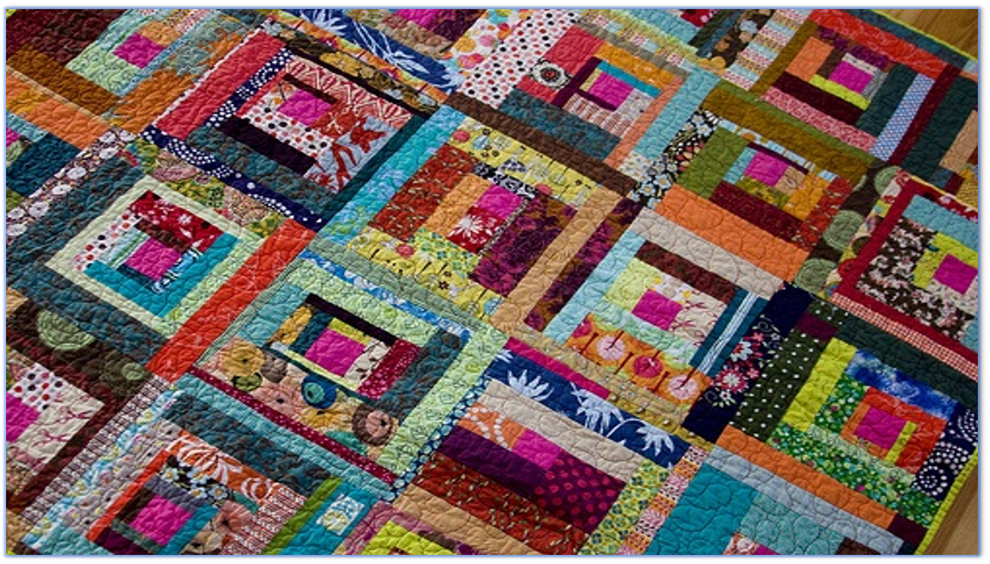
Provincial/territorial (P/T) differences are a unique challenge for vaccine safety research in Canada

Slide 17

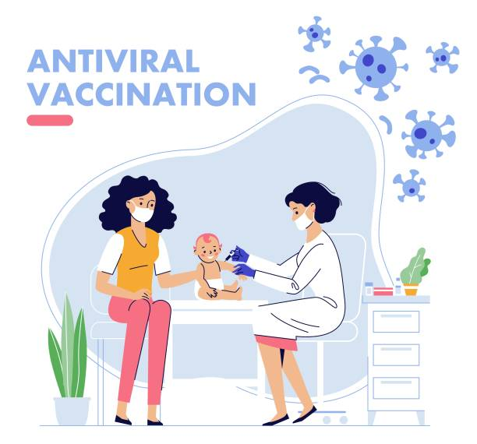

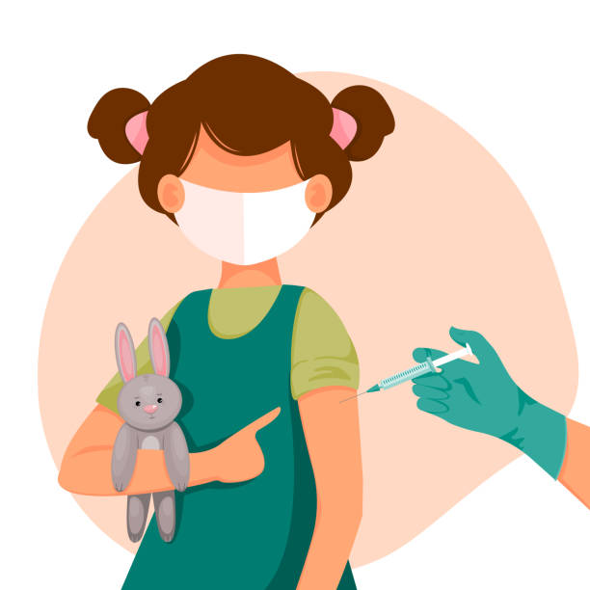
Publicly-funded routine immunization schedules vary by P/T
HPV
2 doses
RSV
Shingles
MMR-V
DTaP-IPV-Hib-HB
Hepatitis B
2 doses
RSV
TdaP
Rotavirus
Grade 5/6
Pneumococcal
Adult
HPV
<26 yrs
Birth, 2, 4, 6, 12, 18 months
MMR
Pneumococcal
65+ yrs
Meningococcal-C
TdaP
DTaP-IPV
4-6 years
Men-C-ACYW-135
Grade 4/6/7/8/9/12
Annual vaccines: Influenza, COVID-19

Slide 18
Data systems vary across Canada, which can pose challenges for vaccine safety surveillance and research
Province-wide immunization registry
Sub-provincial registries within province
* There is no national immunization registry
* First Nations communities are not commonly included in provincial registries due to unique governance considerations

Slide 19


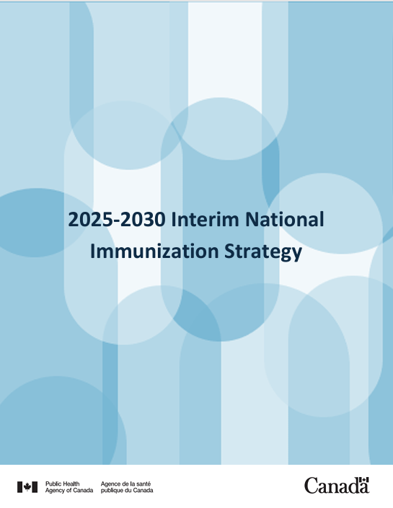
Canada’s current research priorities

Slide 20




The Science of Vaccine Safety: Bridging across the pillars
Social, Cultural, Environmental & Population Health
Biomedical
Clinic
Health services
CIHR Pillars
Basic Research
Discovery
Pre-clinical Studies
Phase 1 Safety
Phase 2 Immunogenicity & Safety
Phase 3 Efficacy & Safety
Health Canada Review
NACI Review
Manufacturing, transport & storage
Phase 4 Safety & Effectiveness
Pharmacovigilance
Program evaluation
Adapted from: CDC. The Vaccine Life Cycle. Aug 10, 2024; Health Canada. Regulating vaccines for human use in Canada. June 11, 2025

Slide 21





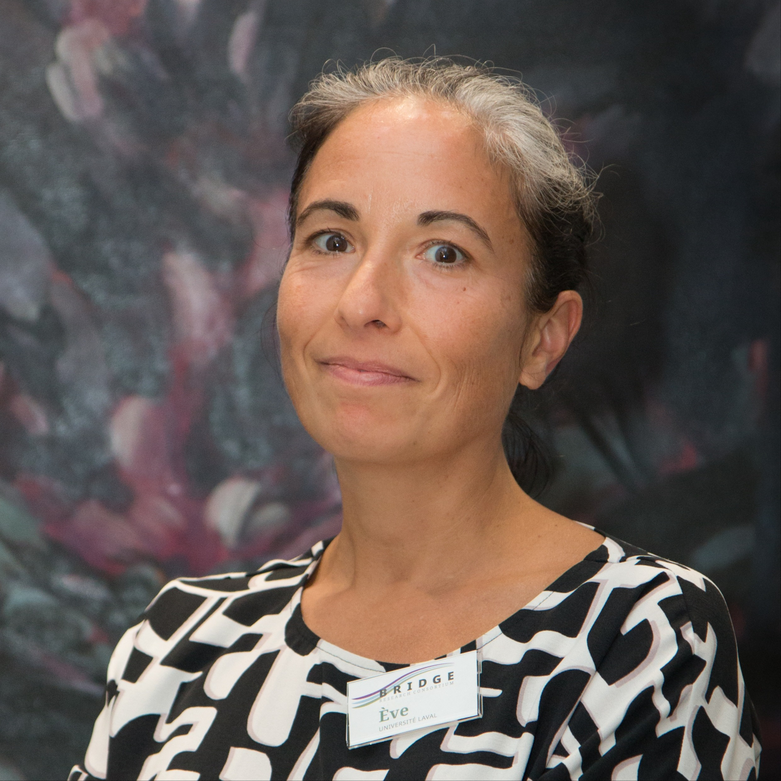
The Science of Vaccine Safety: Bridging across the pillars

