Slide 1








CLINICAL INVESTIGATION OF ADVERSE EVENTS FOLLOWING IMMUNIZATION: COVID-19 VACCINE-ASSOCIATED MYOCARDITIS
Karina Top, MD, MS, FRCPC
Symposium on the Science of Vaccine Safety: Bridging Across Pillars
Li Ka Shing Institute of Virology
University of Alberta
28 October 2025

Slide 2
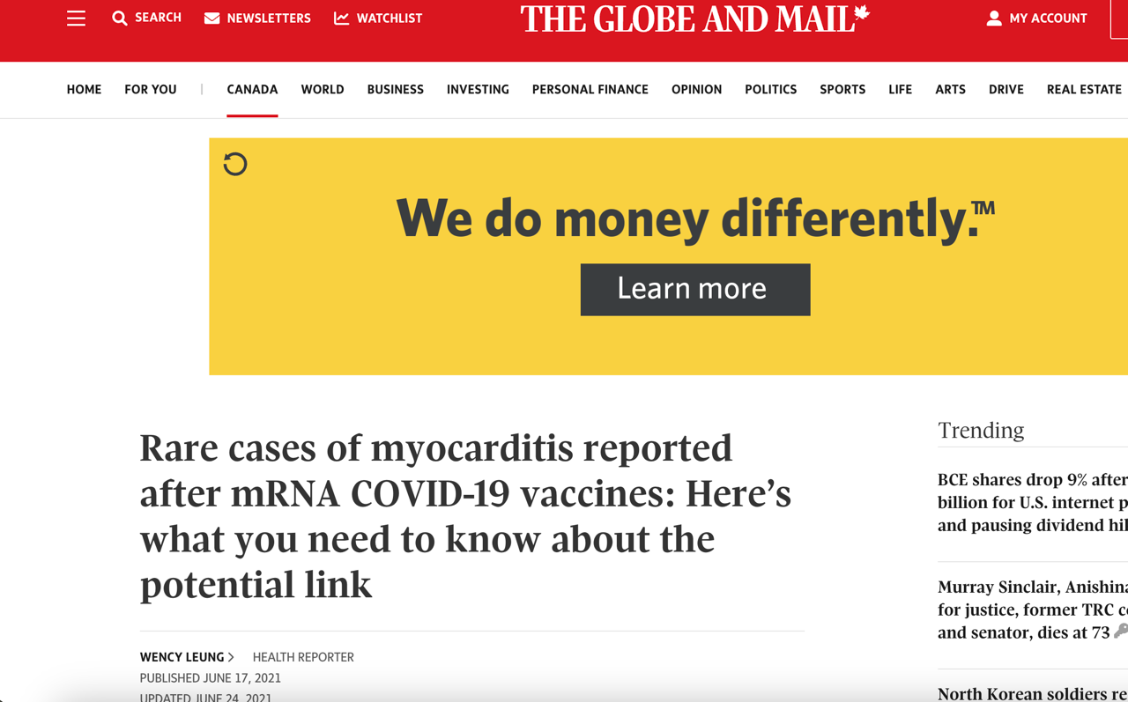

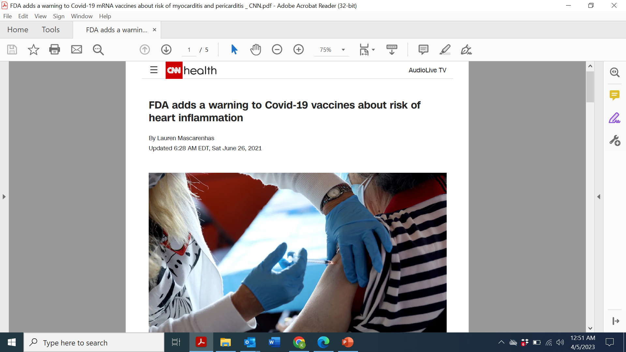


Life Cycle of a Vaccine Safety Concern: COVID-19 vaccine-associated myocarditis
Pharmacovigilance
Epidemiological studies confirm increased rate
Case
report
Case
series
Controlled
studies
Risk/benefit policy
Standard assessment
Plausibility
Alternative
hypothesis
Communications
Societal
Individual
Mar 2021: Israel reports myocarditis in young men after COVID-19 mRNA vaccine
+
(Communications)
Treatment
Compensation
Safer vaccine
Appropriate contraindications
Screening
Pathophysiology
Risk factors
Major gap
Chen RT. Vaccine 2004 PMID: 15121321

Slide 3

Active surveillance of myocarditis & pericarditis in children
  IMPACT conducted active hospital-based surveillance for serious adverse events following immunization (AEFIs) in children 0-16 years 1991 to 2023 at Canadian pediatric hospitals
  Objective: To compare characteristics and outcomes of children assessed for myocarditis, myopericarditis, and pericarditis by COVID-19 vaccination status
Top et al, J Pediatr, 2025: doi: 10.1016/j.jpeds.2025.114642

Slide 4
Methods
  From Jun 2021 to Dec 2022 nurse monitors searched admission lists, ED discharge diagnoses for:
    Children 0-16 years of age
    Physician diagnosis of myocarditis, myopericarditis or pericarditis
  Demographic and clinical data collected on all cases of myocarditis/pericarditis
  Descriptive analysis comparing:
    Vaccine proximate cases (onset within 0-21d )
    Remotely vaccinated (onset >21d)
    Unvaccinated
  Self-controlled case series to compare relative risk of myocarditis 0-21 days after vaccination versus non-exposed periods
Top et al, J Pediatr, 2025: doi: 10.1016/j.jpeds.2025.114642

Slide 5
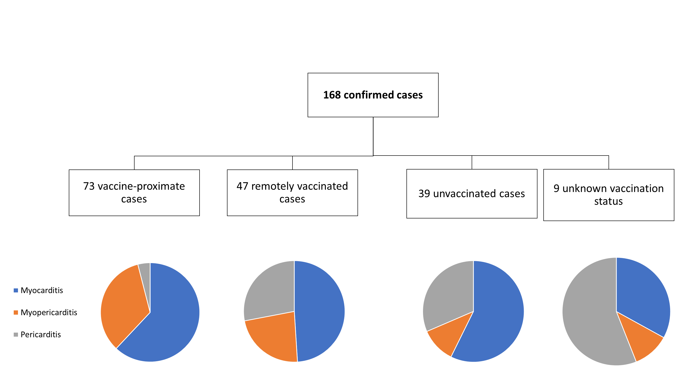
From 2021-22: 43% of confirmed cases were vaccine proximate
Top et al, J Pediatr, 2025: doi: 10.1016/j.jpeds.2025.114642

Slide 6
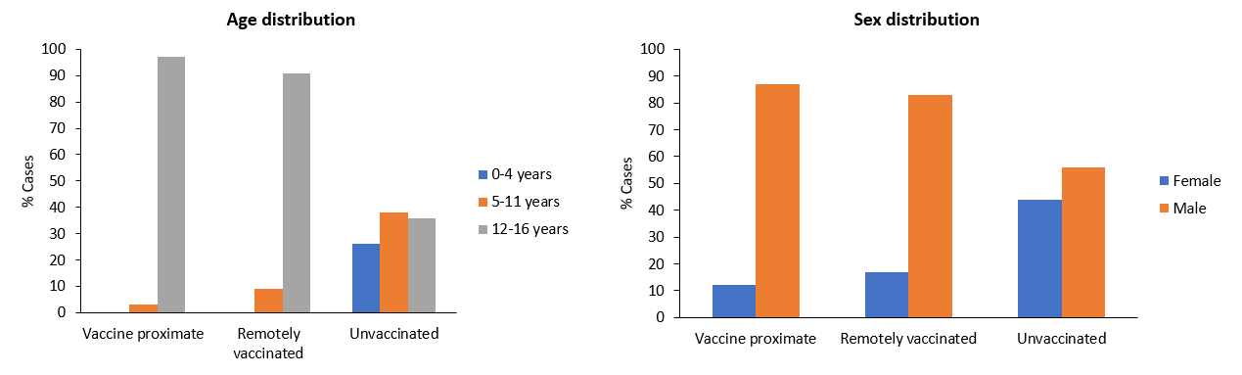
Vaccine-proximate cases were primarily adolescent males
  Acute SARS-CoV-2 infection diagnosed in 3% VP, 10% RV, 18% Unvaccinated
Top et al, J Pediatr, 2025: doi: 10.1016/j.jpeds.2025.114642

Slide 7
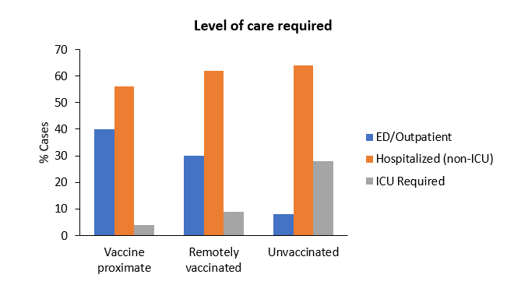
Few vaccinated cases needed ICU care and nearly all recovered by discharge
  >95% vaccine-proximate and 100% remotely vaccinated had fully recovered or expected to make a full recovery
  No deaths among vaccinated patients
  <5 deaths among unvaccinated children
Conclusion: COVID-19 vaccinated children who develop myocarditis/pericarditis may have a less severe initial course than unvaccinated children
Top et al, J Pediatr, 2025: doi: 10.1016/j.jpeds.2025.114642

Slide 8
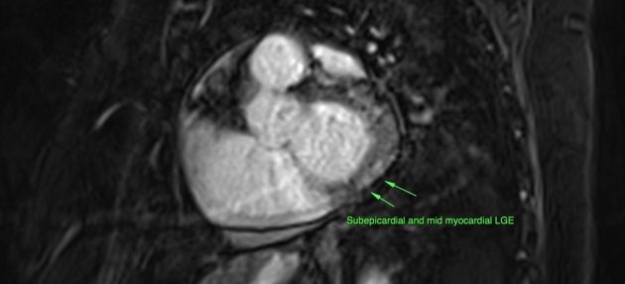

Managing patients with cardiac adverse events following COVID-19 vaccination
Dr. Piché-Renaud
MD

Slide 9
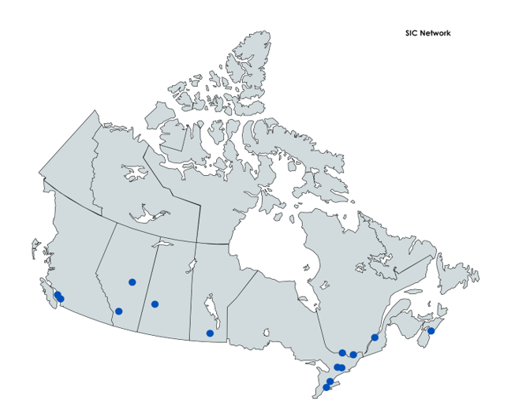
Special Immunization Clinic (SIC) Network
Aim: Standardize and improve immunization practices for patients with previous adverse events following immunization
  National team of expert clinicians with an interest in vaccine safety
    Infectious disease specialists, allergist-immunologists
    Other specialists: neurology, cardiology
  Platform for research
Notes:
Modeled after SICs in other locales

Slide 10





SIC Approach:
Integrated with clinical care
  Healthcare provider or public health refer patient to SIC
  Patients undergo standardized assessment of the adverse event
    Risk-benefit assessment for proceeding with revaccination
    Recommendations regarding revaccination are made based on network protocols
  Patients are vaccinated in the SIC or via public health
  Follow up post-vaccination
  De-identified data is entered into national database
Notes:
SIC is integrated into clinical care. Patients are referred by MD

Slide 11
Patients with cardiac events following COVID-19 vaccination in the SIC network (Jan 2021-Feb 2023)
Piche-Renaud et al, ESPID 2023; Piche-Renaud et al, Under review
Notes:
Most patients recommended for revaccination, including 90% of those with HS events, recommended for revaccination were revaccinated
61% neuro

Slide 12

Conclusions and clinical guidance
  Revaccination with a COVID-19 vaccine can be considered for those with chest pain that does not meet criteria for myocarditis
  For those with confirmed myocarditis or pericarditis, revaccination may be considered in people with risk factors for severe COVID-19 with close monitoring

Slide 13



How do COVID-19 mRNA vaccines trigger myocarditis?

Slide 14

A global standing network to investigate causes and risk factors of rare AEFIs
  Established in 2021, INSIS brings together experts in vaccine safety, specialist clinicians, systems biology & pharmacogenomics in countries across the globe.
  Co-Leads: Dr. Karina Top (Canada), Dr. Robert Chen (US)
Aims: To combine clinical and systems biology “adversomics” approaches to:
  Gain insight into mechanistic basis of adverse events detected after vaccine introduction
  Define relationship of adverse events to specific vaccine products and platforms
  Identify populations at risk
  Initial targets: Myocarditis, pericarditis, vaccine-induced thrombosis with thrombocytopenia
Notes:
Aim to answer the “how” and “why” of AESIs and “how” we can make vaccines even safer – starting with MC/PC/TTS, developing AESI X protocol, partnering with LMICs

Slide 15
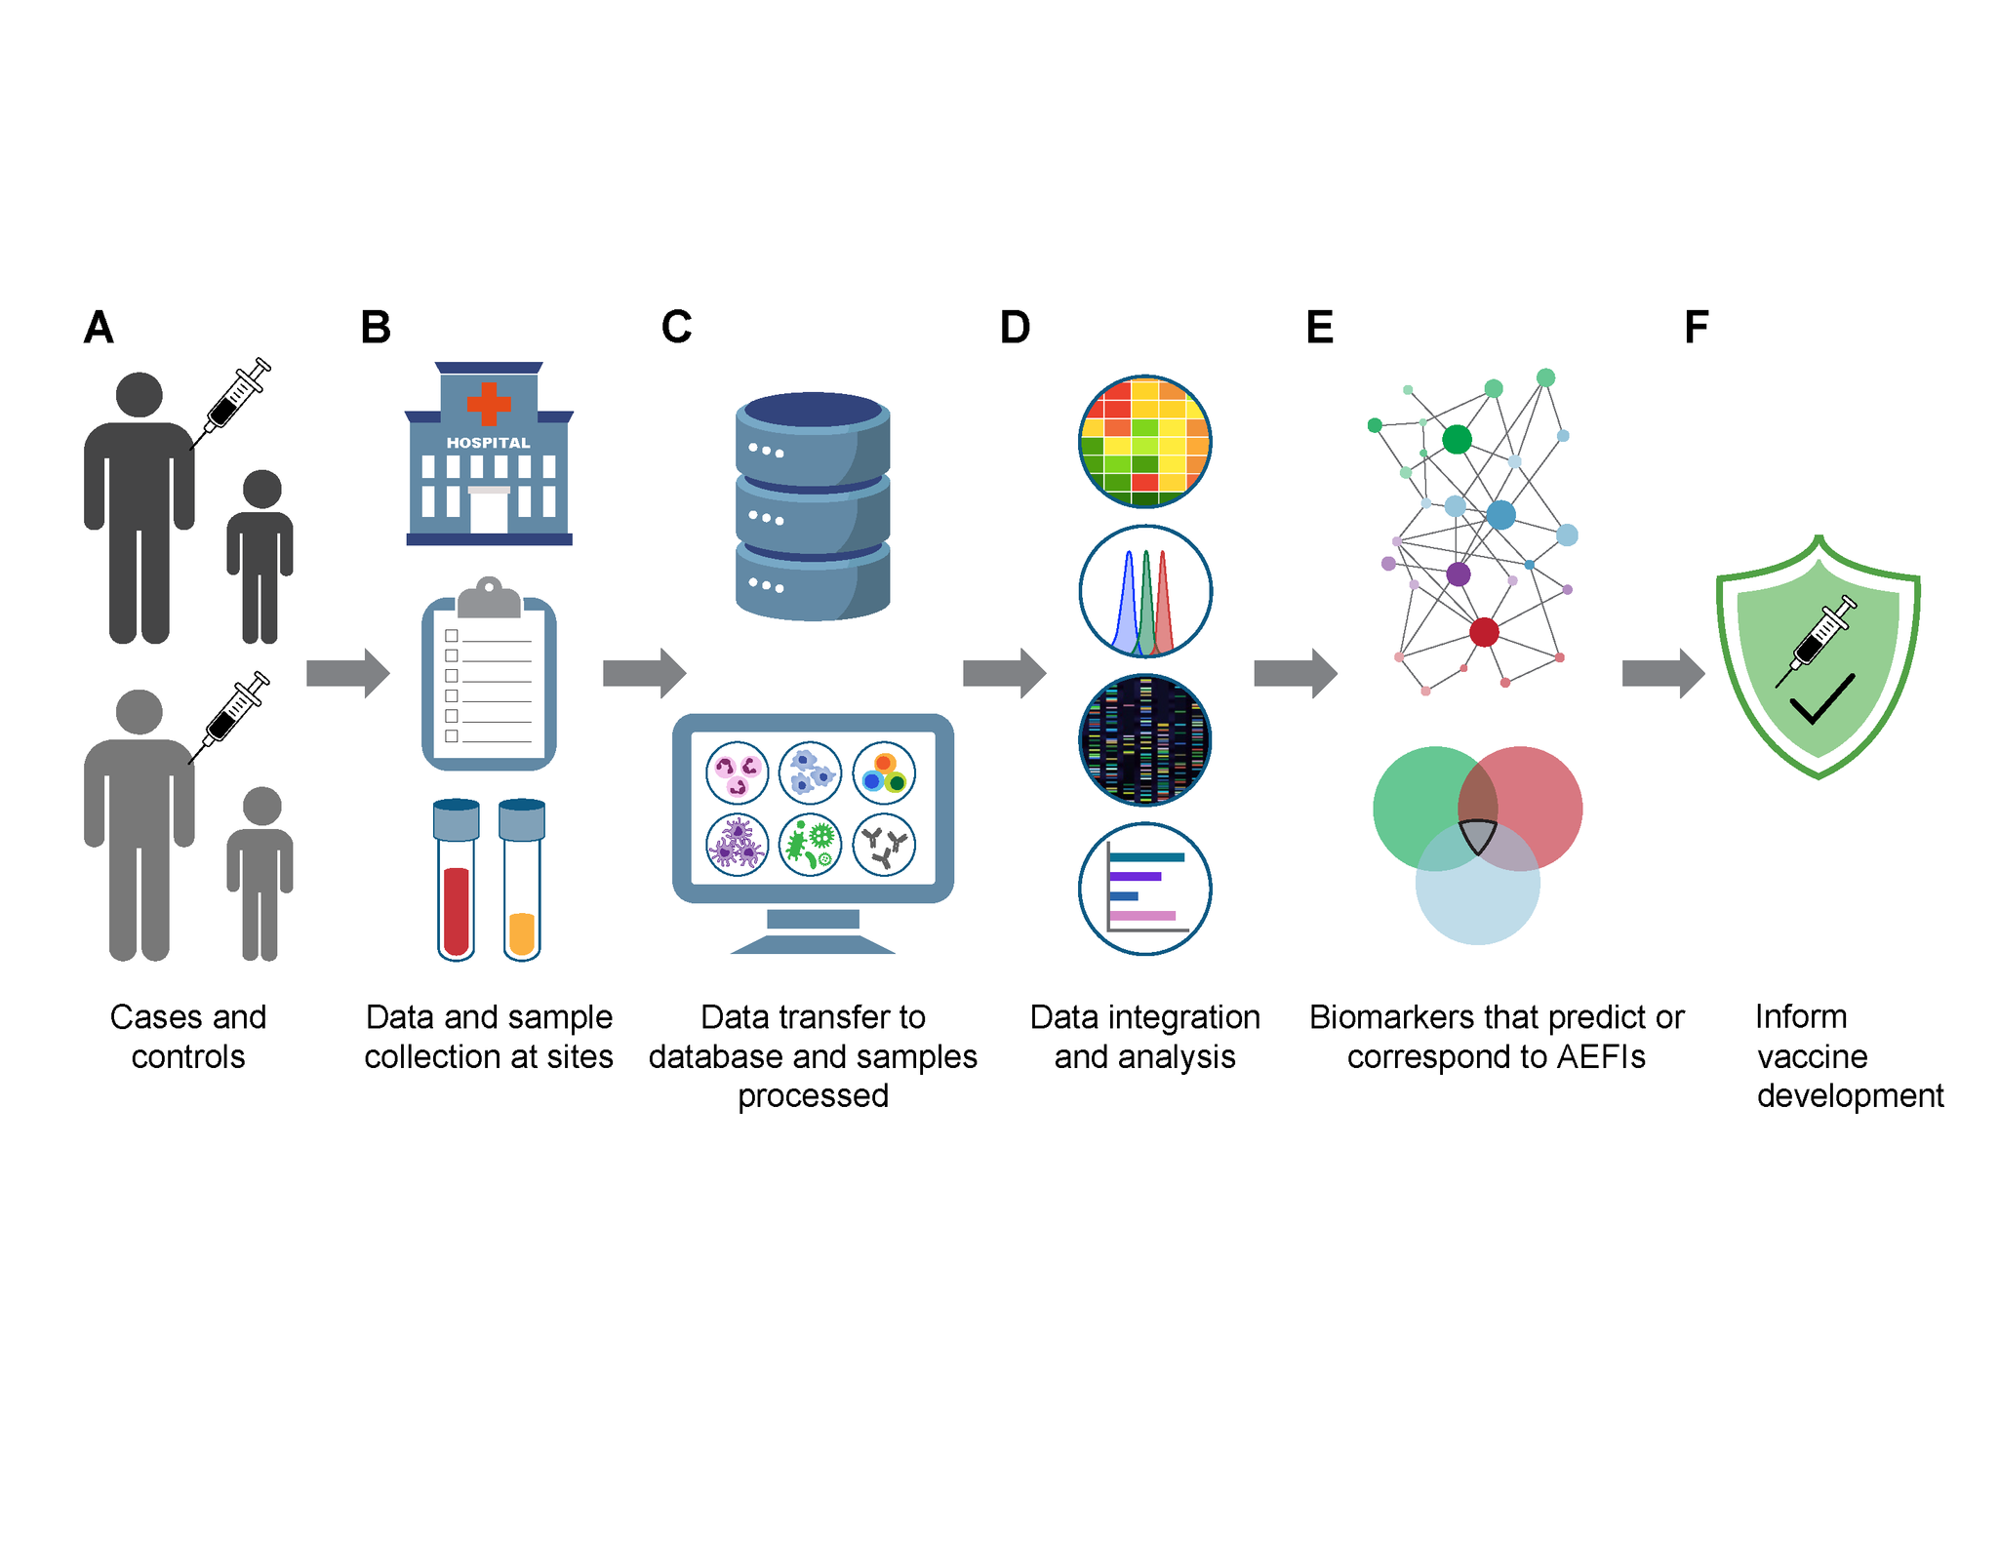
INSIS Approach
Diray-Arce et al, Longitudinal Meta-cohort Study Protocol using Systems Biology to Identify Vaccine Safety Biomarkers, Vaccine, 2025, 10.1016/j.vaccine.2025.127504
Graphic courtesy of Precision Vaccines Program, Boston Children’s Hospital
Notes:
Healthy controls with same vaccine exposure; controls with same disease (not vaccine associated)
Serial sampling during and after AESI; similar timepoints in controls
Proposed analysis: Transcriptomics, proteomics, metabolomics, flow-based immunophenotyping, in vitro modelling; comparing between groups and within group over time

Slide 16
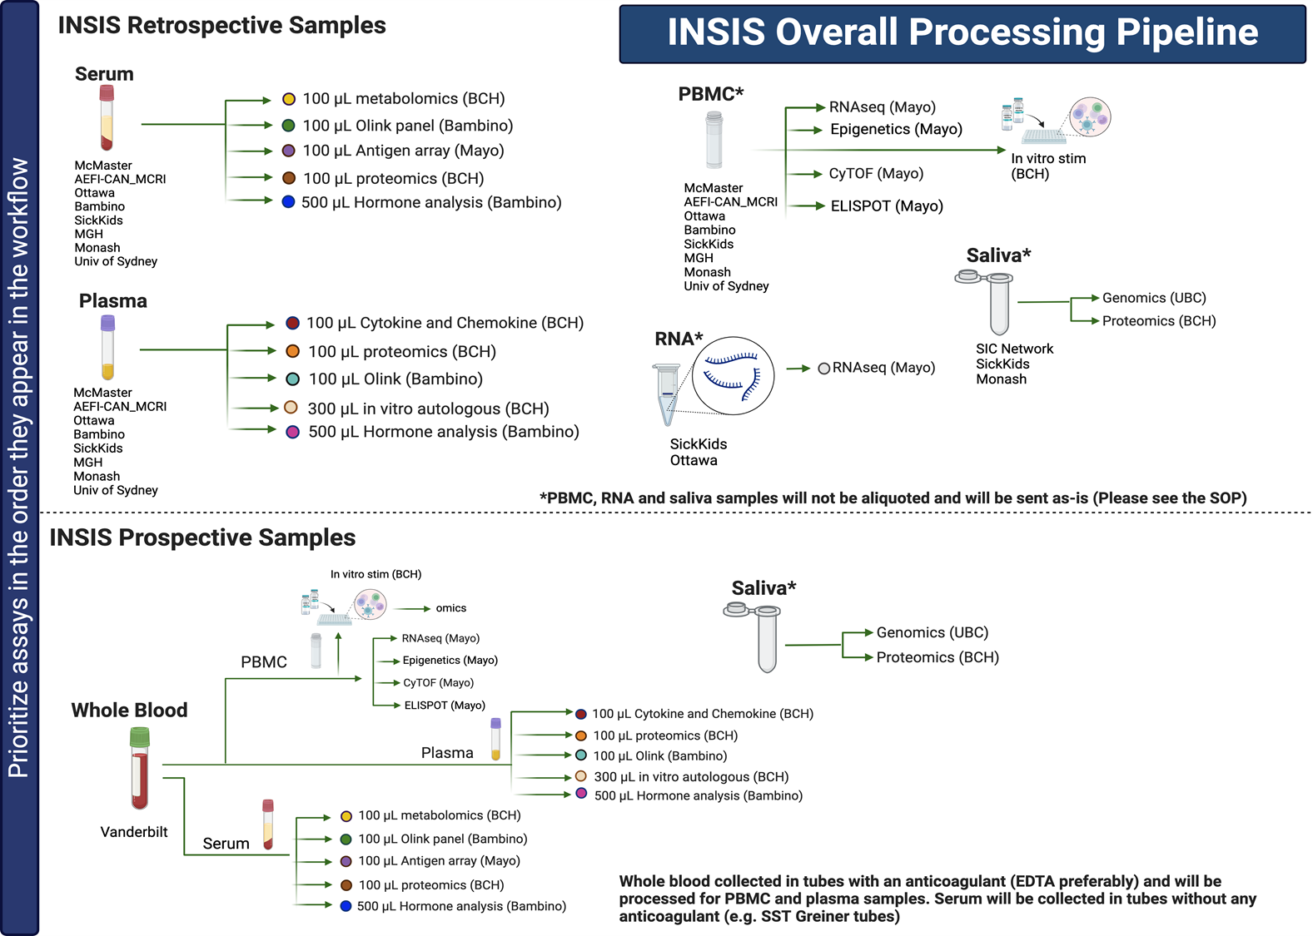

Slide credit: Dr. Joann Arce, Precision Vaccines Program, Boston Children’s Hospital
Notes:
We have identified about 300 cases and 600 controls to date and are working with colleagues in Denmark to identify further cases and controls
-Dr Carleton with the GVDN genomics study has identified >1000 cases of myocarditis and over 300 with TTS

Slide 17
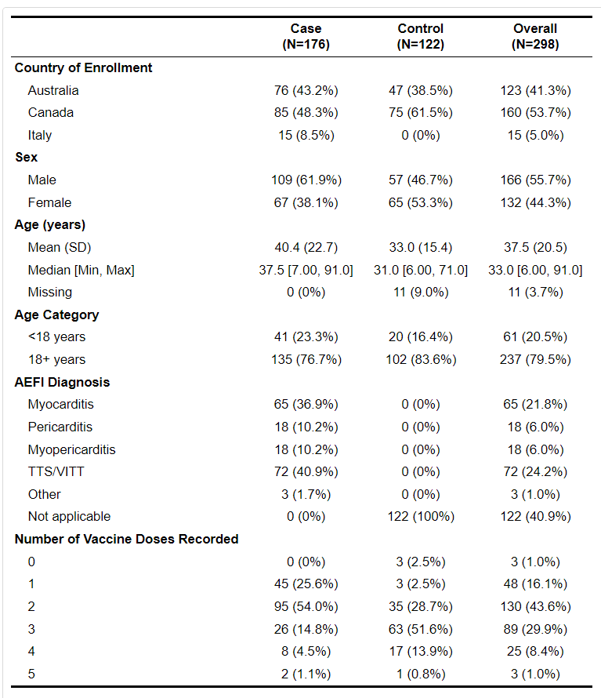
Overview of INSIS participants to date
Courtesy of Precision Vaccines Program,
Boston Children's Hospital
Notes:
Represents data from 7 sites
-recently added 2 more and anticipating further 1-2 sites
-The "Other" AEFI diagnosis category contains: ​
MIS-C​
Chest pain (2 instances)​
Costochondritis​

Slide 18


Genetic variants of myocarditis
  First 50 Brighton Collaboration Level 1 Myocarditis Cases​
  Exome-captured library preparation was sequenced with the Illumina NovaSeq 6000 system, reaching an average depth of 100x​
  Reads were aligned to the GRch38 human reference genome​
  49 samples passed the quality control process​
  Examine variant frequencies ≥ 50% in cases when global allele frequency (ClinVar) is ≤ 15%
Slide credit: Dr. Bruce Carleton, University of British Columbia
Notes:
mean age 26.5, 80% M, 75% pfizer, 72% dose 2
onset 4 d (3-26)

Slide 19
No.​ | Gene​ | Function​ | SNP ID​ | Minor allele frequency (n=49)​ | Global allele frequency (n=5,008)​ | Fisher's exact ​ P-value​ | Odds ratio​ (95% CI)​
1​ | LRP8​ | Missense​ | rs5174​ | 0.398​ | 0.144 (T)​ | 9.58x10⁻¹⁰​ | 3.92 (2.53 - 5.99)​
2​ | VKORC1​ | Intron​ | rs2884737​ | 0.306​ | 0.0914 (C)​ | 2.44x10⁻⁹​ | 4.38 (2.74 - 6.87)​
3​ | AGTR1​ | 3 Prime UTR ​ | rs5186​ | 0.327​ | 0.118 (C)​ | 5.34x10⁻⁸​ | 3.63 (2.29 - 5.64)​
4​ | ACAN​ | Missense​ | rs3817428​ | 0.316​ | 0.114 (G)​ | 9.56x10⁻⁸​ | 3.59 (2.25 - 5.60)​
5​ | SUMF1​ | Missense​ | rs2819590​ | 0.306​ | 0.117 (T)​ | 5.24x10⁻⁷​ | 3.34 (2.09 - 5.23)​
6​ | WDR62​ | Synonymous​ | rs2301734​ | 0.316​ | 0.125 (A)​ | 6.93x10⁻⁷​ | 3.24 (2.04 - 5.05)​
7​ | TTN​ | Missense​ | rs36051007​ | 0.316​ | 0.126 (T)​ | 8.22x10⁻⁷​ | 3.21 (2.02 - 5.00)​
8​ | TTN​ | Missense​ | rs35833641​ | 0.316​ | 0.127 (G)​ | 9.74x10⁻⁷​ | 3.18 (2.00 - 4.96)​
9​ | ANHX​ | Missense​ | rs36146434​ | 0.316​ | 0.129 (C)​ | 1.40x10⁻⁶​ | 3.12 (1.96 - 4.86)​
10​ | ALPP​ | Missense​ | rs1048988​ | 0.327​ | 0.141 (C)​ | 3.02x10⁻⁶​ | 2.96 (1.87 - 4.60)​
11​ | TTN​ | Missense​ | rs12463674​ | 0.310​ | 0.130 (G)​ | 3.25x10⁻⁶​ | 3.01 (1.89 - 4.68)​
12​ | EDARADD​ | 3 Prime UTR​ | rs6428955​ | 0.316​ | 0.138 (T)​ | 5.75x10⁻⁶​ | 2.90 (1.82 - 4.51)​
13​ | MCPH1​ | Intron​ | rs1961222​ | 0.330​ | 0.150 (T)​ | 7.24x10⁻⁶​ | 2.80 (1.78 - 4.32)​
14​ | MSH6​ | Missense​ | rs1800935​ | 0.306​ | 0.135 (C)​ | 1.12x10⁻⁵​ | 2.82 (1.77 - 4.42)​
15​ | CHRNA5​ | Missense​ | rs16969968​ | 0.316​ | 0.150 (A)​ | 4.47x10⁻⁵​ | 2.63 (1.65 - 4.10)​
16​ | SUGP1​ | Stop Gained​ | rs11555053​ | 0.306​ | 0.149 (A)​ | 8.74x10⁻⁵​ | 2.52 (1.57 - 3.94)​
17​ | VPS53​ | Missense​ | rs11558129​ | 0.296​ | 0.145 (A)​ | 0.000138​ | 2.47 (1.54 - 3.88)​
18​ | TTN​ | Missense​ | rs12464787​ | 0.296​ | 0.147 (A)​ | 0.000152​ | 2.45 (1.53 - 3.84)​
7 variants across four genes identified with clear linkage to ​cardiovascular function​
Slide credit: Dr. Bruce Carleton
Notes:
genes include in LDL R-related protein (cholesterol metabolism), AGII type 1 receptor, linked to CV inflammation/MI, vit K signaling (CV disease), Titin - DCM/myocarditis

Slide 20
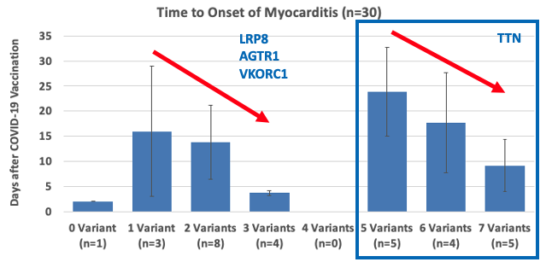
Number of genetic risk variants correlates with time to onset of myocarditis
These findings suggest genetic predisposition to COVID-19 mRNA vaccine-induced myocarditis, where an increased burden of risk variants may accelerate onset of myocarditis symptoms
Next step: a genome-wide study on the full cohort (275 cases and 2,750 vaccine-platform-matched controls) once the enrollment is target is reached
Slide credit: Dr. Bruce Carleton, University of British Columbia
Notes:
next steps are further analysis nad validation of WES -reaching sample size targets for GWAS (275:2750)

Slide 21

Expected outcomes & impact
  “Product agnostic” global platform to study mechanisms of AEFIs
  Identify biomarker risk factors for myocarditis, pericarditis that can be used to:
    Inform risk-benefit assessment mRNA platform
    Identify at risk populations
    Predict potential for AEFIs with new vaccines before implementation
  Global vaccine safety effort may help support public confidence
Notes:
Identify populations at risk that may benefit from different product (eg genetic marker)
Biomarkers that can be tested in preclinical and phase 1-2 trials
Can modify platforms to avoid triggering mechanisms

Slide 22





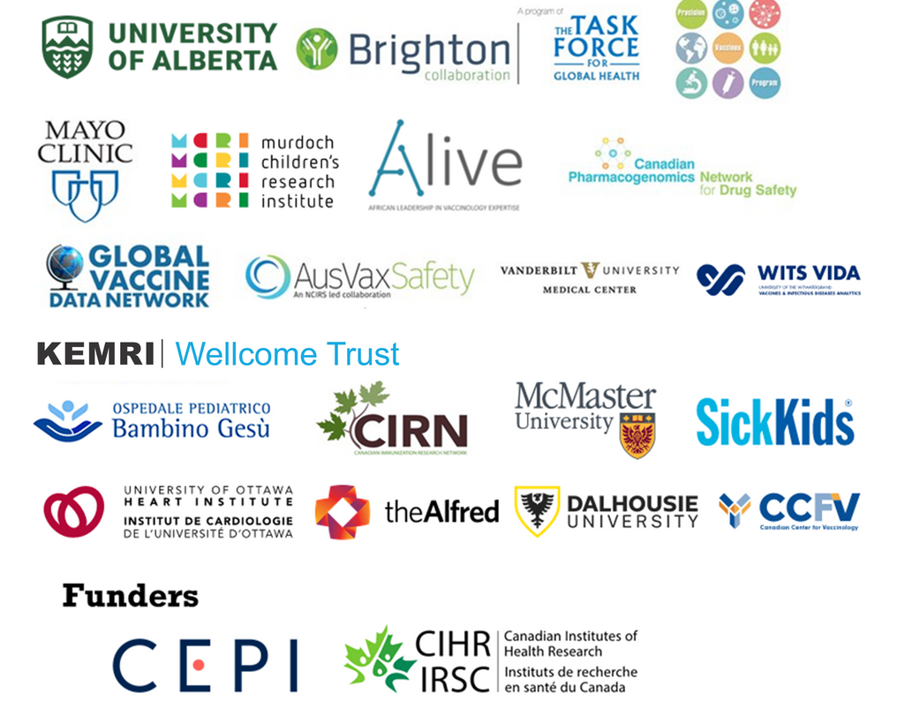
Acknowledgements
IMPACT COVID-19 co-PIs: Drs S Morris, F Kakkar, S Halperin, M Sadarangani, J Bettinger
IMPACT investigators, nurse monitors
IMPACT Data Centre team
Canadian Paediatric Society
Funders
SIC Network co-PI: Dr J Cowan
SIC Network investigators, nurse coordinators
SIC Data and Coordination team: JL Chew, P Kebedom, K Gandhi
Canadian Center for Vaccinology staff
Contact: sicnet@ualberta.ca
INSIS Co-PI: Dr RT Chen
INSIS Clinical Data leads: Dr A Ozonoff, A Hoch
INSIS OMICs leads: Dr O Levy, Dr J Arce, A Chang
Genomics lead: Dr B Carleton
Steering Committee members: Drs CB Creech, C Cutland, N Crawford, P Palma, R Kennedy, S Kochhar, S Black
INSIS Network Management Office: S Moradipoor, A Bodhi, A Naz
Contact: insis@ualberta.ca
Website: http://insisvaccine.org

Slide 23
Thank you!
Questions?

