Slide 1
Integrating vaccine safety into health services research and economic evaluation
Current practice and future directions
Ellen Rafferty, PhD

Slide 2

Who am I?
Senior Principal Health Economist at the Institute of Health Economics and an Assistant Professor in the Department of Medicine, University of Alberta.
Co-lead a portfolio of work on the epidemiologic and economic impact of infectious diseases and public health policies, in particular vaccination, using mathematical and statistical modelling methods.
Health services research is integrated throughout my work.
Integrating vaccine safety into health services research
Notes:
I wanted to share this, because I wanted it to be known that while health services research is integrated throughout my work. Health services research is a broad field and I don’t have expertise in all areas. So I will be mainly focusing on my area of expertise – which is health economics.

Slide 3
Table of Contents
What is Pillar 3?
4
Vaccine safety in health services research
5-7
Economic evaluation of vaccines
8-11
Current practice – vaccine safety in EE
12-16
Future directions – vaccine safety in EE
17-24
Questions
25
Integrating vaccine safety into health services research
Notes:
I will briefly go through what type of research pillar 3 focuses on.
Then I will discuss how vaccine safety is incorporated into the larger field of health services research.
Then I will briefly discuss economic evaluation of vaccines
Followed by how vaccine safety is current incorporated in economic evaluations/health economics and what we can do better.

Slide 4
Health services research focuses on improving health care for everyone. By studying how health care services are organized, supported, and delivered across Canada, we can make the overall system better.
Health services research (Pillar 3)
– Canadian Institute for Health Research
Integrating vaccine safety into health services research
Notes:
This research generates information to help enhance care for patients, reduce costs, and address the needs of health care providers.

Slide 5

Examples of vaccine safety in health services research
Integrating vaccine safety into health services research

Slide 6



Vaccine safety in health services research
Impact of vaccine safety outcomes of health services use
Health care use for adverse events following immunizations (AEFIs)
Vaccine provider and safety outcomes
How AEFIs differ by vaccine provider
Impact of dedicated vaccine safety clinics
Post-marketing vaccine safety surveillance
Limited number of people included in clinical trials
Often vaccine safety signals are only captured when distributed to larger populations
Integrating vaccine safety into health services research

Slide 7



Vaccine safety in health services research
Integration into routine care
How we can integrate vaccine safety monitoring into primary care and hospital systems.
Vaccine safety monitoring systems
Setting up appropriate systems to capture AEFIs
Evaluating the impact of these programs
Health Economics
Better estimates of cost-effectiveness of vaccines
Better vaccine decision-making
Appropriate pricing
Integrating vaccine safety into health services research

Slide 8
Overview economic evaluation of vaccines
Integrating vaccine safety into health services research

Slide 9
What is an economic evaluation?
Economic evaluation is the comparative analysis of alternative courses of action in terms of their costs and consequence
    Elements needed in an economic evaluation
      Comparison of alternatives (e.g., current practices vs. new vaccine)
      Cost of alternatives
      Consequences or effects of the alternatives
Integrating vaccine safety into health services research
Notes:
Because it will be central to a lot of the discussion today. I will give a brief overview of what economic evaluations of vaccines look like.
Current practice could be whatever treatment is available or another vaccine. Basically comparing a world with vaccination to a world without vaccination.
With vaccination we have need to consider both the direct individual effects and any impacts of herd immunity.
Therefore:
A cost analysis is not a complete economic evaluation
Reporting the costs and outcomes of a single course of action (i.e., no comparison) is not an economic evaluation

Slide 10

Purpose of economic evaluations
In a world with limited resources
  Estimate cost-effectiveness
  Determine value for money and resource allocation
  Optimize limited funds
Notes:
And why does it matter.

Slide 11

Parts of an economic evaluation
Disease/intervention model
Economic analysis
  Data inputs
    Relevant outcomes
    Relevant costs
Integrating vaccine safety into health services research
Notes:
So what are the parts of an economic evaluation we need to consider.
First we need to build a model of the disease and the vaccine. So we can compare the alternatives (i.e., treatment for chickenpox vs. a chickenpox vaccine).
Then we layer the economics on top, which includes relevant outcomes and relevant costs for all disease events and interventions for both the current practice and the new vaccine.

Slide 12
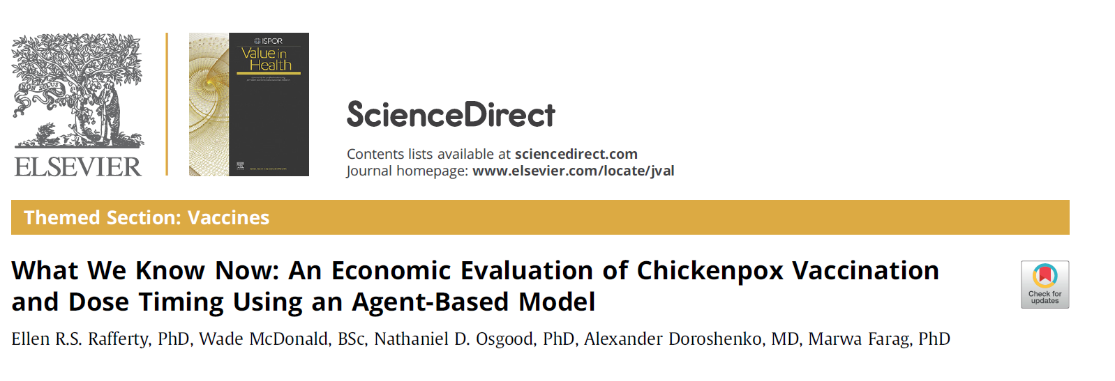
Integrating vaccine safety into health services research
Notes:
Going to walk through an example of a vaccine economic evaluation and discuss where vaccine safety may be captured with current practice.
This example relates to the cost-effectiveness of chickenpox vaccine.
Can we guess some places in this type of study that vaccine safety may be captured?

Slide 13

Vaccine safety in economic evaluations: Current practice
AEFIs
  Health outcomes associated with immunization
Chickenpox example
  Febrile seizures
Integrating vaccine safety into health services research
Notes:
Safety is typically captured in two ways:
The first is the impact of adverse events associated with immunization.
For an economic evaluation we need to capture the health outcomes associated with AEFIs (e.g., if you have a serious adverse event – this may lead to severe loss of quality of life).
In the case of chickenpox on AEFI we decided to include was the small risk of febrile seizures.

Slide 14
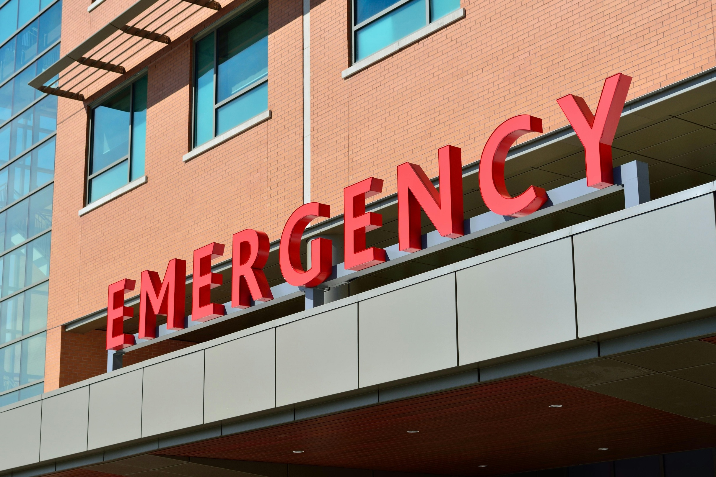
Vaccine safety in economic evaluations: current practice
AEFIs
  Health outcomes associated with immunization
  Healthcare service use
Chickenpox example
  Emergency room visits for febrile seizures
Integrating vaccine safety into health services research
Notes:
Once we have decided on the relevant AEFIs to capture, we need to determine how people will use health services if they get an AEFI.
This may include ER visits, hospitalizations, primary care visits. IN the case of the economic evaluation of chickenpox we focused on ER visits.

Slide 15
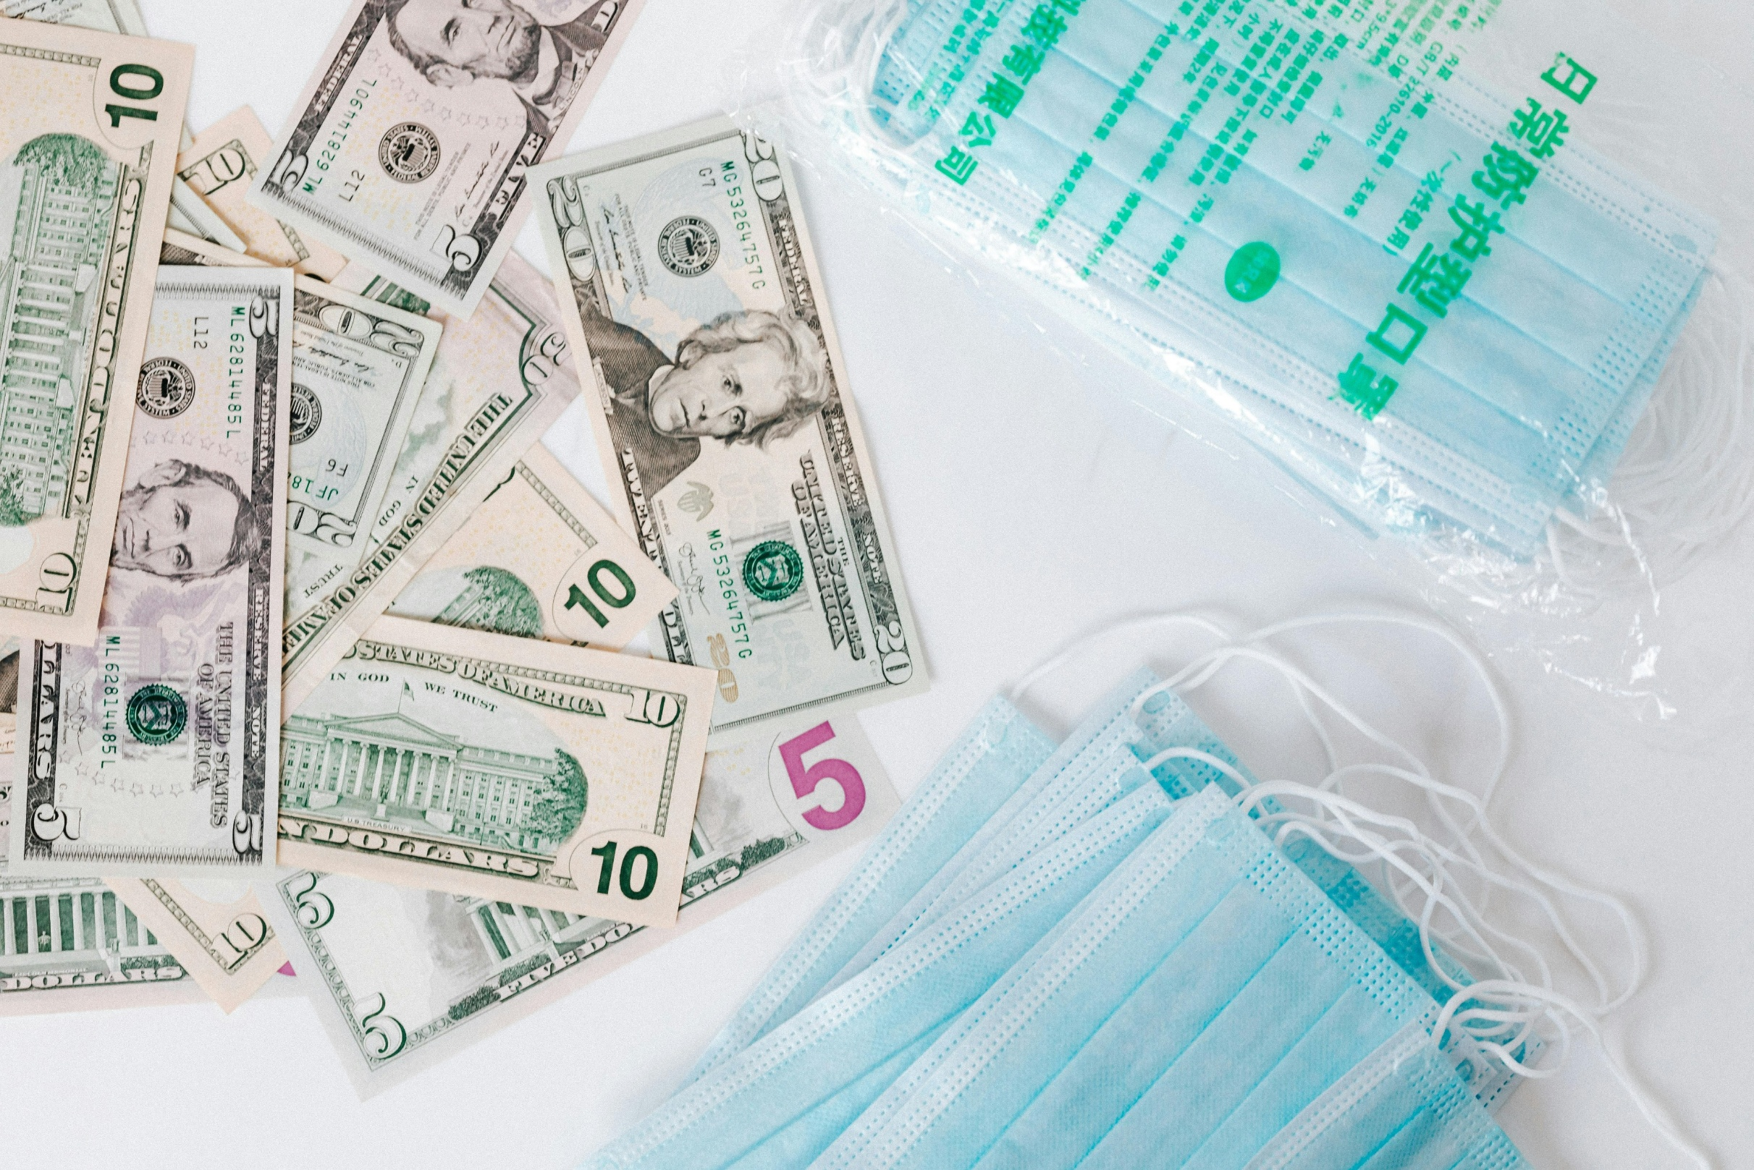
Vaccine safety in economic evaluations – current practice
AEFIs
  Health outcomes associated with immunization
  Healthcare service use
  Healthcare and productivity loss costs
Chickenpox example
  Health care costs associated with febrile seizure
  Time spent going to and from care
  Parking
Integrating vaccine safety into health services research
Notes:
Finally we need to capture the health care, productivity and travel costs associated with the AEFI.
Chickenpox example
Health care costs associated with febrile seizure
Time spent going to and from care
Parking

Slide 16

Vaccine safety in economic evaluations – current practice
AEFIs
  Health outcomes associated with immunization
  Healthcare service use
  Healthcare costs
Coverage
Chickenpox example
  How will safety concerns impact overall vaccine uptake?
Integrating vaccine safety into health services research
Notes:
While it is important to capture outcomes and costs associated with AEFIs in economic evaluation, they rarely sway the cost-effectiveness of vaccines. Where safety can have a big impact on cost-effectiveness is when preference and ideas about the safety of the vaccine have impacts on coverage.
This was reflected in our assumed coverage rate in the chickenpox model. With different assumptions about the uptake for MMRV vs. just chickenpox vaccine.
There are also elements of health services that are not captured and it is probably OK because this is not captured for any health events. So it would be a concern for both the intervention and the alternative. Some examples include:
Cost of specialty vaccination clinics
Cost of post-marketing surveillance

Slide 17
Future directions
Integrating vaccine safety into health services research
Notes:
Where I think we can do a better job of integrating vaccine safety into health economics and economic evaluation.
As you can see so far, it is relatively basic.

Slide 18
Areas of future direction
1. Capturing immunization preference and choice
Integrating vaccine safety into health services research

Slide 19
Product (Vaccine or mAb) | Type / Platform | Indication / Population
Abrysvo (Pfizer) | Protein subunit vaccine | Adults 60+
Arexvy (GSK) | Protein subunit vaccine | Adults 60+
mRESVIA (Moderna) | mRNA vaccine | Adults 60+
Nirsevimab (Beyfortus, Sanofi/AstraZeneca) | Monoclonal antibody | Infants during first RSV season
Clesrovimab (Enflonsia, AstraZeneca) | Monoclonal antibody | Neonates/infants entering first RSV season
Product (Vaccine or mAb) | Type / Platform | Indication / Population
Comirnaty (Pfizer/BioNTech) | mRNA vaccine | Broad use (children & adults)
Spikevax (Moderna) | mRNA vaccine | Broad use
Vaxzevria (AstraZeneca) | Viral vector vaccine | Adults (some countries)
Nuvaxovid (Novavax) | Protein subunit vaccine | Adults & adolescents
Integrating vaccine safety into health services research
Notes:
We are in a world that has exploded with vaccine choice. I have just put the options for immunization for COVID-19 and RSV, and as you can see there is a large amount of choice for both governments and potentially the individual, if it comes to private market. So how do we navigate this world of choice and how may vaccine safety impact those choices.

Slide 20
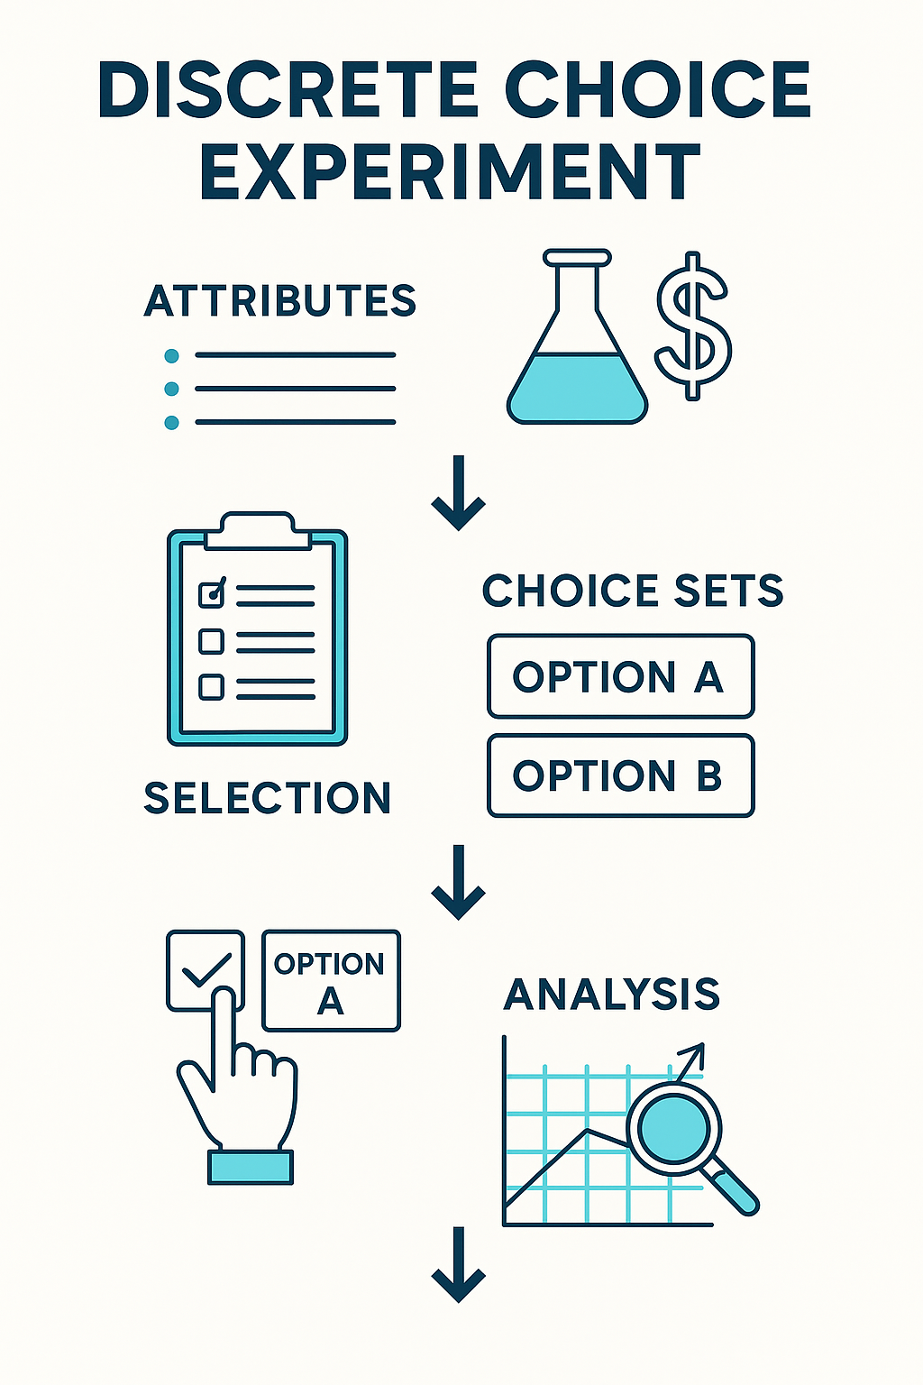
Discrete choice experiment
Participants shown series of hypothetical examples
  “Which vaccine would you choose?”
  Option A: 95% effective, mild side effects in 1/100, two doses, $20
  Option B: 85% effective, no severe side effects, one dose, free
  They pick the option they prefer in each scenario
These can then be incorporated into decision tree models and economic evaluations
Also allows for estimations of willingness to pay
  Which can help set prices for vaccines, especially for the private market.
Integrating vaccine safety into health services research
Notes:
One way to capture vaccine preferences is through discrete choice experiments.
Allow us to determine apriori how the public may react to various vaccine safety characteristics.
These can then incorporated into modelling of how the public will respond to vaccination, how to improve coverage.
How does it work.

Slide 21
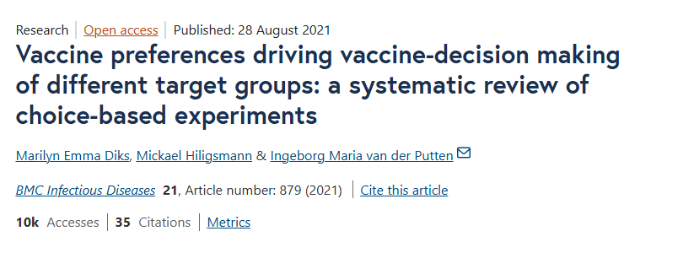
100
%
Of studies looking at what vaccine preferences are driving vaccine-decision making found vaccine risk was a significant factor.
Integrating vaccine safety into health services research
Notes:
We see the impact of vaccine safety in these discrete choice experiments. For instance, this paper…
Found that in all studies looking at which vaccine preferences are driving vaccine-decision making vaccine risk was a significant factor.
Vaccine safety is often at the top of the list in these choice experiments, demonstrating perceptions around safety can play a big role in uptake.

Slide 22
Areas of future direction
1. Capturing vaccine choice
2. Risk-based pricing
Integrating vaccine safety into health services research
Notes:
Another complex but interesting concept develop by some of our colleagues at IHE and U of A, is risk base pricing.

Slide 23
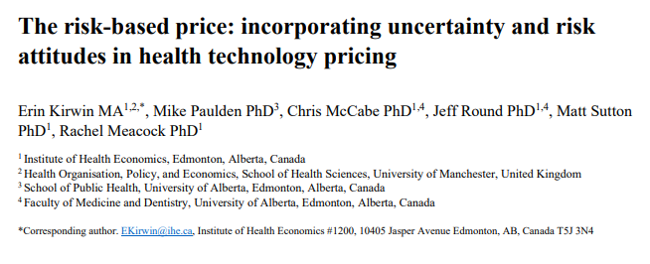
Integrating vaccine safety into health services research
Notes:
This is a method for incorporating uncertainty in important elements like vaccine safety into vaccine pricing.
We know there is uncertainty in what adverse events we may see with vaccines and how that may impact uptake and the ultimate effectiveness of the vaccine.
These types of agreements allow us to account for the unknowns in things like vaccine safety.
Also know as managed access agreements, which are quite popular in Europe.
Which allows us to price vaccines considering the uncertainty we are often faced. There is bound to remain uncertainty in the safety of a vaccine since it often rolled out to such a large population – much larger than the clinical trials. And so rare safety signals may only be seen after it is marketed in the population. We can think about how to adjust prices to account for this.

Slide 24
Areas of future direction
1. Capturing vaccine choice
2. Risk-based pricing
3. Earlier integration of vaccine safety considerations into economic evaluations
Integrating vaccine safety into health services research
Notes:
And last but not least, earlier integration of vaccine safety considerations, including DCE, into economic evaluations.

Slide 25
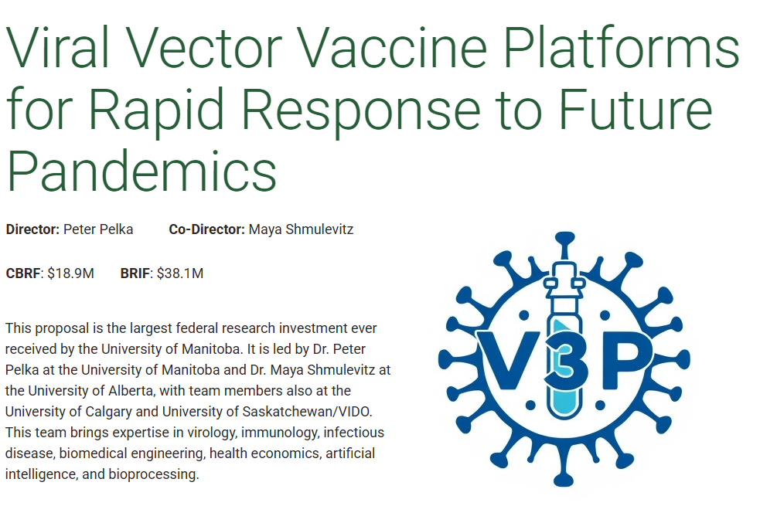
When to integrate vaccine safety?
Integrating vaccine safety into health services research
Notes:
I am part of one of the CBRF grants where my role is to do exactly that.
We are trying to evaluate vaccine candidates at an earlier stage to account for potential difference in things like AEFIs, to better select the candidates that we move forward to full evaluation.

Slide 26
Thank you! Questions?
        Ellen Rafferty, PhD
        Emails: erafferty@ihe.ca eraffert@ualberta.ca

