Slide 1


Overview of Vaccine Safety Research
University of Alberta Symposium on the Science of Vaccine Safety | October 2025
Overview of vaccine safety research across the CIHR pillars PILLAR 4
University of Alberta Symposium on the Science of
Vaccine Safety: Bridging Across Pillars
Professor Kelley Lee
Bridge Research Consortium
Notes:
Presentation:
20 min + 5 min Q&A
Panel discussion:
How your research related to vaccine safety could benefit from research carried out by researchers whose work focuses on the other pillars. What are the gaps in your pillar that another pillar might be able to address (or vice versa)? What are the opportunities to enhance vaccine safety research? How can improve knowledge mobilization and communication of research on vaccine safety?

Slide 2

Overview of Vaccine Safety Research
University of Alberta Symposium on the Science of Vaccine Safety | October 2025
Land Acknowledgement
We respectfully acknowledge that our BRC team members work and live across Canada on the unceded and traditional territories of the First Nations, Métis and Inuit Peoples.
The BRC Secretariat is based in the unceded territories of the xwməθkwəy̓ əm (Musqueam), Sḵwx̱wú7mesh Úxwumixw (Squamish), səlilwətaɬ (Tsleil-Waututh), q̓íc̓əy̓ (Katzie), kwikwəƛ̓əm (Kwikwetlem), Qayqayt, Kwantlen, Semiahmoo and Tsawwassen peoples

Slide 3
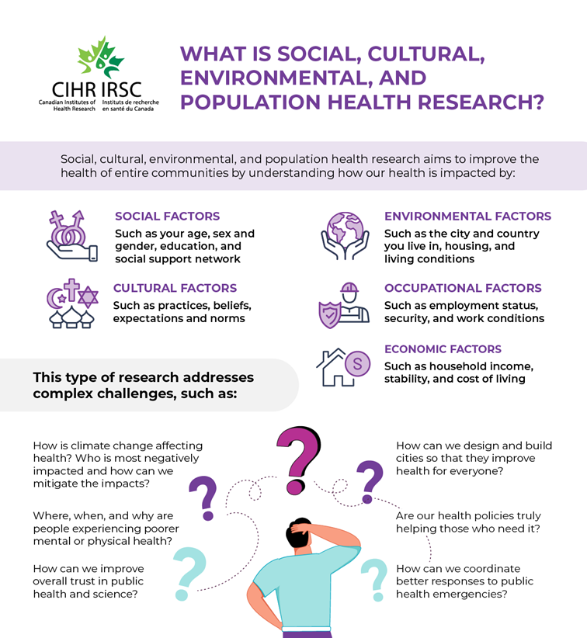
CIHR Pillar 4: Social, cultural, environmental and population health research
Overview of Vaccine Safety Research
University of Alberta Symposium on the Science of Vaccine Safety | October 2025
the ways in which social, cultural, environmental, occupational and economic factors influence the health of individuals and communities
focus on improving the health of populations by understanding the broader social determinants of health
CIHR Institute of Population and Public Health (IPPH) is the Pillar 4 “champion” in collaboration with other CIHR institutes and external organizations

Slide 4
DETERMINANT | EXAMPLES
SOCIAL | What are the structural barriers to accessing vaccines in Canada within priority populations (e.g., location, income, work)? How does lack of equitable access to vaccines impact uptake? How does the media influence public understanding of risk related to vaccines?
CULTURAL | How is risk understood and managed within specific cultural groups? What are sources of trusted information about vaccine safety within religious communities? How do values about autonomy align with Canadian vaccine policies?
ENVIRONMENTAL | How is post market surveillance (adverse reactions) impacted by rural versus urban contexts? To what extent are extreme weather events a risk to cold chain integrity?
OCCUPATIONAL | What has been the experience of healthcare workers in reporting adverse reactions? How is risk assessed by different occupational groups for applying vaccine mandates? How should risk communication be adapted on vaccine safety for different occupations?
ECONOMIC | Are individuals of lower socioeconomic status more susceptible to adverse reactions due to baseline health disparities? Which post market surveillance systems are most cost-effective for ensuring vaccine safety? How do economic considerations factor into considerations of risk related to vaccine safety?

Slide 5
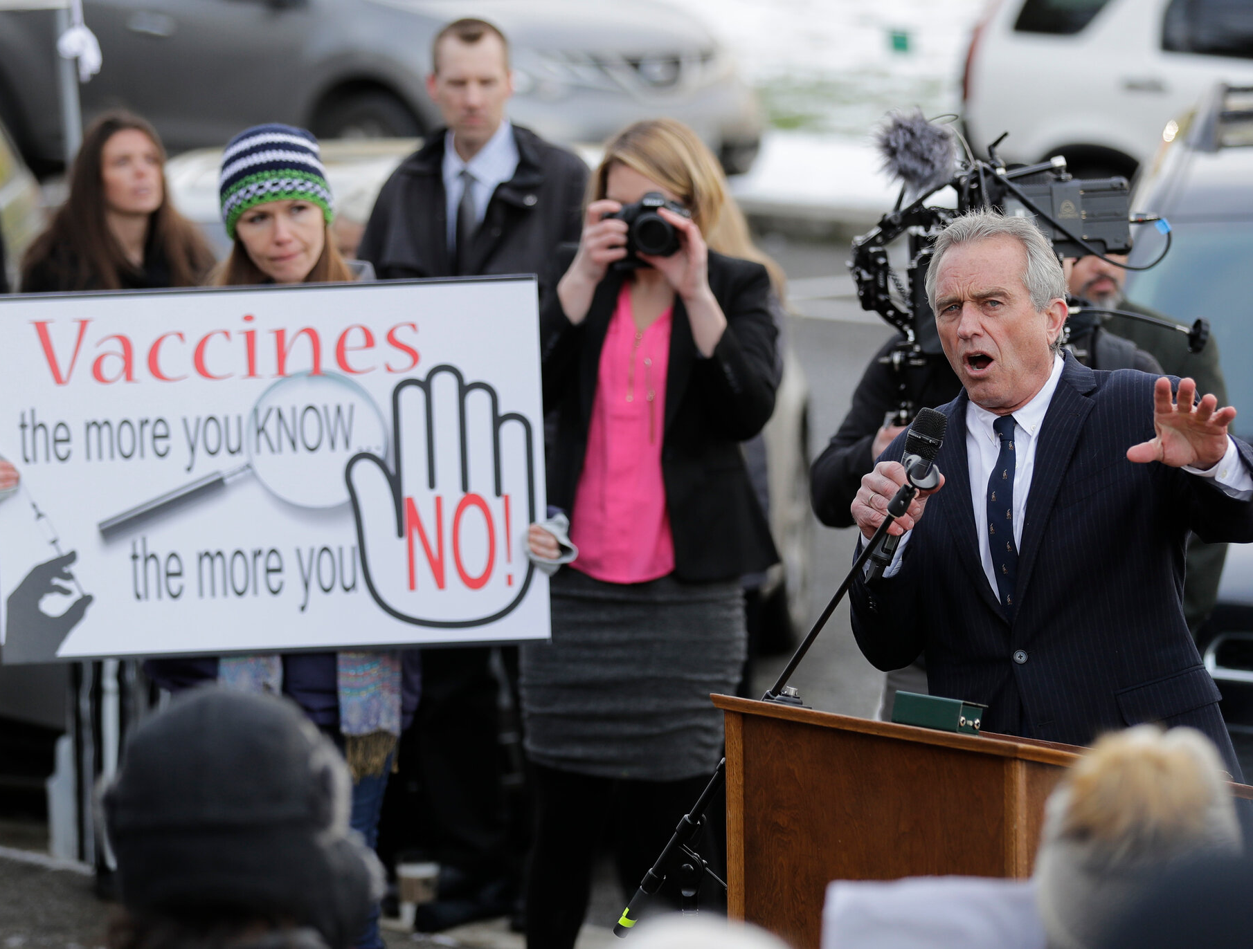
Overview of Vaccine Safety Research
University of Alberta Symposium on the Science of Vaccine Safety | October 2025
Shifting contexts
old alliances unreliable including unprecedented tensions in Canada-US relations
greater political polarization at home and abroad underpinned by socioeconomic inequities and wealth inequalities
governance crisis at domestic and global levels including weakening of social contract and withdrawal from multilateralism
deterioration of information and equity ecosystem
need to pivot Canadian domestic AND foreign policy together (e.g., national security through infrastructure investments, defence spending, new trading partners)

Slide 6
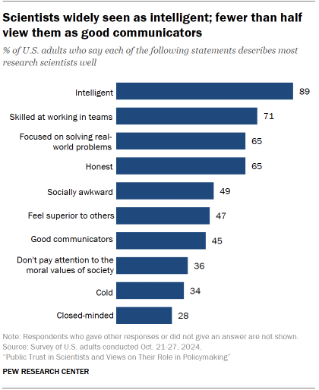
Overview of Vaccine Safety Research
University of Alberta Symposium on the Science of Vaccine Safety | October 2025
“Institutions and experts struggle to adapt precisely because the skills needed to thrive – relational communication, conversational fluency, responsiveness, and emotional resonance – are largely absent from traditional educational and institutional training.”

Slide 7
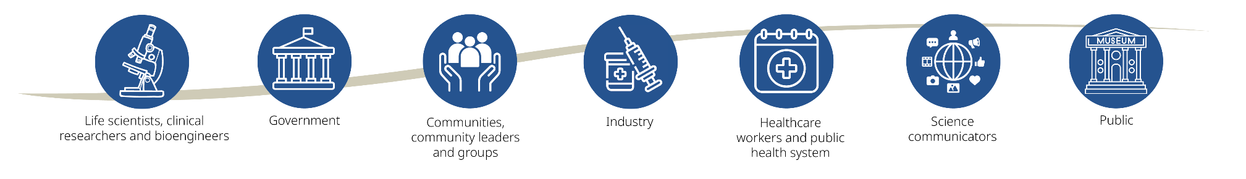
Overview of Vaccine Safety Research
University of Alberta Symposium on the Science of Vaccine Safety | October 2025
Mission
We bring together wide-ranging expertise and perspectives to better understand and support public trust and equitable access to new vaccines and immune-based innovations that strengthen Canada’s readiness for future public health emergencies.
The BRC is funded by the Canada Biomedical Research Fund, Canada Foundation for Innovation, and the BC Knowledge Development Fund to support Canada’s Biomanufacturing and Life Sciences Strategy.
A project supporting Canada’s Immuno-engineering and Biomanufacturing Hub (CIEBH) led by the University of British Columbia

Slide 8
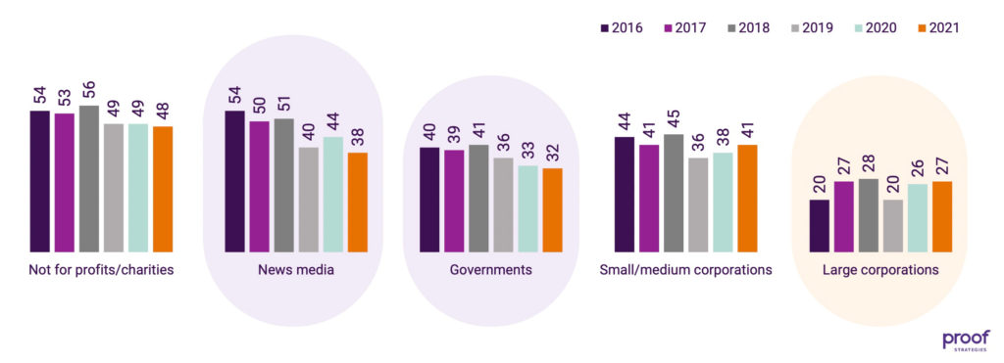
PHAC Adult National Immunization Coverage Survey
Overview of Vaccine Safety Research
University of Alberta Symposium on the Science of Vaccine Safety | October 2025
2023 national survey data reports that safety/side-effect concerns were the single largest cited reason for adult vaccine hesitancy in Canada (45% of those hesitant)
baseline data on how perceived risk links to trust and information sources
Source: https://www.thecharityreport.com/news/%EF%BF%BCpublic-trust-in-government-and-institutions-further-deteriorating/

Slide 9
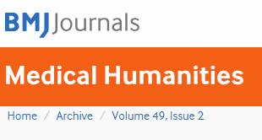
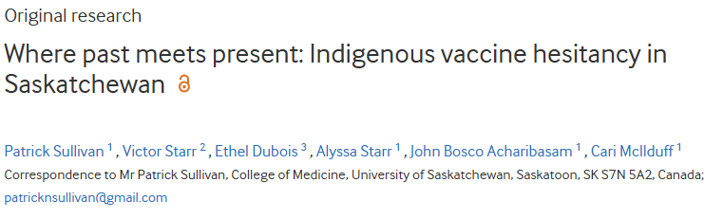
Overview of Vaccine Safety Research
University of Alberta Symposium on the Science of Vaccine Safety | October 2025
“Results demonstrated the importance of exploring an Indigenous community’s self-determined solution…alongside the exploration of external solutions….some sources of vaccine hesitancy, such as cultural barriers, can also be used to promote vaccine confidence. When attempting to overcome barriers, empathy is crucial as vaccine fears exist, and antivaccine groups are prepared to take advantage of empathetic failures…. Messaging…should avoid polarising vaccine-confident and vaccine-hesitant people to the point where the benefits of community influence are limited.”

Slide 10

Overview of Vaccine Safety Research
University of Alberta Symposium on the Science of Vaccine Safety | October 2025
Faith and Vaccine Decisions in Muslim, Sikh And Hindu Communities
Understanding how religious beliefs and intersecting social identities impact vaccination behaviours in Canada
Focus
Published scoping review of the relationships between religious beliefs and vaccine hesitancy (BMC Public Health)
Article published in Policy Options
Received a $120,000 CIHR Doctoral Award
Upcoming community interviews and focus groups
Haaris Tiwana, BDS, MPH
PhD student, Bridge Research Consortium
Notes:
Deleted “Cultural Factors” header

Slide 11


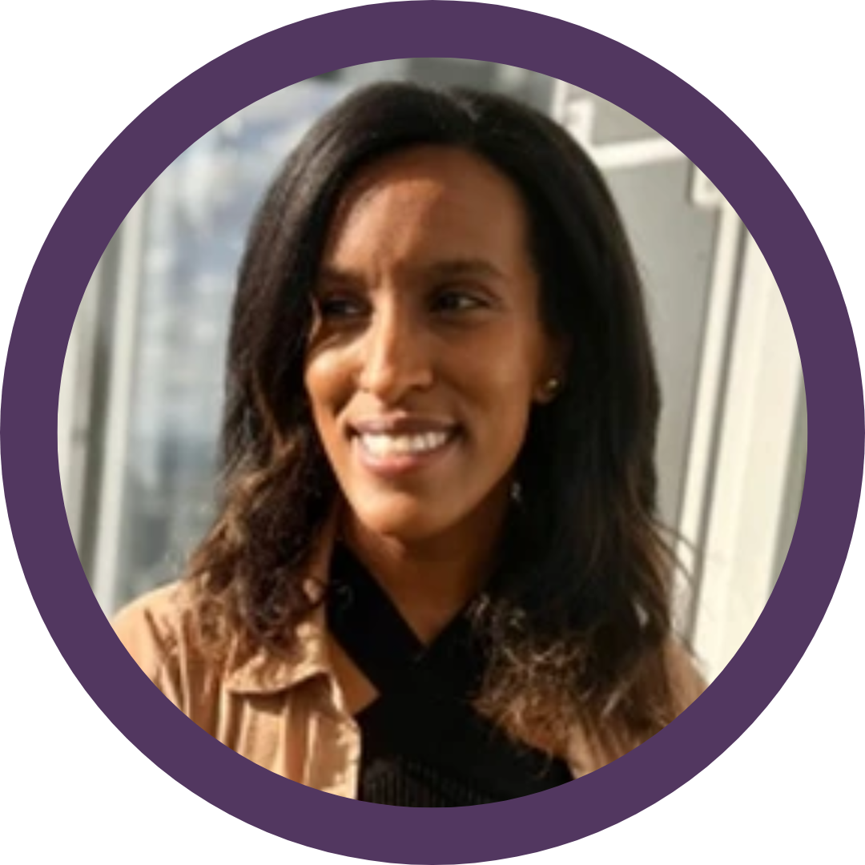
Overview of Vaccine Safety Research
University of Alberta Symposium on the Science of Vaccine Safety | October 2025
Animal Rearing and Vaccine Risk Decision Making
Understanding the perspectives and practices of farming communities and meat industry workers in managing risk
Focus
Poultry farming and H5N1 Vaccine acceptance: Looking beyond online information, CIHR Project Grant (PI: Eve Dube)
Crises in the coop: Poultry farmers’ decision-making strategies amidst multiple challenges, SSHRC (PI: Kaylee Byers)
Sustainable smallholder pig farming and One Health, ACIAR Grant (PI: Sara Davies)
Dr. Ève Dubé, Laval University
Dr. Kelley Lee and Dr. Rackeb Tesfaye, Simon Fraser University
Notes:
G: Deleted »Occupational Determinants » header
Note: This box says Projects and all the other ones say Focus.
*Coordinating with PHAC and other researchers across Canada,

Slide 12
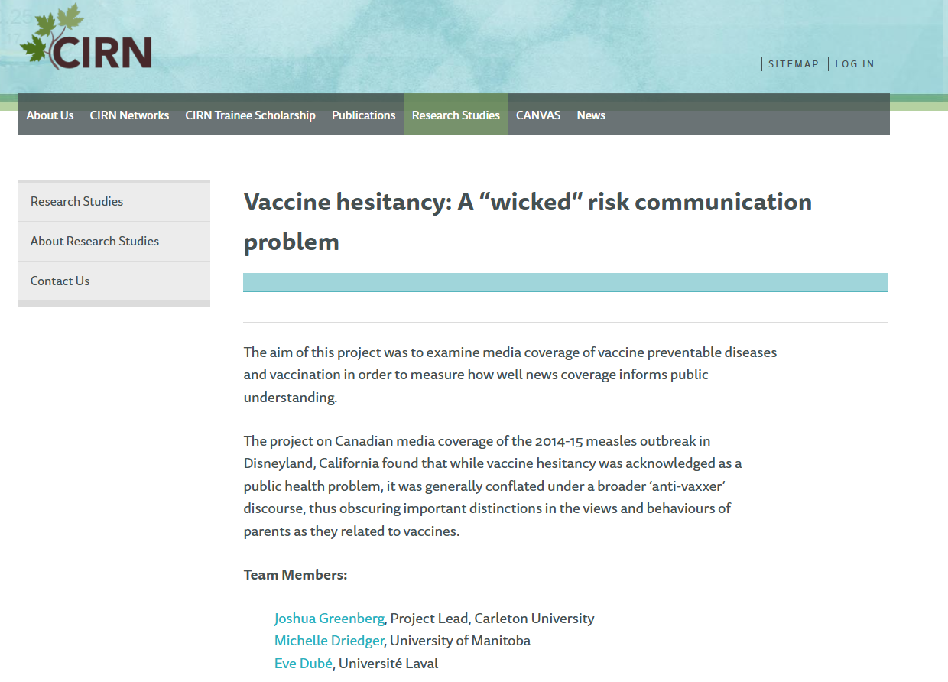
Overview of Vaccine Safety Research
University of Alberta Symposium on the Science of Vaccine Safety | October 2025

Slide 13

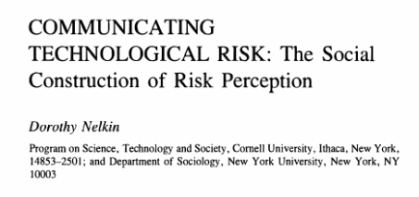
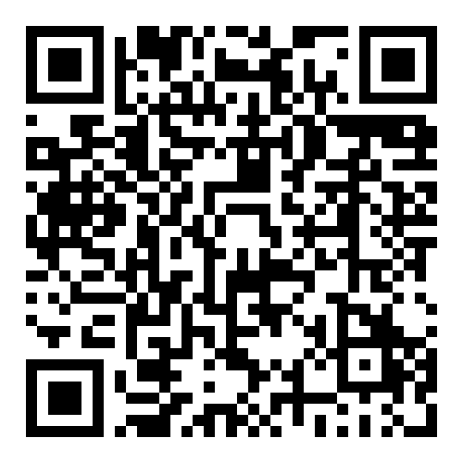
Overview of Vaccine Safety Research
University of Alberta Symposium on the Science of Vaccine Safety | October 2025
“Evaluating risk requires interpretive judgement in the face of technical uncertainty and scientific disagreement. What constitutes significant and meaningful evidence? Whose judgement is to be considered in evaluating the severity and acceptability of risk? What rules of evidence should guide legal and policy decisions. Communicating risk involves questions of social responsibility and political legitimacy. What information should be conveyed to the public? What level of certainty is necessary before risks are communicated? What are the appropriate roles and limits of government in controlling and communicating information? In the context of conflicting scientific interpretations, who can be believed?”
1989, 10: 95-113. https://doi.org/10.1146/annurev.pu.10.050189.000523

Slide 14

Overview of Vaccine Safety Research
University of Alberta Symposium on the Science of Vaccine Safety | October 2025
Political Ideology and Misinformation in Shaping Public Discourse in Vaccine Risk
How political identity and affiliation relate to public trust
and confidence in new vaccine safety and efficacy
Focus
Role of partisan politics in how elected officials talk about vaccine safety
Misinterpretation and misrepresentation of data from vaccine adverse events reporting systems on social media
Dr. Timothy Caulfield
University of Alberta
Notes:
Deleted “Social factors” header

Slide 15
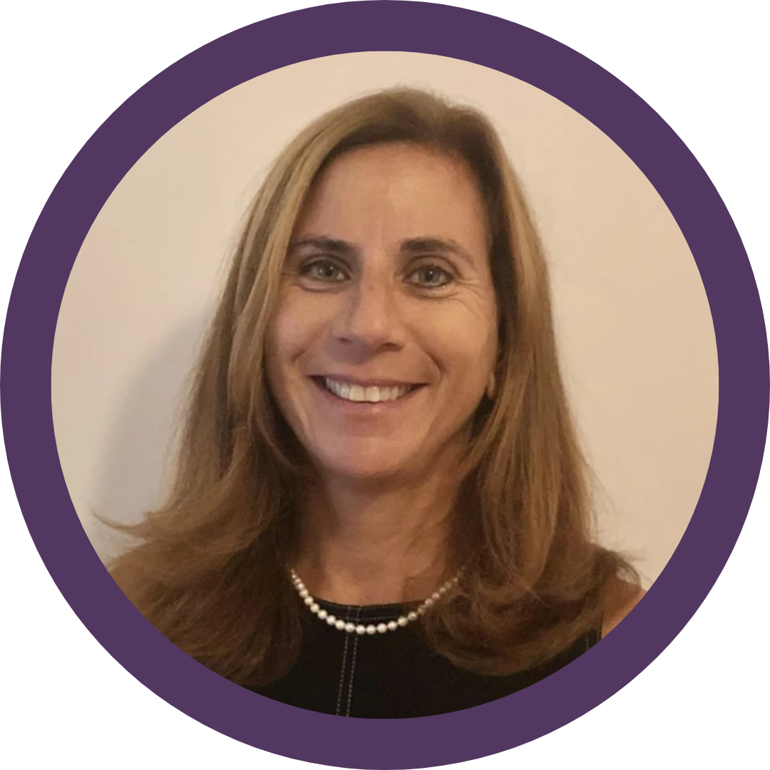
Overview of Vaccine Safety Research
University of Alberta Symposium on the Science of Vaccine Safety | October 2025
Guide To The Therapeutic Pipeline
An accessible guide to demystify how new vaccines and immuno-therapeutics are developed and approved for use
Testing, regulatory approvals and postmarket surveillance as main public concerns during COVID-19
Accessible explanations of phases along pipeline
Explain why roles for public and private actors and need for good governance to support public trust
Target audiences include healthcare workers and general public
Dr. Jillian Kohler, University of Toronto
Dr. Kelley Lee, Simon Fraser University
Notes:
G: Deleted “Political Economy Factors” header

Slide 16
Overview of Vaccine Safety Research
University of Alberta Symposium on the Science of Vaccine Safety | October 2025
Public trust in vaccine safety: Not business as usual
"Today, public attention flows through a far more diffuse, competitive ecosystem—one where influence is shaped by networks rather than hierarchies. The old gatekeepers have been replaced by new ones: algorithms that curate content, high-follower social media accounts that influence what goes viral, and deeply engaged niche creators who enjoy immense legitimacy within their communities"
“experts and non-partisan analysts must rethink not just their channels of communication but also their theory of influence”
“Institutes and experts…generally continue to signal credibility via authority: facts presented alongside credentialling markers such as educational degrees, institutional brands, or peer review. Influencers win attention and legitimacy via authenticity, relatability, and direct audience connection.”
Carnegie Endowment for International Peace, September 2025

Slide 17
Key messages
Overview of Vaccine Safety Research
University of Alberta Symposium on the Science of Vaccine Safety | October 2025
Pillar 4 research more important than ever given the shifting societal context within which vaccine safety must be advanced and communicated
strong but historically underfunded Pillar 4 research community of social scientists and humanities scholars in Canada conducting mixed methods research to understand social, cultural, environmental
and population health research
BRC funded by CBRF to support public trust and equitable access to new vaccines and immuno-therapies ahead of future pandemic
urgent need to better understand and engage meaningfully with needs, lived experiences and perspectives of Canada’s diverse populations
scientific innovation under Pillars 1-3 must also be accompanied by innovation under Pillar 4 (not business as usual)

