Slide 1
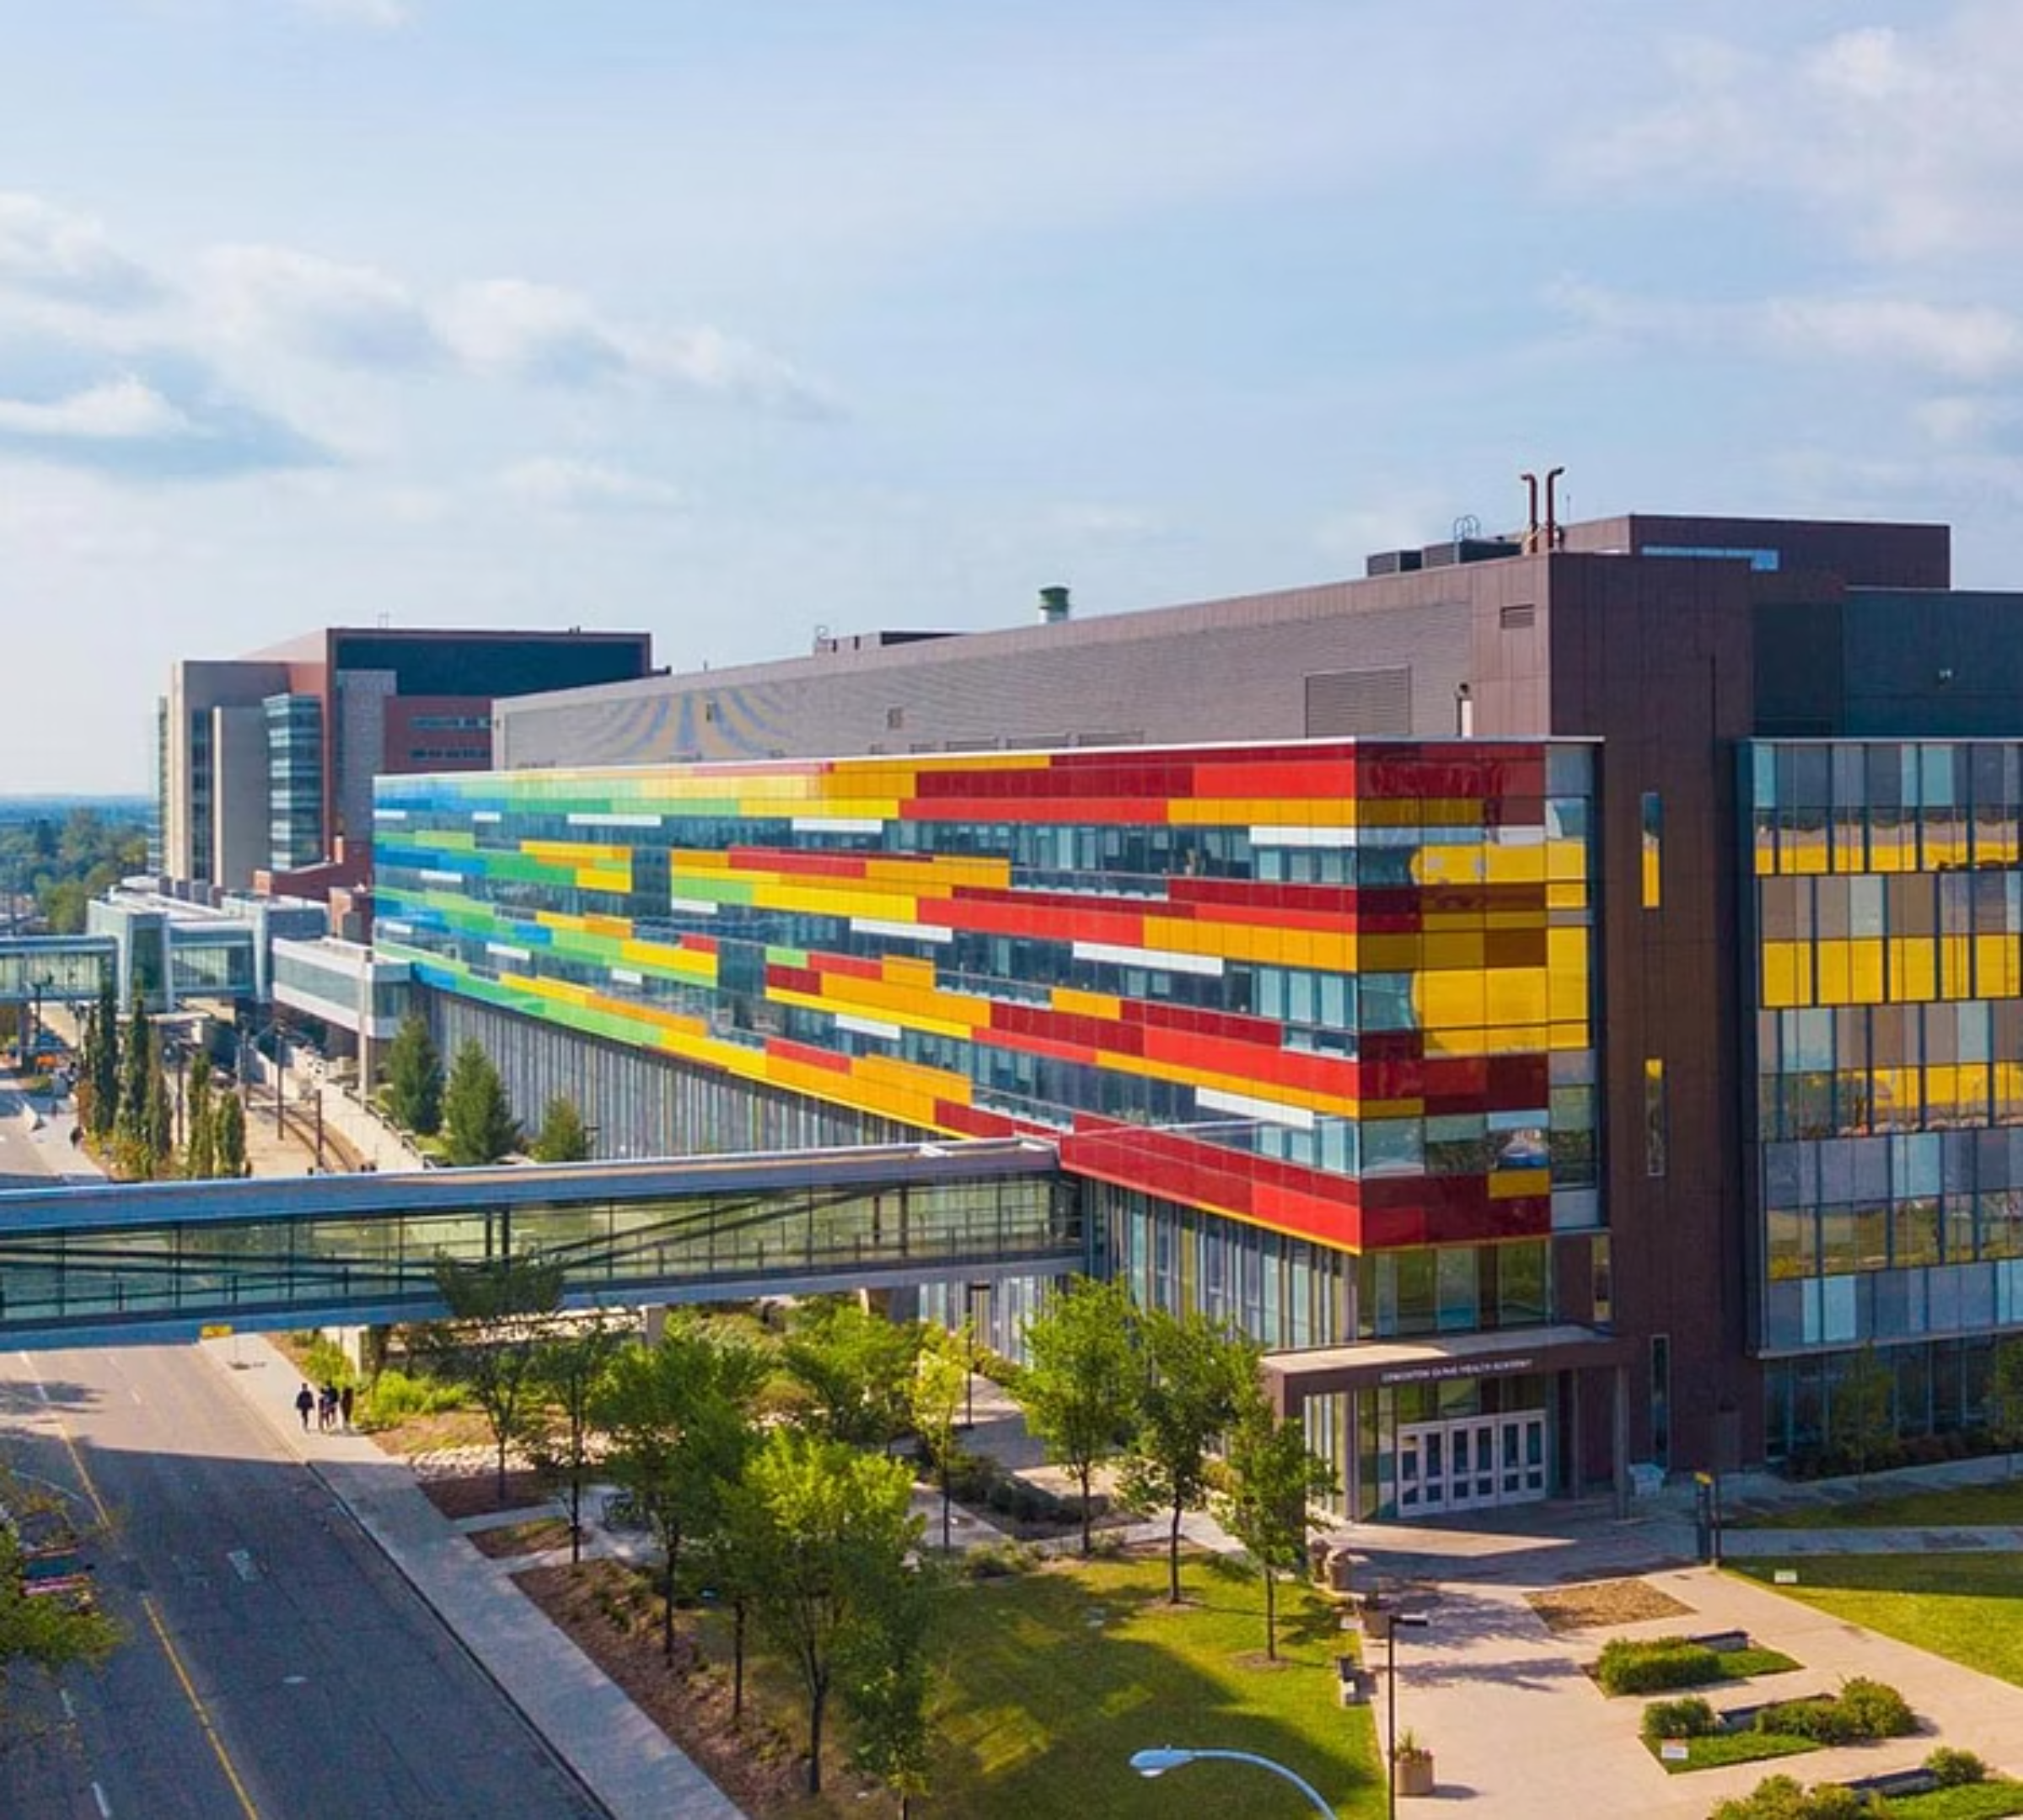
University of Alberta
Pediatric Gastroenterology

Slide 2
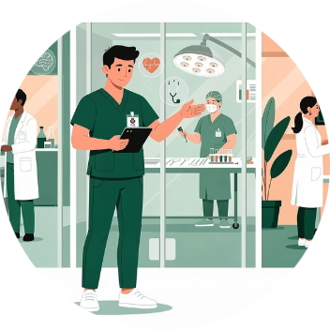

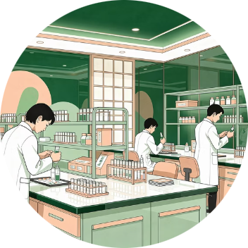
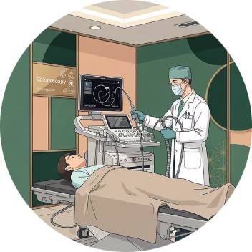



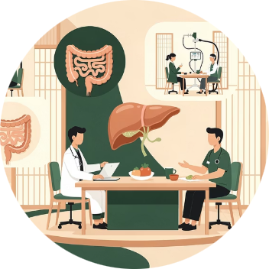
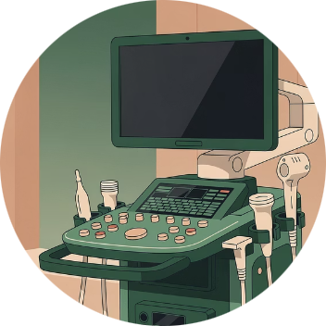

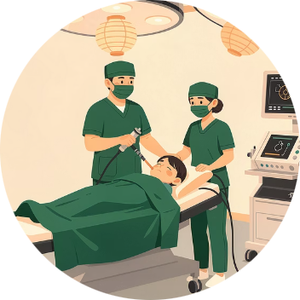
Program Structure
2-year core program with support to pursue a third year of clinical and/or research subspecialization
Inpatient Service
Outpatient Clinics
Research
Adult Endoscopy
Consults, Transplant, Intestinal Failure (11.5 blocks)
4 blocks
4 blocks
1 block
Pathology
Nutrition
Motility
Electives
½ block (2 weeks)
½ block (2 weeks)
½ block (2 weeks)
2 blocks
Intestinal US
Continuity Clinics
Endoscopy
Longitudinal
Longitudinal
Longitudinal
Notes:
2-year core program that can be flexible to accommodate trainee interests
Each block is typically 4 weeks
We also provide strong support to pursue a third year of clinical and/or research subspecialization based on trainee and obtaining competitive funding
All of our trainees that have been interested in a third year have been successful in obtaining funding
Although the focussed nutrition block is 2 weeks, nutrition concepts are heavily incorporated throughout residency
The continuity clinics are longitudinal and trainees will have both a general GI stream and a subspecialty stream that they can select based on their interests
Pediatric endoscopy is incorporated on a weekly basis with options for additional exposure. Our center is unique in the exposure to interventional procedure for trainees, including completing your training with competencies in endoscopic balloon dilation, endoFLIP, variceal banding and sclerotherapy in addition to high volume diagnostic gastroscopy and colonoscopy. Due to complex patient population including ECMO, liver and cardiac transplant , the volume of GI bleeds is also higher which is important in building competency for indepent staff practice.

Slide 3
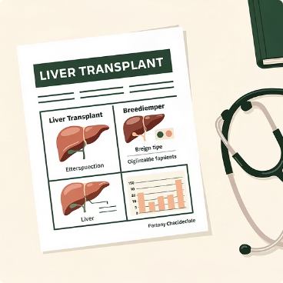
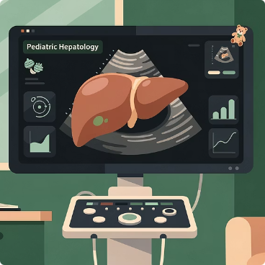
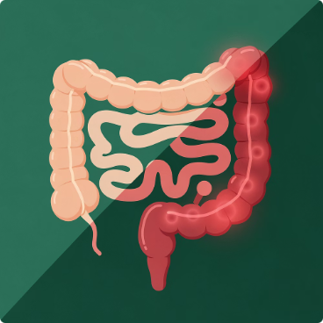
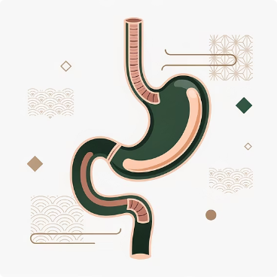
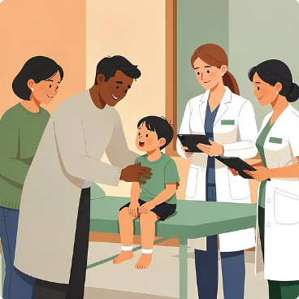
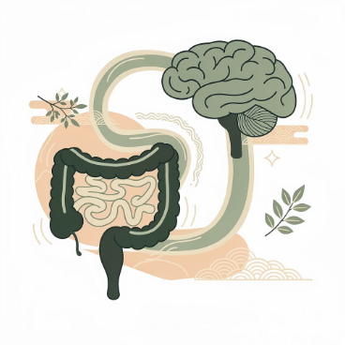

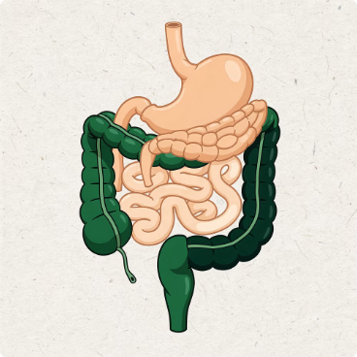
Specialized Clinics
Provide trainees with concentrated, collaborative multidisciplinary exposure to pediatric GI care
Transplant Clinic
General Hepatology Clinic
IBD Clinic
Eosinophilic GI Conditions
Pre- and post-transplant care
Integrated intestinal ultrasound
Aerodigestive Clinic
Chronic Abdominal Pain Clinic
Celiac Clinic
Intestinal Rehabilitation Program
GI, ENT, pulmonary, SLP and general surgery
GI and psychiatry
Including management of home parenteral nutrition
Notes:
These are some of the specialied clinics we hold in addition to general GI clinics
A combined CF multidisciplinary clinic also exists, and we also see VEOIBD patients in conjunction with the immunologists

Slide 4
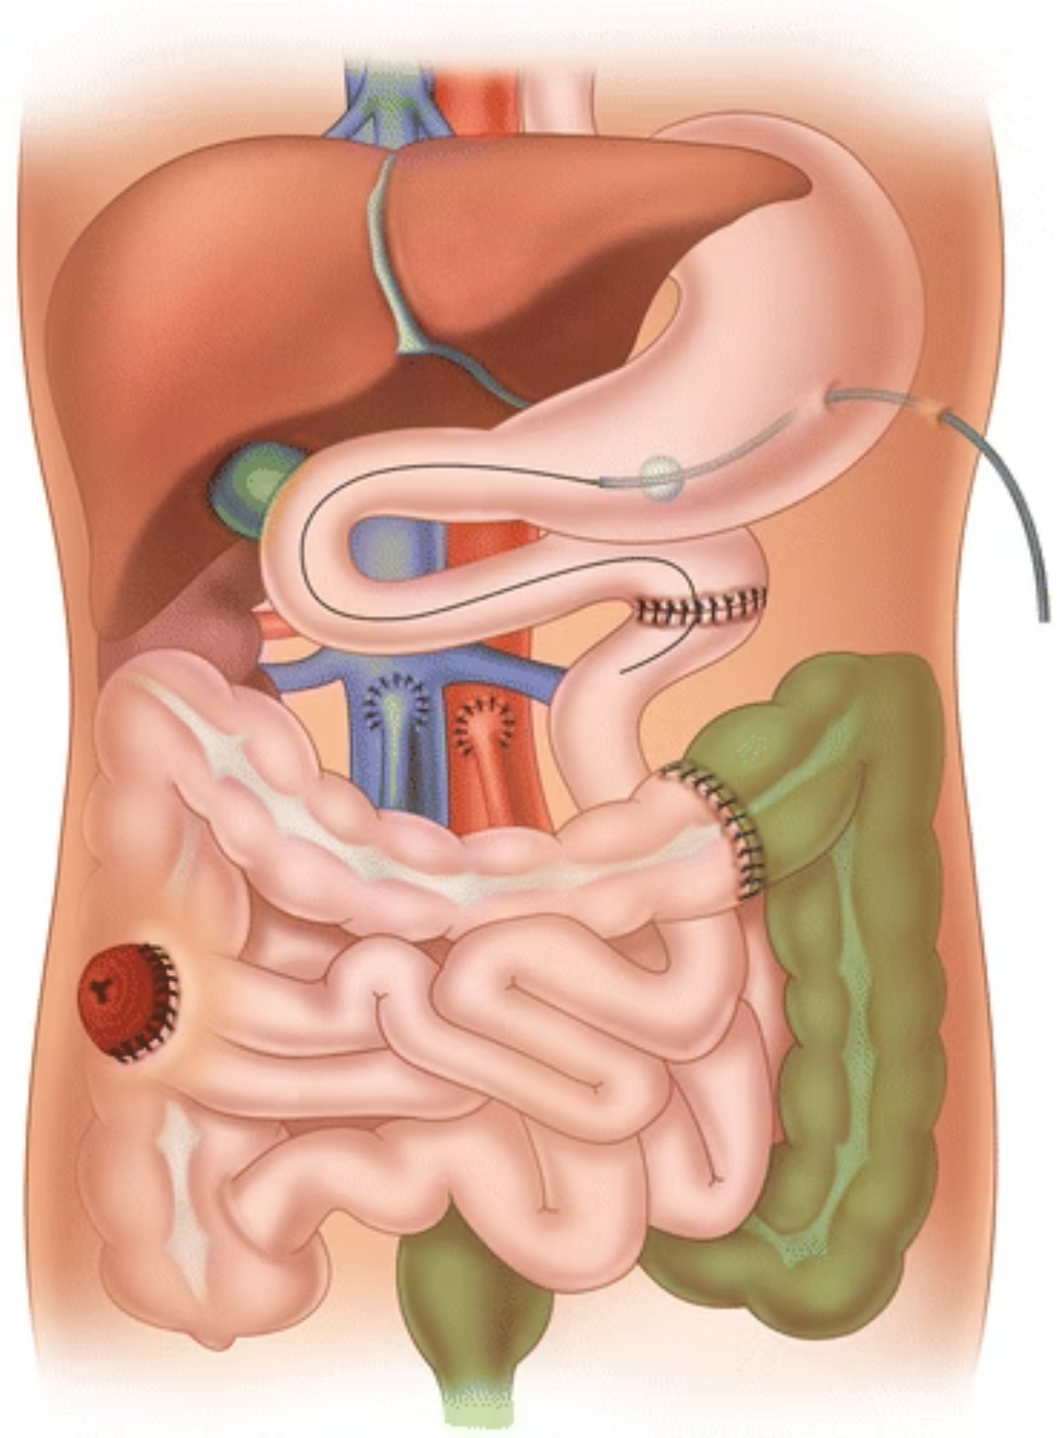
Liver & Multi-Visceral Transplant
Quaternary Exposure
Western Canada's referral centre for liver and MV transplant
Comprehensive Experience
Crucial hands-on management of acute and chronic liver failure, as well as intestinal failure
Team Integration
Trainees are key members of the multidisciplinary transplant team

Slide 5
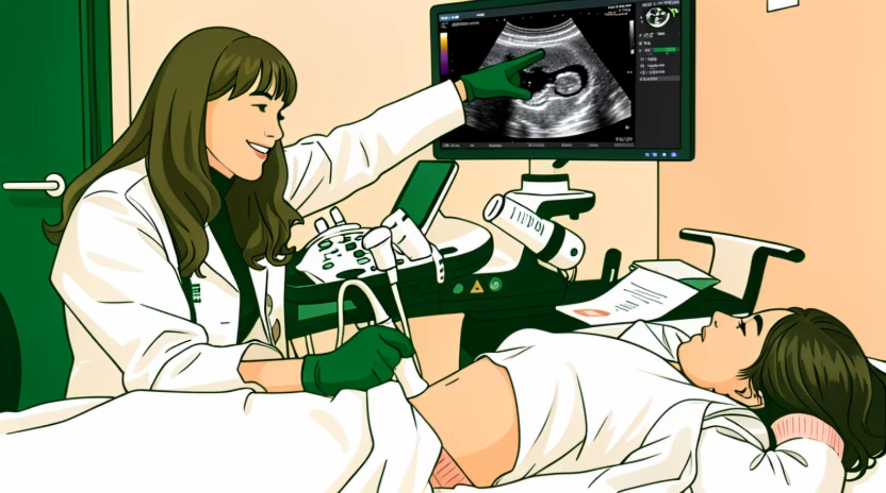

Intestinal Ultrasound Curriculum
First integrated IUS curriculum in Canada
Enhances real-time diagnostic capabilities for IBD diagnosis and management
Graduate with internationally recognized certification in IUS
Notes:
• This curriculum is the first of its kind in Canada, offering integrated longitudinal IUS training
• IUS enhances our ability to diagnose and manage inflammatory bowel disease (IBD) through real-time, non-invasive monitoring
Our center is an IBUS and iUSCAN recognized training site. Graduates have the opportunity to pursue internationally recognized certification in IUS, positioning them at the forefront of this emerging field.
IUS skills give our trainees advanced diagnostic capabilities to better serve their patients and a desirable skill for the post-training job market

Slide 6



Established Academic Half-Day Curriculum
Protected Time
Dedicated weekly academic half-day on Tuesday afternoons
Expert Faculty
Staff-facilitated interactive teaching integrating evidence-based practice and Royal College objectives
Progressive Learning
Structured two-year curriculum responsive to trainee feedback

Slide 7
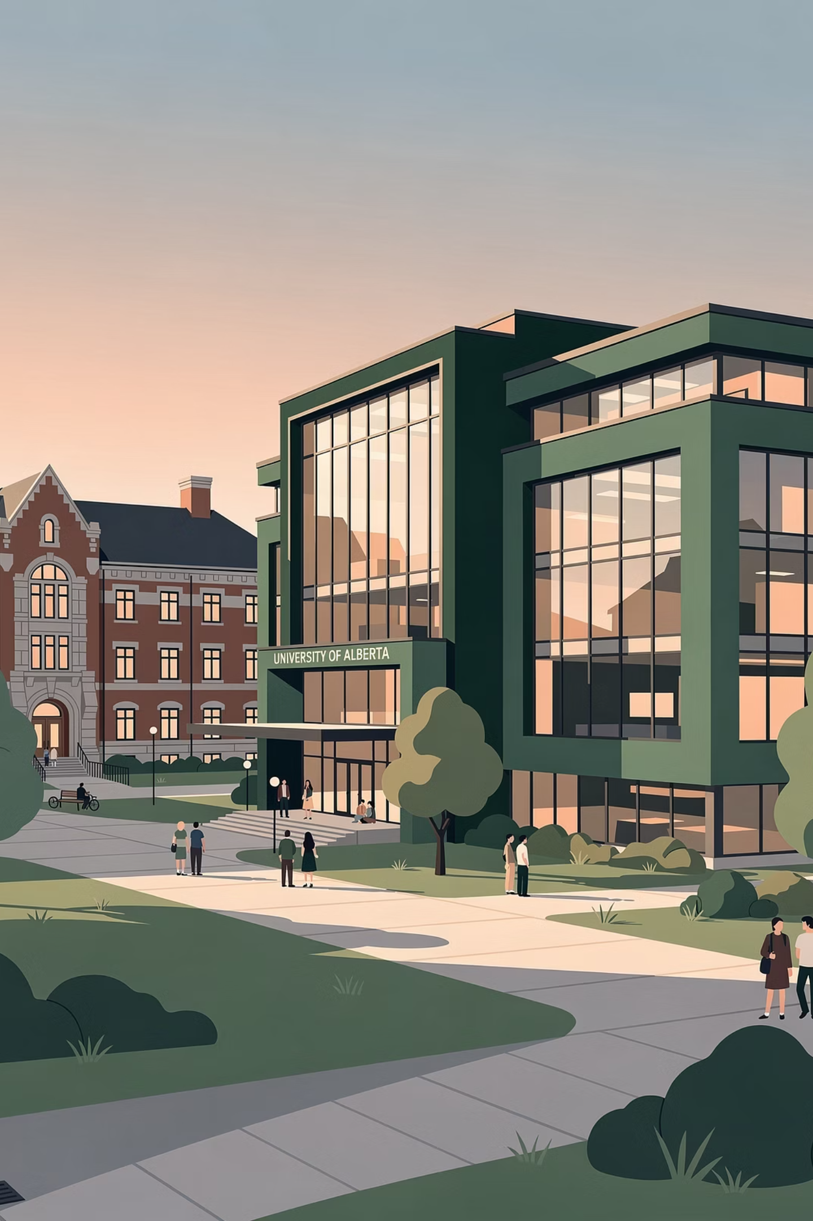
Supportive Research Environment
Abdundant clinical research opportunities
Translational research in microbiome and metabolomics
Artificial intelligence applications in gastroenterology
Incorporation in CIDsCaNN initiatives
Clinical trials and innovative therapeutic studies
Funding success: Consistent funding support for third-year training, in addition to trainee research and presentation grants

Slide 8
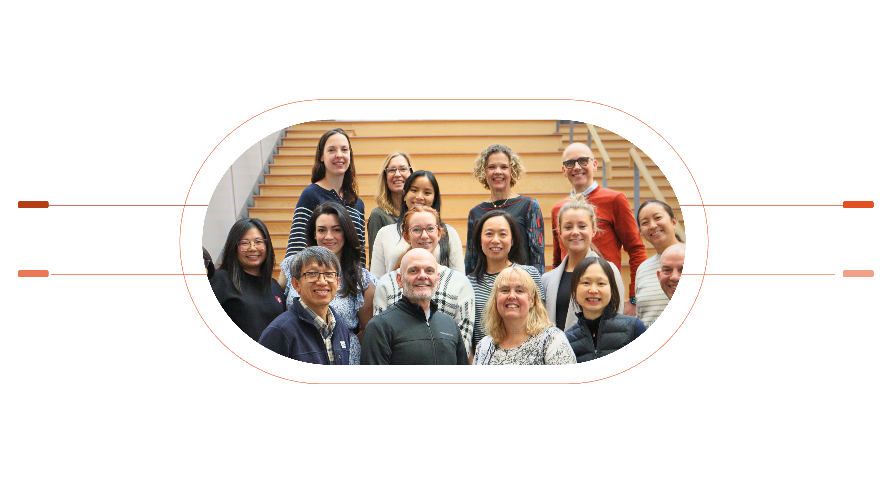
Collaborative Interdisciplinary Care
Pathology and Radiology
Dietitians and Nurses
Joint rounds Integrated clinical partnership
Expert clinical and nutritional support
Adult GI
Pediatric Surgery
Combined academic rounds and endoscopy training
Combined clinical and academic rounds
Multidisciplinary mentorship and committed faculty engagement leads to enhanced clinical learning and research opportunities for trainees.

Slide 9

Life in Edmonton
Thriving arts and culture scene, diverse culinary options, and year-round festivals
Edmonton River Valley is North America's largest urban parkland - many opportunities for outdoor activities like cycling, running and hiking
Affordable living
Easy access to the Canadian Rockies
McDavid!

Slide 10
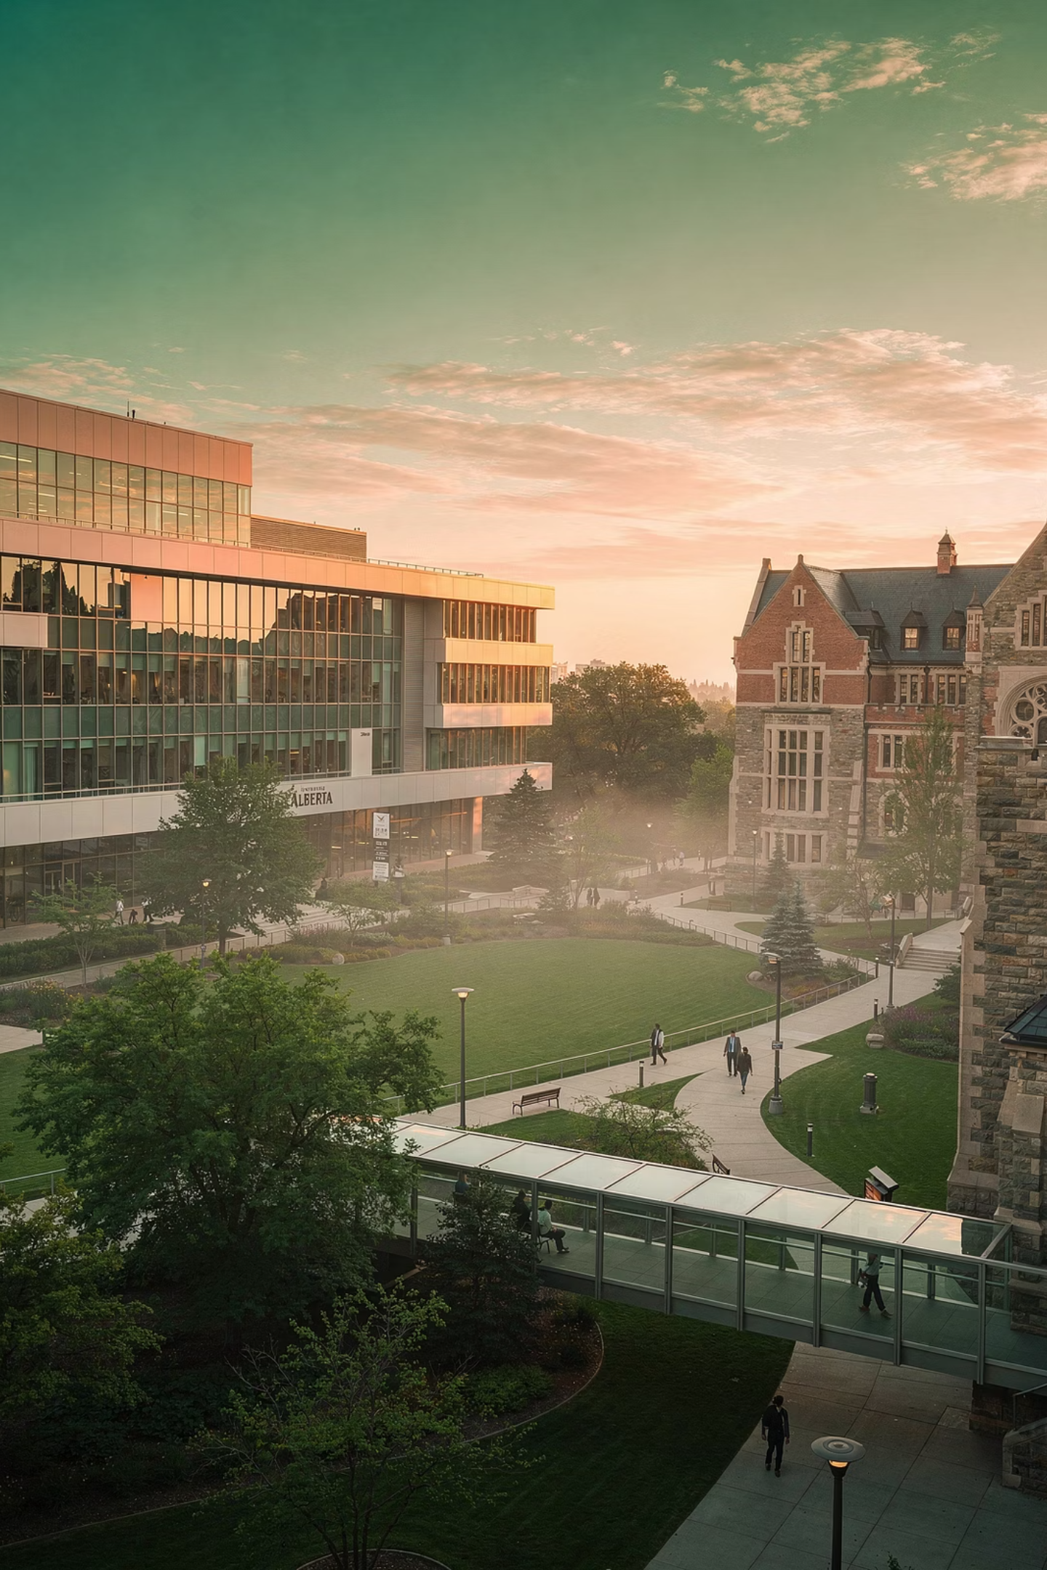




Train with us
Clinical Excellence
Transplant, specialized clinics, advanced procedural training
Innovative Curriculum
Graduate with a robust clinical foundation and in-demand skills for the job market
Research Leadership
World-class facilities, funding for academic development
Supportive Environment
Dedicated mentorship and collaborative culture
Notes:
Graduate as highly competitive candidate for the job market with a robust clinical foundation and in-demand skills to provide effective and compassionate care for your patients

