Slide 1
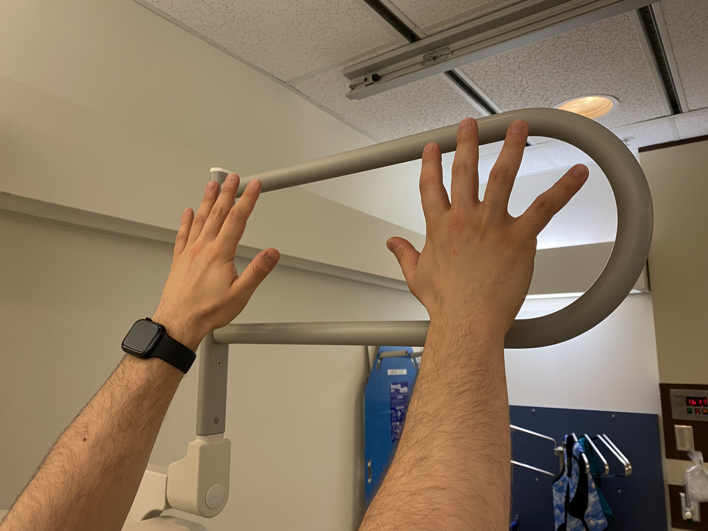
Hands Up!
Adequacy of Lateral Chest X-Rays with Arm Abduction.
The simple action of raising hands and arms up to a higher level resulted in improved quality of lateral CXR.
Our project looked at the adequacy of Lateral CXR and found that too many had the upper chest obscured by the arms.
The simple intervention was to raise the arms higher by asking patients to hold a higher rung on the hand support for lateral CXR.
IT WORKED!
Insert Photo
John Ross Bonanni, MD, Dr. Jordan Fingard and Dominic CollinDoyle

