Slide 1
Emergence of AI tools for regulatory compliance
Randy Goebel
AMII Fellow & Co-founder
Professor of Computing Science
rgoebel@ualberta.ca

Slide 2
Regulatory Compliance

Slide 3
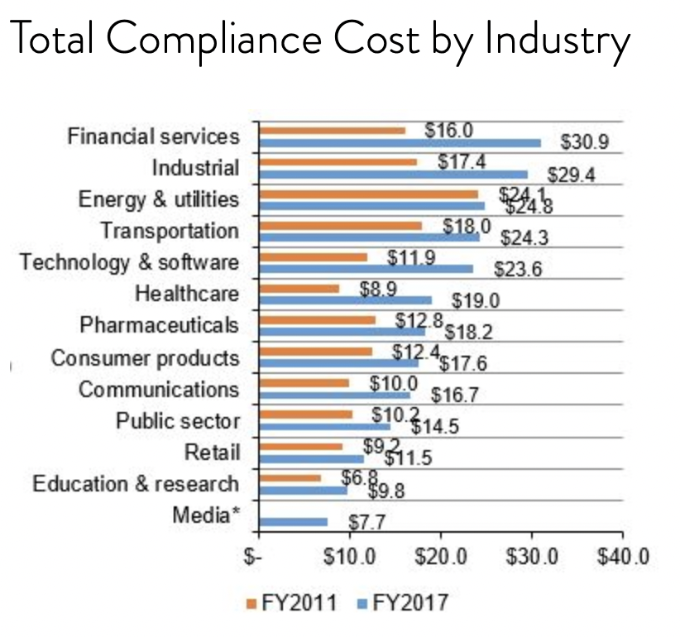
Estimates of compliance costs
https://www.globalscape.com/blog/3-factors-driving-compliance-costs-financial-services

Slide 4
Regulatory Compliance Cost (RCC)
“Empirical findings reveal that the regulatory burden faced by an SME is affected by its size and revenue. The larger a firm's size and revenue, the lower the intensity of regulatory compliance costs on that firm.”
Analysis from Canada Census, 2011,
https://ised-isde.canada.ca/site/paperwork-burden-reduction-initiative/en/survey-regulatory-compliance-costs/impact-regulatory-compliance-costs-business-performance-october-2020#empirical

Slide 5
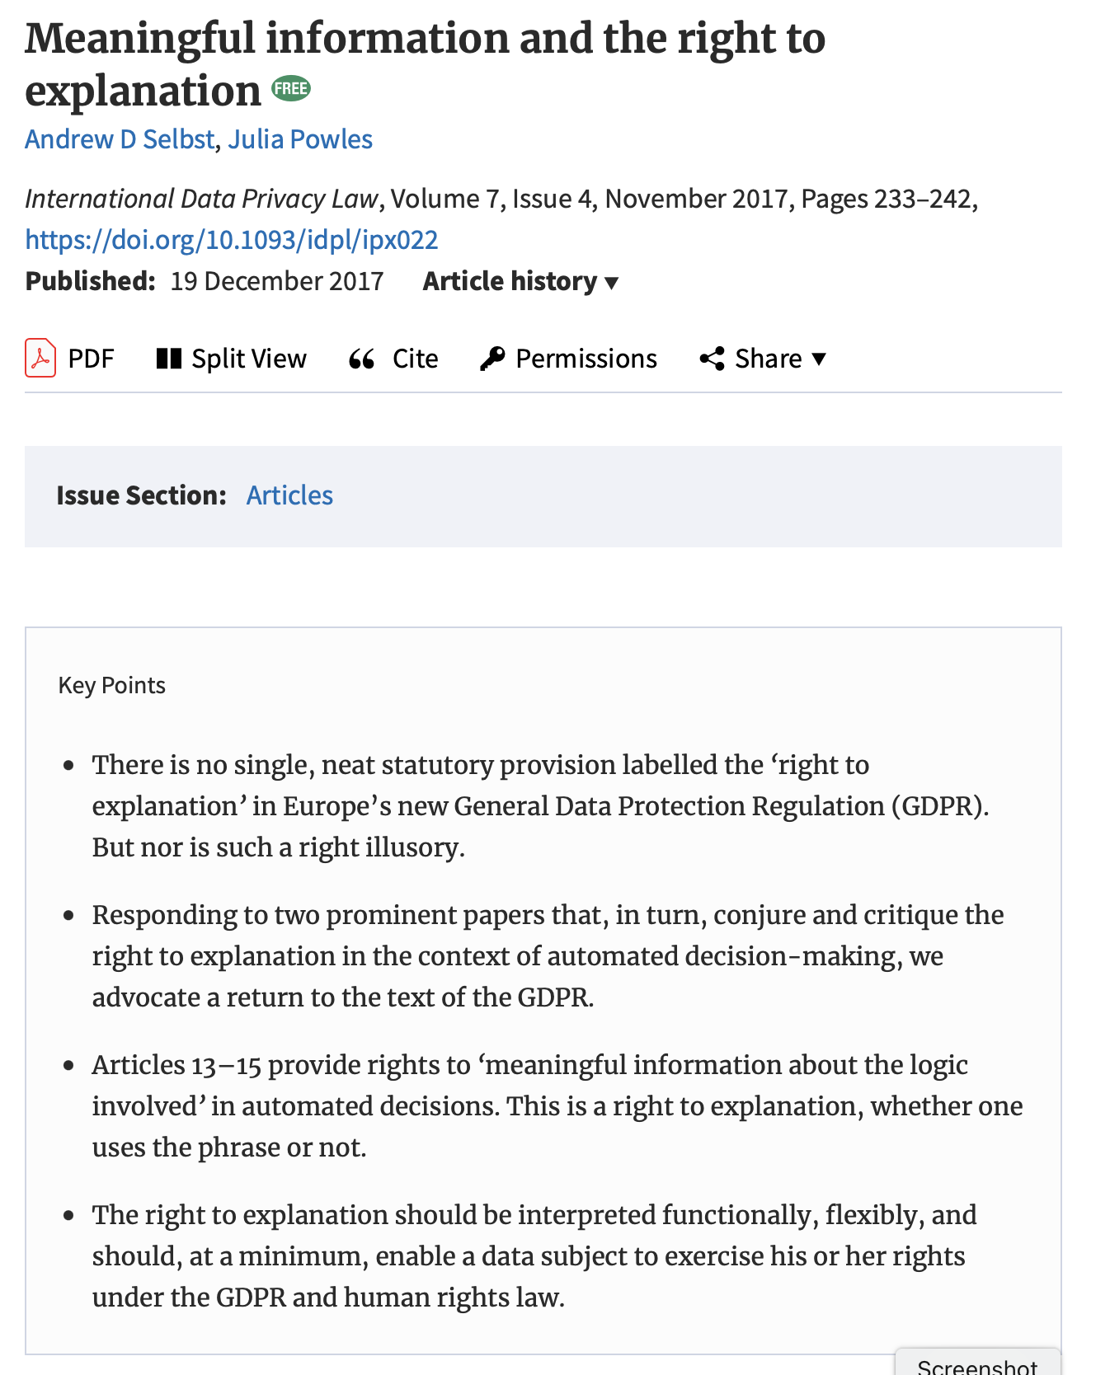
Regulatory practices impinging on AI
“The right to explanation should be interpreted functionally, flexibly, and should, at a minimum, enable a data subject to exercise his or her rights under the GDPR and human rights law.”
https://academic.oup.com/idpl/article/7/4/233/4762325

Slide 6
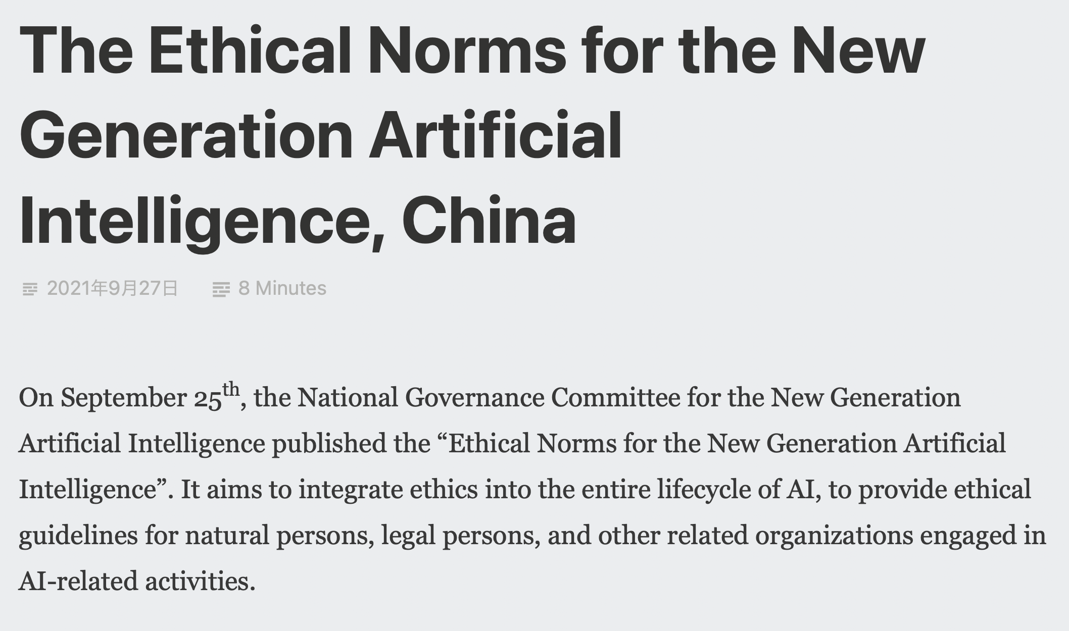
Regulatory practices impinging on AI
China publishes national guidelines for ethical norms for Artificial Intelligence.
https://ai-ethics-and-governance.institute/tag/ai-governance/

Slide 7
EU Regulatory Compliance for AI
https://digital-strategy.ec.europa.eu/en/policies/regulatory-framework-ai

Slide 8
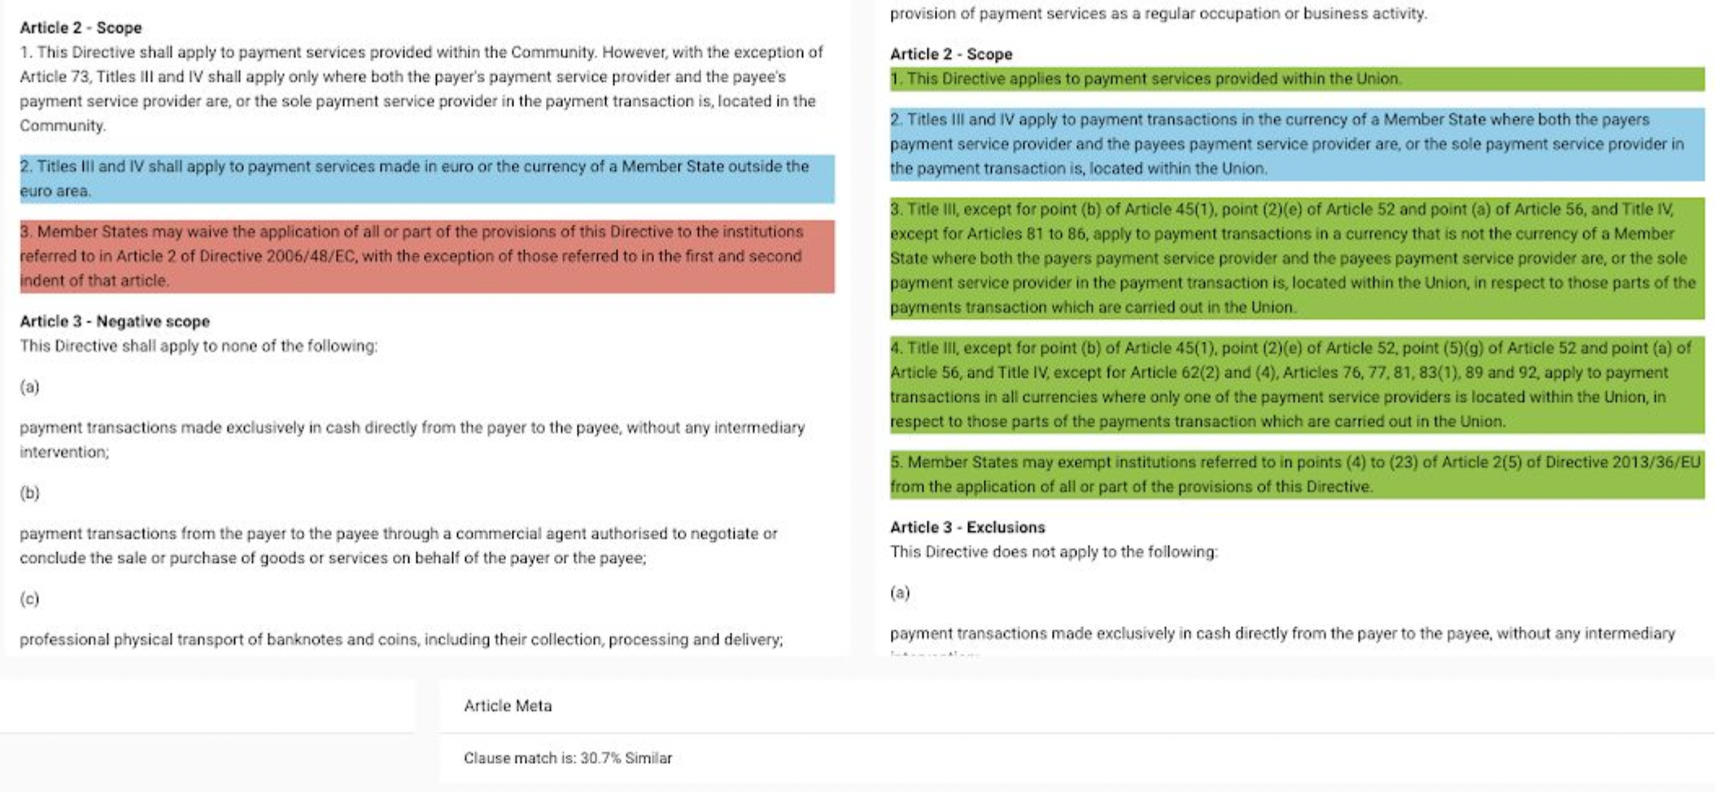
Regulatory Compliance of legal documents

Slide 9
The Challenge of Legal Informatics

Slide 10
Competition on Legal Information Extraction and Entailment (COLIEE)
Yearly competition to develop AI & Law research community
Organized by UofA (Goebel, Kim, Rabelo) and NII/Shizuoka/Hokkaido (Satoh, Kano, Yoshioka)
Run since 2014, in collaboration with International Conference on AI and Law (2017, 2019, 2021, …) and Japanese Society for AI
Competition tasks for statue law and case law
Statute law: ≈ 1400 statues, questions from Japanese bar law exam
Case law: ≈ 4200 legal cases, mostly from Federal Canadian judgements (courtesy of Colin LaChance, Vlex/Compass Law
https://sites.ualberta.ca/~rabelo/COLIEE2022/

Slide 11
COLIEE Statue Law Challenge
Statute
Question
If a person … in order to allow a principal to escape imminent danger to the principal's person, reputation or property, the Manager shall not be liable to compensate for damages ...
In cases where an individual rescues another person from getting hit by a car by pushing that person out of the way, causing the person's luxury kimono to get dirty, the rescuer does not have to compensate damages for the kimono
Yes/No?

Slide 12
COLIEE Case Law Task 1: Case Retrieval
summary₁
decision₁
summary_{x}
+
facts₁
noticed
decision_{x}
…
facts_{x}
query case
summary₂₀₀
decision₂₀₀
facts₂₀₀

Slide 13
COLIEE Case Law Task 2: Case Entailment
summary₁
≈
0.3
0.88
0.56
0.29
decision₁
≈
+
facts₁
entailment
≈
…
…
query case
≈
summary₂₀₀
decision₂₀₀
facts₂₀₀

Slide 14
Where do AI Methods Fail?

Slide 15
Error analysis
Error type | Accuracy (%) | Error type | Accuracy (%)
Specific example case | 7.45 | Paraphrasing | 42.55
Exceptional case | 8.09 | Constraints in premise | 28.09
Condition, conclusion mismatch | 3.19 | Reference to another article | 3.19
Need to complement our knowledge base with paraphrasing dictionary.
Need to capture better models of legal text structure

Slide 16
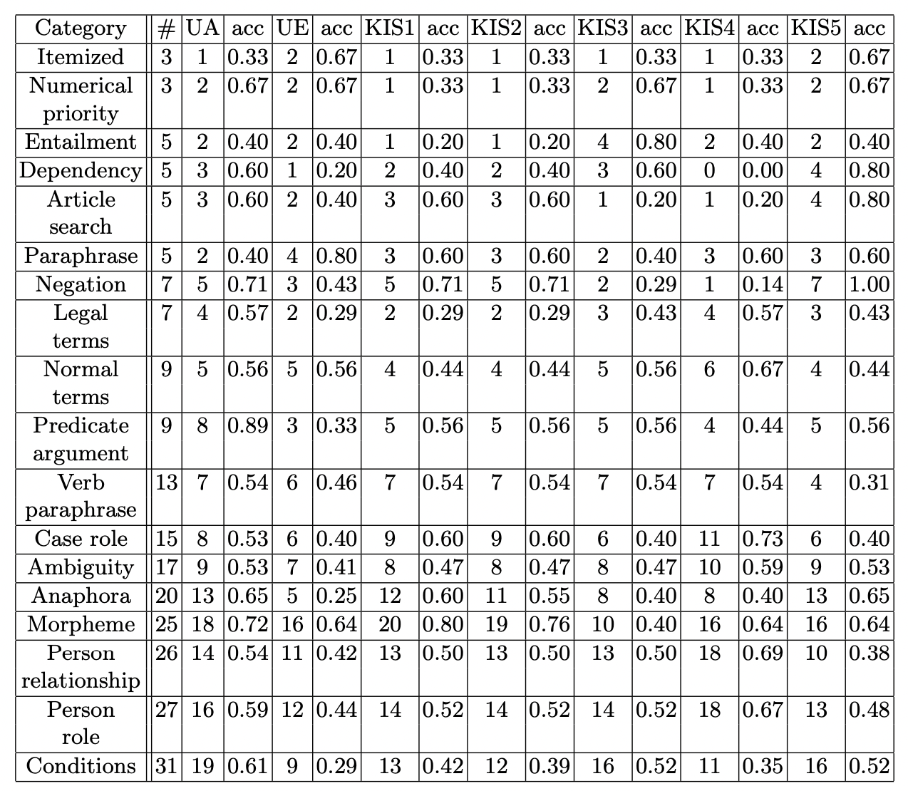
Error analysis
Table 4. Technical category statistics of questions, and correct answers of submitted runs for each category. # stands for number of corresponding questions, team names stand for their number of correct answers for the corresponding for accuracy of its left-hand-side correct answers∗.
(from Yoshioka et al., “Overview of Japanese Statute Law Retrieval and Entailment Task at COLIEE-2018”
https://www.semanticscholar.org/paper/Overview-of-Japanese-Statute-Law-Retrieval-and-Task-Yoshioka-Kano/155dc253a145debb85e835d54b71f345bcce9f05

Slide 17
Under the hood of current AI NLP methods

Slide 18
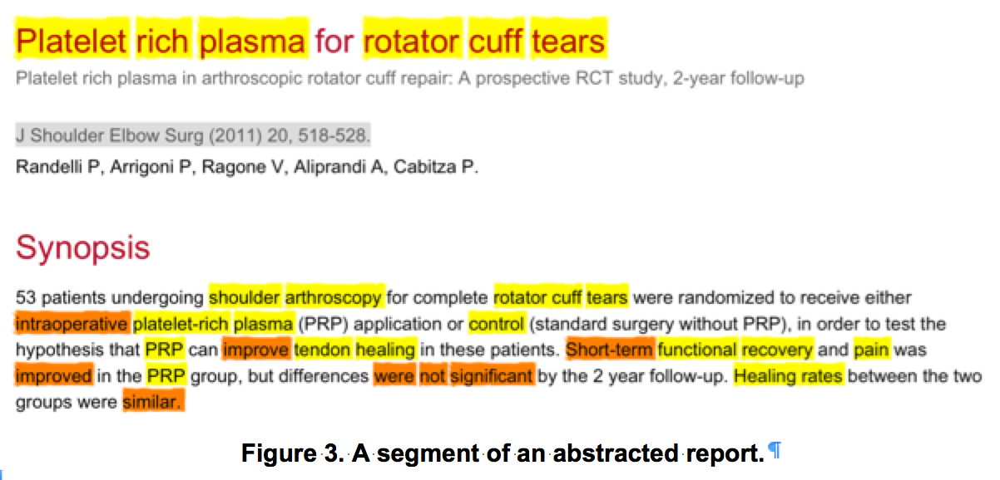
Abstraction of Orthopedic RCTs
noun
verb

Slide 19
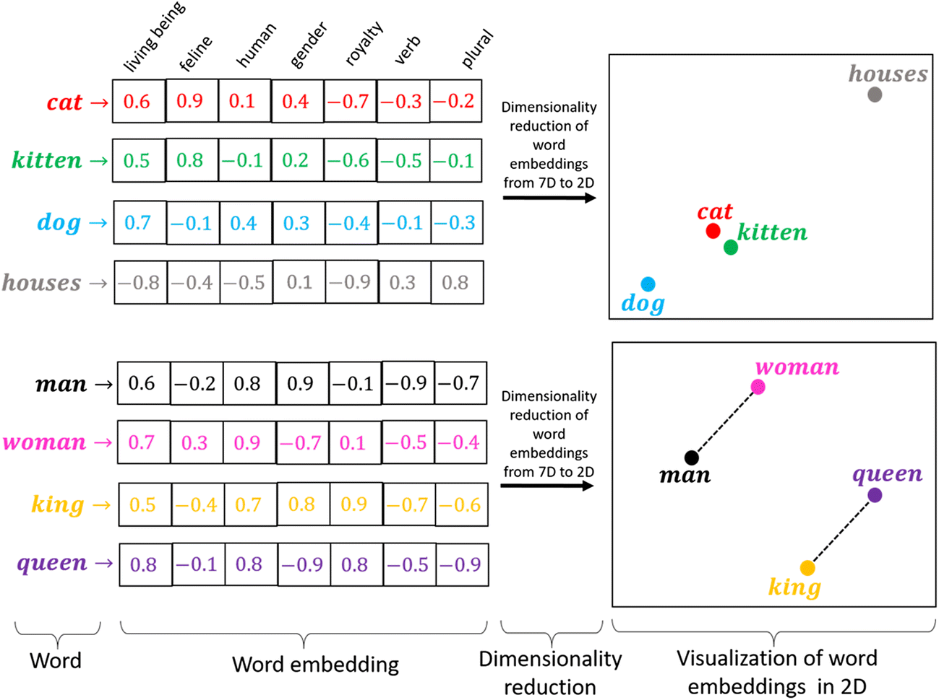
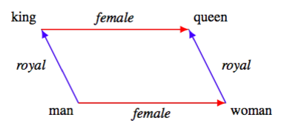
Word Embeddings
Distributed numerical representation of words automatically learned
Allows for semantic (as opposed to syntactic) representation of words
Source: https://medium.com/@hari4om/word-embedding-d816f643140
Source: https://kawine.github.io/blog/nlp/2019/06/21/word-analogies.html

Slide 20
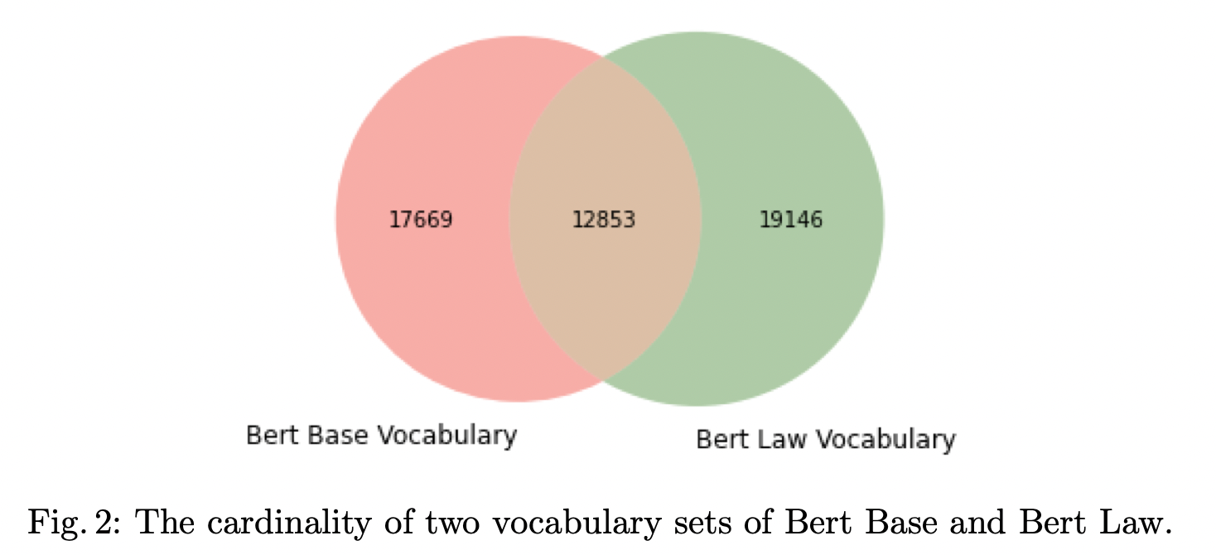
Domain-specific word embedding models
Thanh et al., JNLP Team, Deep learning for legal processing in COLIEE 2020, https://arxiv.org/pdf/2011.08071.pdf

Slide 21
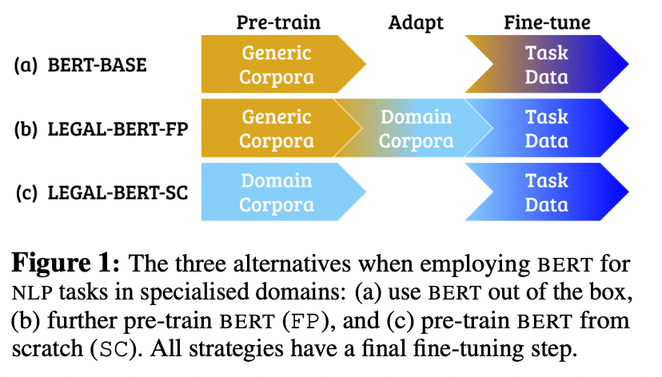
Application specific transformers: Legal-BERT
Chalkidis, Ilias & Fergadiotis, Manos & Malakasiotis, Prodromos & Aletras, Nikolaos & Androutsopoulos, I.. (2020). LEGAL-BERT : The Muppets straight out of law school.

Slide 22
Application specific transformers: Legal-BERT
Chalkidis, Ilias & Fergadiotis, Manos & Malakasiotis, Prodromos & Aletras, Nikolaos & Androutsopoulos, I.. (2020). LEGAL-BERT : The Muppets straight out of law school.

Slide 23
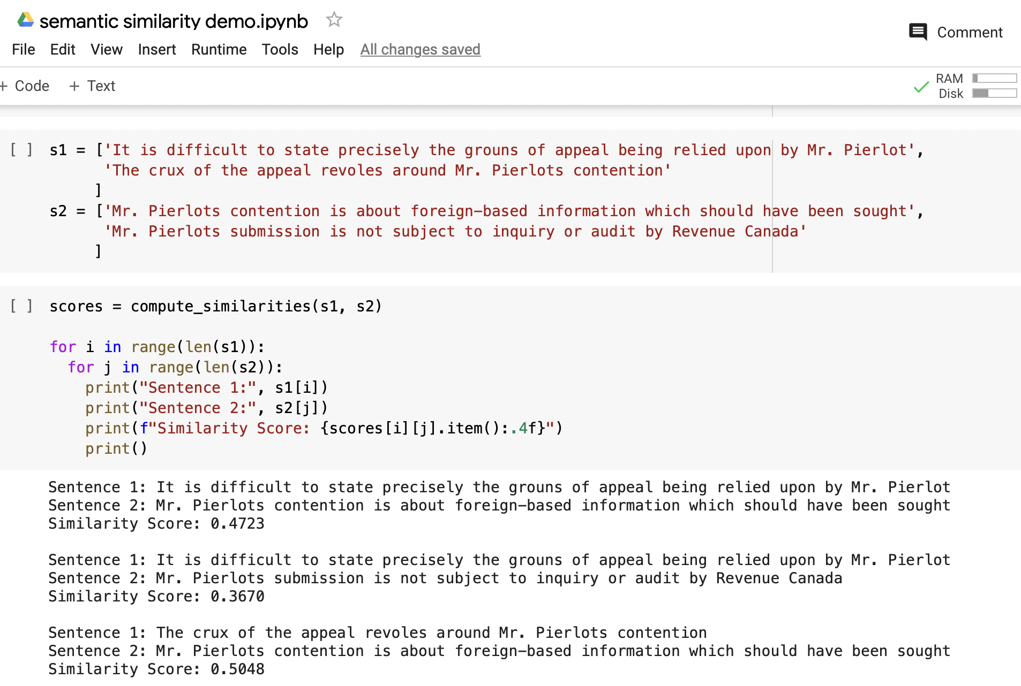
Example: crude paraphrase approximation with transformers
Jupyter notebook to execute text fragment similarity with transformer models.
“Semantics” emerges ONLY from the deep learning construction of transformer models on text corpus.
Similarity measures are only numbers …

Slide 24
Summary

Slide 25
Summary
The development and deployment of AI methods for legal tasks, including regulatory compliance, is accelerating.
It is estimated that 70% of the challenge in all areas of legal informatics, including regulatory compliance, arises from weaknesses in natural language processing (NLP).
There is an increasing emphasis in all jurisdictions on formalizing regulatory compliance (banking, finance, insurance, health)
Because the cost of compliance is so high, the value of automating, or at least semi-automating, the process of regulatory compliance is significant.

