Slide 1
EDI in SSHRC Grants
Presented by:
Sylvia Ijeoma Madueke
Ayantika Mukherjee
Craig Taylor
Notes:
Thank you to everyone who were able to join us at our very first EDI in SSHRC Grants campus-wide session today. My name is Ayantika Mukherjee and I am one of the Research Partners for Social Sciences and Humanities. We have a number of wonderful speakers today.

Slide 2
Land Acknowledgements
The University of Alberta, its buildings, labs and research centers and stations are primarily located on the territory of the Néhiyaw (Cree), Niitsitapi (Blackfoot), Métis, Nakoda (Stoney), Dene, Haudenosaunee (Iroquois) and Anishinaabe (Ojibway/Saulteaux), lands that are now known as part of Treaties 6, 7 and 8 and homeland of the Métis. The university recognizes the persistence of colonialism, oppression, and domination in systems of settler research practices and training and this acknowledgement signifies the university's respect for the sovereignty, lands, histories, languages, knowledge systems and cultures of all First Nations, Métis and Inuit nations as we strive to work in Good Relations with them.
Notes:
Before we begin, I would like to first start off with the land acknowledgements.

Slide 3
Structure of the Session
Contextual information on why we need to consider EDI in SSHRC grants
Existing supports for SSHRC grant applicants at the U of A.
Workshop for how to integrate EDI in SSHRC grants
Notes:
This session will proceed as follows:
I will first provide contextual information on why applicants need to start explicitly articulating EDI in their SSHRC grant applications and discuss SSHRC EDI guidelines. I also have my fellow Social Science and Humanities Research Partners Sylvia Ijeoma Madueke and Craig Taylor who are moderating the chat today.
Next, we will have Hector Rendon, who is the VPRI EDI Research Program Officer and Tim Ira, who is the CSSH Strategic Initiatives Officer - Indigenous Initiatives & Equity, Diversity and Inclusion. Both of them will present on their roles and the existing supports they can provide for SSHRC grant applicants.
Finally, we will have Natalie Loveless, who is the Associate Dean for EDI for the Faculty of Arts, and Carrie Smith, the Vice Provost for EDI, who will provide an overview of their roles and lead a workshop on the best practices for integrating EDI in SSHRC grants.
Together, our objective is to preemptively provide support to faculty members so that they can get ahead of the curve for writing effective grant applications.
This session is not recorded. I will be sharing my slides and a supplementary document of existing resources after the session. Please feel free to add your questions and converse in the chat.

Slide 4
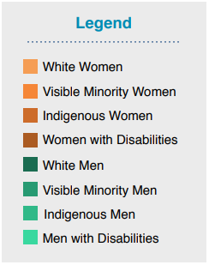
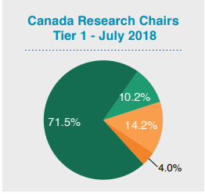
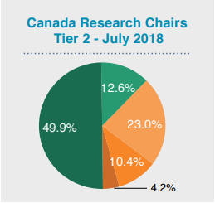
Why a session on EDI in SSHRC Grants?
The Diversity Gap in 2018
Notes:
The call for EDI started with the Canada Research Chairs Program (CRC), which is a federal funding program. The purpose of the CRC is for universities to attract and retain talented scholars who generate new knowledge in natural sciences and engineering, health sciences, and social sciences and humanities across Canada.
In 2003, a case was filed against the CRC program with the Human Rights Commission because there was an overrepresentation of white men who were nominated as Chairs as compared to other groups of people.
In 2006, the federal government set targets to increase hiring of researchers from 4 groups - women, people with disabilities, Indigenous peoples, and visible minorities.
According to University of Alberta’s 2018 report, entitled The Diversity Gap, CRCs continued to remain overwhelmingly white men.
Additional resources:
See a 2002 report of Gender-based Analysis of the Canada Research Chairs Program.
CRC's EDI Requirements and Practices Equity, Diversity and Inclusion Requirements and Practices
Malinda S. Smith's The Diversity Gap in 2018: Where are the Equity Groups at the University of Alberta?

Slide 5
Why a session on EDI in SSHRC Grants?
The Diversity Gap in 2018
Notes:
In addition to the bias in CRC nominations, white men have overwhelmingly been hired at the University of Alberta as compared to other groups.
This is a problem that persists in other universities. As of 2019, the government established new targets as very little progress had been made and now universities have till 2029 to meet their targets to ensure more inclusive hiring and that their CRCs don't get cut.
Additional Resources:
Michaël Séguin's 2002 essay The Changing Diversity and Inclusion Landscape of Canadian Universities: The Université de Montréal Case
For national statistics, see University of Alberta Academic Women's Association’s audit known as Diversity Gap Campaign
Ian Munroe's 2021 article on the latest settlement in CRC equity issue in University Affairs

Slide 6
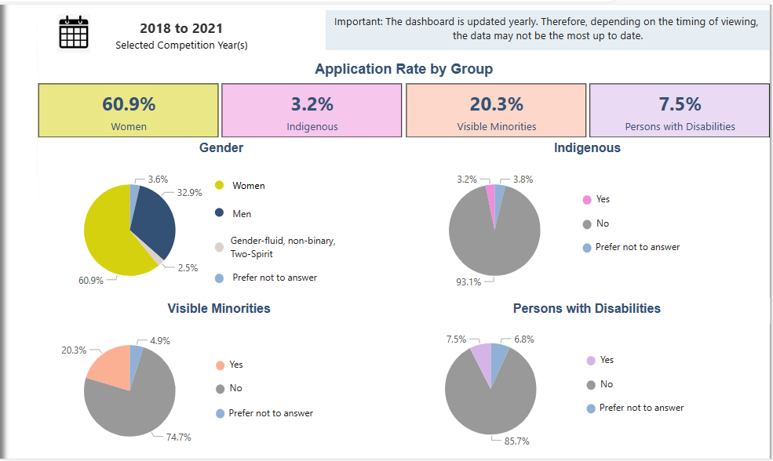
Why is SSHRC Concerned about EDI?
Notes:
SSHRC stands for the Social Sciences and Humanities Research Council.
This data is from SSHRC’s EDI dashboard. Between 2018 to 2021, the number of applicants for SSHRC competitions from historically underrepresented groups (except women) was low.
SSHRC is part of the Tri-Agency along with Natural Sciences and Engineering Research Council of Canada (NSERC) and Canadian Institutes of Health Research (CIHR). The Tri-Agency's EDI action plan is increase application rates from historically underrepresented groups and also diversify participants in peer review/selection committees
The Tri-agency also launched a strategic plan, entitled Setting New Directions to Support Indigenous Research and Research Training in Canada in 2020, which has now been extended to 2026 to ensure that targets to increase the number of applications from Indigenous Peoples is met.
For additional resources, see:
SSHRC’s EDI dashboard.
Underrepresentation also occurs in other federal departments
Tri-Agency EDI Action Plan 2018-2025.
Tri-Agency Statement on Equity, Diversity and Inclusion
Setting New Directions to Support Indigenous Research and Research Training in Canada

Slide 7
EDI According to SSHRC
Equity: An allocation of resources and decision-making that challenges systemic barriers
Diversity: Ensuring that a project takes into consideration a variety of perspectives and lived experiences
Inclusion - Ensuring that all individuals involved in the project are valued and respected for their contributions and are supported
Notes:
Equity is about providing different levels of support to individuals who have historically been underrepresented or disadvantaged so that they can fully access or participate in a research project.
Diversity means accounting for differences can be based on but not limited to age, culture, disability, education, ethnicity, gender expression and gender identity, immigration and newcomer status, Indigenous identity, language, neurodiversity, parental status/responsibility, place of origin, religion, race, sexual orientation, and socio-economic status.

Slide 8
EDI in SSHRC Partnership Grants (PG)
EDI in Research Practice (EDI-RP)
EDI in Research Design (EDI-RD)
Team Composition and Trainee Recruitment Processes
Research Work Environment
Mentoring and Training Opportunities
Approaches that include intersectionality, gender-based analysis plus (GBA+) anti-racist approaches, and/or disaggregated data collection and analysis
Approaches that include Indigenous research approaches and methodologies where relevant
Notes:
Now, the Tri-agencies are requiring their research applicants to explicitly consider EDI in research proposals. SSHRC is starting this with the merit indicators in the PG competitions, we think other competitions, eg: the Insight Grant and Insight Development Grant , will also include this requirement in the future.
The purpose of PG is to foster new research and/or research-related activities in relation to new or existing partners.
Partnerships can occur amongst multiple institutions and/or organizations to advance research, research training, and knowledge mobilization.
In a PG application, applicants are expected to consider EDI in Research Practice and also in Research Design. EDI is evaluated as part of the Challenge and Feasibility evaluation criteria of a PG.
For more information on EDI in Research Design, see also Scholarship on Different Approaches

Slide 9
EDI in Research Practice
Notes:
For the next few slides, I provide sample statements from past award winners, which I will unpack. Feel free to converse about it in the chat. I withheld the names to protect the identity of the applicants.

Slide 10
Team Composition and Trainee Recruitment Process
“Our research and collaboration team include members of numerous marginalized communities, including disabled, Indigenous, racialized, Black, newcomer, and non-binary scholars.”
Notes:
This is a sample statement on composition of a research team. What makes this statement effective is that the author does not say that the team is already complete or diverse but mentions what that diversity consists of without providing personal information about a specific team member. Remember to not provide personal information of a team member or trainee without their consent.
What could make this statement even stronger is to identify and describe the concrete practices that were used to create the team. For instance, what is the current state of diversity within your discipline, department, faculty or even university that informs your team composition or even recruitment decisions? How might including equity-denied and/or emerging scholars as co-PIs or co-applicants be a commitment to mentorship?
When it comes to describing the process of hiring RAs or postdocs, where will you advertise for recruitment to ensure that you reach a diverse pool of applicants?
For more examples, see Examples of EDI-RP related to team composition and trainee recruitment processes

Slide 11
Equitable, Inclusive and Accessible Research Work Environment for Trainees and Team Members
“I will maintain a list of support resources for the underrepresented groups, such as the university’s Specialized Support and Disabilities Services, the Indigenous Student Services Centre, and facilities such as multi faith prayer and nursing rooms, which will be made available to team members where applicable.”
Notes:
No PI can ever have expertise in everything. In this example, the researcher describes how they will promote university resources to the team to ensure that everyone feels supported.
What could make this example stronger is to articulate if a team member or trainee has a conflict with the PI, what are some support systems on campus that the PI could preemptively share so as to sensitively manage conflicts that respects the privacy and confidentiality of those involved.
For more examples, see Examples of EDI-RP in creating an equitable, inclusive and accessible research work environment for trainees and team members

Slide 12
Diversity and Equity in Mentoring, Training and Access to Development Opportunities
“To disrupt the learned unconscious bias we all carry with us, I have developed a learning module that each member and trainee will be asked to participate in upon our first dialogue to minimize its effects on our research”
Notes:
This statement provides the reader some information about the training the PI is providing and why it would be valuable. It also shows that regardless of position, everyone is included in receiving training.
What could make the statement stronger is if the PI makes clear how they will make the course accessible to everyone. For instance, will it be offered free of charge or at a subsidized rate? If relevant, how might the PI present information in the course to accommodate individuals who may have learning disabilities?
Other considerations include: How will you ensure that the labor of mentoring is divided equitably amongst team members? Also, how will you ensure that trainees have opportunities to publish, network, and advance their own research?
For more examples, see Examples of EDI-RP related to diversity and equity in mentoring, training and access to development opportunities

Slide 13
EDI in Research Design (EDI-RD)
"Photovoice begins by providing children and youth in care with
cameras and training so that they can take pictures and post them to a private Facebook group, where researchers and other participants can respond to and have increased awareness of community issues."
“Consistent with terms of UNDRIP and the Tri-Council, Indigenous participants will play a lead role in refining the project design, implementation and outcomes; they will determine how, or if, research is carried out in relation to their families, and homelands. This will translate into budget planning and allocation.”
Notes:
EDI should be considered in research design as well. In the first sample statement the applicant uses photovoice as part of participatory action research with children in care. By providing the cameras and training to the children, the researcher increases feasibility that the children can participate in the project. What makes this example effective is that the researcher has designed a project in consideration of the individuals involved.
Now, let’s take a look at the second statement. The PI highlights that decisions will be made in co-creation with the community not just in terms of the research questions but also in how money is organized and spent. One of the ways to make this statement even stronger is to discuss how data ownership, control and possession will be organized amongst communities and groups involved in the research if at all.
A key takeaway is that EDI should be considered throughout the proposal:
Research questions: What are the EDI challenges related to your research question?
Literature review: Have you included diverse perspectives in the sources consulted and referenced in your application?
Methods: What method would be the most effective for the individuals and/or communities you wish to have an impact on?
Theoretical frameworks
Knowledge mobilization activities: Who benefits from the research findings?
Budget: Does your proposal consider the different forms of support required (e.g., financial, logistical, cultural, linguistic) to ensure that the individuals or communities involved are able to meaningfully participate in it?
For more examples, see Examples of guiding questions to consider while designing your research and OVPRI’s EDI in Research: An Action Plan
For more resources, see also:
Guidelines for the Merit Review of Indigenous Research,
Chapter 9: Research Involving the First Nations, Inuit and Métis Peoples of Canada of the Tri-Council Policy Statement: Ethical Conduct for Research Involving Humans—TCPS 2 (2022),
Indigenous Research Statement of Principles

Slide 14
SSHRC CV/SSHRC CCV
Here are other sections to demonstrate past commitment to EDI:
Past Recognitions
Past Contributions,
Supervisory Activities - *always get permission from students to mention their names
Notes:
The SSHRC CV and SSHRC CCV are additional avenues to promote your past commitment to EDI.
This can include past awards, certifications, projects. You can mention students you have supervised but make sure to get their permission before doing so.

Slide 15
Additional Resources for Grant Development
Check out the Successful Grants Library for sample applications from past award winners
Check out the Grant Excellence Toolkits (“GrEx”) in the Education and Research Archive
The CSSH Office of Research has also created a library of videos (e.g. how to prepare a budget and how to prepare a CV) to provide faculty members with practical, on-demand, asynchronous assistance in support of grant application success

