Slide 1
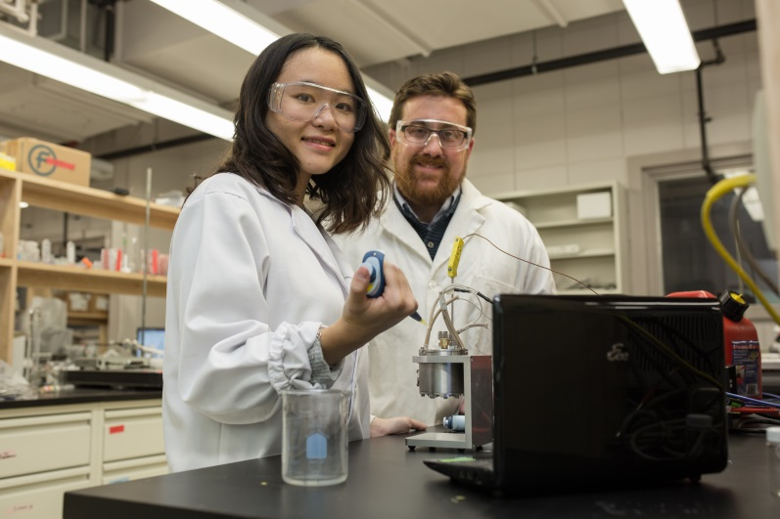
Making the most of your summer research
May 3, 2017
Campus Saint-Jean

Slide 2
What makes you nervous about starting your research?
How can I have a productive relationship with my supervisor?
How can I manage my time/tasks effectively?
How/where do I present or publish my work?
Ugh…what happens if I make a mistake?
What do I do if I hate my project? ☹
Where can I find…[X]?

Slide 3
During this session you will:
Articulate some research & skill development goals for the summer
Develop your own list of questions to discuss with your supervisor
Practise asking for advice effectively
Learn some research tips
Learn about resources to support your research

Slide 4
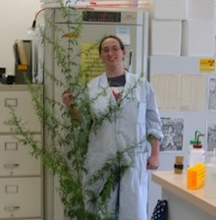
Everyone starts somewhere
You get out of your experience what you put into it:
Your attitude
Your willingness to learn
Your work ethic
You will make mistakes. You will fail sometimes. You will also learn.

Slide 5
What are your goals?
What are your research goals?
What are your skill development goals?
Are your goals:
Specific
Measurable
Agreed upon (with your supervisor)
Realistic
Time-based

Slide 6
Setting your research goals
Do you have a clearly defined research question?
What is your role in this project?
What is your approach?
Methodology
Timelines
What do you need to start?
Materials/supplies
Knowledge (e.g. background reading)
Skills/techniques/training
What are your expected outcomes?
By the end of the summer, I will complete…X
Review with supervisor!

Slide 7
What are 2-3 research goals for this summer?

Slide 8
Skill development goals
What do you already know?
Skills inventory
What do you want to know/learn/do/improve?
Skills inventory
Careers in Academia worksheet
What opportunities do you have to develop these skills?
Through my project
Training/courses
Mentorship
How will you know you have achieved your goals?
Completion of research milestones
Feedback from supervisor

Slide 9
What are 2-3 skill development goals for this summer?

Slide 10
Clarifying basic expectations
Review your research & skill development goals – does your supervisor have similar expectations?
Hours of work – don’t assume “normal” business hours
Who do you report to? – how, how often?
Who should you go to for guidance? – for what types of issues/decisions?
What training or orientation is required?
*Safety, research ethics, etc.
What self-directed learning is expected?
What other “ground rules” do you need to know?

Slide 11
Getting along with your supervisor
Like any relationship -communication is key!
Clarify expectations early & often. (Always ask!)
Develop a plan for your project -- include measurable milestones & timelines
How will you know you are making progress? How will your supervisor evaluate your work?
If something isn’t working, or you make a mistake – speak up!

Slide 12
Getting along with your research group
Take time to get to know the people in your group. Learn from them!
Learn the group culture.
Respect the workspace.
Help each other out – be willing to step up and take the initiative & show gratitude for those who help you.
Remember: Behaviour is what we see; motivation isn’t always obvious -- try to understand the whole picture before reacting to someone’s behaviour

Slide 13
What questions do you have for your supervisor or research group?

Slide 14
How to ask for advice...effectively.
Provide context:
What were you doing? Why?
What did/didn’t work?
What do you think is happening? Why?
What are some options you’ve considered?
Remember: Your supervisor may be the expert, but YOU are closest to your own work.

Slide 15
Think of a time when someone asked you for advice. What would have helped you understand the situation and effectively offer advice?

Slide 16
Research record-keeping
Record-keeping is CRUCIAL – not just for you, but for everyone who comes after you.
Update your research notes daily: don’t fall behind! (schedule it into your day)
Have someone check over your notes
Get in the habit of labeling materials, data & files consistently.
Keep an inventory of materials related to your project & their storage locations.

Slide 17
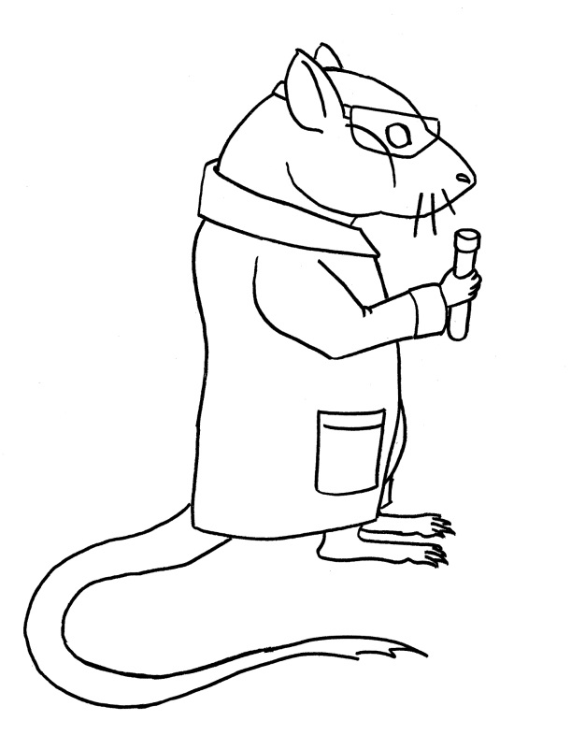
Tech tips…from other students
Lab math: Do the math once, save it for later!
Write storage temperatures/locations on bottles until you remember them.
Make sure you understand why you are using a protocol and how it works.
Plan ahead: time, supplies, calculations, equipment use, etc.
Read a little bit every day.

Slide 18
Writing & Presenting your results: What to think about NOW
Don’t wait to start reading – learn the literature early!
Keep track of what you’re reading; take notes & consider using a reference manager (e.g. RefWorks, Zotero)
Write up your work as you go and get feedback on your writing.
Consider how you will analyze your data – e.g. what stats will you use, what control groups, etc. (Good experimental design NOW will save you time later.)

Slide 19
What are some strategies I will use to effectively manage my time this summer?

Slide 20
Presentation & Publication opportunities
Festival of Undergraduate Research & Creative Activities (FURCA)
Undergraduate Journals
Faculty/Department research days (check with your supervisor for submission deadlines)
Peer-reviewed publications with your supervisor

Slide 21
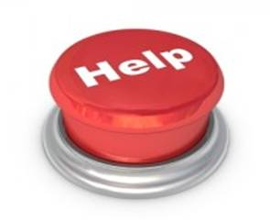
Help! What do I do if…?
I make a mistake?
I don’t get along with someone in my group (or my supervisor)?
I realize my project/research isn’t for me?
My supervisor wants me to present, but my project isn’t finished?
Other concerns…?

Slide 22
Next steps – when your project is over…
Make sure all of your data & materials are labeled & stored appropriately, and are accessible to those who continue your project.
Write up any reports required by your supervisor and/or your funding agency.
Prepare abstracts/presentations, if necessary.
Reflect on what you’ve learned – and your own next steps.

Slide 23
Campus Resources – URI
Seminars/workshops (funding, publication/presentation, next steps, etc.)
Funding – URI Support Fund, URI Stipend
Poster Tip Sheet: http://bit.ly/2oQKqw8
FURCA (March 2018)
e-newsletter

Slide 24
Campus Resources – U of A Library
Liaison Librarians
Undergraduate Research LibGuide
RefWorks
Research Data Management Week
Education & Research Archive
Open Journal System (Undergraduate Journals)
Tutorials: http://www.library.ualberta.ca/tutorials/

Slide 25
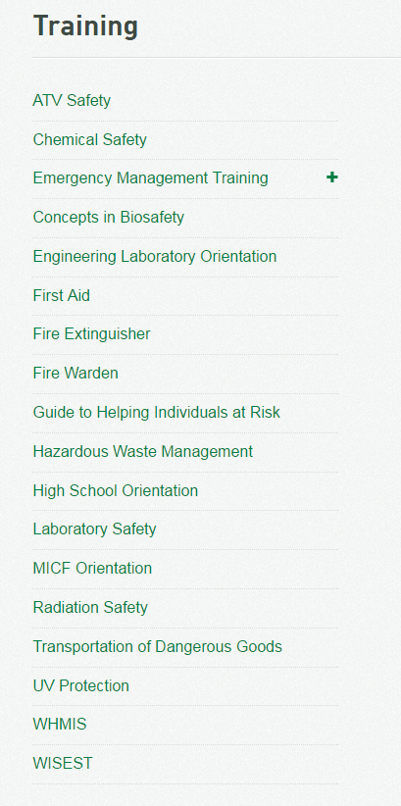
Environmental Health & Safety
Online training in lab, chemical, radiation & biosafety.
Even if you don’t need it now...plan to take advantage of the free training while you’re a student. It will pay off later!
https://www.ualberta.ca/environment-health-safety/training

Slide 26
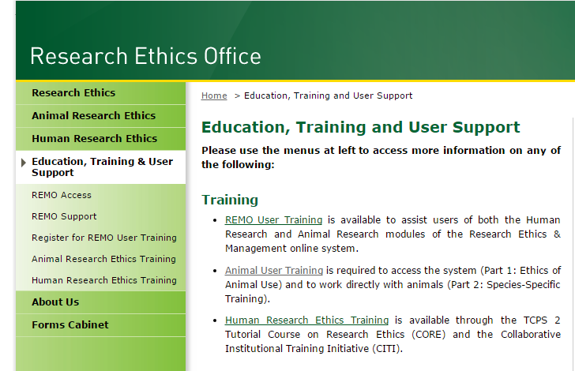
Research Ethics Office
Online training
Part 1 Animal Ethics
Human Ethics
REMO (online system)
In-person training
Animal handling
http://www.reo.ualberta.ca/Education-Training-User-Support.aspx

Slide 27
Other Campus Resources
Field Research Office – (field safety, training, permits)
Student Success Centre -- (workshops/consultations)
Centre for Writers – (writing help – any discipline!)
SUBPrint – (large format printing)

Slide 28
Other Resources
Undergrad in the Lab: http://www.undergradinthelab.com/
Council for Undergraduate Research: http://www.cur.org/
WebGURU: Undergraduate Research: http://www.webguru.neu.edu/undergraduate-research
Zotero: reference management app: https://www.zotero.org/

Slide 29
And don’t forget to have fun...
“I had no technical knowledge when I was taken on. But it was soon apparent that a general overview of physics is often more valuable than expertise and routine.
What one acquires through the sheer joy of finding out is a useful, versatile instrument in the hands of a living being”
~Albert Einstein in an open letter to an unsure physics student

Slide 30
For more information
Crystal Snyder Undergraduate Research Coordinator, URI cs2@ualberta.ca 780-492-4183 2-701 SUB
www.uri.ualberta.ca

