Slide 1
Timekeeper Boot Camp
November 2019

Slide 2
Objective of Today
HRS Functional Realignment
Clarity on the Timekeeper Role
Introduction of T&L Administrator Role in HRS
Challenges from a Payroll perspective
Timekeeper Reminders
Introduction of Timekeeper Focus Group Concept

Slide 3
Our Collective Mandate
Pay Employees Accurately and On Time

Slide 4
Guiding Principles
Align work for effectiveness and efficiency
Mitigate risk to the University
EMPLOYMENT SERVICES | BENEFITS | PAYROLL
Responsible for life cycle of employee (hire through to retire) | Responsible for the benefit impact as a result of employee life cycle changes (including life events such as marriage, divorce, coverage changes, birth of child) | Responsible for the accuracy of the employees pay as a result of employee life cycle, benefit changes and Time Reporting (Responsible for gross to net accuracy)

Slide 5
Payroll & Benefits Org Chart
Manager Payroll & Benefits
Tracy Berthelette
Payroll Coordinators
Starry Duchin
Shalene Ainsworth
-------------
Oversee Operational Payroll Cycle
Off cycles
Overpayments
Oversight on Banking Garnishment Mgmt
Pre Confirm Audits
Lea Matton
-------------
Post Confirm Support
Tax Reporting
Project oversight
Payroll System Changes
Testing
Pension Analyst
Helen Slinko
------------
Pension Audit
Year end Processing
Leave Costings
Benefits Advisor
Carol Baraniuk
Deanne Clarke
Dawn Baier
Kelsey LeBlanc
Kaileigh Mcdonald
Judith Shaw
-----------------
Third Party Liaison
Ben Admin Inquiry
Benefit Entitlement
Retirements
Prepaid Benefits
Payroll Assistants
Candy Razon
Kristy Guenther
Val Teljega
Jeremy Murphy
Krista Silver
------------
Payroll adjustments (gross to net validation) for employees – life cycle changes from ES
POI, Visiting Speakers, Honorarium, one time payments
Retro Calcs, TD1, Banking, deductions
T&L Administrator
Lisa MacNeill
--------------
Time Audit
Troubleshooting
Mass Approval
Reporting & Analysis

Slide 6
Timekeeper Role
Having a Timekeeper Role supports Payroll in the following ways:
The first point of contact within your Department(s) for employee and supervisor questions related to an employees time at work
The owner of all hours being submitted for each pay period for both salaried and hourly paid employees
You advise, educate and train Employees and Supervisors
You are Payroll’s voice as it relates to time administration functions
You are accountable for the hand off to payroll for accurate payments to our employees

Slide 7
Timekeeper Role
In order for you to do your role effectively we have to understand each other’s roles, responsibilities and challenges.
When we don’t they collide and it hinders our collective mandate:
PAY EMPLOYEES ACCURATELY AND ON TIME

Slide 8
Time & Labour Administrator Role
Assume responsibilities to ensure functions that support the accuracy of timely payments to employees.
Must be aware of the direct connection and impact from the time module across PeopleSoft and input into the payroll module as it relates to the impact of an employee’s net pay.
Expected to work closely with Time Administrators across campus as the subject matter expert
Expected to resolve daily issues, recommend and implement changes to the campus time and labour processes.
Liaison and collaborate with employees, faculty, department HR contacts or other units across campus to answer questions and process time for input into PeopleSoft
Work closely with HR Systems and Reporting and IST/TCS to seek support for time & labour processing

Slide 9
Observations after 3 months
REMINDERS
Timekeeper Checklists
Pay Period Audits
Rejected Time
Terminations
Managing Delegations/workflow
Overtime
General Holiday Pay
NEW
Payroll Deadlines
Payroll Critical Action Period
Process for Mass Approved Hours
Before submitting an IST Help Ticket
HR Contact Update
Removal of incorrect OT Hours

Slide 10
Timekeeper Checklist – Key Points
Ensure all hours for the pay period are entered no later than the current time entry deadline
Ensure Supervisors approve all hours no later than the current time approval deadline
Ensure all hours are entered and approved up to and including their last day worked for all employees ceasing employment and/or commencing a leave
Run the Job Expected End Date Report monthly
Remind Supervisors – Do Not Pushback Negative Hours
Routinely run multiple jobs query and T&L audit queries
Watch for employees who enter time on a Scholarship job
It’s the Departments responsibility to ensure all General Illness hours are entered on the employee timesheet

Slide 11
Audit Procedures – Why
Zero’s on the timesheet – Slows Time Admin Batch, if no time worked leave blank
Mass Approved Hours – Employee may not be paid correctly
Overtime vs Regular Time – Do you and your Supervisors know the rules when approving the hours?
Pushed Back Time – is never processed and paid until corrected
Not Approved Hours – exception time (vacation, sick, banked time) are just as important to be approved in a timely manner as PeopleSoft balances are directly impacted on employee movements/terminations
Payable time entered beyond current pay period – if you haven’t worked it please do not enter it
Claim all time on the actual date it occurred – payroll reports, Stat Pay, overtime pay are all impacted and not accurate when not entered correctly
Clear Exception Errors every pay period – employee will not be paid if a HIGH error exception is assigned to the submitted hours

Slide 12
Rejected Time
Rejected time occurs when time admin runs and although approved it cannot be paid to an employee. This caused an error that has to be dealt with, it cannot be ignored or left in the system.
90% of Rejected Time is created because:
Employee entered time into the future then the Auto Term process runs and terminates the employee (late extensions)
Timekeeper entered time for an employee while the employee is on a paid leave (enter time in the pay period it is worked (late time)
Change was made to previous pay period and no time in current pay period which creates a payroll calculation error - negative net pay (late time)
Terminated employees (late time)

Slide 13
Terminations
Before the employee is Terminated
Run Job Expected End Date report early
Ensure all hours are entered before the employees last day worked
Supervisor is required to approve hours on or before the last day worked (LDW)
Consider an internal process be put in place to have the Supervisor enter hours on behalf of the employee on the their last day worked
If you can’t do the above send to Payroll for entry on the designated Time Sheet

Slide 14
Managing Delegations
Remind all Supervisors to put a delegation for Time and Labour on the system before going on Leave
Distribute the Guideline for Delegating Time and Labour Approvals to all Supervisors
Run the Delegation in my Department query monthly
Remind Supervisors:
Before submitting a delegation clear all Pending Payable time in their queue
Speak to the potential delegate (Proxy) first to check for availability
Review their proxies list to ensure they have one active proxy at a time
Ensure their proxy has taken online training
Ensure the delegation has a start and end date

Slide 15
Where Did the Time Go?
Reminder, if a Delegation is not entered, or a reporting relationship has changed, the hours an employee submits for approval may go to someone else!
Remember, the Reports To App has a schedule when PeopleSoft is updated with the changes.

Slide 16
Overtime Reminders
There are no rules/logic built into the timesheet to determine overtime eligibility. The responsibility lies on timekeepers and Supervisors.
HRS does audit the daily hours worked. If the hours issue is not resolved before the approval deadline, excess hours will be removed from the timesheet and not paid until resolved.
1. Determine the standard daily hours the employee works (job code in HRS)
35 hours per week = 7 hours per day
37.5 hours per week = 7.5 hours per day
40 hours per week = 8 hours per day
All hours over the standard hours (week and/or day) are to be paid as overtime.

Slide 17
Overtime cont’d
Reminder
NASA employees have a minimum 1 hour clause as per Article 6.05 (a). Do not claim overtime in less than 1 hour increments.
Article 6.06 (a) Overtime pay will be calculated to the nearest quarter of an hour, subject to clause 6.05 (i.e. .25, .50 or .75)
Employee Type | Agreement Covered
Regular | NASA Agreement
Casual Level 2 | NASA Agreement
Auxiliary | NASA Agreement
Academic Hourly | Employment Standards – No 1 hr min
Excluded Students | Employment Standards – No 1 hr min
Casual Level 1 / FT Student | NASA Agreement – No 1 hr min rule

Slide 18
General Holiday Pay
Reminder - Changes to General Holiday Pay
The removal of the qualifying period for holiday pay
The employee is eligible from date of hire as long as they were active and accountable on the general holiday
All employees at the university will observe the same eleven general holidays
Payment of general holiday pay varies depending on how the employee is paid (hourly vs. salaried) and whether or not they are scheduled to work on the holiday or not.
Do not enter Regular hours on a Stat Holiday if worked. All hours worked are paid at the overtime rate

Slide 19
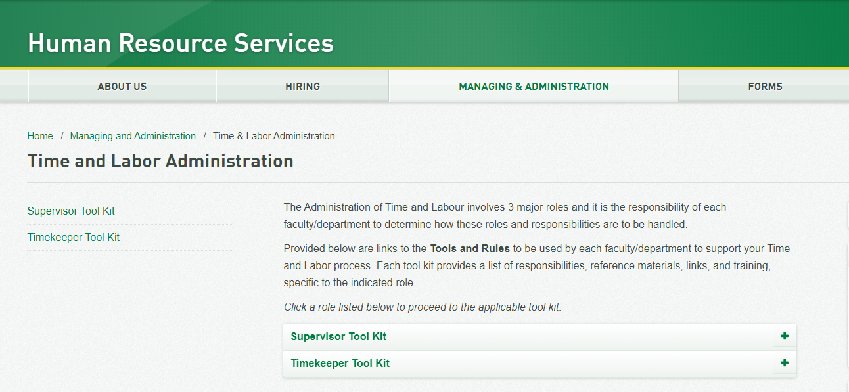
Training Materials

Slide 20
New to You
Annual Payroll Deadlines (all deadlines in one place). 2020 is coming soon…..
2019 Winter Closure documents are completed and can be found on the HRS website: Administrating pay during Winter Closure
Before submitting an IST Help Ticket, call the Time & Labour Administrator, Lisa at 492-4936 first, to determine the nature of the issue
Mass approval(s) are now being run the morning after the time approval deadline date. Supervisors that have not approved their payable time will receive an email asking for confirmation that the Mass Approved hours are accurate
Timekeepers now included in the HR Contact App
Payroll Critical Action Period

Slide 21
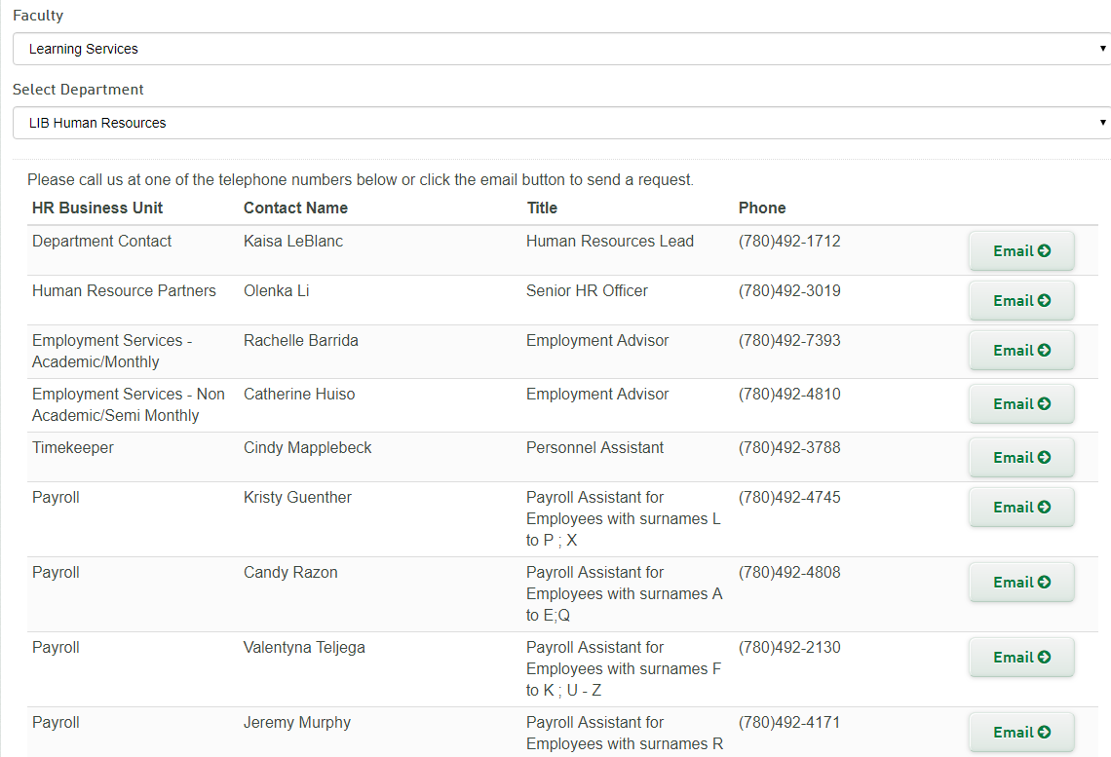
Find HR Contact Web Page
HR Contact App

Slide 22
Payroll Critical Action Period
A period of “pause” in each payroll cycle which starts the day before pay confirm and is not lifted until after pay confirm is complete.
No new changes (job changes, benefit changes, time entry etc.) are introduced into the current payroll cycle unless approved by the Payroll Manager.
These Critical Action Days allow payroll to audit the entire
payroll for the University prior to pay confirm. During this
period introducing any additional work can put the entire
Pay confirm at risk.

Slide 23
What’s on the Horizon
Transition Delegation role corrections to Payroll
Insert Time entry and approval into onboarding process (mandatory training)
Expand the usage of Employee Self Serve Time Entry
Reduce window of correction from current pay period and 4 months to current pay period and 1 month
Review Mass Approval Process
Schedules/Embed Rules into Timesheet
eSecurity access request will default to HR approval before a Timekeeper role is added to an employee’s PeopleSoft profile
Decommission Supervisors with Timekeeper Role
Insert Payroll cycle controls (time entry, approval and pay cycle frequency)

Slide 24
How do we get there?
WITH YOUR HELP!!!
Can you commit 2 - 4 hours a month starting in 2020?
Are you interested in having a voice?
Do you have a challenge that hasn’t been addressed?
If you would like to participate in a Time & Labour Focus Group please let us know by emailing Payroll at payroll.operations@ualberta.ca

