Slide 1
IMMIGRATION 302 Presented by Immigration Services (HRS) Dallas Pelkey & Cyndi Killingsworth

Slide 2
AGENDA
Background information on International Mobility Program
Procedure for inviting foreign visitors
Practical exercises related to International Mobility Program
Providing immigration advice and guidance
Q & A
Evaluation

Slide 3
Rationale for Introduction of IMP
Why did the federal government decide to introduce the International Mobility Program?
In 2013 alone, 221,273 LMIA-exempt workers entered Canada.
For LMIA-exempt workers, no employer declarations were signed by Canadian hosts/employers.
Some hosts/employers didn’t abide by the terms of invitations (to LMIA-exempt workers).
It was cumbersome to prosecute Canadian hosts/employers.
It was felt that penalties were inadequate.

Slide 4
Purpose of Employer Compliance Fee
To exempt taxpayers from administrative costs
To cover the cost of a robust compliance system
To carry out inspections that could lead to penalties against employers
To cover administrative costs of imposing bans from hiring foreign nationals
To cover costs of criminal investigation

Slide 5
Audits
How many employers will immigration audit each year?
One in every 4 employers
One I every 12 employers
One in every 50 employers
One in every 100 employers

Slide 6
Penalties
Up to $100, 000 fine
Up to 5 years’ imprisonment
Inability of University to participate in foreign worker programs for 2 years
Blacklisted on Internet
Revoked work permits and/or LMIA’s

Slide 7
Inviting Foreign Visitors
Click before you invite http://www.hrs.ualberta.ca/en/HiringandManaging/Immigration.aspx
Submit Foreign Visitor Category Assessment form to: Immigration.services@ualberta.ca
Fill out the appropriate immigration-vetted invitation template
Follow instructions sent by Immigration Services
Have foreign visitor contact Canadian immigration authorities for needed documents
Send copy of visitor’s work permit to Immigration Services*

Slide 8
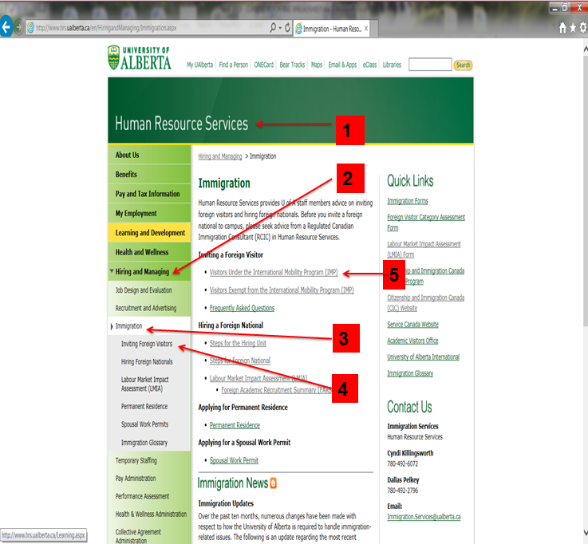

Slide 9
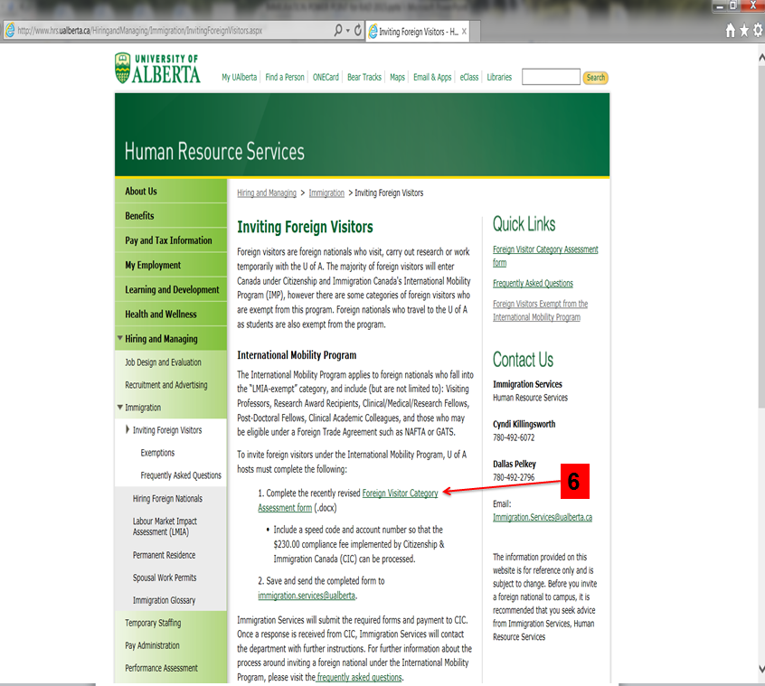

Slide 10
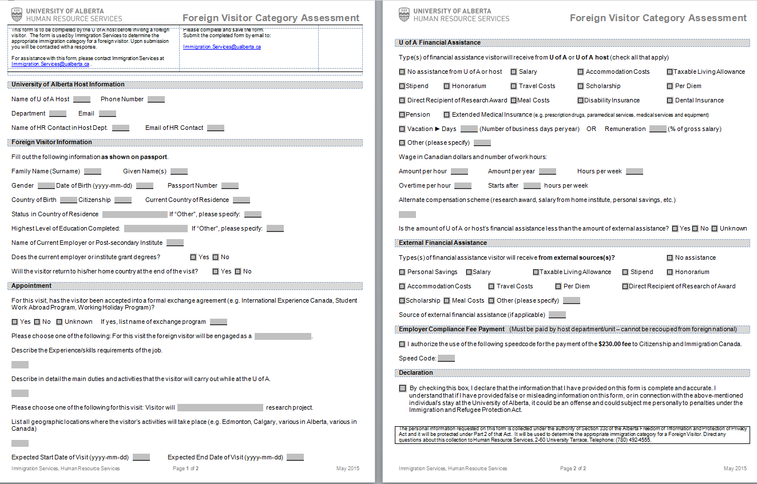
Foreign Visitor Category Assessment

Slide 11
Causes of Processing Delays
Wrong or missing speed code (must be five characters in length)
Wrong or missing passport number
Changing date of visitor’s arrival or duration of stay
Adding or changing visitor’s activities
Volume

Slide 12
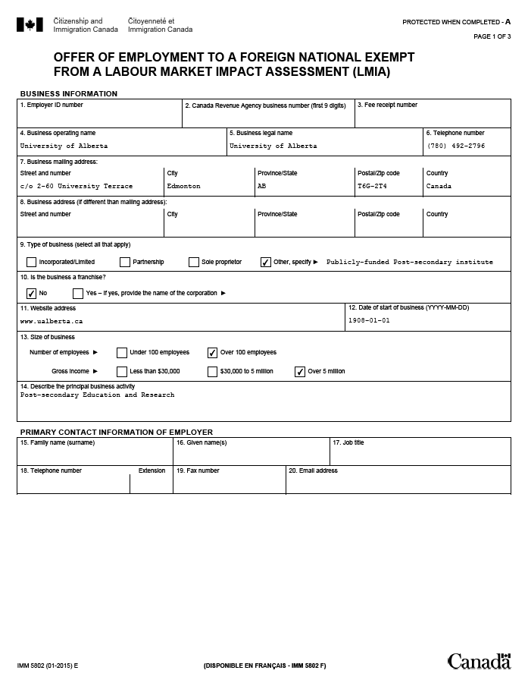

Slide 13
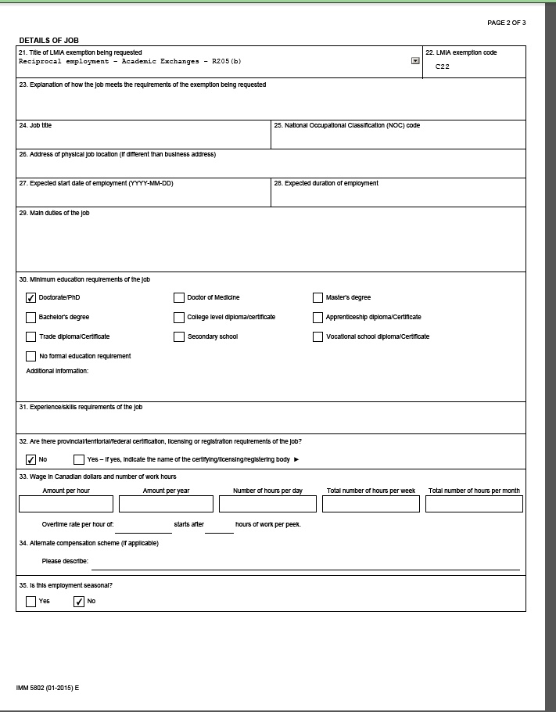

Slide 14
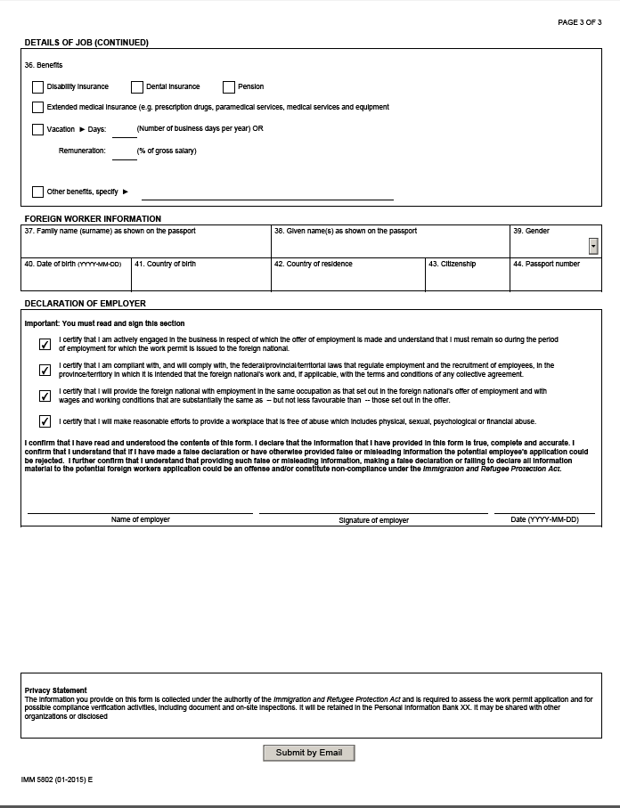

Slide 15
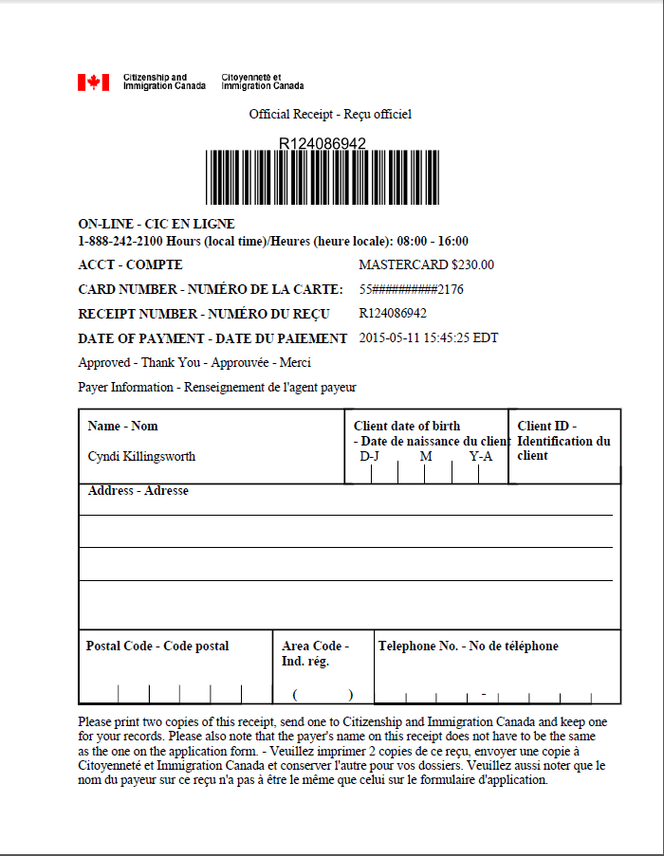

Slide 16
Exercise 1
Who should sign the Offer of Employment to a Foreign National Exempt from a Labour Market Impact Assessment (IMM5802)?
Why should that person be responsible for signing?

Slide 17
Exercise 2
Can a foreign national complete the Foreign Visitor Category Assessment form?
Why or why not?

Slide 18
Exercise 3
Dr. Danison will invite a foreign national to Canada to help with field research. The foreign national says he will be able to enter Canada under International Experience Canada.
Will Dr. Danison have to pay the Employer Compliance Fee?

Slide 19
Exercise 4
Immigration Services sent me an Offer of Employment to a Foreign National Exempt from a Labour Market Impact Assessment (IMM5802).
Can I make changes to the IMM5802 as long as I do it before my foreign visitor arrives?
Why or why not?

Slide 20
Exercise 5
Dr. Saffron is a foreign Postdoctoral Fellow at the Department of Earth and Atmospheric Sciences. When he first came to the U of A, his supervisor didn’t need to complete a Foreign Visitor Category Assessment form nor pay the Employer Compliance Fee. Dr. Saffron needs to renew his work permit.
Will his U of A supervisor need to pay the fee?
Why or why not?

Slide 21
Exercise 6
Mr. Hernadez is a Spanish citizen living in the USA. He holds a “green card”. Computing Science wants him to work at the U of A as a Research Assistant. The U of A host tells Mr. Hernandez that he can come to Canada under the provisions of NAFTA.
Can Mr. Hernandez do so?
Will the U of A host need to pay the $230 employer compliance fee?
Are there other issues that could be a problem?

Slide 22
Exercise 7
Chemical and Materials Engineering wants to hire the spouse of a U of A staff member. Will it be necessary to pay the $230 Employer Compliance Fee?
Why or why not?

Slide 23
Exercise 8
Which foreign nationals are subject to the International Mobility Program?

Slide 24
Visitors Subject to IMP
Postdoctoral Fellows
Research Award Recipients
Clinical Fellows
Research Fellows
Clinical Research Fellows
Participants in International Exchanges*
Guest Lecturers
Visiting Professors
Foreign Nationals entering Canada under NAFTA
Interns

Slide 25
Visitors Exempt from IMP
Guest Speakers/Seminar Leaders (speaking engagements of 5 days or less)
Interviewees
Conference/workshop/seminar attendees
Academic Evaluators
Academic Examiners
Foreign Delegates
Holders of “Open” Work Permits (e.g. spouses, postgraduates)
Staff members who require an LMIA

Slide 26
Providing Immigration Advice
If you are not a regulated Canadian Immigration Consultant, what advice and guidance can you give to a foreign national?
Information about how to apply for permits
Information about how to contact immigration
Information about what category they can enter Canada under
Information about implied status

Slide 27
Immigration Advice You Can Provide
Directing someone to the immigration website to find information on immigration programs or forms
Directing someone to an authorized immigration representative
Providing translation services
Providing courier services
Providing medical services (i.e. medical exams)
Making travel arrangements
Advising a student on how to select courses or register
Conducting a job interview

Slide 28
Contact Information
Contact Information
for
Immigration Services
Email us: immigration.services@ualberta.ca
Webpage: http://www.hrs.ualberta.ca
► Hiring and Managing
► Immigration

Slide 29
QUESTIONS
?

Slide 30
Online Evaluation Form
We appreciate your help in evaluating this presentation! The RAD evaluation form is accessible online. Click here or click on the blue checkmark below (right-click the hyperlink(s) and click Open Hyperlink to activate).

