Slide 1
Overview
Research Services Office

Slide 2
The Research Services Office (RSO)
A central unit on campus under the Office of the Vice President (Research)
Responsible for administering research funding at the University of Alberta (UofA)
Helps the research community find, apply for, receive and manage research funding
Research Ethics Office
Vice President
(Research)
TEC Edmonton
Research Services Office
Research Facilitation
And Strategic
Initiatives
(Research Facilitation
Services)
Contracts &
Agreements
(Single sponsor agreements)
Partnerships &
Institutional Projects
(Multi sponsor agreements, institutional awards)
Finance & Information Management
(Finance and quality assurance)
Legal Counsel

Slide 3
Research Facilitators (RF)
RSO first point-of-contact for Researchers on end to end research administration
Provide pre-and post-award support to Researchers
Provide institutional sign off on research applications/proposals
Advise on sponsor guidelines and UofA policy
Troubleshoot research-related problems
Educate via workshops and one-on-one training

Slide 4
Research Facilitation Support Administrators (RFSA)
RSO first point-of-contact for faculty/department administrators on end-to-end research administration
Provide post award support on financial management, sponsor terms and conditions and UofA policies and procedures
Assist RFs in reviewing funding applications as necessary
Work with RFs in developing and delivering training sessions, workshops and one-on-one training on research administration
Work with dept/faculties on FYE financial statements

Slide 5
Seeking Research Funding at the UofA

Slide 6
Research Administration Procedure (Roles and Responsibilities)
Procedure is on UAPPOL at
https://policiesonline.ualberta.ca/PoliciesProcedures/Procedures/Research-Administration-Roles-and-Responsibilities-Procedure.pdf
Parent policy, Research Policy, is on UAPPOL at
https://policiesonline.ualberta.ca/policiesprocedures/policies/research-policy.pdf
Current procedure was approved in May 2016
The procedure outlines the responsibilities of the PI, Project Holder, Department, Faculty, and the RSO

Slide 7
Things to Consider When Applying for Funding
Deadlines – Sponsor/RSO/Faculty/Dept
Eligibility – Applicant, Co-Applicants, Collaborators, Partners, Institution
https://policiesonline.ualberta.ca/PoliciesProcedures/Procedures/Eligibility-to-Apply-for-and-Hold-Research-Funding-Procedure.pdf
Type of Research activity
Budget – Indirect costs UofA standard 20% (may be higher or lower depending on sponsor)
Submission process – Paper/Courier/Electronic/Online
Letters of Support – Institutional/Faculty/Dept
Requirements for matching funds
Signatures

Slide 8
Signatures
Two sets of signature requirements must be met:
Sponsor (signature requirements vary by sponsor)
Usually outlined in the application guidelines or on the application form
May or may not be required
University of Alberta (signature requirements set by UofA Policy)
ALWAYS required for full applications
Sometimes required for letters of intent (LOI)
Include PI, Chair (departmentalized faculties), Dean, and ALL UofA Co-Investigators
http://www.rso.ualberta.ca/Applying/ApplicationsProposals/Signatures.aspx

Slide 9
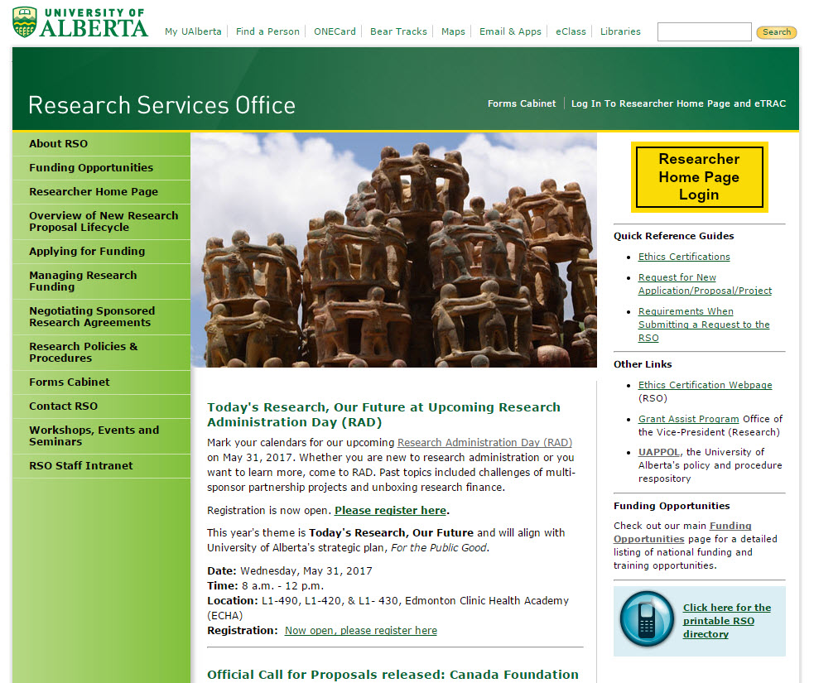
RSO Website (rso.ualberta.ca)

Slide 10
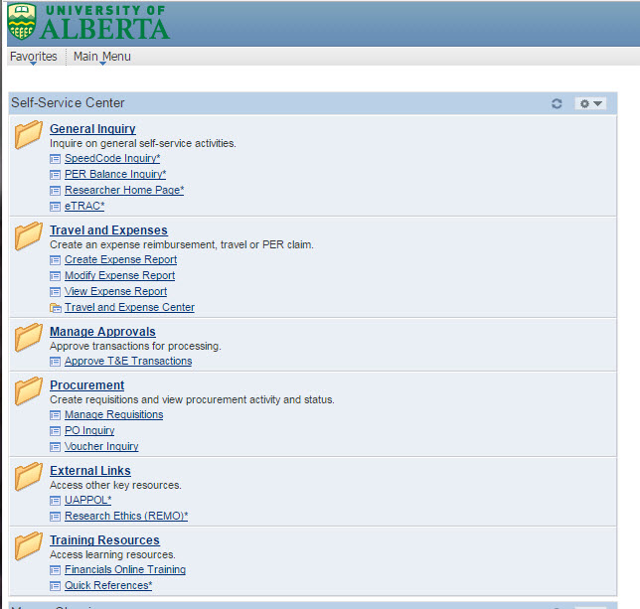

Slide 11
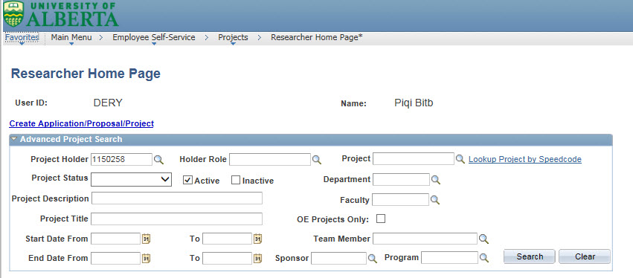
Create New Application Proposal/Project Request

Slide 12
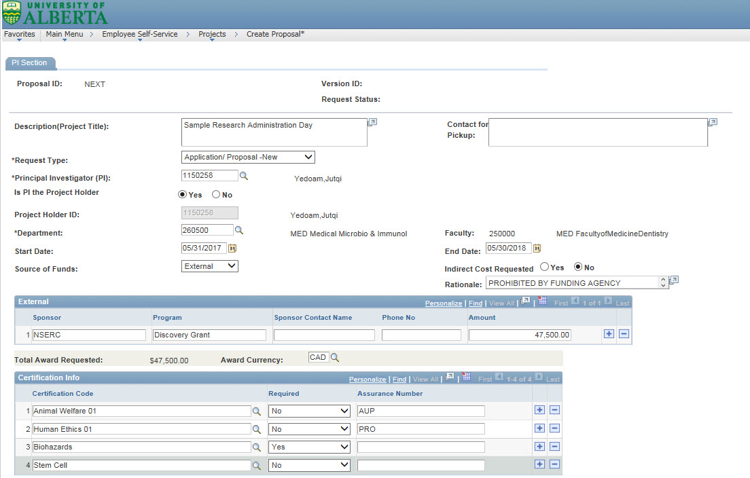

Slide 13
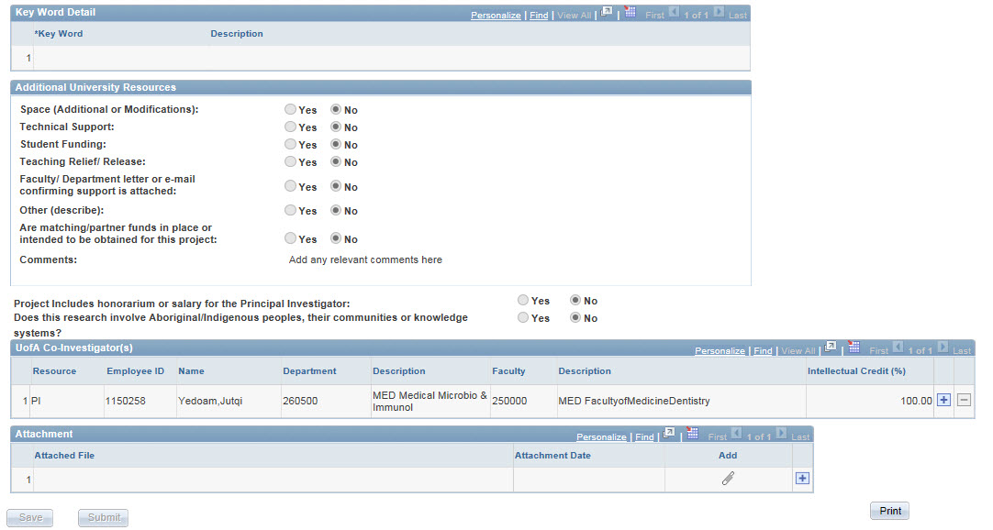

Slide 14
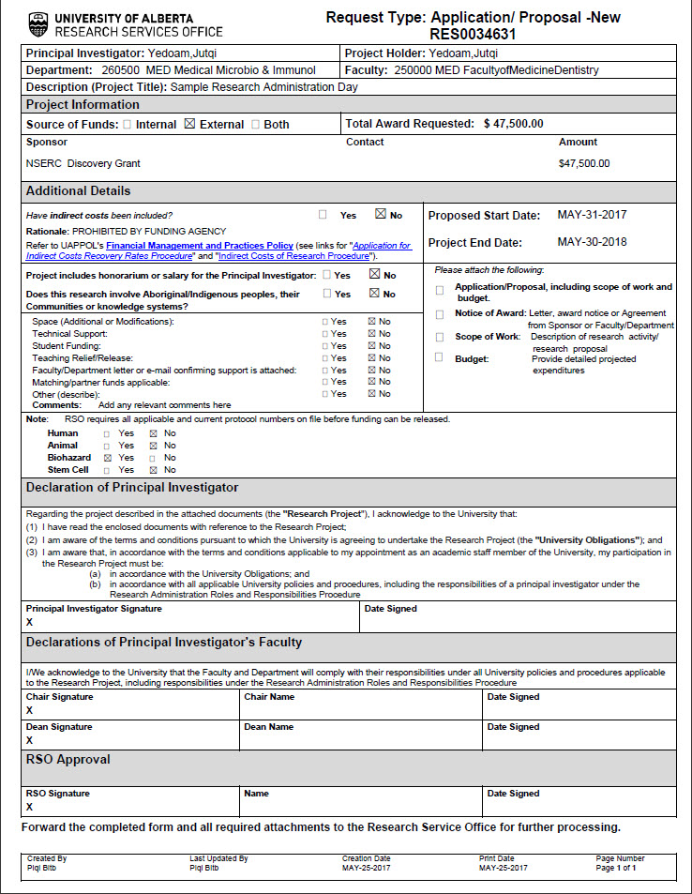

Slide 15
Sending Signed Applications to RSO
Send scanned copy of complete application with signature page(s) to Faculty-specific application mailbox:
rsonse@ualberta.ca
rsossh@ualberta.ca
rsohs@ualberta.ca
Only send funding applications to application mailboxes
Other requests (Amendments, Subgrants, Authorized OE, etc.) should be sent to your RF
Don’t send paper copies of applications to RSO unless the sponsor requires original signature
RSO will review, request any changes and then approve the application
Application can then be submitted to sponsor

Slide 16
The Sponsor’s Decision and Project Setup
16

Slide 17
Notice of Award (NOA)
RSO is not always copied on these by sponsor. Please email NOA to your RF (with proposal #) for processing if RSO not copied
Can be a simple award letter or a complex agreement (researchers must not sign agreements without prior RSO review)
If you receive an NOA for an application that was not reviewed/signed by RSO prior to submission:
create a New Application/Proposal/Project Request
submit a copy of the full application/proposal/budget and signature page to RSO along with the NOA

Slide 18
Award Setup and Activation
RSO reviews the terms and conditions of award to finalize setup
Confirms certifications in place (ethics, biohazard, stem cell research). This is the #1 delay in award activation
Animal and Human certifications provided by the Research Ethics Office (REO)
Biohazard Certification provided by Office of Environment, Health & Safety (EHS)
RSO staff activate Project
RSO sends a New Project Activation Notification email to PI/Holder, Project Administrator, Dept/Faculty contacts, and RF

Slide 19
New Project Activation Notification

Slide 20
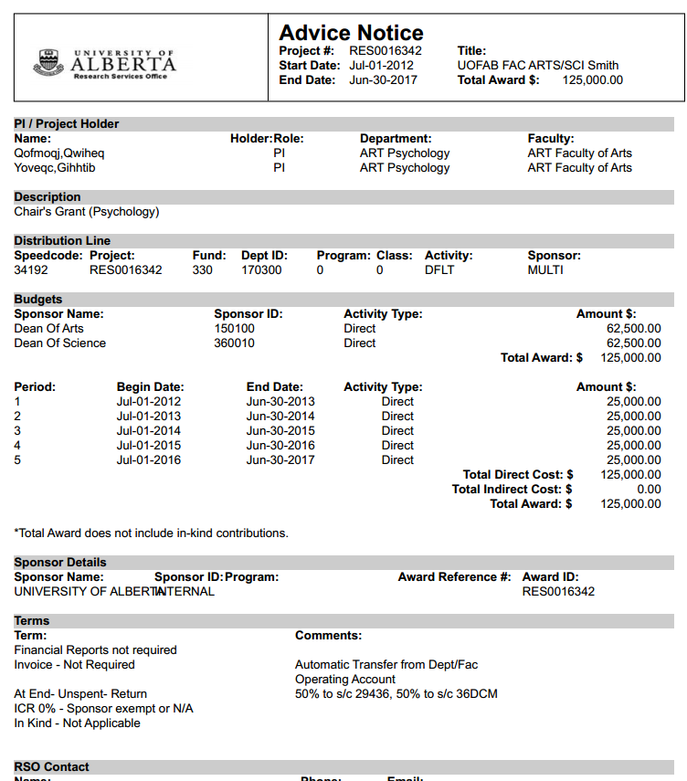
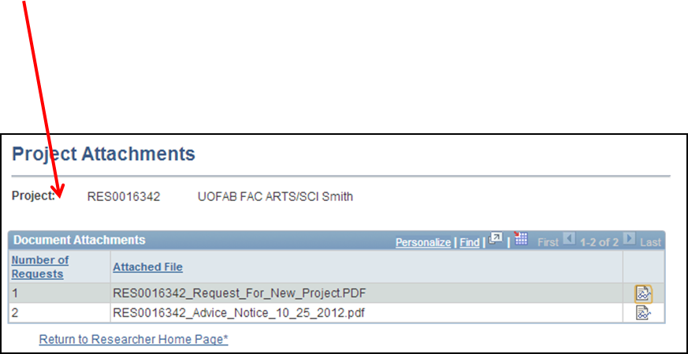
Advice Notice

Slide 21
Managing the Award
21

Slide 22
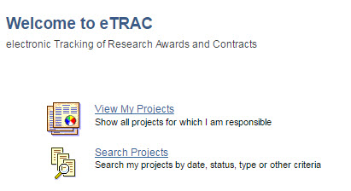
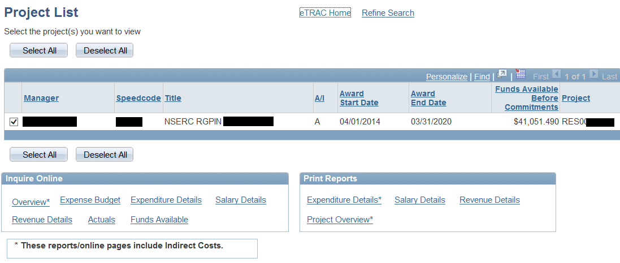
eTRAC (electronic Tracking of Research Awards and Contracts)

Slide 23
eTRAC

Slide 24
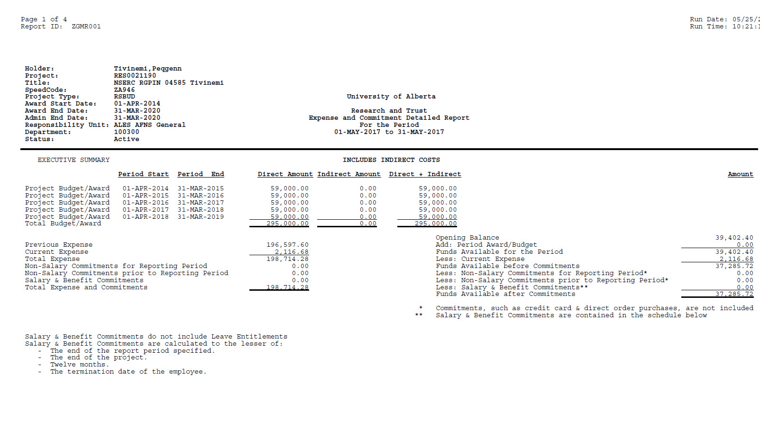
eTRAC Expenditure Details

Slide 25
Researcher Home Page (RHP)
Track proposals and funded research projects
Track project-specific information
Amendments to award (end date extension, increase to awarded amount, change of PI, co-applicants, holder)
Sub-grants or transfers of portions of funding to participating institutions
Authorized Overexpenditure (OE) request

Slide 26
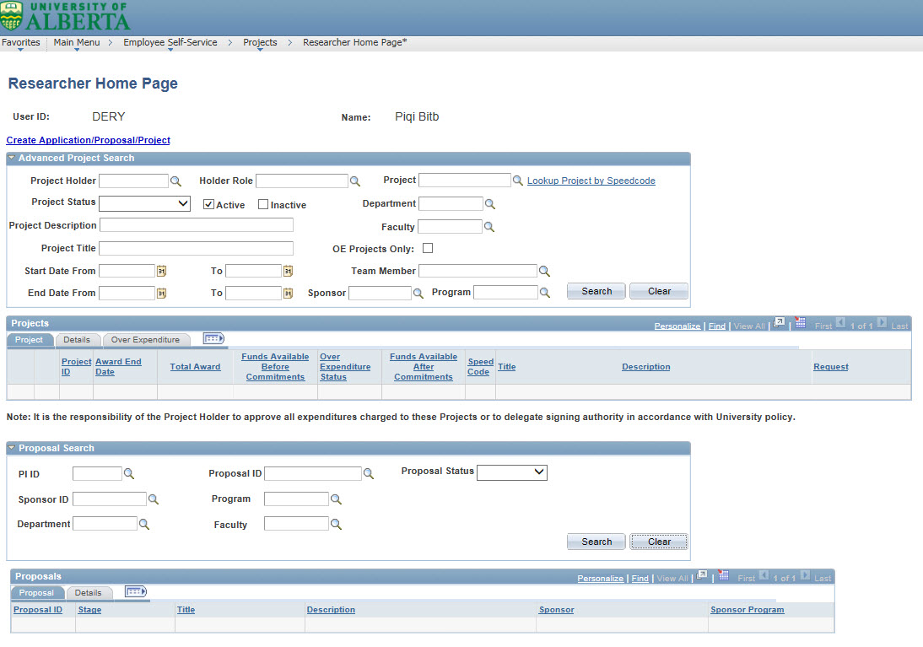
RHP - Track Proposals and Projects

Slide 27
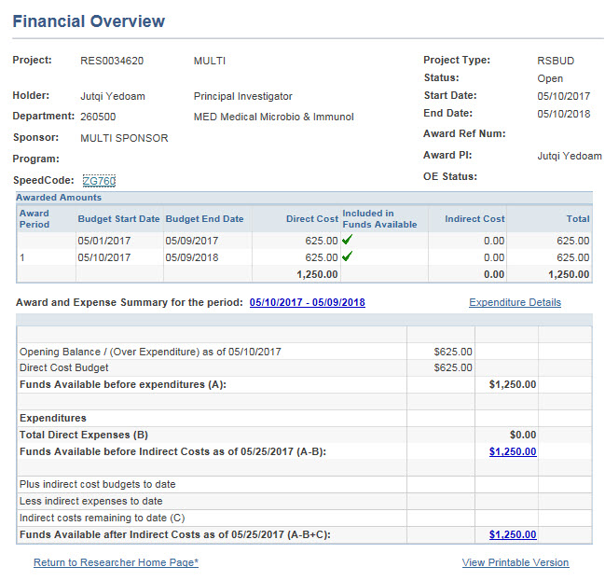
RHP - Track Project-specific Information

Slide 28
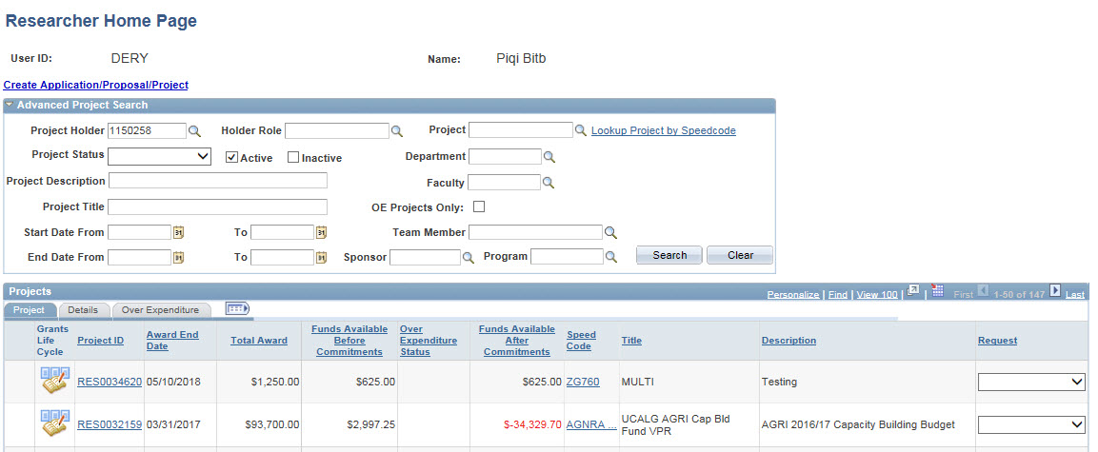
RHP - Track Project-specific Information cont’d

Slide 29
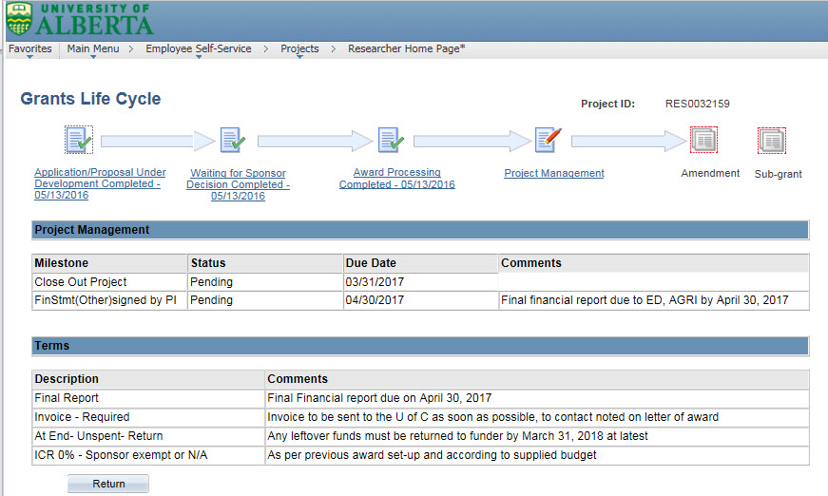
RHP - Track Project-specific Information cont’d

Slide 30
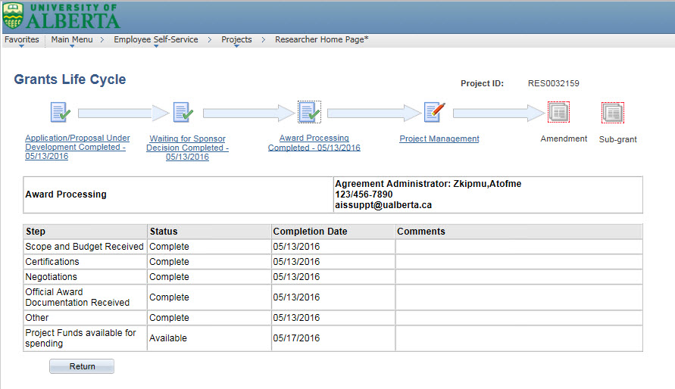
RHP - Track Project-specific Information cont’d

Slide 31
RHP – Amendments, Subgrants, Authorized OE Requests

Slide 32
RHP – Amendments, Subgrants, Authorized OE Requests cont’d

Slide 33
RHP – Amendments, Subgrants, Authorized OE Requests cont’d

Slide 34
RHP – Amendments, Subgrants, Authorized OE Requests cont’d

Slide 35
Project Completion
35

Slide 36
Project Completion
Residual/unspent funds in project
Deliverables (financial reporting; research reports)
Telephones, payroll; standing orders; contracts for service
Retention of documentation

Slide 37
Residual/Unspent Funds in Project
Each sponsor has their own guidelines on unspent funds.
Unspent funds in a given year will often roll over to the next year for multi-year awards but must be used up by the end of award period.
Unspent funds for one-year awards will have the following conditions: returned to sponsor, lapse to university, or PI-retain.
Unless an extension is authorized by the sponsor recipient cannot use unspent funds beyond the award period end date .
In most cases, a written permission from the sponsor is required for an end date extension.

Slide 38
Residual/Unspent Funds in Project cont’d
For example, Tri-Agency sponsors:
NSERC and SSHRC permit an automatic one-year extension for many programs during which a grantee may continue to use up their grant.
NSERC and SSHRC have programs with no automatic one-year grace period. They require written permission for an extension.
http://www.nserc-crsng.gc.ca/Professors-Professeurs/FinancialAdminGuide-GuideAdminFinancier/AnnualFunding-FinancementAnnuel_eng.asp
CIHR provides a minimum of one additional fiscal year, beyond the expiry date to finish use of unspent funds.
CIHR may approve one additional extension (one year) beyond the automatic extension period. Written permission is required.

Slide 39
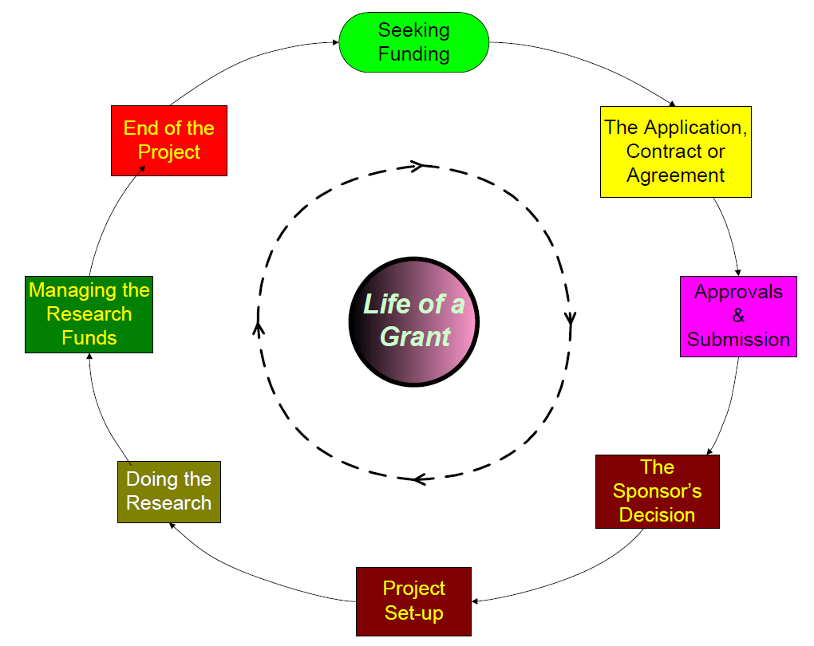
Where Do Administrators Fit In?
39

Slide 40
Remember …
Contact your RF or RFSA first with your questions and queries: http://www.rso.ualberta.ca/en/ContactRSO/RFOs.aspx
Take a look at the RSO Website for information: http://www.rso.ualberta.ca/
Questions?

Slide 41
Online Evaluation Form
We appreciate your help in evaluating this presentation!
The RAD evaluation form is accessible online. Click here or click on the blue checkmark below (right-click the hyperlink(s) and click Open Hyperlink to activate).

