Slide 1
Research Ethics Office
RAD 201b
Kim Kordov - Research Ethics Office

Slide 2
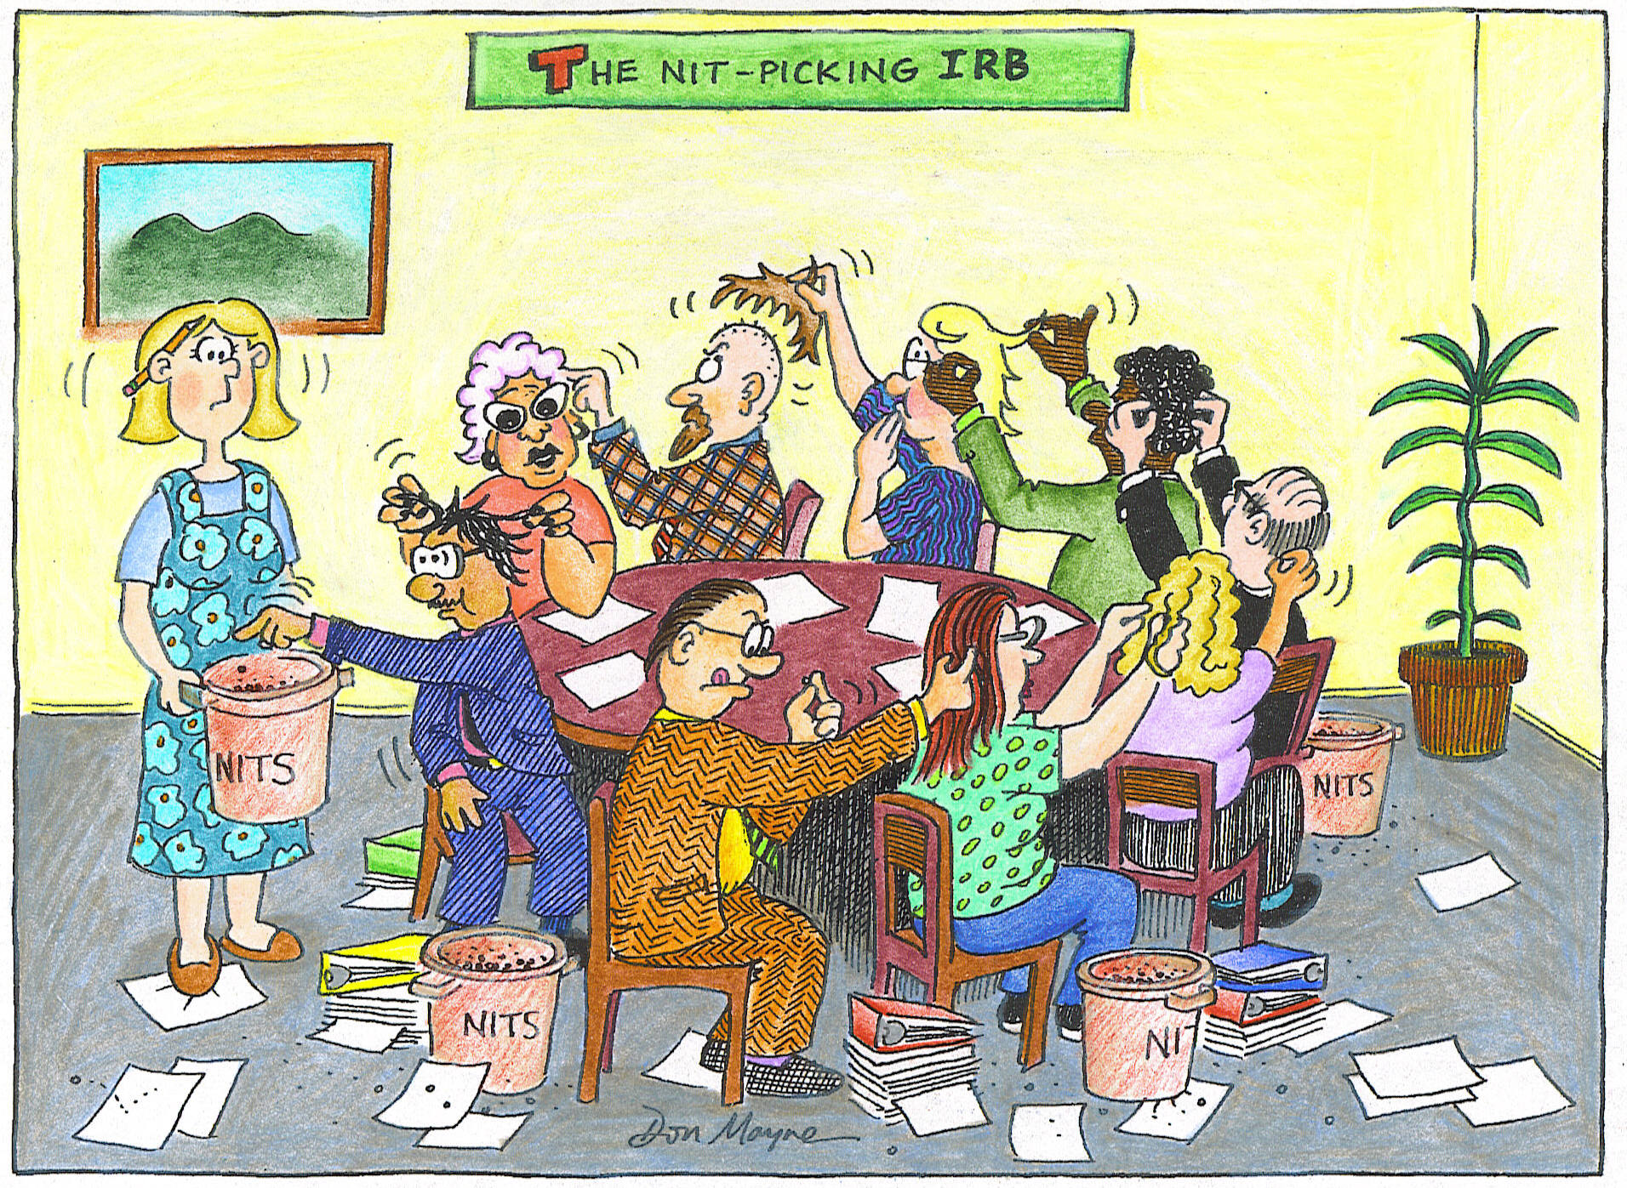
Why Do We Have REB/ACUC?

Slide 3
Why Ethics Review?
Previous abuses in human experimentation have led to guidelines for the ethical treatment of human participants
German experimentation on Jewish prisoners in WWII
The Tuskegee Experiment (1932-1972)
MK ULTRA (CIA) (1950-1970s) – McGill studies on sensory deprivation, LSD and ECT
Ongoing public concern about use of animals in science

Slide 4
What Needs Ethics Review?
The following requires ethics review and approval BEFORE the research commences:
Research involving human participants
Research involving human biological materials (whether derived from living or identifiable deceased individuals)
All research, teaching and testing involving animals
Where - “research” defined as an undertaking intended to extend knowledge through a disciplined inquiry or systematic investigation.

Slide 5
What Needs Review?
All human participant research and animal research, teaching and testing under University jurisdiction (conducted by staff or students) requires approval whether:
it is funded or is non-funded;
it is conducted in Canada or abroad;
it is conducted on University property or off;
it is conducted in a laboratory or in the field;
it is conducted to acquire basic or applied knowledge;
the research is a pilot study or a fully developed project
WHEN IN DOUBT CHECK IT OUT!!

Slide 6
Applicable Policy – Human Research
UAPPOL – Human Research Ethics Policy
https://policiesonline.ualberta.ca/PoliciesProcedures/Pages/DispPol.aspx?PID=48
Tri-Council Policy Statement 2 (2014): Ethical Conduct for Research Involving Humans
http://www.pre.ethics.gc.ca/eng/policy-politique/initiatives/tcps2-eptc2/Default/
UAPPOL – University of Alberta Research and Scholarship Integrity Policy
https://policiesonline.ualberta.ca/PoliciesProcedures/Pages/DispPol.aspx?PID=70
Various other regulations depending on type of research (biomedical/health) and funding (i.e., US NIH), Health Information Act

Slide 7
Applicable Policy – Animal Research
UAPPOL – Animal Ethics Policy
https://policiesonline.ualberta.ca/PoliciesProcedures/Pages/DispPol.aspx?PID=13Tri-Council Policy Statement 2 (2014): Ethical Conduct for Research Involving Humans
Canadian Council on Animal Care in Science (CCAC)
www.ccac.ca

Slide 8
When?
Ethics approval has to be obtained BEFORE the research begins and, in the case of funded research, BEFORE funds are released
Approval has to be maintained (renewed annually) for the duration of the research activity
Changes to the approved research must be approved by the REB or ACUC before they are implemented

Slide 9
Who?
University Faculty
University students
External Researchers – conducting research “under the jurisdiction” of the University

Slide 10
REMO – Research Ethics Management Online
https://remo.ualberta.ca
Link from U of A and Research Ethics Office (www.reo.ualberta.ca) websites
Browsers: Google Chrome is preferred browser, Safari is not compatible with REMO
The first time you use REMO, disengage your pop-up blocker and make REMO a trusted site

Slide 11
Getting Started
Faculty members & clinicians
REMO investigator role auto-generated
Researcher must identify department for approval routing
Study coordinators, students & outside applicants (AHS/Covenant Health, guest applicants)
Log into REMO using CCID and password
Request Additional Role (https://www.youtube.com/watch?v=aXx4osyRsrE)

Slide 12
REMO Resources
Research Ethics Office Website – www.reo.ualberta.ca for resources and contact information & templates
VIDEO Tutorials: http://www.reo.ualberta.ca/Education-Training-User-Support/REMO-Support/Video-Tutorials.aspx
People to call:
REMO Help – 780-492-0459
REB 1 & 2 – Melanie Pankratow 780-492-7550
REB 3 HREB Health Panel – Charmaine Kabatoff 780-492-0302
REB 4 HREB Biomedical Panel
Patricia Lo 780-492-9724
Ann Moore 780-492-6459
Research Ethics Officer – Kim Kordov 780-492-2615

Slide 13
Kim Kordov, Research Ethics Officer, Research Ethics Office, University of Alberta
kim.kordov@ualberta.ca
780-492-2615
www.reo.ualberta.ca
Research & Ethics Management Online (REMO) System
https//:remo.ualberta.ca

Slide 14
Online Evaluation Form
We appreciate your help in evaluating this presentation!
The RAD evaluation form is accessible online. Click here or click on the blue checkmark below (right-click the hyperlink(s) and click Open Hyperlink to activate).

