Slide 1
Environment, Health & Safety
RAD 201c
Michelle Rooker, Operations Team Lead, EHS

Slide 2
How Can We Help You?
EHS database
Research review & approvals
EHS Committees
EHS tools & resources
Welcome, FRO!

Slide 3
EHS Database
EHS transitioning to new database
Phase 1 (launched Jan 2017)
PIs and lab supervisors can register personnel, equipment, hazards in locations
Phase 2 (2017/2018)
Incident reporting
Questions? Contact ehs.info@ualberta.ca

Slide 4
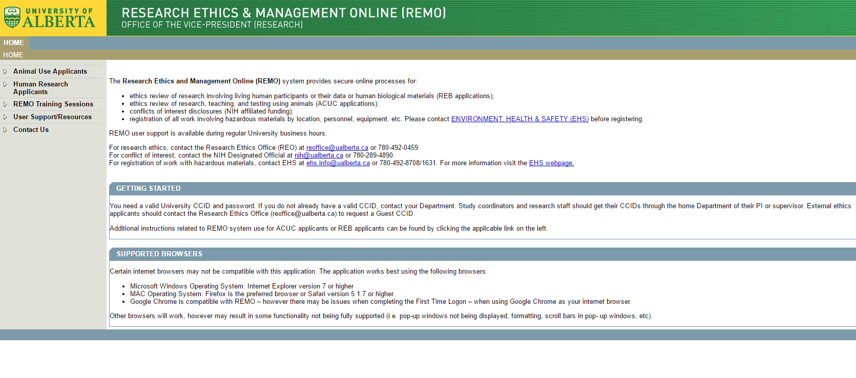
EHS Database cont’d

Slide 5
Research Review & Approvals
Biohazard approvals for grants:
Researcher receives notice of funding & RES number
Researcher applies for biohazards review (New or Subsidiary Grant form)
EHS reviews grant against registry
Request for more info or approval
RSO releases funds

Slide 6
Research Review & Approvals cont’d
Chemical, biohazard, radiation review of human & animal protocols
Researcher submits HERO or AERO application in REMO
EHS receives notification of study
Request for more info or approval

Slide 7
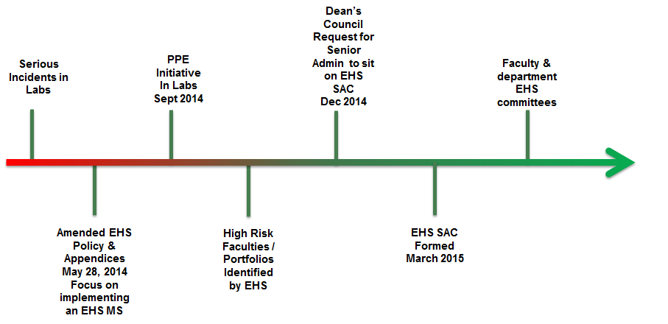
EHS Committees: History

Slide 8
EHS Committees: Purpose & Benefits
Supports the implementation of the EHS Policy
Provides a structured approach to communication with faculty & departments
Unit engagement and demonstration of leadership and commitment
Goal: Every faculty or department has an EHS Committee

Slide 9
Tools & Services: Training
Courses include
WHMIS (new content for 2017)
Radiation safety
Laboratory safety
Chemical safety
Concepts in Biosafety
Transport of Dangerous Goods
Fire extinguisher simulator training (we’ll come to YOU!)
FREE for staff & students (& looks great on a resume!)

Slide 10
Tools & Services: Hazard Assessment Web Application
An online tool for hazard management
Use the app to
Identify hazards (chemical, physical, biological, psychosocial)
Evaluate risk
Assign controls (administrative, engineering & PPE)

Slide 11
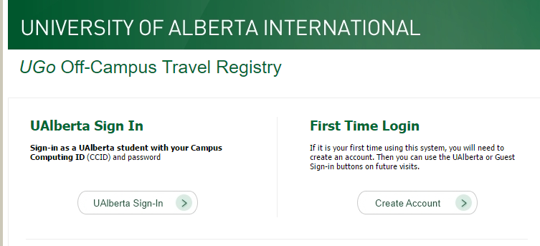
Tools & Services: Emergency Preparedness
Visit the wiki
Build a unit action plan for your department
Develop an operational continuity plan
Planning a special event? Build an event plan!
Heading off campus for work purposes? Register in UGo (off campus travel registry)

Slide 12
Tools & Services: Incident Reporting
What’s reportable?
Injury
Exposure to hazardous substances
Observed safety violation
Property damage
Spill or other uncontrolled release
Near miss

Slide 13
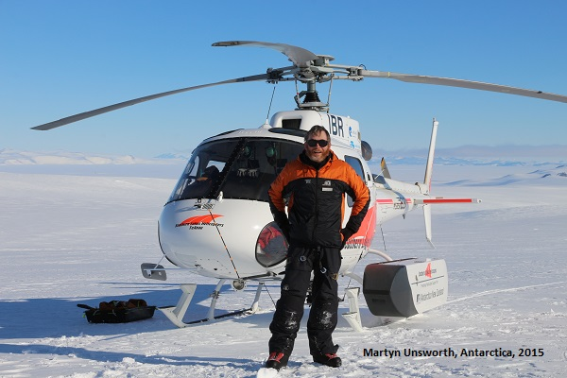
Welcome, Field Research Office!
FRO moved to the EHS office in early 2017
EHS & FRO work collaboratively to achieve health & safety in the field
Kim Schaerer remains the FRO Coordinator
Contact ehs.info@ualberta.ca for more info!

Slide 14
A Bajillion Other Things ...
Lab inspections
Permitting and equipment certification (lasers & x-rays)
Audiometric testing
Waste pickup & management
Assistance with imports of biohazards
Monitor use of chemical weapons and toxic substances
Environmental assessments
Online tools for ergonomics & indoor air quality assessments
“Chematix” chemical inventory
Working alone template
Lab safety checklist
Assistance with importation of biological materials
Tabletop exercises: emergency scenarios
Noise management
Incident investigations
Yada yada yada ...

Slide 15
A Bajillion Other Things ...
Oh, and respirator fit-testing

Slide 16
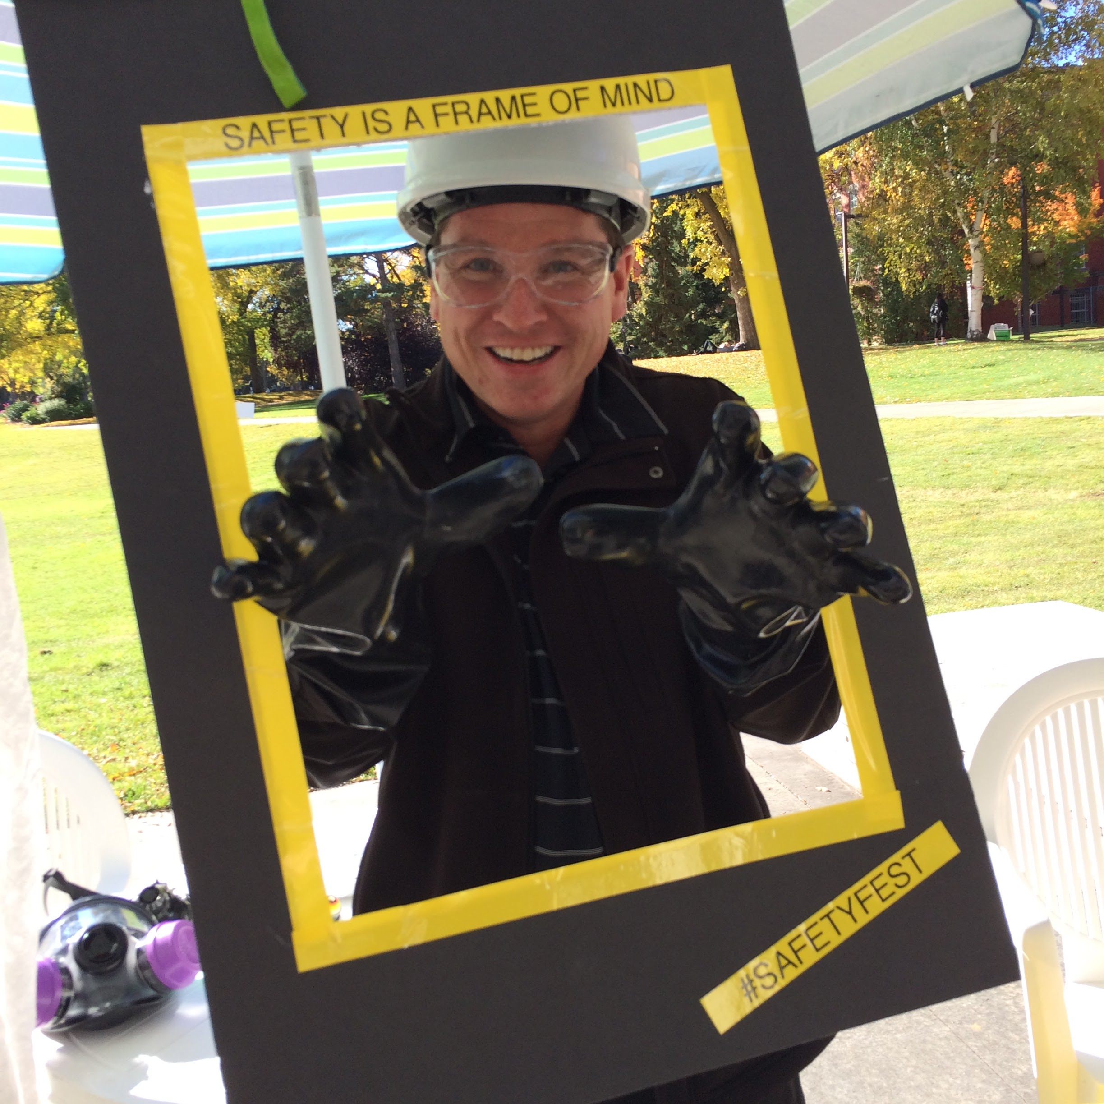
Where Can You Find Us?
Risk Management Symposium (January)
NAOSH Week pop-up booths (May)
Safety Fest (late September)
New staff orientations (March, August, November)
Fire extinguisher simulator training (Book a session through EHS)

Slide 17
Questions?
Environment, Health & Safety
3107 Research Transition Facility
uab.ca/ehs ● @UofA_EHS ● @UAlbertaEHS ● ehs.info@ualberta.ca

Slide 18
Online Evaluation Form
We appreciate your help in evaluating this presentation!
The RAD evaluation form is accessible online. Click here or click on the blue checkmark below (right-click the hyperlink(s) and click Open Hyperlink to activate).

